Slide 1
Import Components
Secure Components
Protect Components
Output
Description: Accept Computer, Battery, 120V Port, Topper Charging Mechanism, Internal Cabling, Speaker
Description: Hold Components Firmly in place without disconnecting EE connections
Description: Shield Components from Environmental Elements
Protected Components
Material
Sound Emission
Electrical Components
Charging Unit
Allow Material Flow
Description: Enable Sound Waves to emanate from Sound Generator
Attached/Removed Toppers
Sound Generation Device
Acoustics Unit
RF Signals Received
Water/Dust
Toppers
Store Material
Release Material
Description: Provide storage space for multiple (6) toppers
Description: Allow removal of individual toppers
Human Energy
Interface Material
Description: Connect Charging Apparatus to the Cone Topper
Transmit Signal
Auxiliary Charging units
RF Signals
Description: Permit Signal to permeate the housing to reach internal computer
Control Unit
Notes:
Boombox

Slide 2
Luminescence Layer
Import Components
Secure Components
Protect Components
Output
Description: Accept Computer, Battery, Charging Mechanism, Internal Cabling, Light Source
Description: Hold Components Firmly in place without disconnecting EE connections
Description: Shield Components from Environmental Elements
Protected Components
Material
Light Emission
Electrical Components
Allow Material Flow
Charging Layer
Attached/Removed Toppers
Light Source
Description: Enable Light to emanate from the source with 360 visibility
RF Signals Sent
Water/Dust
Cones
Attach to Material
Release Material
Description: Attach to various Traffic cone designs and boombox easily
Description: Allow removal from traffic cones and boombox easily
Boom Box
Mounting Layer
Human Energy
Interface Material
Description: Connect to boombox through charging apparatus.
Transmit Signal
Intelligent Control Layer
RF Signals
Description: Permit Signal to permeate the housing to reach boombox computer
Notes:
Boombox

Slide 3
SYSTEM OVERVIEW
User Input
Activate System
Flash Lights
Alerted Drivers
Energy
Receive Power
Detect Impact
Emit Sound
Alerted Workers
Traffic Cone
Mount to Cone
Dismount from Cone
Traffic Cone

Slide 4
TOPPER OVERVIEW
Energy
Receive Power
Dismount from Cone
Traffic Cone
Traffic Cone
Mount to Cone
Activate Topper
Emit Light ‘Wave’
Alert Drivers
Impact Detection
Detect Vehicle Impact
Send Signal to Boombox
Alert Workers

Slide 5
BOOMBOX OVERVIEW
Energy
Receive Power
User Input
Activate Boombox
Cancel Alarm
Signal From Topper
Receive Signal
Activate Alert
Alert Workers

Slide 6
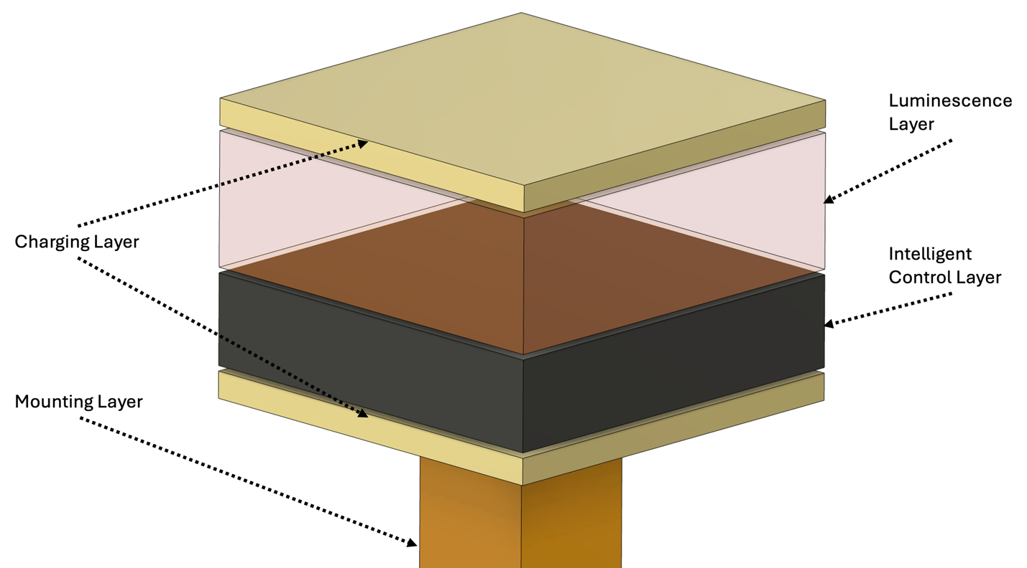
3.50 in
3.50 in
3.00 in

Slide 7
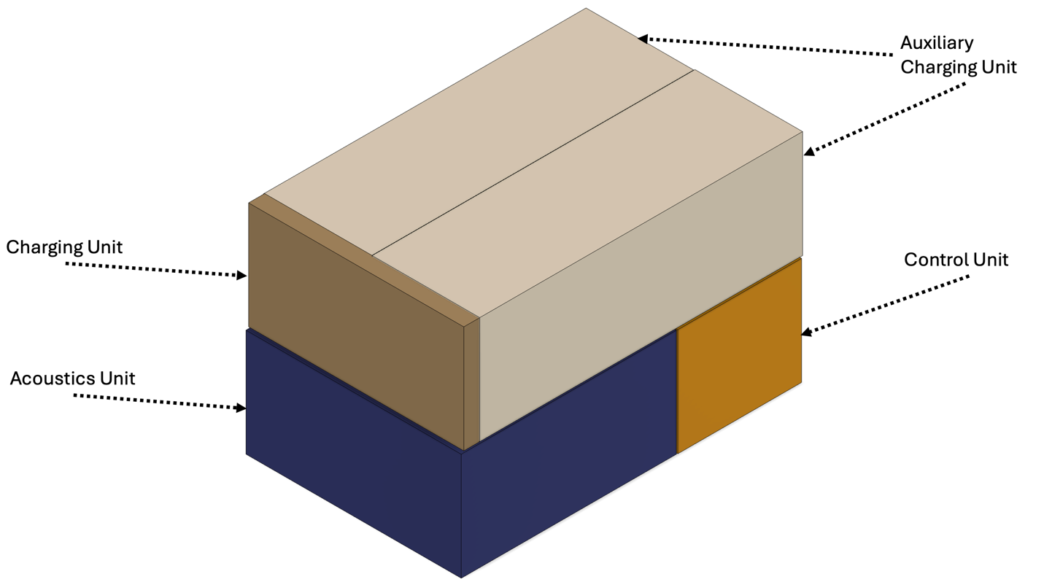
8.00 in
12.00 in
8.00 in
3.00 in

