Slide 1
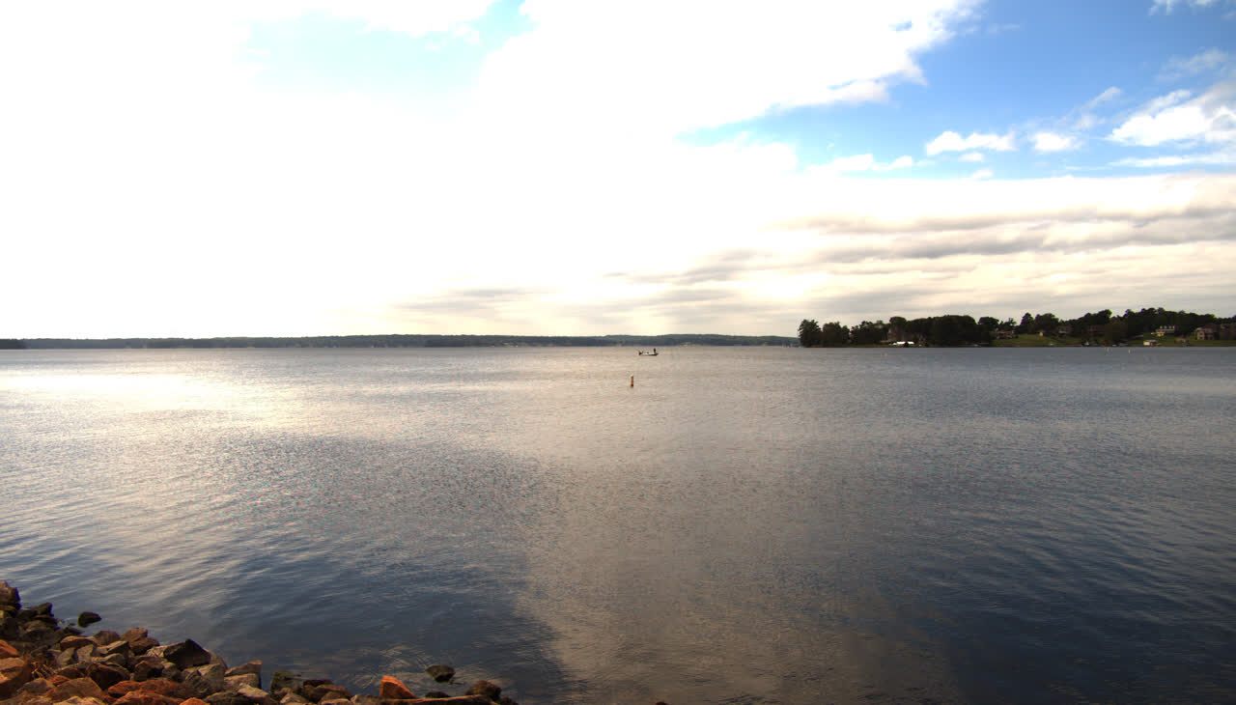
Radar–camera detection
Boat and buoy detection across three fusion strategies
Boats and buoys • 300 frames • IoU 0.50
J.C. Vaught
Notes:
[Sources]
- Source image. data/rgb_out/119_rgb.png on comech-2422.
- Experiment scope. out/datasets/dream_fusion_yolo/manifest.jsonl.

Slide 2
COMPARISON DESIGN
02
Radar enters each pipeline at a different stage
1 Vision only
Camera frame
Overlapping tiles
Grounding DINO
Detections
2 Confidence gate
Camera frame
Tiled candidates
Radar-supported gate
Detections
3 Radar-bounded crops
Radar returns
Padded image crops
Grounding DINO
Remap + merge
Dream Fusion detection experiments
J.C. Vaught
Notes:
[Sources]
- Vision and confidence-gated implementation. run_detection_experiments.py.
- Radar-bounded crop implementation. dream_multi_fusion.py on comech-2422.

Slide 3
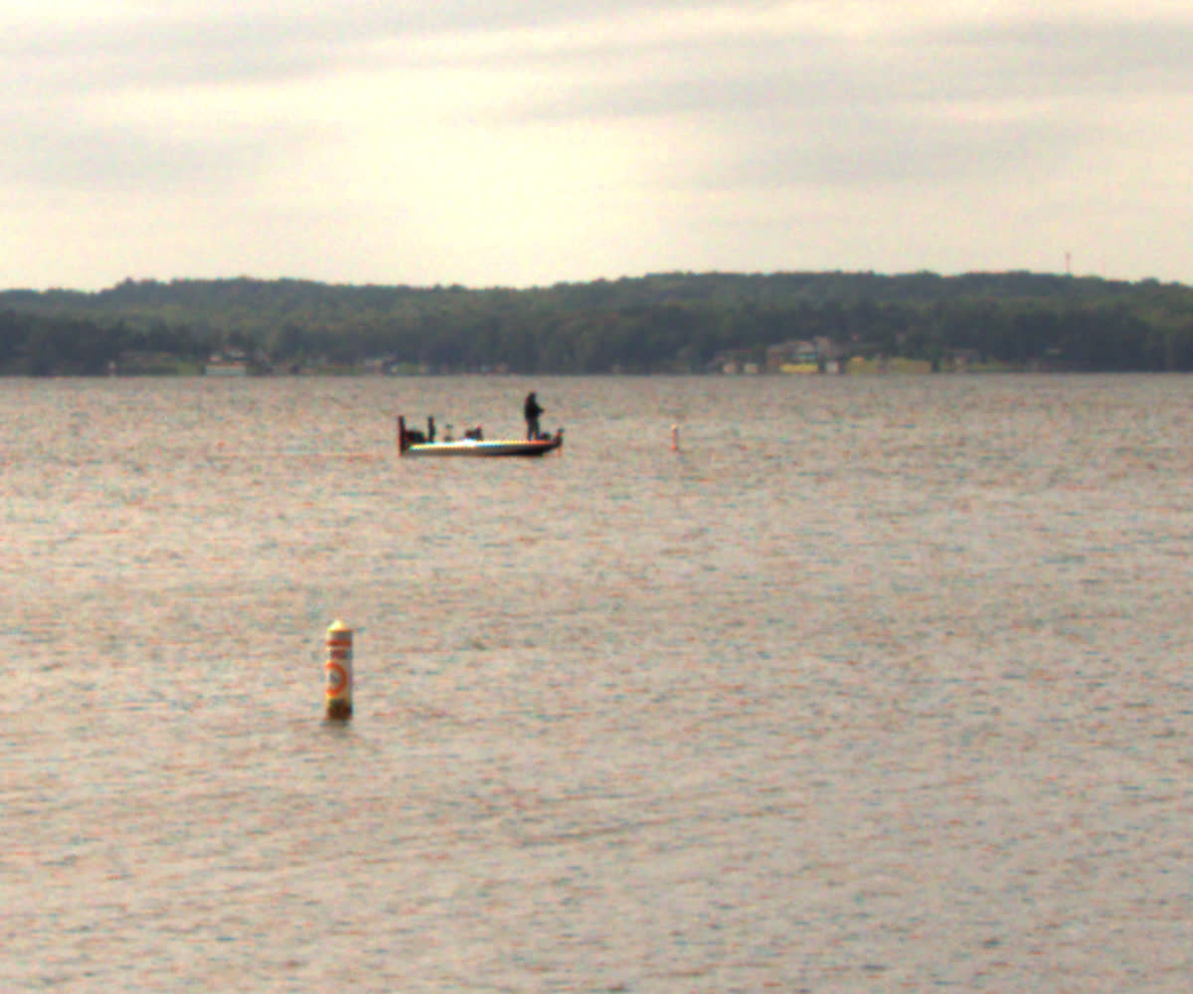
GROUND TRUTH
03
The evaluation is strict and dominated by tiny buoy instances
Full 5320 × 3032 frame
Nearby b2 ground truth • 4.7–6.1 px wide
300
300
2,192
camera frames
boat instances
buoy instances
Dream Fusion detection experiments
J.C. Vaught
Notes:
[Sources]
- Ground truth counts and bounding boxes. out/datasets/dream_fusion_yolo/manifest.jsonl.
- Source images. data/rgb_out/119_rgb.png on comech-2422.
- Matching rule. evaluate_detection_experiments.py.

Slide 4
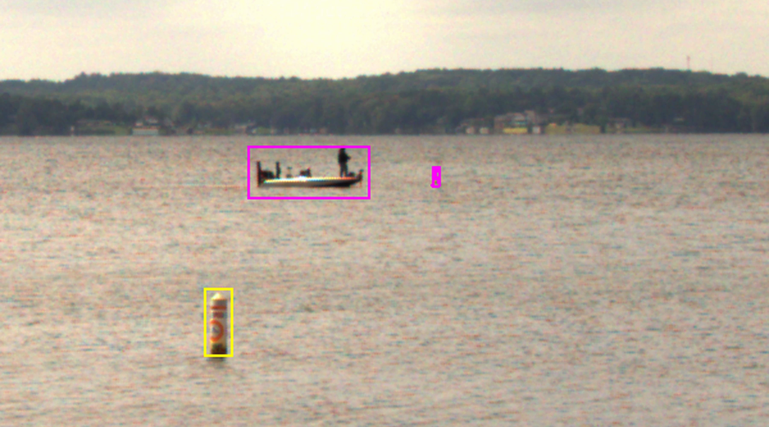
APPROACH 1
04
Tiling preserves detail, but tiny targets still disappear
5320 × 3032 frame
Nine overlapping tiles
DINO at 1024 / 1600
Class-aware NMS
100%
8.9%
boat recall
buoy recall
98.6%
0.336
overall precision
overall F1
SUCCESS — All 45 test boats found; one false positive.
FAILURE — Distant buoys remain below useful model scale.
Frame 119 • boat and main buoy detected • b2 missed
Dream Fusion detection experiments
J.C. Vaught
Notes:
[Sources]
- Pipeline settings. run_detection_experiments.py.
- Test metrics. experiments/detection_comparison/metrics.json.
- Visual evidence. 11_zoom_exp1_vision_only.mp4, camera frame 119.

Slide 5
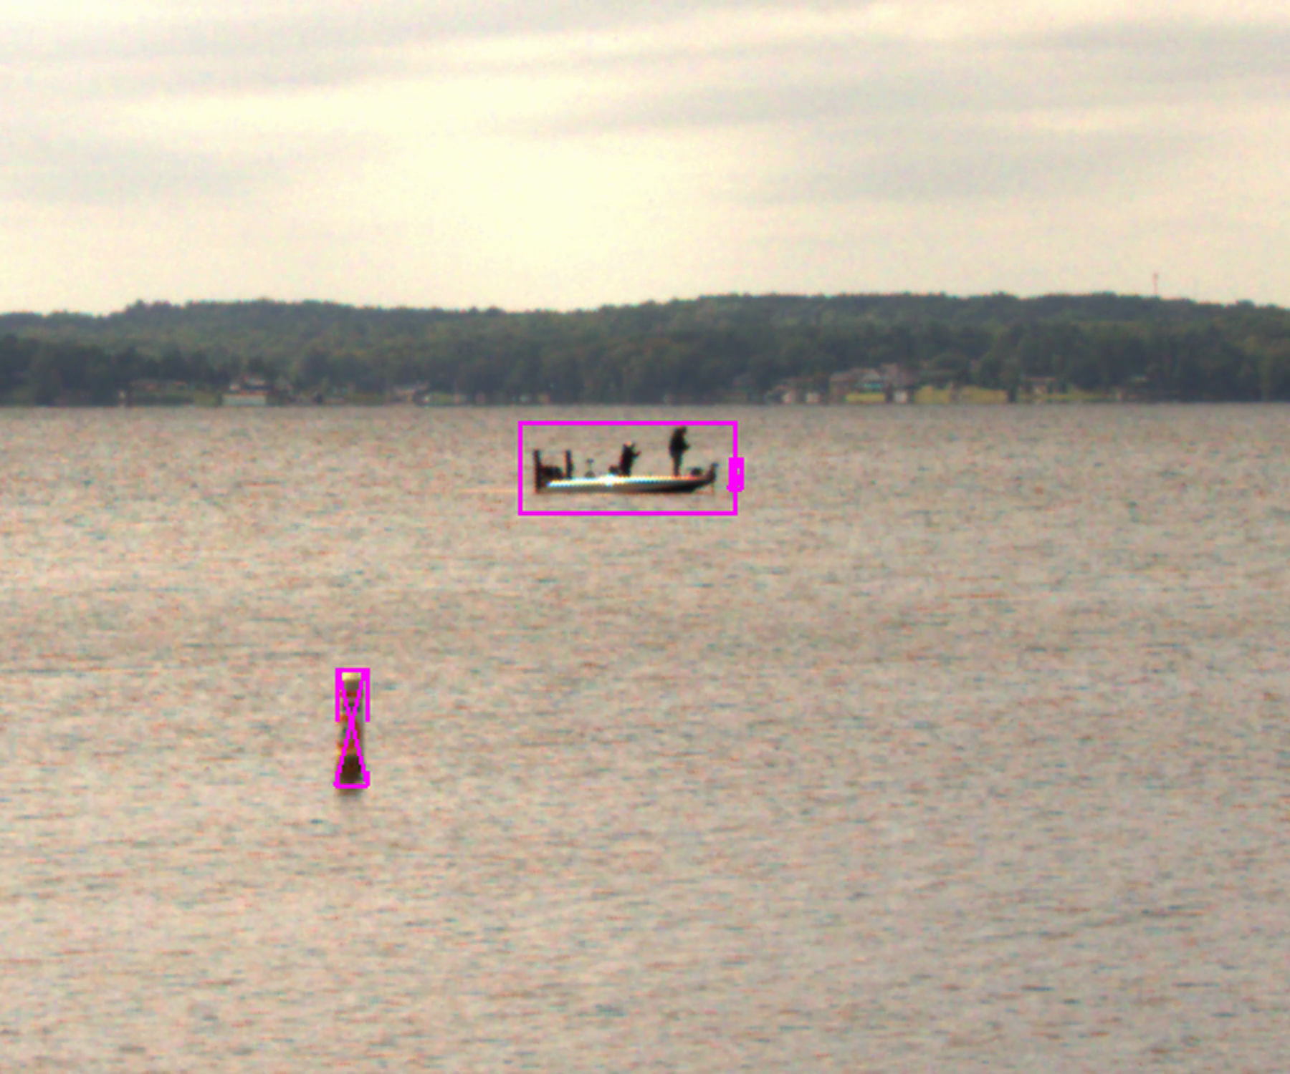
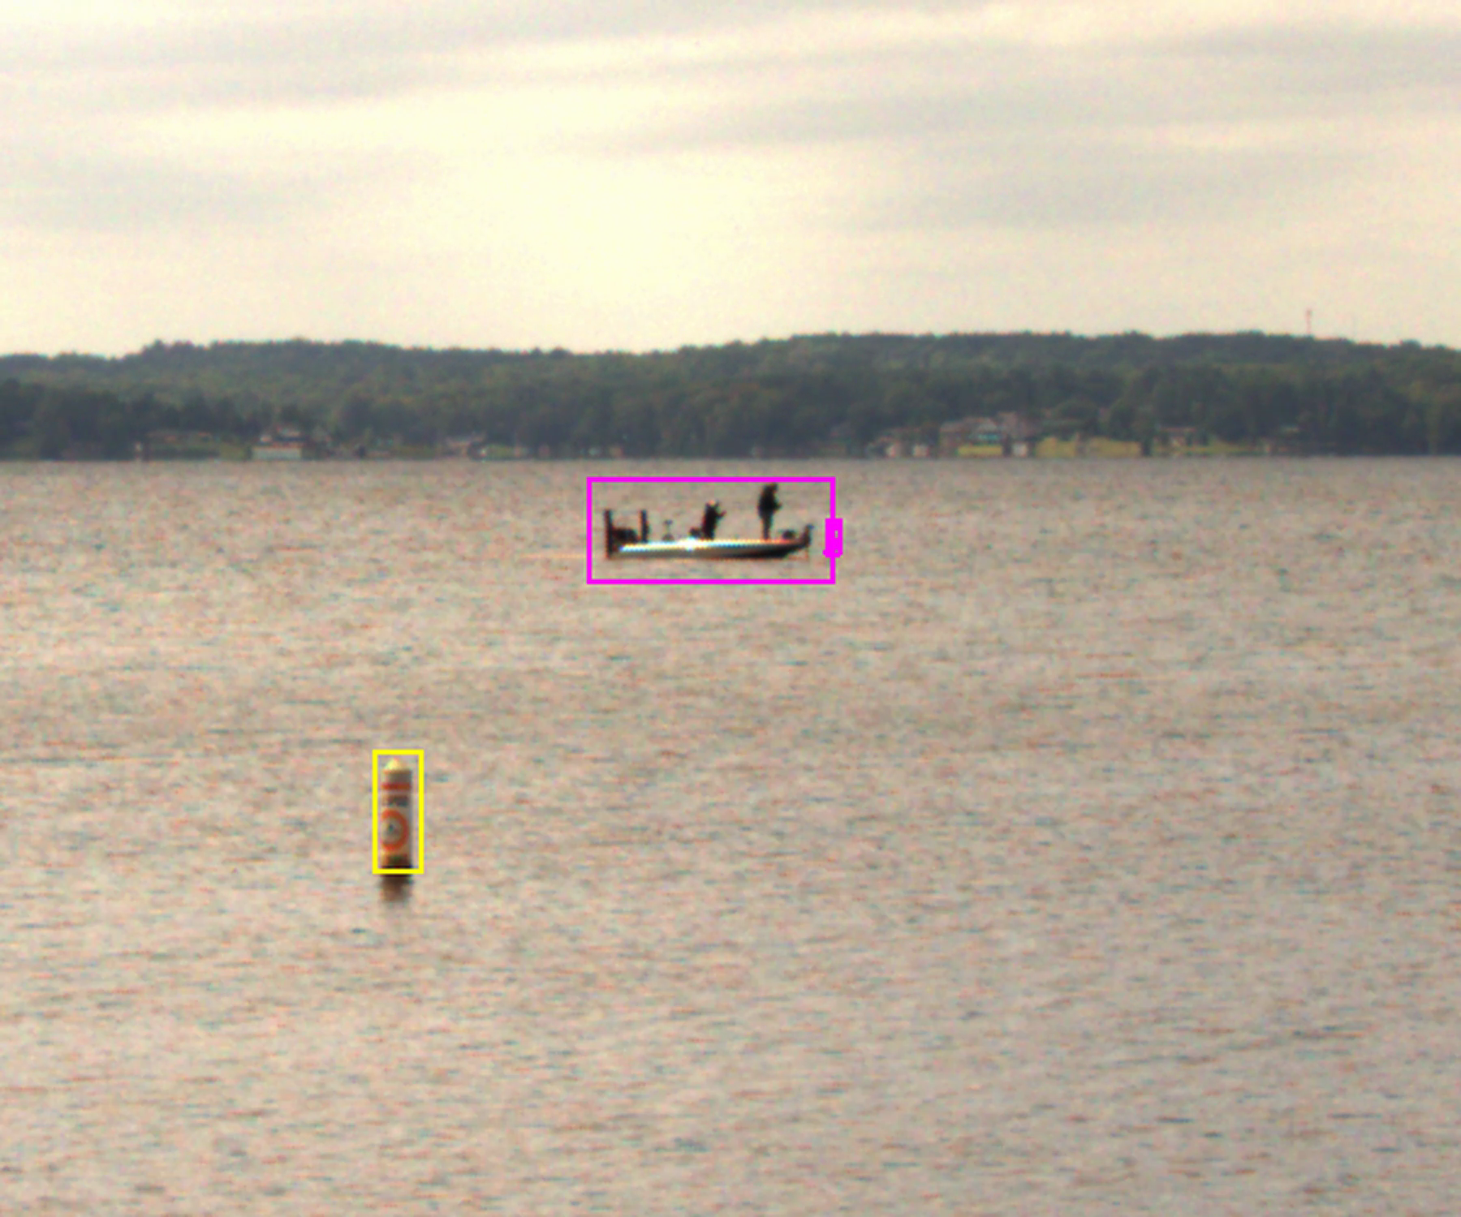
APPROACH 2
05
Radar gating recovers some low-confidence detections
Tiled candidates ≥ 0.10
Accept ≥ 0.18 anywhere
Accept 0.16–0.18 near radar
Class-aware NMS
Vision only • b1 missed
Radar gate • b1 recovered
83
5
12.1%
MECHANISM — Radar rescues weak candidates; it cannot create a missing candidate.
true positives
false positives
buoy recall
Dream Fusion detection experiments
J.C. Vaught
Notes:
[Sources]
- Pipeline settings and radar support rule. run_detection_experiments.py.
- Validation-only threshold selection and test metrics. experiments/detection_comparison/metrics.json.
- Visual evidence. 11_zoom_exp1_vision_only.mp4 and 12_zoom_exp2_radar_gated.mp4, camera frame 203.

Slide 6
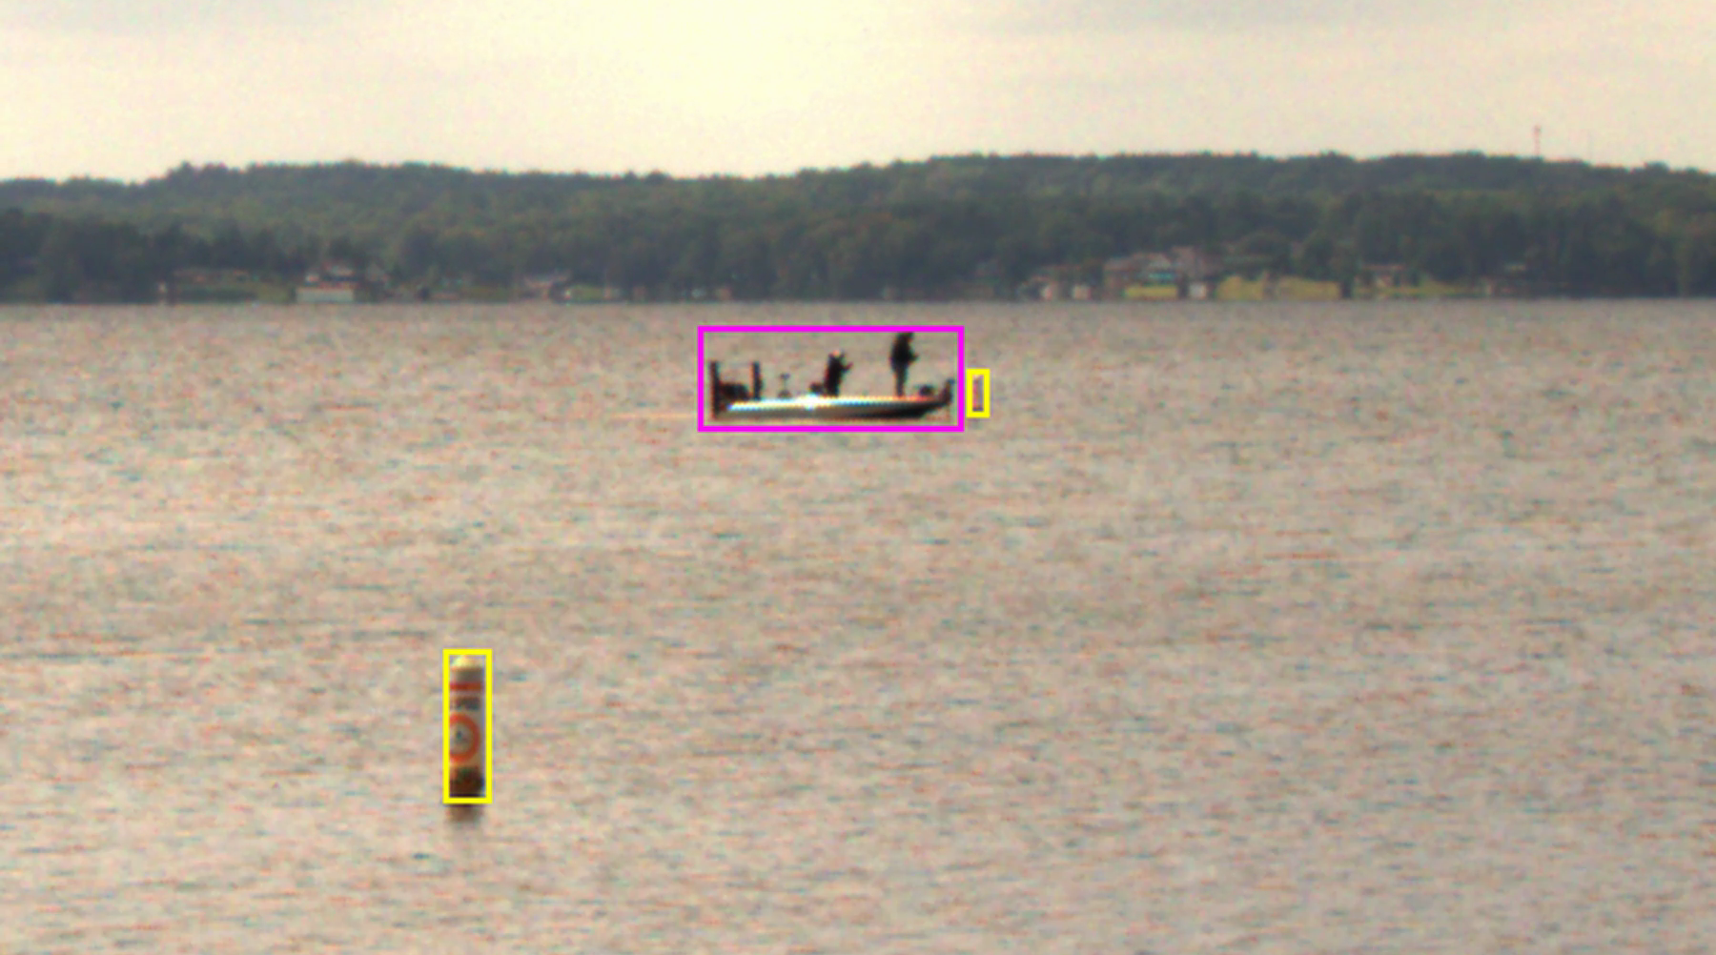
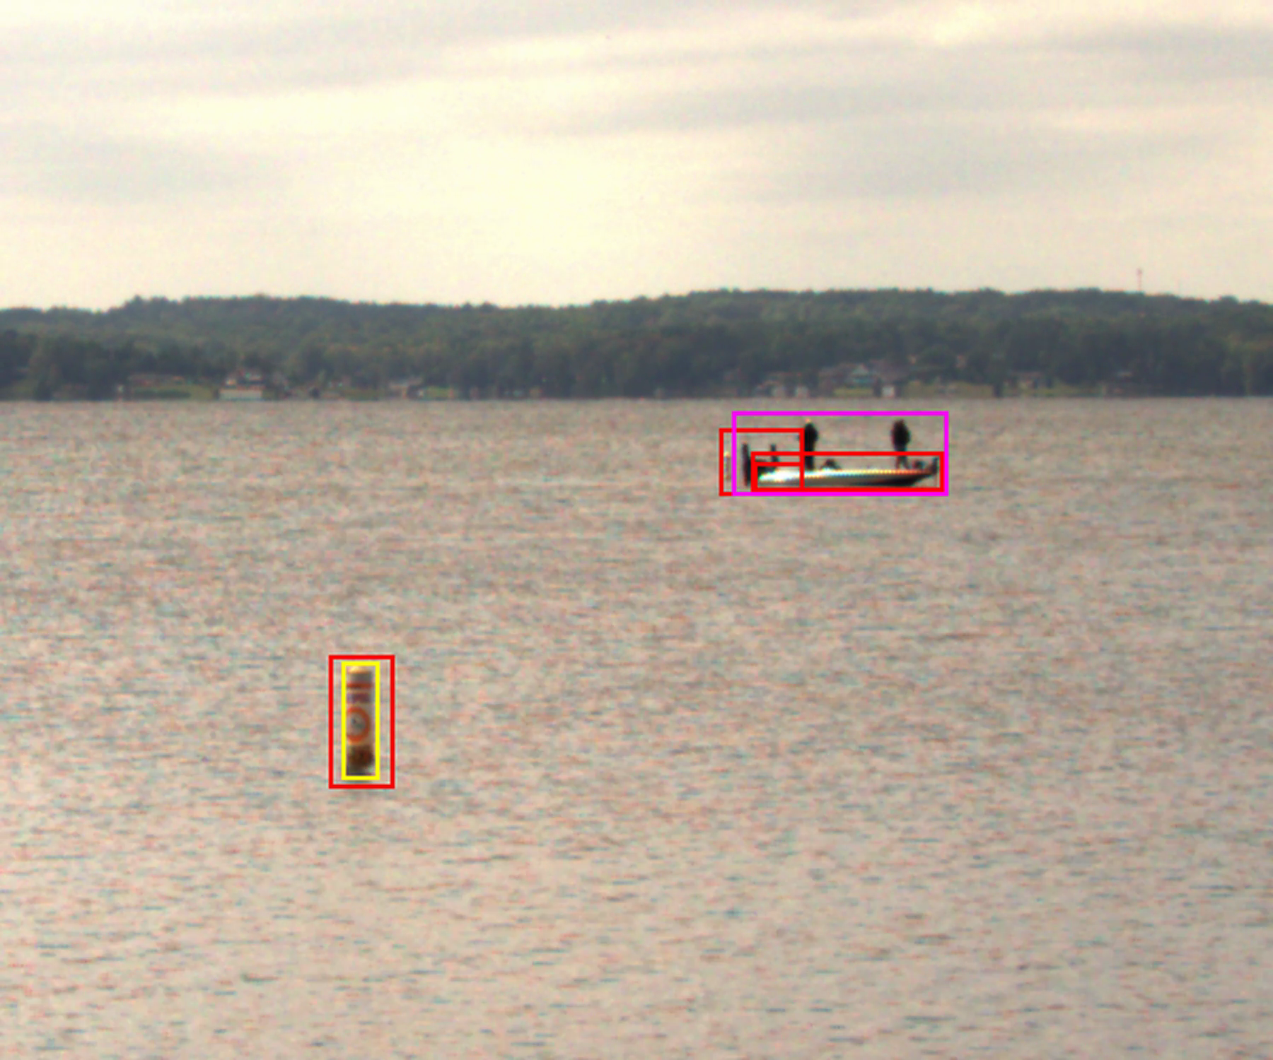
APPROACH 3
06
Radar crops magnify targets and clutter together
Radar returns
Water / shape filtering
150 px padded crops
DINO + remap + NMS
Frame 203 • b2 recovered
Frame 408 • clutter and duplicates
25.0%
61
59.6%
BEHAVIOR — Crops recover b2 on 13 frames, while also amplifying clutter.
overall recall
false positives
overall precision
Dream Fusion detection experiments
J.C. Vaught
Notes:
[Sources]
- Radar crop, water filtering, resizing, merging, and NMS. dream_multi_fusion.py on comech-2422.
- Test metrics. experiments/detection_comparison/metrics.json.
- b2 frame-level matches. out/detections.jsonl evaluated against the ground-truth manifest.
- Visual evidence. 13_zoom_exp3_radar_bounded.mp4, camera frames 203 and 408.

Slide 7
FAILURE MODES
07
Each method fails for a different technical reason
Scale-limited candidate generation
Gate-limited recovery
Crop-amplified false alarms
Vision-only inference misses tiny targets when no sufficiently confident candidate survives tiling and resizing.
Radar gating helps only after a candidate exists. Very small buoys can remain absent even inside a valid radar region.
Bounded crops magnify targets, background structure, and imperfect hypotheses. Remapping can leave duplicates or poor localization.
Shared limitation This sequence is stationary and visually consistent. The comparison measures behavior on this scene, not robustness across weather, range, camera motion, or radar quality.
Dream Fusion detection experiments
J.C. Vaught
Notes:
[Sources]
- Representative detections. zoomed experiment videos on camera frames 203 and 408.
- Dataset scope. out/datasets/dream_fusion_yolo/manifest.jsonl.
- Pipeline behavior. run_detection_experiments.py and dream_multi_fusion.py on comech-2422.

Slide 8
HELD-OUT TEST
08
Boats are saturated here; buoy recall separates the methods
Method | Class | TP | FP | FN | Precision | Recall | F1
Vision only | Boat | 45 | 1 | 0 | 97.8% | 100.0% | 0.989
Vision only | Buoy | 28 | 0 | 287 | 100.0% | 8.9% | 0.163
Radar gated | Boat | 45 | 5 | 0 | 90.0% | 100.0% | 0.947
Radar gated | Buoy | 38 | 0 | 277 | 100.0% | 12.1% | 0.215
Radar bounded | Boat | 45 | 33 | 0 | 57.7% | 100.0% | 0.732
Radar bounded | Buoy | 45 | 28 | 270 | 61.6% | 14.3% | 0.232
BOATS — All 45 are found; false positives and box quality differ.
BUOYS — Recall rises; crop-based precision falls.
Dream Fusion detection experiments
J.C. Vaught
Notes:
[Sources]
- Held-out test metrics. experiments/detection_comparison/metrics.json.
- Test ground-truth counts. out/datasets/dream_fusion_yolo/manifest.jsonl.

Slide 9
HELD-OUT TEST
09
The observed tradeoff is recall versus false alarms
Method | TP | FP | FN | Precision | Recall | F1
Vision only | 73 | 1 | 287 | 98.6% | 20.3% | 0.336
Radar confidence gated | 83 | 5 | 277 | 94.3% | 23.1% | 0.371
Radar-bounded crops | 90 | 61 | 270 | 59.6% | 25.0% | 0.352
Vision only → gated
Gated → bounded crops
Interpretation boundary
10 more TP • 10 fewer FN • 4 more FP
7 more TP • 7 fewer FN • 56 more FP
IoU 0.50 does not encode the cost of misses, false alarms, or computation.
Test set 45 frames • 360 labeled instances
Dream Fusion detection experiments
J.C. Vaught
Notes:
[Sources]
- Held-out test metrics. experiments/detection_comparison/metrics.json.
- Ground-truth split and instance counts. out/datasets/dream_fusion_yolo/manifest.jsonl.

Slide 10
DECISION FRAMING
10
The next discussion should focus on operating constraints
False-alarm tolerance
How costly is an incorrect buoy or boat alert compared with a missed target?
Minimum target size
Which buoy sizes, ranges, and visibility conditions must the system detect reliably?
Radar dependence
How should performance degrade when radar returns are missing, merged, or land-contaminated?
Runtime budget
What latency and compute envelope must inference satisfy on the intended platform?
Generalization evidence
What additional scenes, weather, motion, and sensor configurations are required before comparing robustness?
These questions determine how the same precision–recall evidence should be interpreted.
Dream Fusion detection experiments
J.C. Vaught
Notes:
[Sources]
- Decision questions derived from the observed method behavior and dataset limitations.
- Evidence base. experiments/detection_comparison/metrics.json and the three zoomed evaluation videos.

Slide 11
APPENDIX
11
Evaluation settings and reproducibility
Ground truth
Vision only
300 camera frames • boat and buoy boxes • b2 removed after frame 211
2048 × 1600 tiles • 300 px overlap • confidence ≥ 0.18
Splits
Confidence gate
210 train • 45 validation • 45 held-out test frames
Candidates ≥ 0.10 • final radar-supported cutoff 0.16 selected on validation
Matching
Radar bounded
Class-aware one-to-one matching • IoU ≥ 0.50
Water fraction ≥ 0.90 • 150 px padding • crop merge + class-aware NMS
Model
Outputs
Grounding DINO base with a boat / vessel / buoy prompt
Per-frame JSONL detections, metrics, full-resolution and zoomed evaluation videos
Primary result artifact • experiments/detection_comparison/metrics.json
Dream Fusion detection experiments
J.C. Vaught
Notes:
[Sources]
- Ground truth and splits. out/datasets/dream_fusion_yolo/manifest.jsonl.
- Vision and confidence-gate settings. run_detection_experiments.py.
- Radar-bounded settings. dream_multi_fusion.py on comech-2422.
- Evaluation implementation. evaluate_detection_experiments.py.
- Metrics artifact. experiments/detection_comparison/metrics.json.

