Slide 1

AR/VR Workshop Introduction
Phillip G. Bradford
University of Connecticut

Slide 2
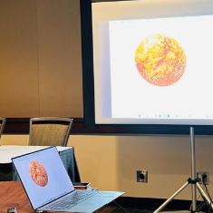
Full select demo – how you can do …
Basic-Mars-Landing

Slide 3
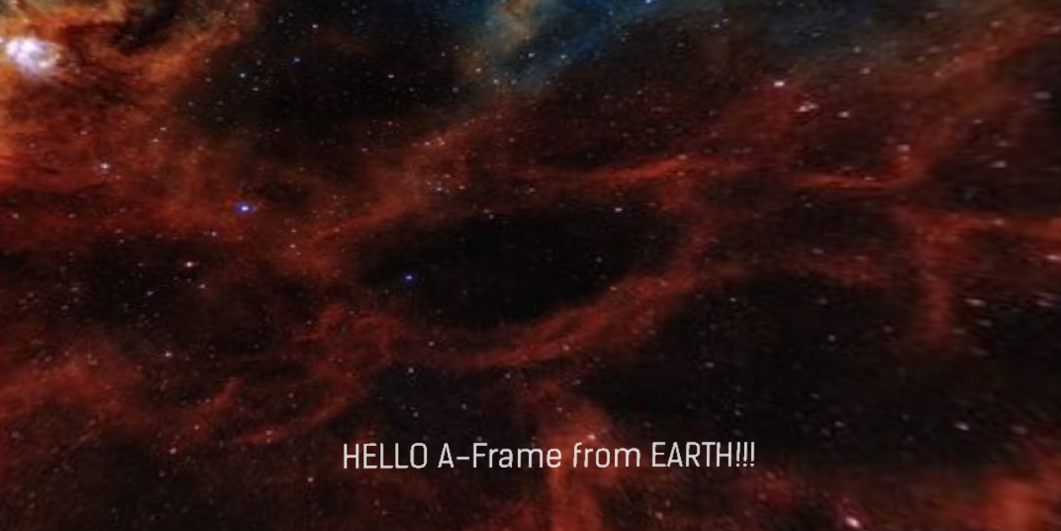
Module demo highlights: 3D image

Slide 4

Outline
Overview
No installations needed
Github pages
Our first VR/AR examples

Slide 5
High level view and learning path
Web components
OpenGL
WebXR
Three.JS
A-Frame

Slide 6
A-frame
3D virtual reality system built by Mozilla
A-frame is a component system built on Three.js
Three.js is built on WebXL which is built on WebGL
A-frame is HTML that uses web-components
Declarative – tell it what you want to see,
it figures out how to do it

Slide 7
No installation VR
Easy
Only Python3 installed
Goto wonder-phil.github.io or YOUR_USER. github.io
Clone https://github.com/wonder-phil/wonder-phil.github.io.git

Slide 8
Overview: wonder-phil.github.io
Computer
Mobile phone
Github pages
Github pages

Slide 9
Laptop view
git clone https://github.com/wonder-phil/wonder-phil.github.io.git
cd wonder-phil.github.io
Term1> python –m http.server
In a browser go to http://localhost:8000/
Term2> code .

Slide 10
Basic HTML
<html>
<head>
</head>
<body>
</body>
</html>

Slide 11
index.html and not-index.html
<a-scene>
<a-sky color="#0000EE“>
</a-sky>
<a-text
font="kelsonsans"
color = "#FFFFFF"
value="HELLO A-Frame!!!"
width="6"
position="0 -1 -5"
></a-text>
</a-scene>
<html>
<head>
<meta charset="utf-8">
<title>Hello A-Frame Example</title>
<script src="https://aframe.io/releases/1.4.1/aframe.min.js"></script>
</head>
<body>
<a-scene>
<a-sky color="#0000EE"></a-sky>
<a-text
font="kelsonsans"
color = "#FFFFFF"
value="HELLO A-Frame!!!"
width="6"
position="0 -1 -5"
></a-text>
</a-scene>
</body>
</html>

Slide 12
VR glasses steps
On your phone go to your github pages
wonder-phil.github.io
Use VR glasses to view the project on your phone

Slide 13



simple-sky.html
$$y$$
<a-scene>
<a-sky color="#0105EF"> Select a color at https://www.w3schools.com/colors/colors_picker.asp
</a-sky>
<a-text
font="kelsonsans"
color = "#FFFFFF"
value="HELLO A-Frame!!!"
width="6"
position="0 -1 -5“ Note: x-horizontal, y-vertical, and z-depth*
></a-text>
</a-scene>
*this translates to 1 meter below the origin and 5 meters into the page
$$z$$
$$x$$

Slide 14
simple-sky.html: changing the view
<a-scene>
<a-sky color="#0105EF">
</a-sky>
<a-text
font="kelsonsans"
color = "#FFFFFF"
value="HELLO A-Frame!!!"
width="6"
position="0 -1 -5"
></a-text>
</a-scene>
Replace the current index.html on glitch
with not-index.html
Simple-sky.html
← a-scene now looks like this

Slide 15
Putting it all together
You have now created virtual reality text on a 3D background
We can also
Change background – to the nebula
What if it doesn’t work? TROUBLESHOOTING!
2. Move text around in the nebula
What if it doesn’t work? TROUBLESHOOTING!

Slide 17
Getting a-frame from aframe.io
<head>
<script src="https://aframe.io/releases/1.7.1/aframe.min.js">
</script>
</head>
Or to run outside of Glitch.com to help TROUBLE SHOOTING
<body>
<script src=“../js/aframe.io_releases_1.7.1_aframe.min.js">
</script>

Slide 18
TROUBLESHOOTING!
CTRL-ALT-I in browser for a-frame debugging
CMD-Option-I in browser for a-frame debugging
SHIFT-CTRL-J in browser for Chrome/FireFox debugging
CTRL-O in browser to load a file

