Slide 1
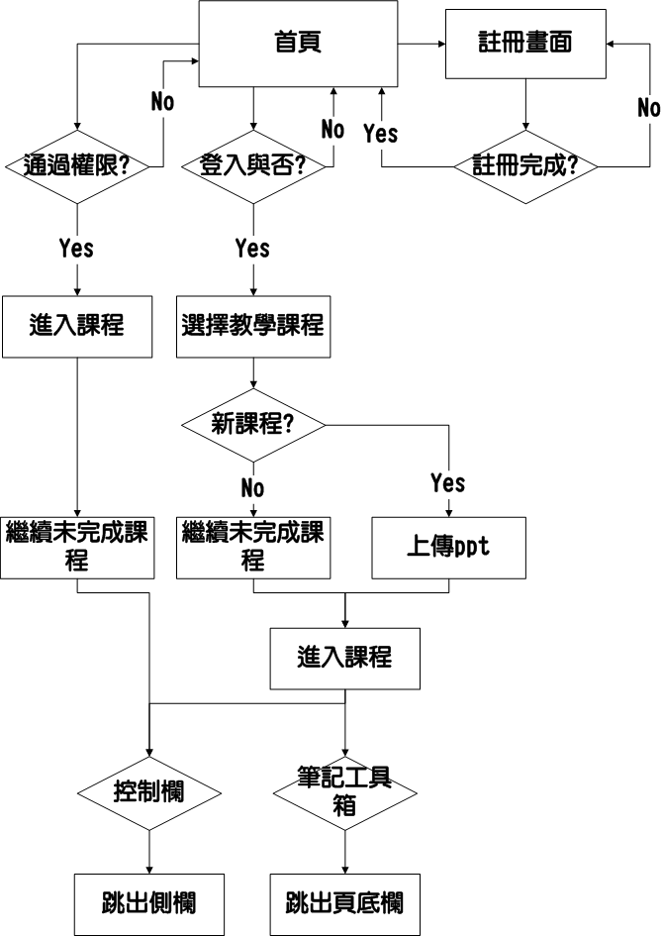

Slide 2
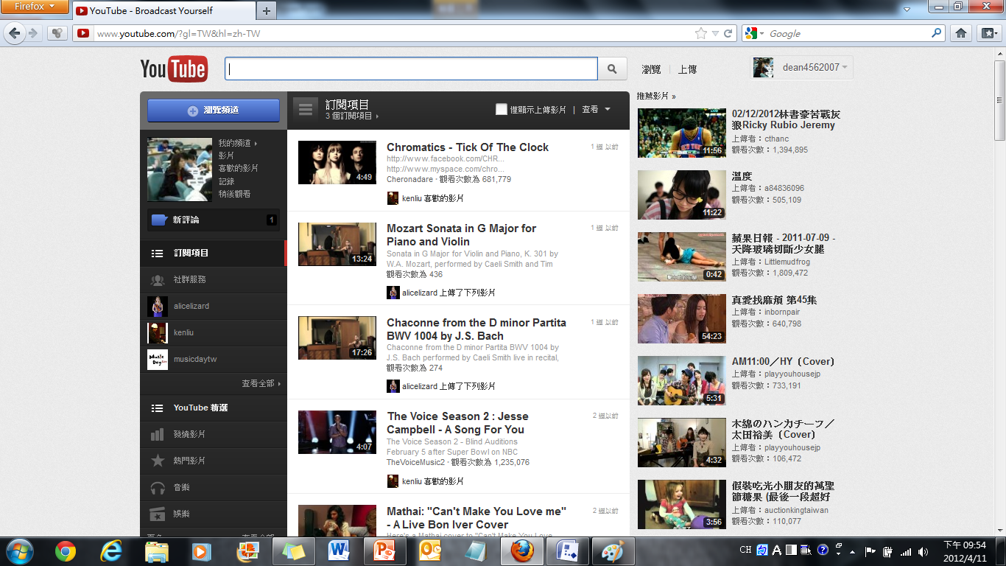
首頁
Snacks!!
Account
+
?
Search
Password
Popular
Top rated
My favorite
Math
English
+
Teach
Learn
+
Top rated
Top rated
new class
Teach you violin.
How to be me.
Recent classes…
Popular
Learning math is just like chasing girls.
How to be me.
Introduction:…
How to be me.
How to be me.
Top rated
Top rated
Teach you violin.
How to be me.
How to be me.
Top rated
Top rated
How to be me.
Teach you violin.
How to be me.
How to be me.

Slide 3
首頁
Snacks!!
Search
師
Hi, Mike Chen
Popular
Top rated
My favorite
Math
English
+
Teach
Learn
+
Top rated
Top rated
new class
Teach you violin.
How to be me.
Recent classes…
Popular
Learning math is just like chasing girls.
How to be me.
Introduction:…
How to be me.
How to be me.
Top rated
Top rated
Teach you violin.
How to be me.
How to be me.
Top rated
Top rated
How to be me.
Teach you violin.
How to be me.
How to be me.

Slide 4
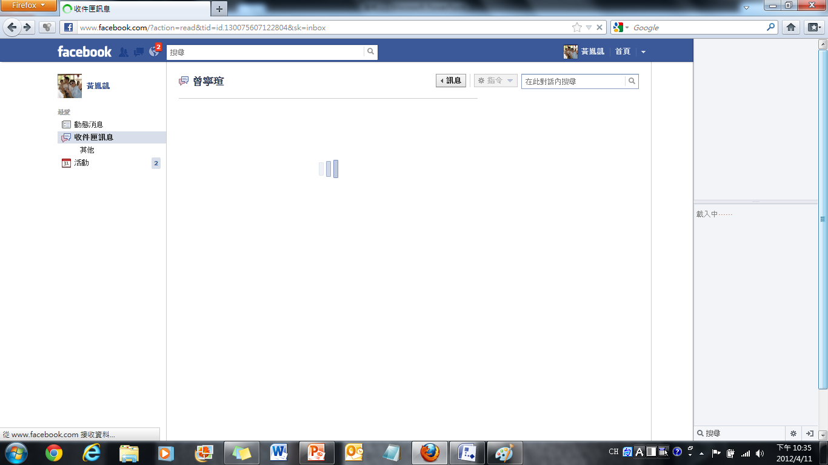
註冊頁
Snacks!!
Account
+
?
Search
Password
Create New Account
Login with
Account Name:
Mike Chen
Name:
Mike Chen
…
Submit

Slide 5
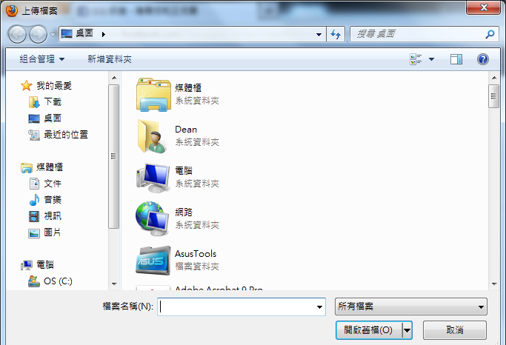
首頁
Snacks!!
Search
師
Hi, Mike Chen
Popular
Top rated
My favorite
Math
English
+
Teach
Learn
+
Top rated
Top rated
new class
Teach you violin.
How to be me.
Recent classes…
Popular
Learning math is just like chasing girls.
How to be me.
Introduction:…
How to be me.
How to be me.
Top rated
Top rated
Teach you violin.
How to be me.
How to be me.
Top rated
Top rated
How to be me.
Teach you violin.
How to be me.
How to be me.

Slide 6
編輯課程
Snacks!!
Account
+
?
Search
Password
Popular
Top rated
My favorite
Math
English
+
Teach
Control Panel
Learn
+
Top rated
Top rated
new class
Teach you violin.
How to be me.
Our PPT
Recent classes…
Popular
Learning math is just like chasing girls.
How to be me.
How to be me.
Introduction:…
Comments
How to be me.
Top rated
Top rated
Teach you violin.
How to be me.
How to be me.
Top rated
Top rated
How to be me.
Teach you violin.
How to be me.
Tool Box
How to be me.

Slide 7

編輯課程
Record
Snacks!!
Account
slide
+
?
Search
Password
1
Popular
Top rated
My favorite
Math
English
+
Teach
Learn
Control Panel
3:48
2
+
Top rated
Top rated
new class
Teach you violin.
How to be me.
Our slide
3:48
Recent classes…
3
Popular
Learning math is just like chasing girls.
How to be me.
3:48
4
Comments
How to be me.
Introduction:…
3:48
How to be me.
Top rated
Top rated
5
Teach you violin.
How to be me.
How to be me.
Tool Box
3:48
Top rated
Top rated
6
How to be me.
Teach you violin.
How to be me.
3:48
How to be me.

Slide 8
編輯課程
Snacks!!
Account
+
?
Search
Password
Popular
Top rated
My favorite
Math
English
+
Teach
Control Panel
Learn
+
Top rated
Top rated
new class
Teach you violin.
How to be me.
Our PPT
Recent classes…
Popular
Learning math is just like chasing girls.
How to be me.
Comments
Mike Chen:
Introduction:…
How to be me.
我覺得很難耶
> <
How to be me.
Top rated
Top rated
Andrew:
Teach you violin.
How to be me.
不會啊
我生下來就會了
How to be me.
把你當掉
Top rated
Top rated
How to be me.
Teach you violin.
How to be me.
Tool Box
How to be me.

