Slide 1





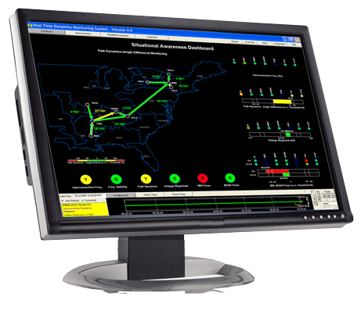


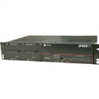

PHASOR SYSTEM DESIGN & PDC CHARACTERISTICS
Ken Martin, Senior Principal Engineer
Electric Power Group, LLC (EPG)
Presented to ERCOT Synchrophasor Work Group
March 7, 2014
enhanced PDC
Real Time Dynamics Monitoring System Alarming
Phasor Grid
Dynamics Analyzer

Slide 2
Presentation
Synchrophasor system architecture
The PDC element
Latency considerations
PDC features and functions
PDC guide & standard
Page <number>

Slide 3
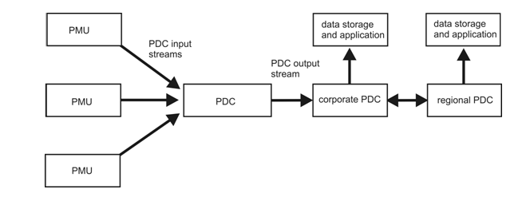
Basic Phasor Measurement System
PMUs in substations make measurements
Data flow to PDC – correlates data from many PMUs
Applications use streams at any point
Page <number>

Slide 4
Architecture – typical & variation
Typical – star architecture
  PMUs send data to near PDC
  PDCs cascade to higher levels
  Easy to manage
  Delays a challenge
Variation 1 – dual star
  PMUs send data directly to all PDCs
  Duplicate stream or multicast
  More difficult to manage/more bandwidth
  Delays minimized
Variation 2 – direct to applications
  Best for minimal latency
PMU
PMU
Application
PDC
PMU
Application
PDC
Application
PMU
PMU
Application
PDC
PMU
Application
PDC
Application

Slide 5
System architecture notes
Hierarchal star architecture most common
  Fits well in most utilities
    Direct communications between substations & control center
    Serial or network
  Easy to implement and manage
  Easy to expand into grid-wide measurement
  However - delays between companies difficult to manage
Dual star direct to higher levels
  Needs more bandwidth OR use of multicast
  A little more difficult to manage
Point-point (peer-peer) for special applications
  Needed for high-speed, low latency applications

Slide 6
Phasor Data Concentrator (PDC) defined
A PDC gathers data from a number of devices and forwards it as a single stream
PDC defined in C37.244:
  A function that collects phasor data, and discrete event data from PMUs and possibly from other PDCs, and transmits data to other applications.
PDC defined in C37.118.1/2
  A device used in phasor measurement systems that combined data from several sources
Definitions basically equivalent, but the semantic difference is debated
IEEE PDC Guide C37.244-2013
  Covers definitions, functions, performance, & testing

Slide 7
Basic PDC functions
Input data from PMUs
  Decode, error check & manage communications
Combine input data, generally by timetag
Output data to applications
  Construct messages & manage communications
Manage measurement system
  Create record of outages, errors
  Provide real-time monitor of operation
ESSENTIAL – phasors must be matched by timetag to compare phase angles across system

Slide 8
Basic PDC architecture
Three principle subsystems
  Input System
  Data table
  Output System
Some kind of overall management
Many variations possible
System management
Input system
Data table
Output system

Slide 9
Data correlation
Correlate data by timestamp
  Data becomes a synchronous table (“snapshot”)
  Data sent as synchronized ‘sample’
  Easy use for applications, all data synchronized
  Processing late data & loss of sync more difficult
  Different rate data needs adjustment algorithms
Store data uncorrelated
  Each input stored in separate buffer
  No input correlation problems
  Different rates easy to manage
  Data synchronized on output or sent separately
  Use by applications more complicated

Slide 10
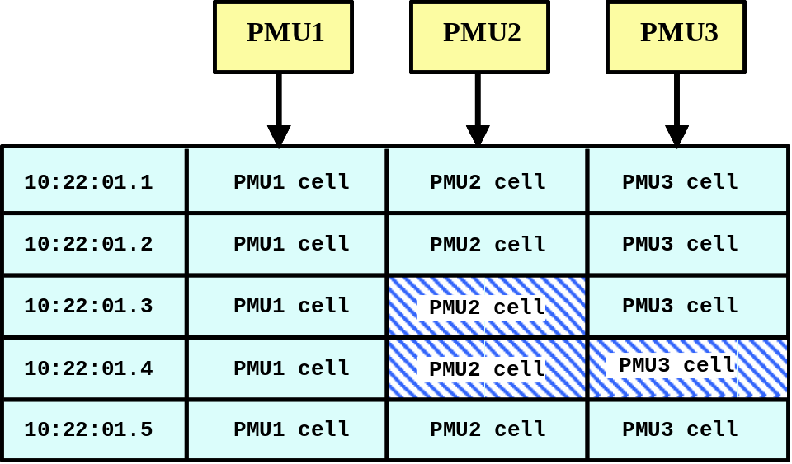
Input data correlation by timetag
PDC has table for holding data
Data is placed in table by timetag
  Facilitates time alignment of data
PDC sets appropriate table size, controls looping
Table becomes series of ‘snapshots’ of the system
Oldest data
Data received
Put in correct cell
Processing-
Error check
Extract parameters
Row currently being filled
Most current data

Slide 11
An input processing approach
Table allows waiting for delayed data
  Table length longer than maximum communication delay
  Convenient length for management (Eg: 1 min)
When PMU sync lost (time error)
  Apply local timetag (sort by arrival)
When timetag outside of table
  Discard data
  If bad timetag consistent, apply local timetag
Different data rates sorted to nearest timetag
  Interpolation or down sampling where necessary

Slide 12
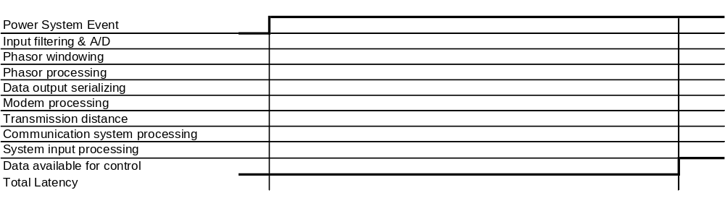
Latency in synchrophasor data
Latency or delay is the time for data to pass through the communication system
Includes processing in modems, routers, switches, etc.
Diagram shows relative times of each element

Slide 13
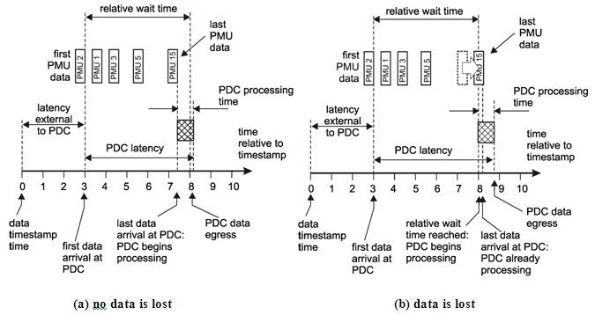
Data Aggregation
Wait time – time interval waiting to receive all data with given timestamp
  Relative wait time starts with first PMU for given timestamp
  Absolute wait time starts by local clock
Page <number>

Slide 14
Latency and data aggregation
Aggregated output based on the longest latency
  Communication latency is usually small & consistent
    Based on fixed elements & distances
Latency variation
  Overloaded communication link
    Local buffering or re-transmission
  Alternate routing – failed link
  Equipment problem
Long delays & large variation indicate a problem—FIX the problem!
Page <number>

Slide 15
Data output management
Wait for data availability
  Long enough for transmission delays
  Short enough for application delays
Match to application
Wait set too long –
output too slow
for application
Wait set too short -
important data lost
Row currently being filled
Missing data

Slide 16
Data output issues
When wait time is too short, delayed data is lost.
When wait time is too long, all applications are delayed
Simple approach----
Establish wait time based on application
  Real-time controls need specified limits
  Displays and alarms should not wait more than 2 sec
  Data recording can wait very long
  Set wait times less than max but realistic
Monitor data loss & adjust as needed
  If settings will not give good performance, find & fix problem!

Slide 17
More essential functionality
Support required input/output protocols
Manage & support all communications
Monitor system operation
  Input/output communication, data loss & errors,
  Keep performance & operation logs
  Display performance information & supply problem alarms
Configuration management
Input & output reporting rate conversions

Slide 18
Additional functionality – from PDC guide
Data forwarding without alignment
Output data buffering
Data rate conversions
Configuration management
Data format & coordinate conversion
Data phase and magnitude adjustment
Latency calculation
Redundant & duplicate data handling
Data re-transmission
Cyber security

Slide 19
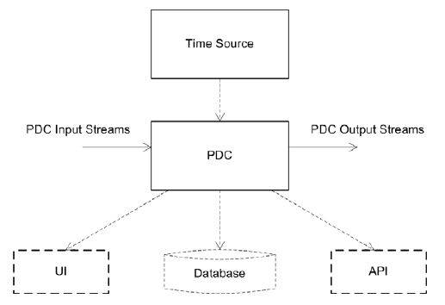
PDC testing – from PDC guide
Test categories, test interfaces and setups
Test outlines, test reporting and tools
Page <number>

Slide 20
PDC guide & standard
PDC guide C37.244-2013
  Defines PDC terminology & illustrates application
  Recommends certain basic features
PDC standard PC37.247
  Work started in 2013
  Builds on concepts of guide for required features
  Consensus is building slowly
  Expect completion in 2015
Page <number>

Slide 21
Architecture & PDC Summary
Basic architecture follows typical power system
  PMUs send data to control center
  Aggregated data forwarded to higher entity
  Variations possible
PDC provides basic aggregation of data
  All PDCs provide basic aggregation & communication
  Vary greatly in additional functions provided
PDC guide available
  Summarizes features & defines terms
PDC standard under development
Page <number>

Slide 22
PHASOR SYSTEM INSTALLATION & TESTING
Ken Martin, Senior Principal Engineer
Electric Power Group, LLC (EPG)
Presented to ERCOT Synchrophasor Work Group
March 7, 2014
enhanced PDC
Real Time Dynamics Monitoring System Alarming
Phasor Grid
Dynamics Analyzer

Slide 23
Presentation
Review installation elements
Checkout procedures
Summary
Page <number>

Slide 24
Phasor system pre-installation
At this point
  System design complete
  PMU locations set
  Signals to measure selected
  Communications designed
Equipment has been procured
Installation scheduling planned
  Deadlines accounted for
  Available workforce planned
  Outages scheduled

Slide 25


Physical installation overview
Signal input
Timing input
Data output
Physical layout
Power input
Local subsystem
Maintenance & service
PMU
Data
output
PMU
Data
output
Data
storage
Data
output

Slide 26
PMU signal inputs
v₁
Where are the signal sources?
  Separate buildings – need several PMUs
  Analog or digital (status) inputs
Need aux current or voltage transformers? Usually plan for--
  I < 4x (full load)
  V < 2x (rated voltage)
  PMUs are not usually used for fault conditions
Need remote access to PMU?
  Separate data-comm required & available?
Power for PMU
Relay
House
1
v₂
Relay
House
2
breaker
Device 2
Device 1

Slide 27

Measurement timing
GPS
  Needs lock indication
  Cable length limits
IRIG – B
  Needs lock indication
  Needs edge for sync
    Level shift, Manchester coding, or 1 PPS
IEEE 1588
  Distributed by Ethernet
  Needs time quality
  Requires qualified network
Internal LO for holdover
Timing
Module
(GPS)
IRIG-B
Phasor
reference
signals
Measured
Signals
Local
oscillator
A/D
converter
Synchrophasor
estimator
KEM

Slide 28
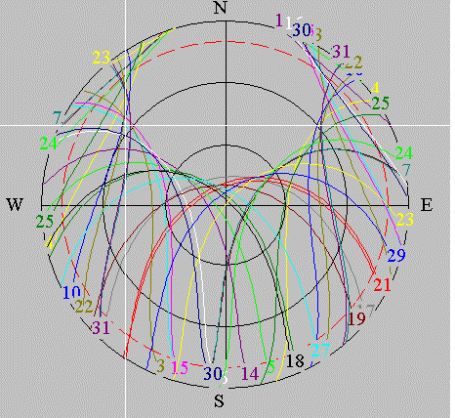
GPS input – Antenna mounting
Best - clear 360° horizon above 10 deg. elev
10 deg
Elevation
GPS Antenna
Control House
10 deg
Elevation
2nd best – clear 180° horizon or more to South above 10 deg. elev
Mount on South side of pole or structure
3/4” Pipe
Control
House
24 Hr. satellite trajectory plot
KEM

Slide 29
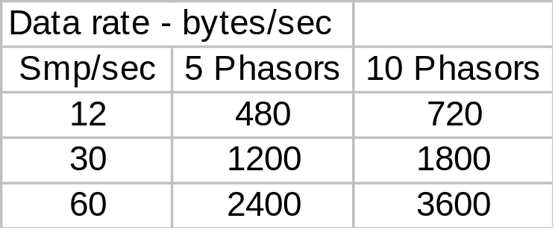
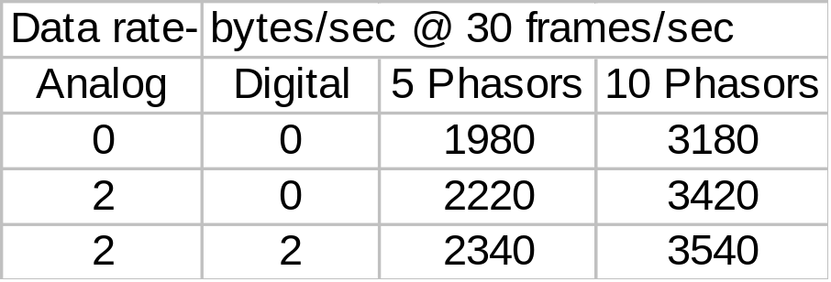
PMU communications
Interface between PMU & communication system
  Modem, router, SPDC
  Match for interface on both sides
PMU output is continuous in data frames
  Size communication bandwidth to handle message size including overhead
  Latency (delay) in transmission within application limits
PMU output – C37.118, all integer
PMU output – C37.118, all floating point
Data rate in bits/sec (BPS) is approximately 10X(rate in bytes/sec)
KEM
Notes:
The typical system sends data from the PMU to the PDC, and then the PDC to applications. Each data link needs to be calculated based on these requirements. These data rates are bytes/sec. Communication is usually calculated in bits/sec, so a simple way to estimate that requirement is multiply all the numbers by 10. Give examples. In the WECC, we use a 30 sample/sec data rate, so these are highlighted in the charts. PMUs are typically set for 5-10 phasors per unit, with 5 or 10 the most common. The PDC output is always on Ethernet because the PDCs we are using only outputs via Ethernet. It is obvious that any serial link would quickly be overloaded. The actual PDC loads were shown before and vary from 2 to 20. these values were calculated based on an average of 8 phasors/PMU.

Slide 30

Installation checkout
Purpose is to confirm operation
  Assure timing, measurements, & communications
  PMU certification & calibration done previously
Measurements
  Confirm correct signal inputs, phasing, scaling
  Assure values by comparing with other measurements
Check PMU timing input & synchronization
Communications
  Establish communications
  Check datacomm quality & latency

Slide 31
PMU installation
3-phase AC signals (V & I)
  Check phase rotation, magnitude, relative phasing
GPS or other timing input
  Achieves sync and lock
  Detects and indicates loss of signal and sync
    (eg, disconnect antenna)
GPS
synchronization
Clock
PT/CT
inputs
PMU
Data reading
device
3-phase
signals
Digital
phasor data
Notes:
The typical system sends data from the PMU to the PDC, and then the PDC to applications. Each data link needs to be calculated based on these requirements. These data rates are bytes/sec. Communication is usually calculated in bits/sec, so a simple way to estimate that requirement is multiply all the numbers by 10. Give examples. In the WECC, we use a 30 sample/sec data rate, so these are highlighted in the charts. PMUs are typically set for 5-10 phasors per unit, with 5 or 10 the most common. The PDC output is always on Ethernet because the PDCs we are using only outputs via Ethernet. It is obvious that any serial link would quickly be overloaded. The actual PDC loads were shown before and vary from 2 to 20. these values were calculated based on an average of 8 phasors/PMU.

Slide 32
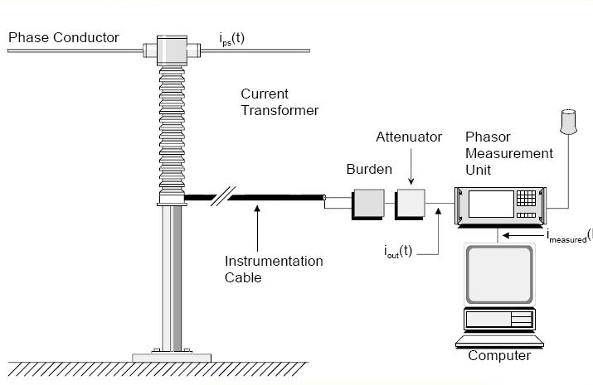
Measurement comparisons
At substation
  Portable or installed instruments
At control center
  SCADA or other reported data
Local
measurement
Compare
PT / CT
Phasor
measurement
system
Instrument
signal
Compare
SCADA
system
Diagram - EIPP measurement
accuracy doc, S. Meliopoulis

Slide 33
Communication checkout
Connect with destination device
  Check that data received correctly
  Observe over time (24 hr) - check reliability, latency
Problems with connection or data?
  Check addressing & routing setup
  Use network analyzer for troubleshooting (Ethereal, etc)
Communications usually works or doesn’t
PMU
Router/
switch
Router
Data channel
PDC
PMU
Notes:
The typical system sends data from the PMU to the PDC, and then the PDC to applications. Each data link needs to be calculated based on these requirements. These data rates are bytes/sec. Communication is usually calculated in bits/sec, so a simple way to estimate that requirement is multiply all the numbers by 10. Give examples. In the WECC, we use a 30 sample/sec data rate, so these are highlighted in the charts. PMUs are typically set for 5-10 phasors per unit, with 5 or 10 the most common. The PDC output is always on Ethernet because the PDCs we are using only outputs via Ethernet. It is obvious that any serial link would quickly be overloaded. The actual PDC loads were shown before and vary from 2 to 20. these values were calculated based on an average of 8 phasors/PMU.

Slide 34
Installation summary
Design & equipment procurements complete
PMU certification & calibration done previously
Check that measurements match signals in substation
Check that time lock is steady, indications correct
Validate measurements at control center
  SCADA
  State Estimator
Observe communication without loss
Check that error indications & problem alarms work!
Page <number>

Slide 35
Thank You!
Ken Martin
martin@electricpowergroup.com
John Ballance
ballance@electricpowergroup.com
Prashant Palayam
palayam@electricpowergroup.com
Heng (Kevin) Chen
chen@electricpowergroup.com
201 S. Lake Ave., Ste. 400
Pasadena, CA 91101
626-685-2015
Page <number>

