Slide 1
Online Game Store
Created by: David Gonzalez and Marcus Higgins

Slide 2
Project Overview
Our Project is a website that acts as an online game store.
It allows users to view and purchase games.
Admins are able to add and edit information on the site.

Slide 3
Customer View
From the homepage, a customer can sign in with an existing account or create a new one, but there is no authentication.
Once signed in, the customer can add games from the ones available.
Some games require a subscription which will prompt the customer to specify the start and end date for it.

Slide 4
Admin View
There is only one admin account.
From the admin view, the user can add a new game to the site, as well as edit and delete existing games
The admin can also remove customer accounts from the site

Slide 5
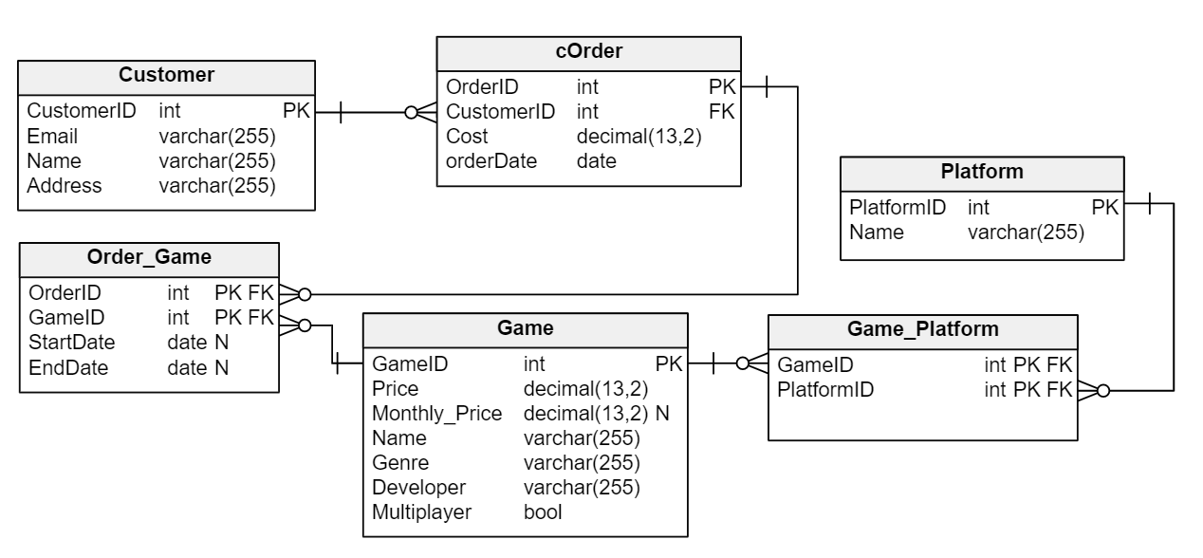
Project ERD

Slide 6
Web Interface
The link is hosted on both Marcus’s and David’s turing account
Interface on Marcus’s turing: https://turing.cs.olemiss.edu/~mjhiggin/Final%20Project/home.php
Interface on David’s turing: https://turing.cs.olemiss.edu/~dgonzal3/FinalProject/home.php

Slide 7
Marcus’s SQL Queries
Query 1 - shows the average price for each genre for the games on windows, ordered in ascending order of the average: SELECT genre, FORMAT(AVG(price), 2) AS AVERAGE FROM game join game_platform using (gameID) WHERE platformID = (SELECT platformID FROM platform WHERE name = "Windows") GROUP BY genre ORDER BY AVERAGE ASC;
Query 2 - shows the games that are on each platform: SELECT platform.name AS 'Platform Name', GROUP_CONCAT(game.name) as 'Game Name’ FROM game JOIN game_platform USING (gameID) JOIN platform USING (platformID) GROUP BY platform.name;

Slide 8
David’s SQL Queries
Query 3 – Shows the platforms and the genres that have multiplayer.
SELECT platform.name Name, GROUP_CONCAT(DISTINCT game.genre) FROM platform NATURAL JOIN game_platform NATURAL JOIN game WHERE multiplayer = True GROUP BY platform.name;
Query 4 – Example of nesting that displays the platform id from a list of games where game id = 1.
SELECT platformID FROM game_platform WHERE gameID = (SELECT gameID FROM game WHERE gameID =1);

Slide 9
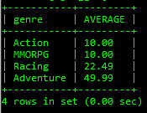
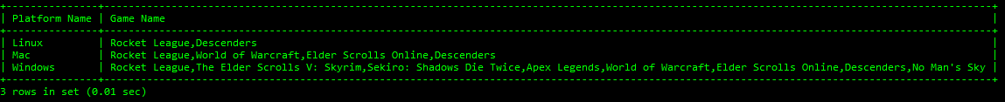
Query Output
Query 1
Query 2

Slide 10
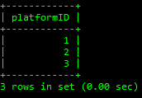
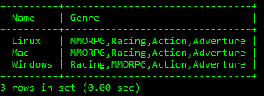
Query Output
Query 3
Query 4

