Slide 1
INSTRUCTIONS
CREATED BY:
VINAY JAISWAL 191210060

Slide 2
Instructions step by step
Project link: https://drive.google.com/drive/folders/1I6LlLAU70V0d7KhsoD75B49Qx8KZ0zv6?usp=sharing
Download project and then go to location of NetBeans project then copy the downloaded project.
Video link:

Slide 3
Instructions step by step
Then go to netbeans eventmanagementsystem project add these two in library of eventmanagementsystem
Link1: https://drive.google.com/file/d/1lD1u-nwKGE2vHsdQWV9UXZq3AVcPaCFR/view?usp=sharing
Link2: https://drive.google.com/file/d/1RG3DYnfraNju9p5FNu5xRYRL4-yxmpAw/view?usp=sharing

Slide 4
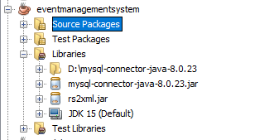

Slide 5
Instructions step by step
After that open MySQL command line client then create database and tables which are :
create database eventmanagementsystem;
create table user(firstname varchar(30),lastname varchar(30),username varchar(30),password varchar(30),gender varchar(30),usertype varchar(30),email varchar(30),mobileNo varchar(30),securityQue varchar(50),answer varchar(30));
insert into user values("V","J","admin","12345","male","admin","admin@gmail.com","9893012404","Your Nickname?","VJ");
create table venue(id varchar(30),name varchar(30),price varchar(30),capacity varchar(30),facilities varchar(30),description varchar(200));
create table photographer(id varchar(30),name varchar(30),contactId varchar(30),price varchar(30),duration varchar(30));
create table caterer(id varchar(30),name varchar(30),contactId varchar(200),price varchar(30),budget varchar(10));
create table event(name varchar(30),partyType varchar(30),photographer varchar(30),catering varchar(30),venue varchar(30),dateOffunction varchar(30),price varchar(30));

Slide 6
Instructions step by step
If your username , password and port for MySQL is different then modify conn.java in source package.
Only modify this line only

Slide 7

Instructions step by step
Then run the project in netbeans.

Slide 8
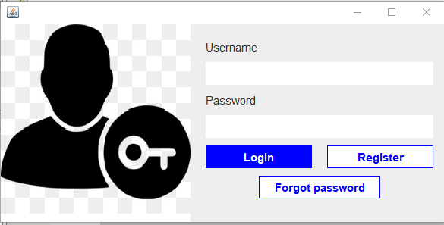
After pressing button Click here to continue then login frame will open

Slide 9
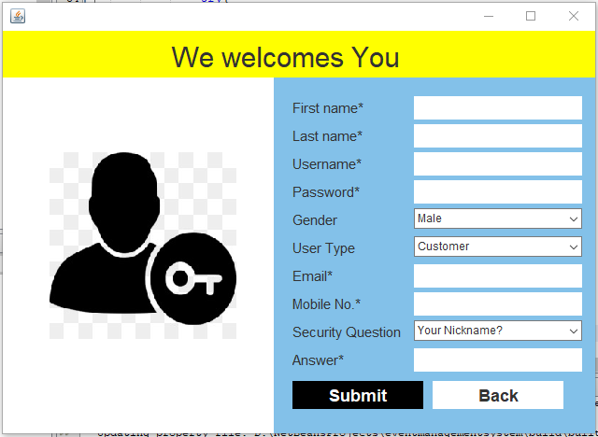
Register frame

Slide 10
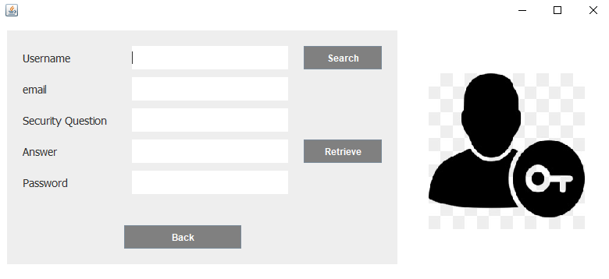
Forgot password frame

Slide 11
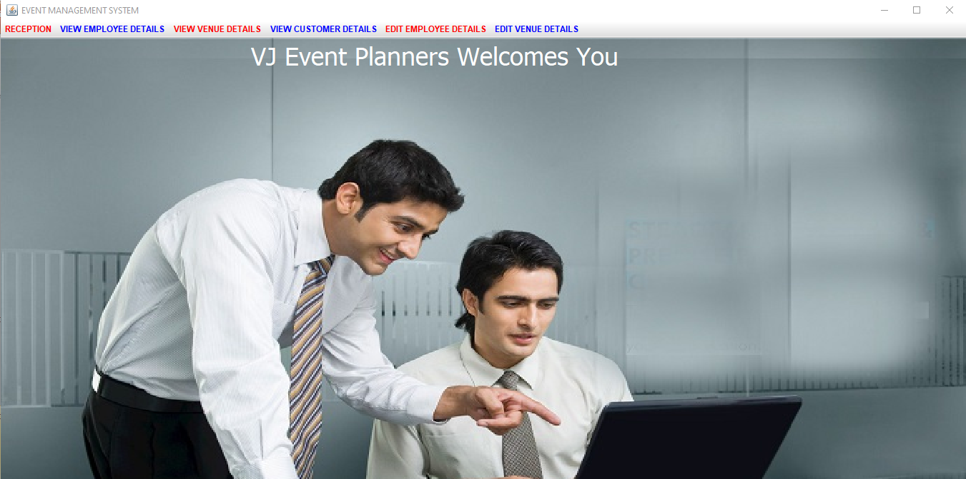
Admin dashboard

Slide 12
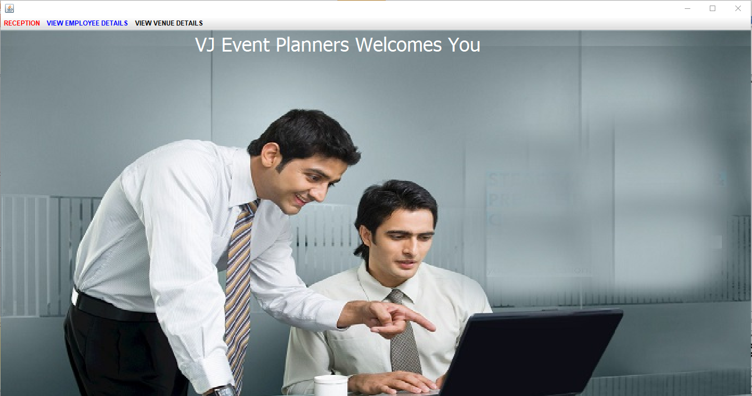
Customer dashboard

Slide 13
Instructions for login
If you are new user then there is an option of register you have to register first then login.
If you are existing user then you can directly login if username and password is correct then new frame will open that is dashboard.
If you had forgotten password then there is an option to retrieve your password by clicking on forgot password button.

Slide 14
Customer instruction for book event
In book event frame your username will filled automatically then you have to select function for your event , and we also avail photographer and caterer if you required. And you can select your venue and date.
Then click on check price then click on book.
After that it will show you booked event successfully.

Slide 15
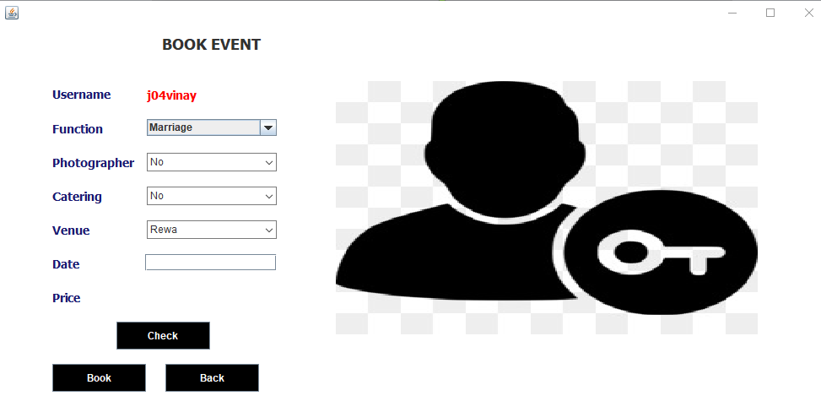
Book event frame

Slide 16
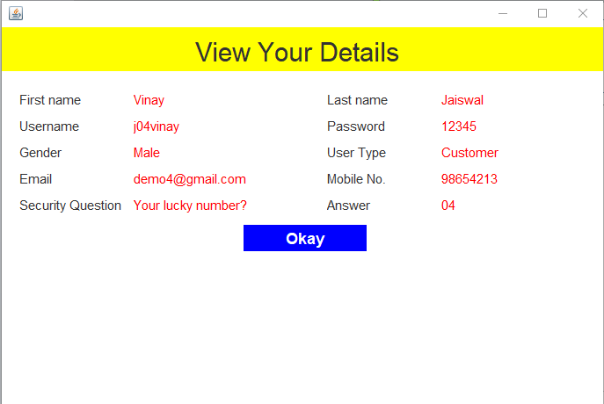
View profile details frame

Slide 17
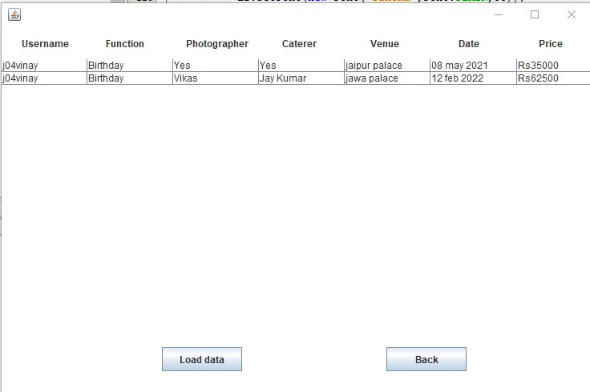
View booked event frame of customer

Slide 18
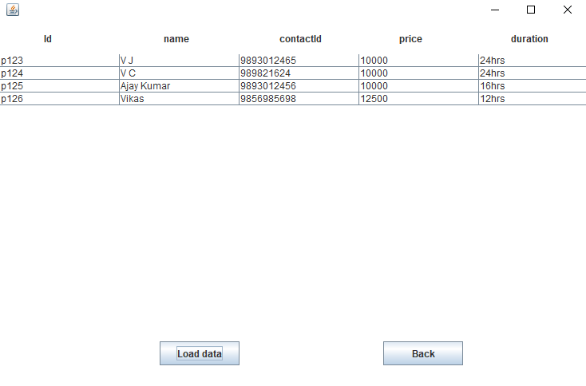
View photographer frame

Slide 19
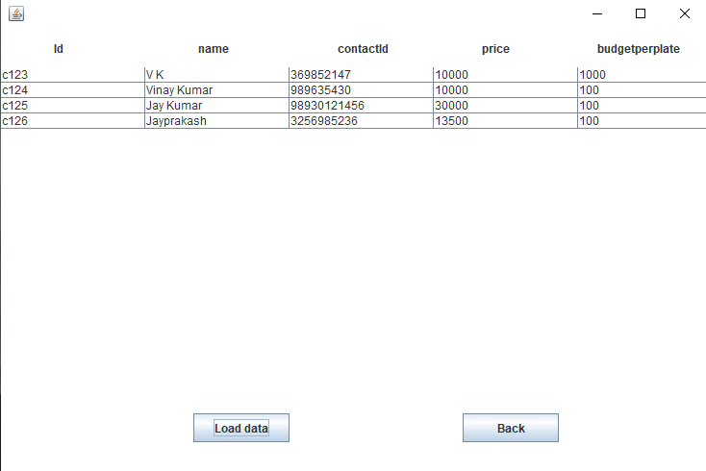
View caterer frame

Slide 20
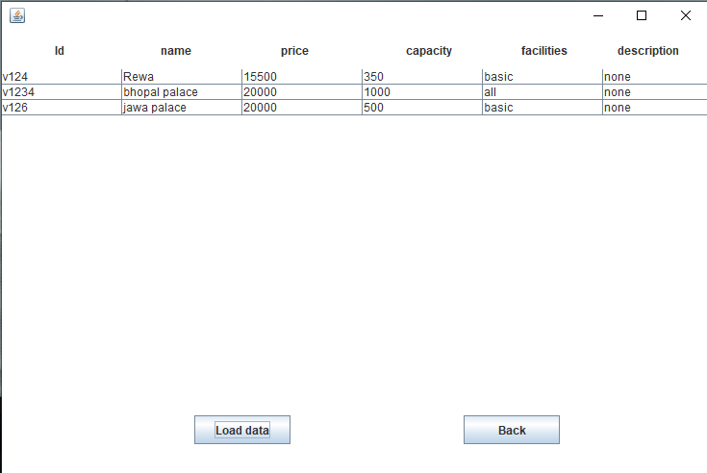
View venue frame

Slide 21
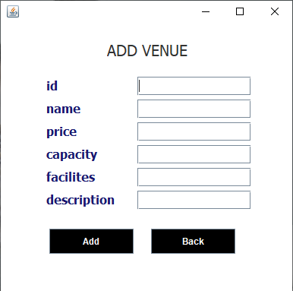
Add venue frame

Slide 22
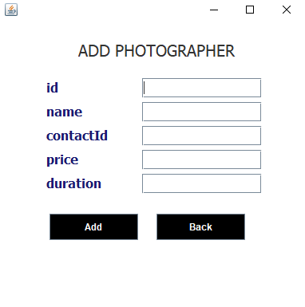
Add photographer frame

Slide 23
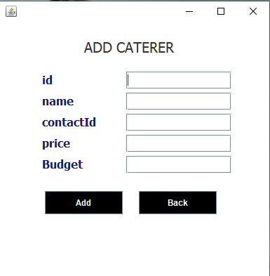
Add caterer frame

Slide 24
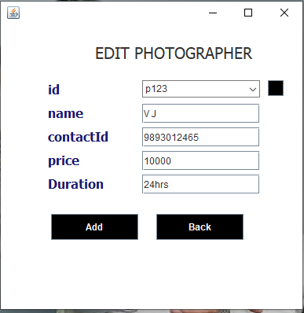
Edit photographer

Slide 25
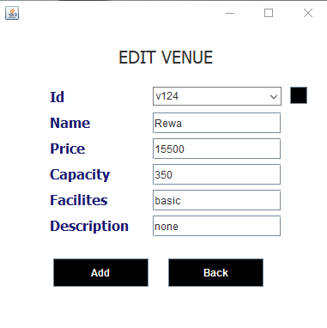
Edit venue frame

Slide 26
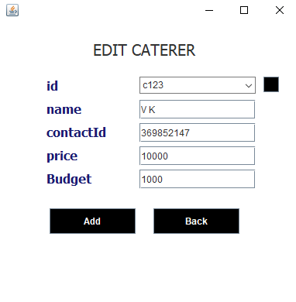
Edit caterer frame

Slide 27
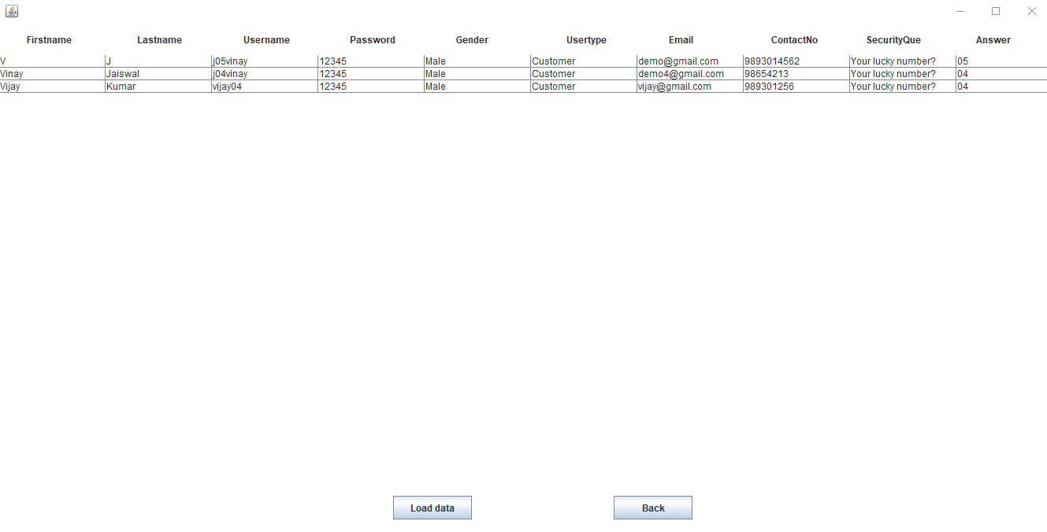
View customer frame

Slide 28
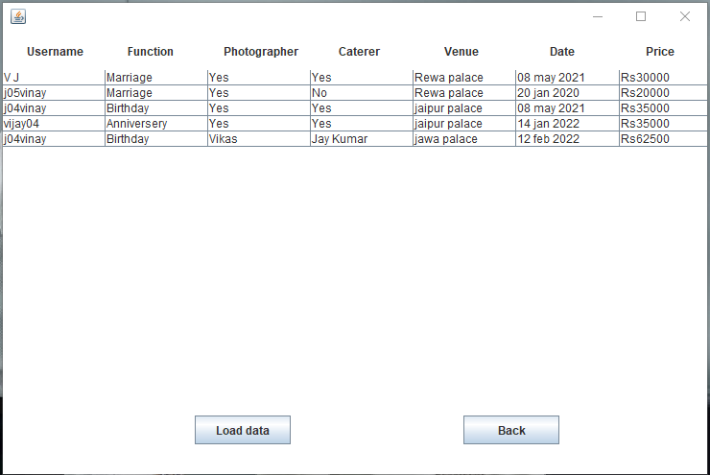
View booked event frame for admin

