Slide 1

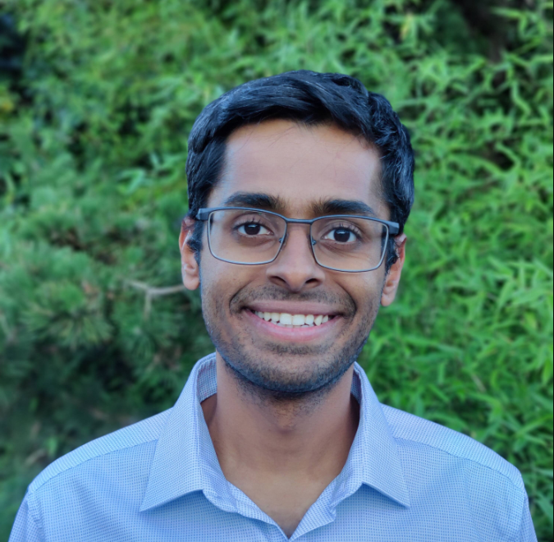




Scalable and Secure Row-Swap: Efficient and Safe Row Hammer Mitigation in Memory Systems
Jeonghyun Woo, Gururaj Saileshwar*, Prashant Nair
*

Slide 2
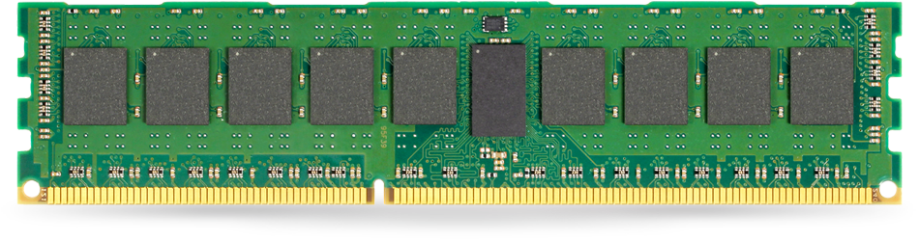
Row Hammer
Victim Row
ACCESS (ACTIVATE)
Aggressor Row
Victim Row

Slide 3
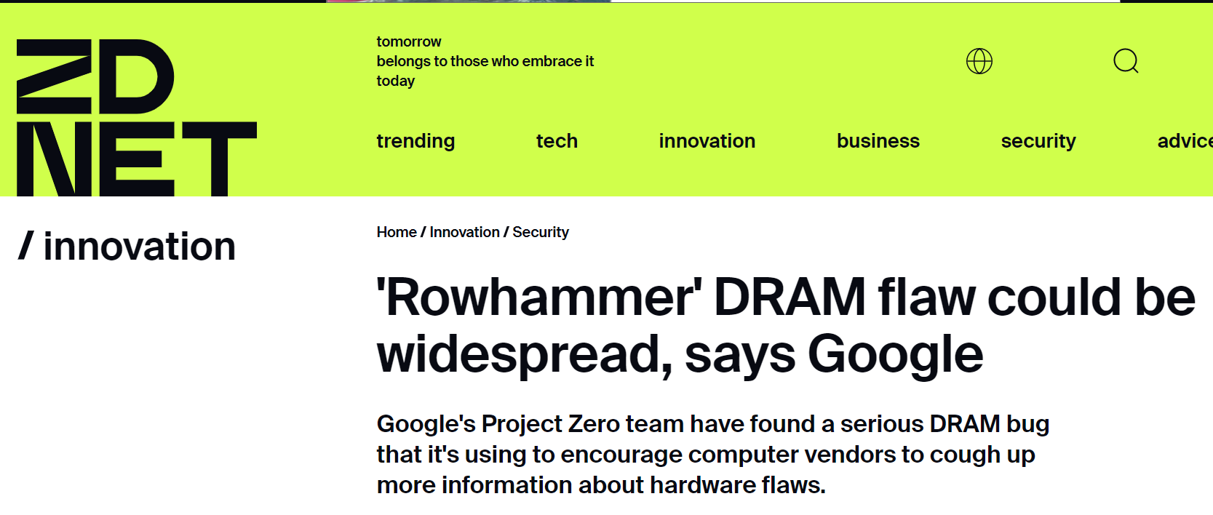



Row Hammer Attacks

Slide 4

Row Hammer is Getting Worse
Row Hammer Threshold: Min. Activations for Bit Flips
Source
Flipping bits [ISCA’2014]
Revisiting RowHammer [ISCA’2020]
29X in Threshold

Slide 5
Victim-Focused Mitigations (VFM)
Target Row Refresh [2015]
TWiCe [ISCA’19] Graphene [MICRO’20] and others …
0
Bit Flip
REFRESH
ACTIVATE
REFRESH

Slide 6
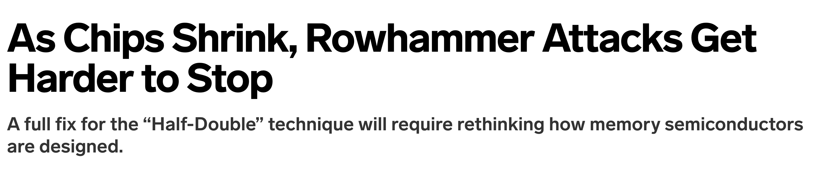
Half-Double Attack on VFM
Google’s Half-Double Attack: Exploits Mitigative Refresh*
0
Bit Flip
Distance-of-2
REFRESH
ACTIVATE
REFRESH
Distance-of-2
Mitigation → Break Defense
Source*: Half-Double [USENIX SECURITY’2022]

Slide 7


Randomized Row-Swap [ASPLOS’22]
Spatial correlation
0
Swap
Bit Flip
Defend Half-Double
Swap Threshold
SWAP
Random Guess
ACTIVATE
Security Performance
Random Guess
SWAP
3+ Years of Security
Random Guess
ACTIVATE

Slide 8
RRS Security Pitfall: Latent Activations
0
Swap
Bit Flip
Memory Controller
ACTIVATE
Swap Buffer
Swap Buffer
SWAP
Swap Operation → 1 Latent Activation
ACTIVATE

Slide 9
RRS Security Pitfall: Latent Activations
0
Swap
Bit Flip
SWAP
SWAP
UNSWAP
Unswap-Swap Operation → 2 Latent Activations
ACTIVATE

Slide 10
Juggernaut Attack
ACTIVATE AGGRESSOR
1
Exploit latent activations
0
Swap
Bit Flip
ACTIVATE
ACTIVATE

Slide 11

Juggernaut Attack
Random Guess
1
Exploit latent activations
0
Swap
Bit Flip
2
Guess Aggressor
Random Guess
Break RRS in < 4 hours
Random Guess
Please see the paper for a detailed security analysis
Random Guess

Slide 12
Secure Row-Swap (SRS)
Unswap
0
Swap
Bit Flip
ACTIVATE
Swap-Only
ACTIVATE
Latent Activations
2+ Years of Security
ACTIVATE

Slide 13

Secure Row-Swap (SRS)
Randomized Row-Swap (RRS)
Unswap
0
…
…
Swap
Bit Flip
Refresh
Refresh
Time
Secure Row-Swap (SRS)
Unswap
…
Refresh
Refresh
Time
Latency Spike
Performance Degradation

Slide 14
Secure Row-Swap (SRS)
Key Idea: Delay unswaps using two separate tables
Unswap Rows in Epoch 1
Unswap Rows in Epoch 2
Unswap Rows in Epoch 3
Odd Table
Epoch 1
Epoch 2
Epoch 3
Epoch 4
Time
Even Table
Refresh
Refresh
Refresh
Refresh
Refresh
Idle
Storing General Mapping
For Unswap
No Performance Overhead

Slide 15
Implementation of Secure Row-Swap
Row Indirection Table (RIT)
Not Swapped
Even
Odd
ACCESS
Tracker
Swapped
UNSWAP
Place-Back Buffer
Please see the paper for our detailed implementation
Memory Controller
DRAM

Slide 16
Insight: Scalable & Secure Mitigation
Outlier rows: Bypassing SRS → Cause Bit Flips
Row Hammer Threshold = 4800 Swap Threshold = 1600

Slide 17
Insight: Scalable & Secure Mitigation
Few outliers bypass SRS
Number of Outlier Rows | Attack Time
1 | 12 Secs
2 | 1.3 Hours
3 | 30.7 Days
4 | 64 Years
Pin these outliers in LLC!
Better Scalability

Slide 18

Scalable and Secure Row-Swap
Cache Lines
0
Swap
Bit Flip
Every 31 days
Cache Lines
.
.
.
Cache Lines
Cache Lines
Pinning Region
Last Level Cache
DRAM

Slide 19
Scale-SRS: SRAM Overhead
Row Indirection Table (RIT)
Overhead Per Bank
Row Hammer Threshold | RRS | Scale-SRS
4800 | 36 KB | 18.7 KB
2400 | 131 KB | 44.4 KB
1200 | 251 KB | 76.9 KB
Even
Odd
Tracker
Place-Back Buffer
Memory Controller
3.3X lower SRAM Overhead

Slide 20
Scale-SRS: Performance
Row Hammer Threshold: 1200
Less than 1% performance overhead

Slide 21
Summary
Juggernaut → Breaks Randomized Row-Swap (RRS) in < 4 hours
Secure Row-Swap: Secure against 2+ years of continuous attacks
Scalable & Secure Row-Swap → Scalable and Low-Cost Mitigation

Slide 22

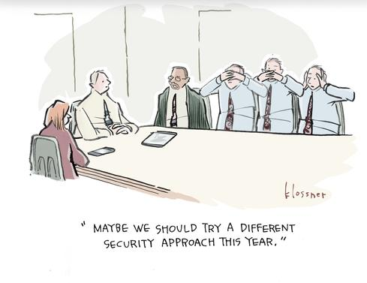



Thank You!
jhwoo36@ece.ubc.ca
JeonghyunW
jeonghyunwoo0306.github.io

Slide 23
RRS versus Scale-SRS
< 4 hours
2+ Years
Security
Security
Performance Overhead
Storage Overhead
Performance Overhead
Storage Overhead
5%
RRS
250KB SRAM/Bank
< 1%
Scale-SRS
3.3X lower

