Slide 1
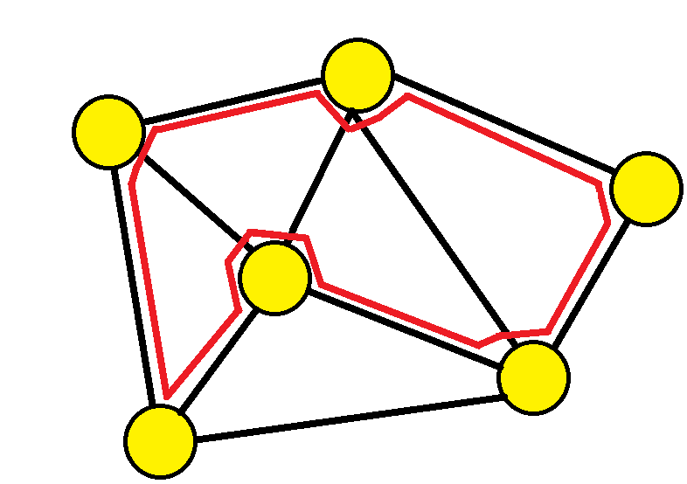
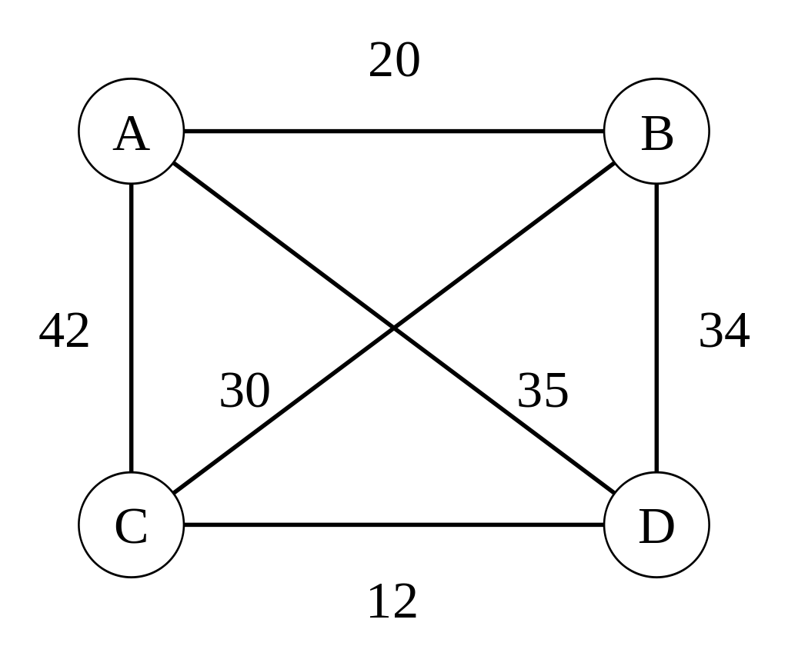
Hamiltonian Cycle Problem (HCP) based on Grover's Algorithm
組別：第十一組
R09942022 蘇宥宸
B08901105 陳天富
B08901136 劉承瀚

Slide 2
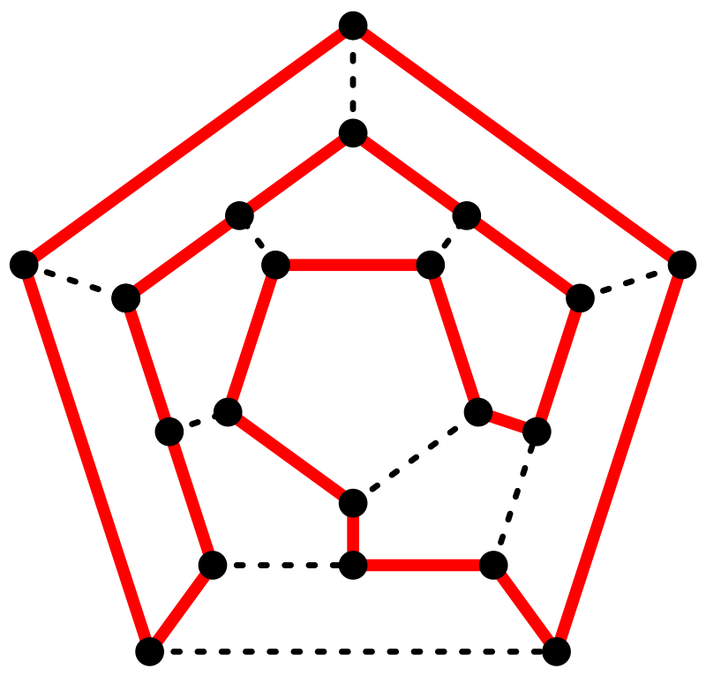
Introduction –TSP^{[1]} and HCP^{[2]}
TSP (travelling salesman problem):
Given a list of cities: Vertices of a graph
and the distances between each pair of cities: Edges of graph, with weight
Find the shortest possible route: Optimization problem
that visits each city exactly once and returns to the origin city: HCP (Hamilton Cycle Problem)
Note: the graph may be directed!
Upper Fig: An example of TSP
Lower Fig: Hamiltonian Path through a Dodecahedron (正十二面體,20 vertices, 25 edges)
Notes:
跳過不講

Slide 3
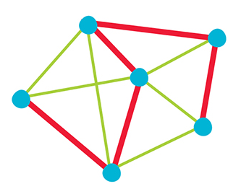
Introduction – HCP (Hamiltonian Cycle Problem)^{[2]}
Hamiltonian Path：
visiting each vertices once
Hamiltonian Cycle：
visiting each vertices once
and return to the initial vertex.
The two problems are both NP-Complete problems.
Other NPC problems can be reduced to them
They can be reduced to other NPC problems (e.g. SAT problem)
Notes:
只講定義，可約化，不解釋如何約化
https://en.wikipedia.org/wiki/File:Hamiltonian.png
https://baniel.github.io/algorithm/DanielAlgorithm7.1/

Slide 4
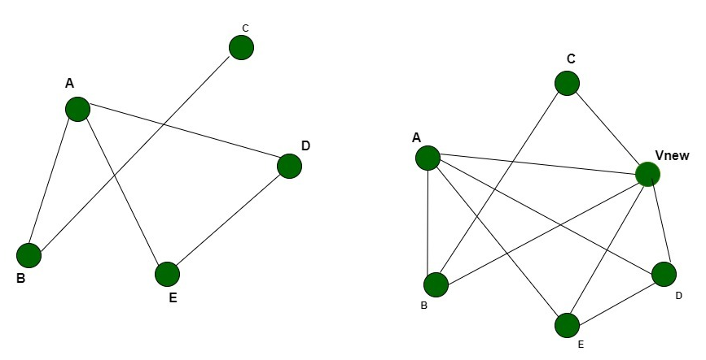
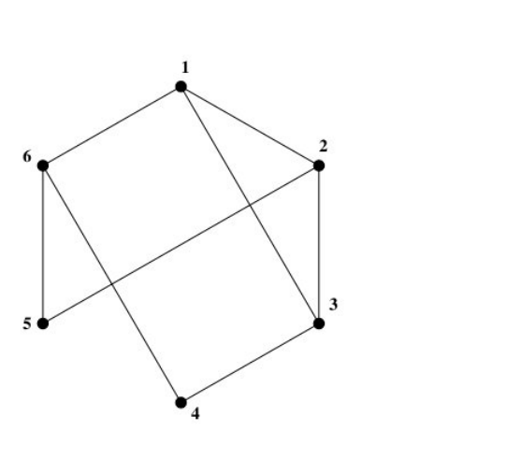
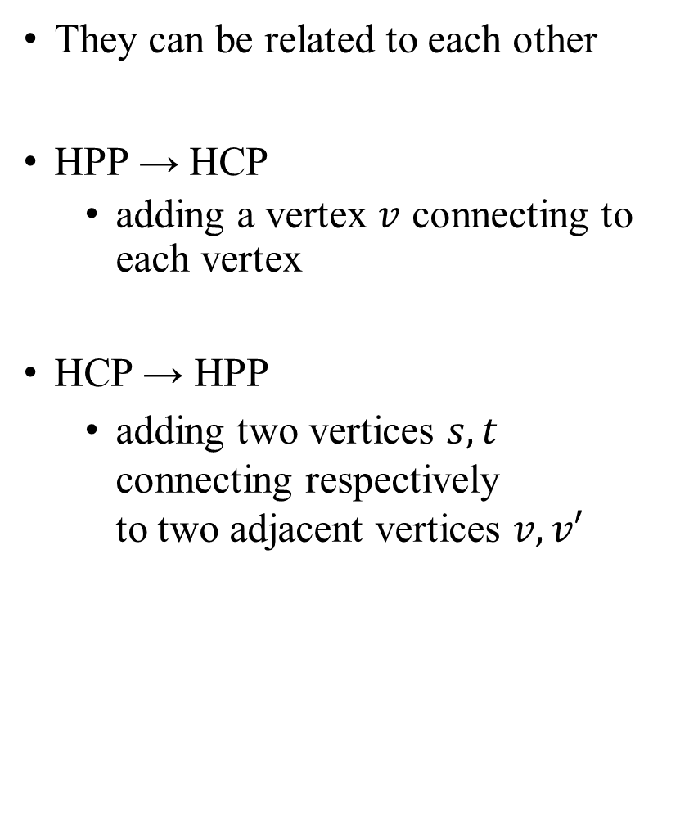
Introduction – HCP (Hamiltonian Cycle Problem)^{[2]}
They can be related to each other
HPP → HCP
adding a vertex $v$ connecting to each vertex
HCP → HPP
adding two vertices $s, t$ connecting respectively to two adjacent vertices $v, v′$
Notes:
跳過不講
https://www.google.com/url?sa=i&url=https%3A%2F%2Fwww.geeksforgeeks.org%2Fproof-that-hamiltonian-cycle-is-np-complete%2F&psig=AOvVaw3ywTojkgI8_lkhDjAdUt0a&ust=1624798715216000&source=images&cd=vfe&ved=0CAgQjhxqFwoTCNCqgYWttfECFQAAAAAdAAAAABAD
https://www.google.com/url?sa=i&url=https%3A%2F%2Fwww.csc.kth.se%2Futbildning%2Fkth%2Fkurser%2FDD2354%2Falgokomp10%2FOvningar%2FExercise6_Sol.pdf&psig=AOvVaw3ywTojkgI8_lkhDjAdUt0a&ust=1624798715216000&source=images&cd=vfe&ved=0CAgQjhxqFwoTCNCqgYWttfECFQAAAAAdAAAAABAJ

Slide 5
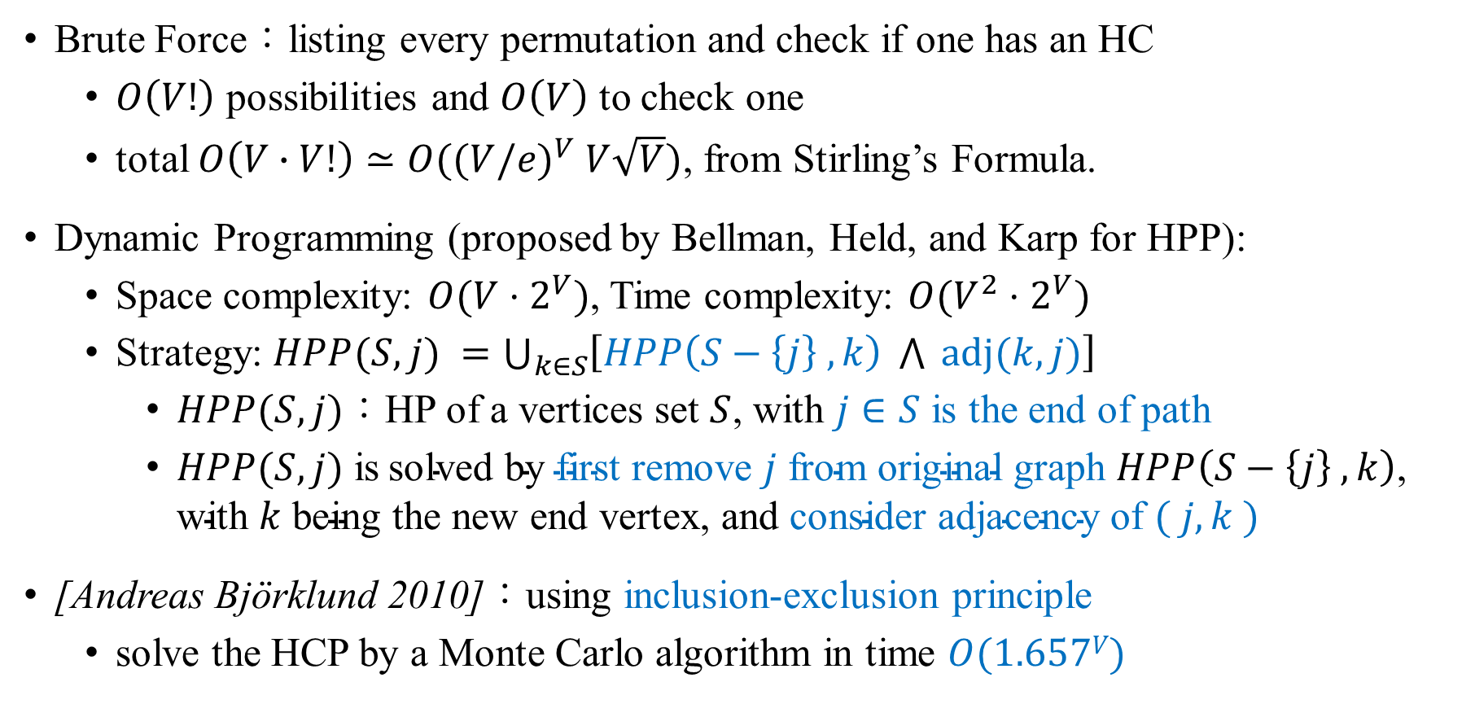
Classical Solution of HCP^{[5][6]}
Brute Force：listing every permutation and check if one has an HC
$O\left(V!\right)$ possibilities and $O\left(V\right)$ to check one
total $O\left(V∙V!\right)≃O({(V/e)}^{V} V\sqrt{V})$, from Stirling’s Formula.
Dynamic Programming (proposed by Bellman, Held, and Karp for HPP):
Space complexity: $O(V⋅2^{V})$, Time complexity: $O(V^{2}⋅2^{V})$
Strategy: $HPP(S, j) =\bigcup_{k∈S}{\left[HPP\left(S−\left\{j\right\} , k\right) \bigwedge{ }adj(k,j)\right]}$
$HPP(S,j)$：HP of a vertices set $S$, with $j∈S$ is the end of path
$HPP(S, j)$ is$\text{solved} \text{by} \text{first} \text{remove} j \text{from} \text{original} \text{graph} HPP\left(S−\left\{j\right\} , k\right)\text{, }\text{with} k \text{being} \text{the} \text{new} \text{end} \text{vertex}\text{, }\text{and} \text{consider} \text{adjacency} \text{of} ( j,k )$
[Andreas Björklund 2010]：using inclusion-exclusion principle
solve the HCP by a Monte Carlo algorithm in time $O(1.657V)$
Notes:
只講暴力和DP的複雜度

Slide 6

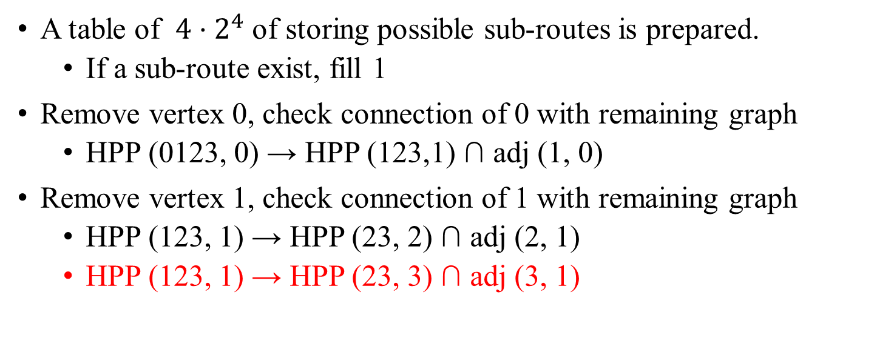

0
1
0
1
Subset: 0123 | 0 | 1 | 2 | 3
…
0011 | - | - | 1 | 1
0111 | - |  |  | 1
1111 | 1
$$2^{4}$$
2
3
2
3
0
1
A table of $4⋅2^{4}$ of storing possible sub-routes is prepared.
If a sub-route exist, fill 1
Remove vertex 0, check connection of 0 with remaining graph
HPP (0123, 0) → HPP (123,1) ∩ adj (1, 0)
Remove vertex 1, check connection of 1 with remaining graph
HPP (123, 1) → HPP (23, 2) ∩ adj (2, 1)
HPP (123, 1) → HPP (23, 3) ∩ adj (3, 1)
2
3
0
1
2
3
Notes:
跳過不講

Slide 7
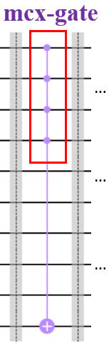
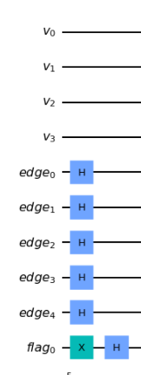
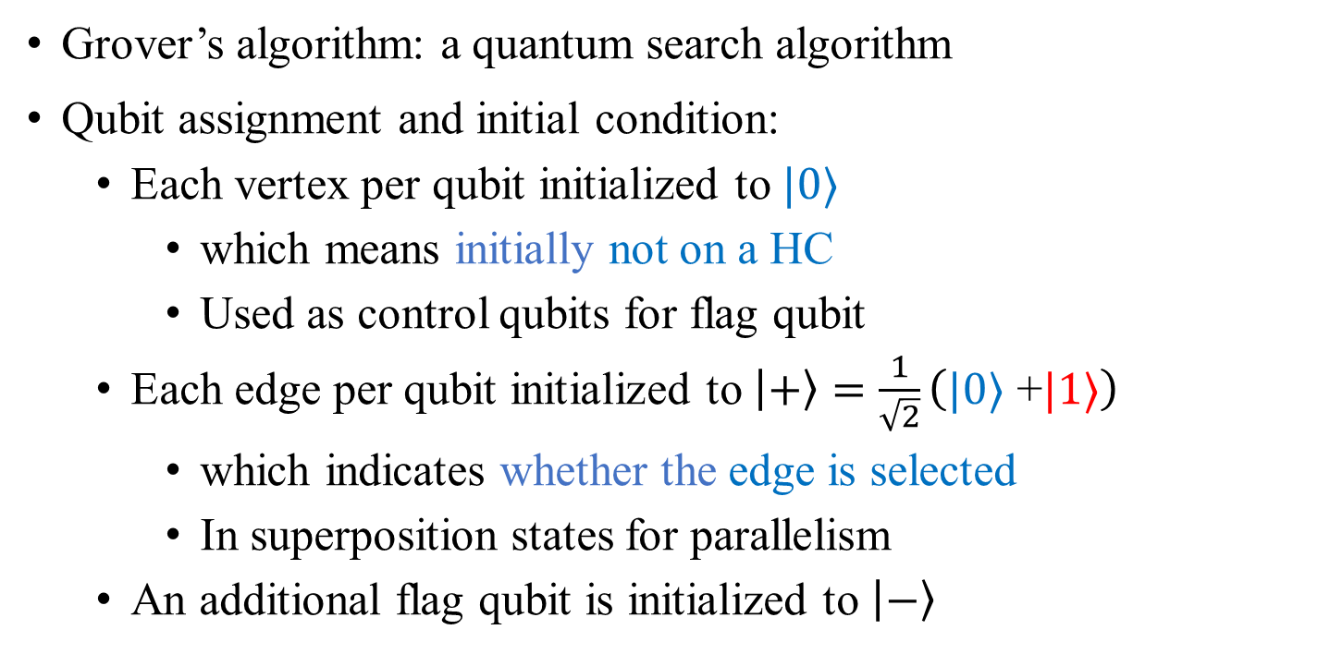
Quantum Solution of HCP – Grover’s Algorithm^{[3]}
0
1
0
2
1
3
4
2
3
Grover’s algorithm: a quantum search algorithm
Qubit assignment and initial condition:
Each vertex per qubit initialized to $|0⟩$
which means initially not on a HC
Used as control qubits for flag qubit
Each edge per qubit initialized to $\left|+\right\rangle =\frac{1}{\sqrt{2}}\left(|0⟩ \text{+}|1⟩\right)$
which indicates whether the edge is selected
In superposition states for parallelism
An additional flag qubit is initialized to $\left|−\right\rangle$
…
…
…
Notes:
不要著墨在gate 上，只講

Slide 8



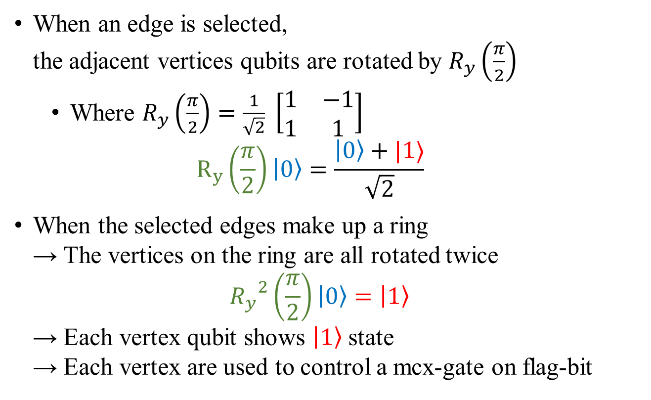



Grover’s Algorithm Solution of HCP – The design of oracle (1/4)
$$R_{y}(\frac{π}{2})|0⟩$$
$$R_{y}(\frac{π}{2})|0⟩$$
0
0
1
When an edge is selected, the adjacent vertices qubits are rotated by $R_{y}\left(\frac{π}{2}\right)$
Where $R_{y}\left(\frac{π}{2}\right)=\frac{1}{\sqrt{2}} \left[\begin{matrix}1 & −1 \\ 1 & 1\end{matrix}\right]$ $R_{y}\left(\frac{π}{2}\right)\left|0\right\rangle =\frac{\left|0\right\rangle +|1⟩}{\sqrt{2}}$
When the selected edges make up a ring → The vertices on the ring are all rotated twice ${R_{y}}^{2}\left(\frac{π}{2}\right)\left|0\right\rangle =\left|1\right\rangle$ → Each vertex qubit shows $\left|1\right\rangle$ state → Each vertex are used to control a mcx-gate on flag-bit
1
2
3
4
2
3
0
$$\left|1\right\rangle$$
1
0
$$\left|1\right\rangle$$
1
2
3
2
$$\left|1\right\rangle$$
4
3
$$\left|1\right\rangle$$

Slide 9
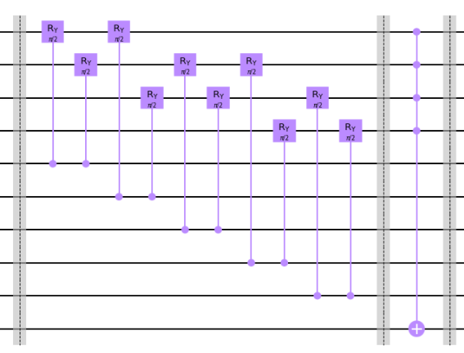

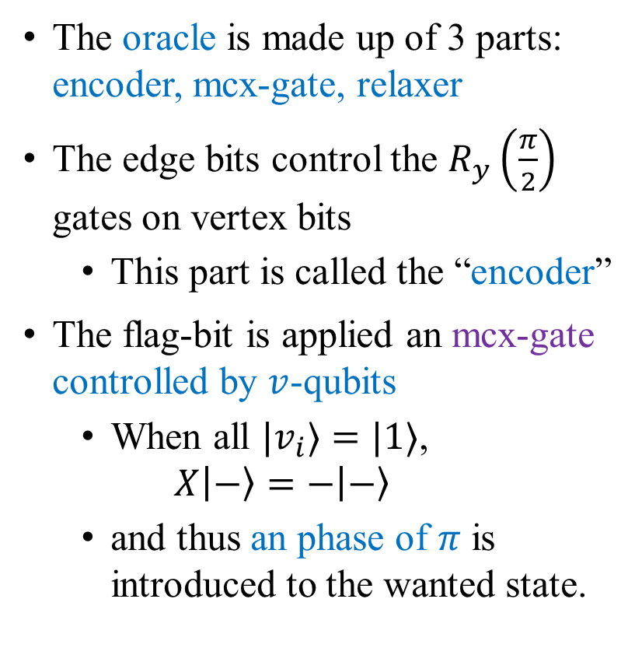
Grover’s Algorithm Solution of HCP – The design of oracle (2/4)
0
1
0
1
2
3
4
The oracle is made up of 3 parts: encoder, mcx-gate, relaxer
The edge bits control the $R_{y}\left(\frac{π}{2}\right)$ gates on vertex bits
This part is called the “encoder”
The flag-bit is applied an mcx-gate controlled by $v$-qubits
When all $|v_{i}⟩=|1⟩$, $X\left|−\right\rangle =−\left|−\right\rangle$
and thus an phase of $π$ is introduced to the wanted state.
2
3
encoder
mcx-gate
…
…
…
…
…
…
$$\left|−\right\rangle$$

Slide 10
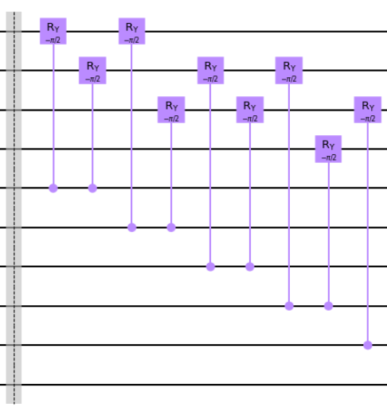
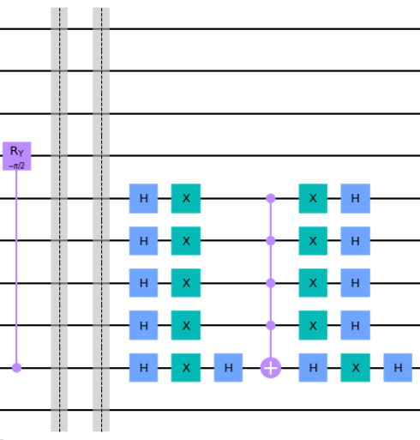
Grover’s Algorithm Solution of HCP – The design of oracle (3/4)
→ T o
M e a s u r e
M e n t
…
…
…
…
…
…
The relaxer
The diffusor

Slide 11
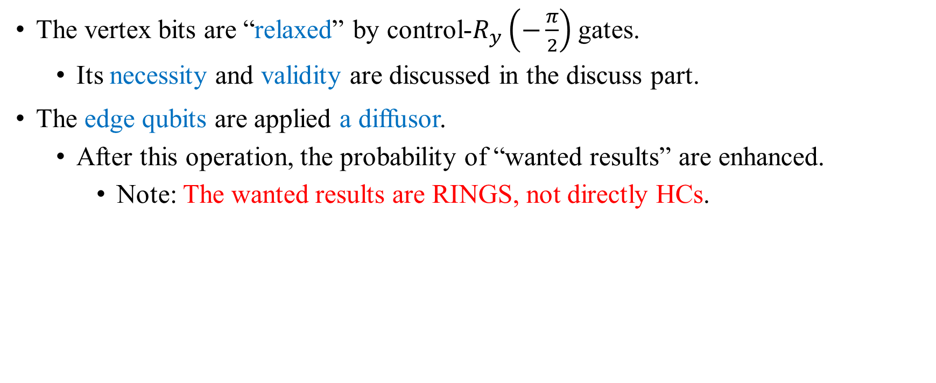
Grover’s Algorithm Solution of HCP – The design of oracle (4/4)
The vertex bits are “relaxed” by control-$R_{y}\left(−\frac{π}{2}\right)$ gates.
Its necessity and validity are discussed in the discuss part.
The edge qubits are applied a diffusor.
After this operation, the probability of “wanted results” are enhanced.
Note: The wanted results are RINGS, not directly HCs.

Slide 12



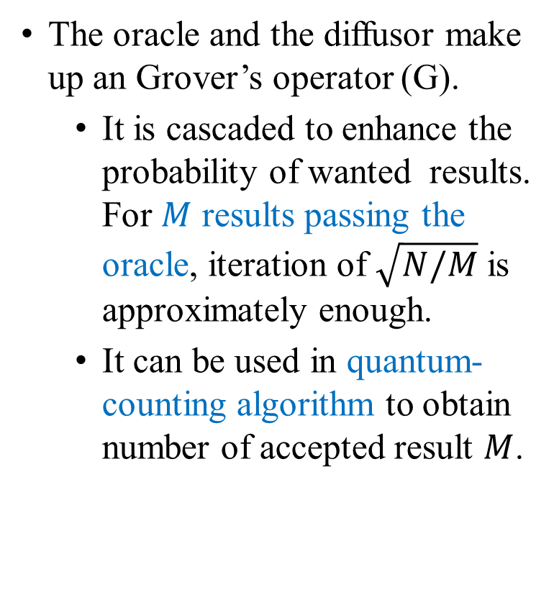


The overall view of the Grover’s circuit
G
The oracle and the diffusor make up an Grover’s operator (G).
It is cascaded to enhance the probability of wanted results. For $M$ results passing the oracle, iteration of $\sqrt{N/M}$ is approximately enough.
It can be used in quantum-counting algorithm to obtain number of accepted result $M$.
Oracle
v. qubits: ${\left|0\right\rangle }^{⊗v}$
Diffusor
e. qubits: ${\left|+\right\rangle }^{⊗e}$
Flag bit: $\left|−\right\rangle$
Classical $n_{e}$ bits

Slide 13
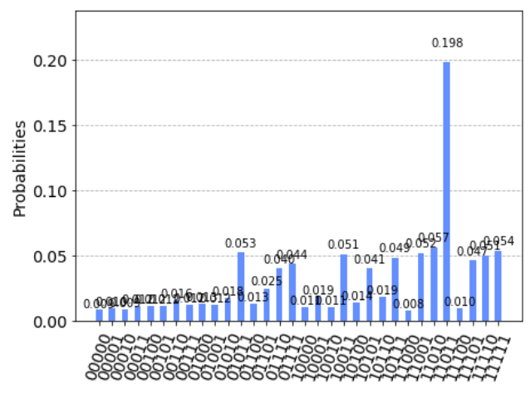
Example of Grover’s Algorithm (1/2)
0
1
0
1
2
3
The upper figure is computed with Grover’s algorithm with 1 iteration under 5,120 tries.
The result is shown in the lower figure.
11011 has the highest probability
From the least to the most significant bit indicates edges from 0 to 4
The result means that edge 0, 1, 3, 4 are chosen
4
2
3
Notes:
不講

Slide 14
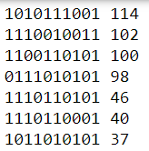
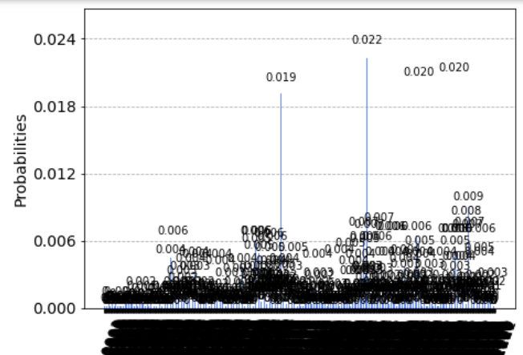
Example of Grover’s Algorithm (2/2)
2
4
0
9
3
0
The upper figure is computed with Grover’s algorithm with 1 iteration under 5,120 tries.
4 highest peak are obtained. The top most results and the results they show up are listed
We can see that the top 4 results are at least twice of the 5th.
However, the total probability of wanted result is only 8%.
7
5
1
1
6
8
4
3
5
2

Slide 15
Checking of Grover’s result (1/2)
2
0
4
Checking results takes polynomial time on classical computers
Check the top 5 results：
1010111001： Edge 0, 3, 4, 5, 7, 9 → an HC
1110010011 ： Edge 0, 1, 4, 7, 8, 9 → not an HC
But still satisfy oracle, it shows two rings
1100110101 ： Edge: 0, 2, 4, 5, 8, 9 → an HC
9
3
0
7
5
1
1
8
6
4
3
5
2
2
0
4
9
3
0
7
5
1
1
8
6
5
4
3
2
2
0
4
9
3
0
7
5
1
1
8
6
5
4
3
2
Notes:
用圖講

Slide 16
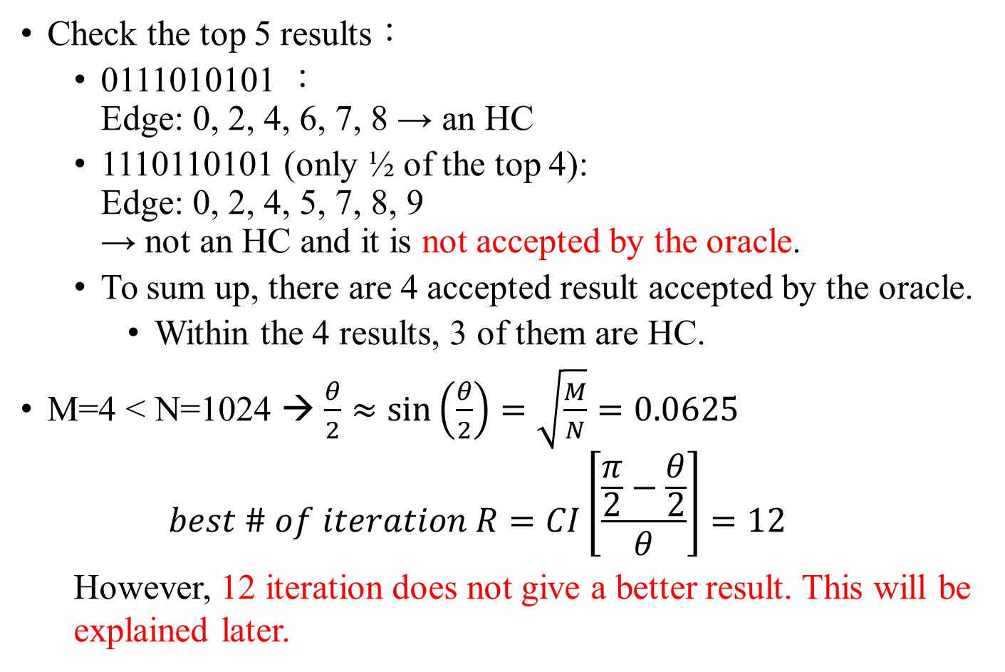
Checking of Grover’s result (2/2)
2
4
0
9
3
0
Check the top 5 results：
0111010101 ： Edge: 0, 2, 4, 6, 7, 8 → an HC
1110110101 (only ½ of the top 4): Edge: 0, 2, 4, 5, 7, 8, 9 → not an HC and it is not accepted by the oracle.
To sum up, there are 4 accepted result accepted by the oracle.
Within the 4 results, 3 of them are HC.
M=4 < N=1024 → $\frac{θ}{2}≈\sin\left(\frac{θ}{2}\right)=\sqrt{\frac{M}{N}}=0.0625$
$$best \# of iteration R=CI\left[\frac{\frac{π}{2}−\frac{θ}{2}}{θ}\right]=12$$ However, 12 iteration does not give a better result. This will be explained later.
7
5
1
1
6
8
4
3
5
2
2
4
0
9
3
0
7
5
1
1
6
8
4
3
5
2
Notes:
也講第五個case

Slide 17
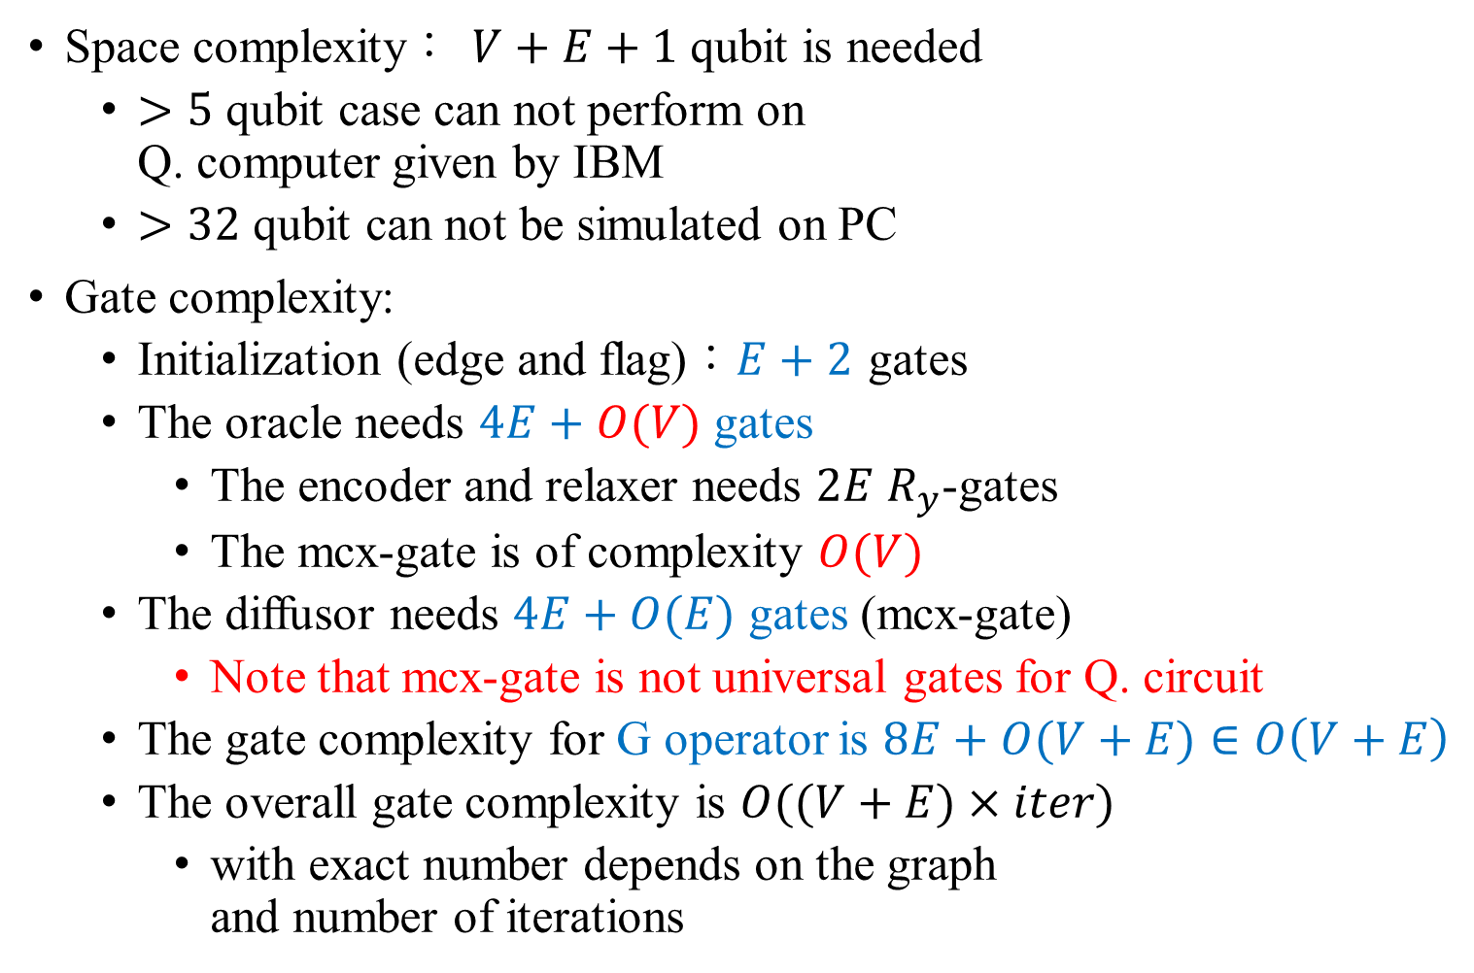
Complexity Analysis of the Grover’s Algorithm
Space complexity： $V+E+1$ qubit is needed
$>5$ qubit case can not perform on Q. computer given by IBM
$>32$ qubit can not be simulated on PC
Gate complexity:
Initialization (edge and flag)：$E+2$ gates
The oracle needs $4E+O(V)$ gates
The encoder and relaxer needs $2E$ $R_{y}$-gates
The mcx-gate is of complexity $O(V)$
The diffusor needs $4E+O(E)$ gates (mcx-gate)
Note that mcx-gate is not universal gates for Q. circuit
The gate complexity for G operator is $8E+O(V+E)∈O\left(V+E\right)$
The overall gate complexity is $O((V+E)×iter)$
with exact number depends on the graph and number of iterations
…
…
…
…
…
…
Notes:
只講oracle和diffusor(可棄)

Slide 18
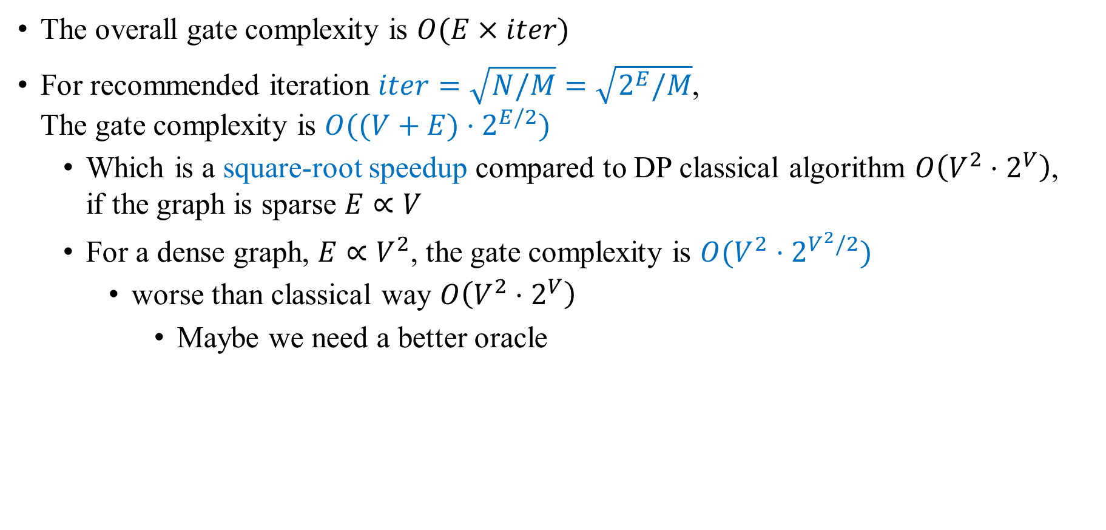
Square-root Speedup of Grover’s Algorithm
The overall gate complexity is $O(E×iter)$
For recommended iteration $iter=\sqrt{N/M}=\sqrt{2^{E}/M}$, The gate complexity is $O((V+E)⋅2^{E/2})$
Which is a square-root speedup compared to DP classical algorithm $O\left(V^{2}⋅2^{V}\right)$, if the graph is sparse $E∝V$
For a dense graph, $E∝V^{2}$, the gate complexity is $O(V^{2}⋅2^{V^{2}/2})$
worse than classical way $O\left(V^{2}⋅2^{V}\right)$
Maybe we need a better oracle

Slide 19
Discussion
The Failure case of Oracle
The Necessity of Relaxation
報告: B08901105 陳天富

Slide 20
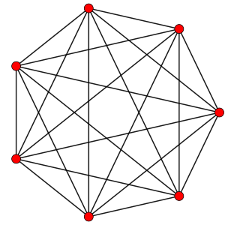

When Oracle Fails… (1/3)
Rotated 6 times：completely the same as rotated twice
$${R_{y}}^{6}\left(\frac{π}{2}\right)\left|0\right\rangle =\left|1\right\rangle$$
Even when all rotated twice： not sure to be connected or multiple rings are found

Slide 21




When Oracle Fails… (2/3)
if rotated once：still has a lower probability to pass mcx-gate （similar for 3 times, etc.）
$$R_{y}\left(\frac{π}{2}\right)\left|0\right\rangle =\frac{1}{\sqrt{2}}\left(\left|0\right\rangle +\left|1\right\rangle \right)$$
$$\frac{1}{\sqrt{2}}\left(\left|0\right\rangle +\left|1\right\rangle \right)$$
…
…
…
…
…
…
$$\frac{1}{16} probability$$

Slide 22



When Oracle Fails… (2/3)
if rotated once：still has a lower probability to pass mcx-gate （similar for 3 times, etc.）
$$R_{y}\left(\frac{π}{2}\right)\left|0\right\rangle =\frac{1}{\sqrt{2}}\left(\left|0\right\rangle +\left|1\right\rangle \right)$$
$$\frac{1}{\sqrt{2}}\left(\left|0\right\rangle +\left|1\right\rangle \right)$$
…
…
…
…
…
…
$$\left|1\right\rangle$$
$$\frac{1}{4} probability$$

Slide 23
When Oracle Fails… (3/3)
the possibilities of failure cases：
rotated 2 times：what we want
can still get wrong answers – unconnected graph, multiple rings …
rotated 0, 4, …, 4k times：never be mistaken
rotated 6, 10, … 4k+2 times：always be mistaken
others（once, 3, 5 … 2k+1 times）：sometimes be mistaken
the closer to the legal selection, the higher possibilities to be mistaken
…

Slide 24
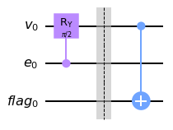
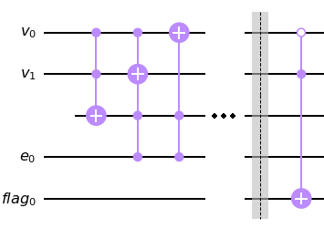
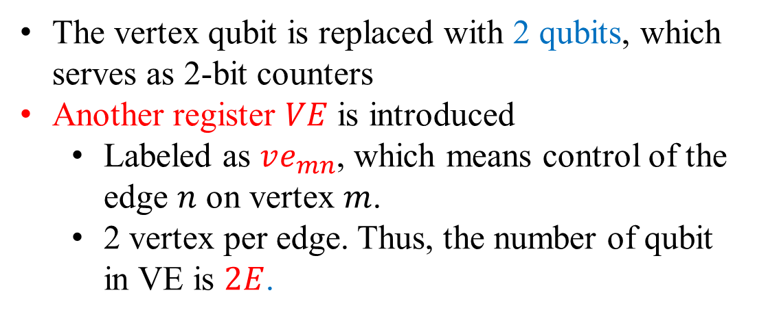



Another Oracle
The vertex qubit is replaced with 2 qubits, which serves as 2-bit counters
Another register $VE$ is introduced
Labeled as $ve_{mn}$, which means control of the edge $n$ on vertex $m$.
2 vertex per edge. Thus, the number of qubit in VE is $2E$.
Vertex associated
$$v_{0a} \left|0\right\rangle$$
$$v_{0b} \left|0\right\rangle$$
$$ve_{00}\left|1\right\rangle$$
“control unit”
Edge associated

Slide 25
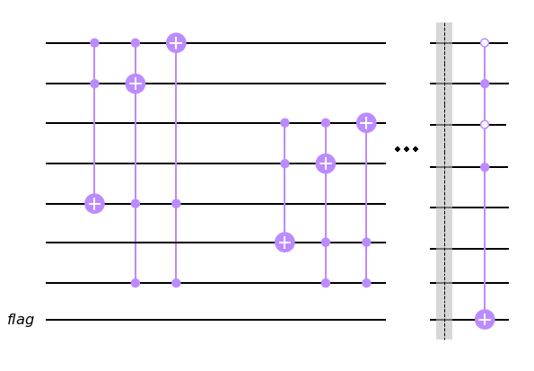







Another Oracle
$$v_{0a} \left|0\right\rangle$$
0
0
$$v_{0b} \left|0\right\rangle$$
1
$$v_{1a} \left|0\right\rangle$$
$$v_{1b} \left|0\right\rangle$$
$$ve_{00}\left|1\right\rangle$$
$$ve_{10}\left|1\right\rangle$$
$$e_{0}$$

Slide 26





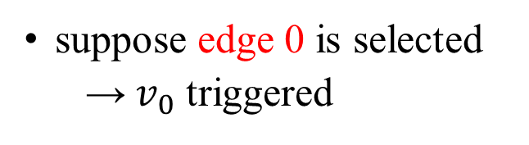


Another Oracle – how it works (1/5)
2
4
0
9
3
0
7
5
1
We check only on one vertex $v_{0}$
0 times：00
1 time ：10
1
suppose edge 0 is selected
→$v_{0}$ triggered
6
8
4
3
5
2
$$v_{0a} \left|0\right\rangle$$
$$\left|1\right\rangle$$
$$v_{0b} \left|0\right\rangle$$
$$\left|0\right\rangle$$
$$ve_{00} \left|1\right\rangle$$
$$e_{0} \left|1\right\rangle$$

Slide 27

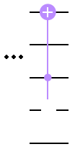






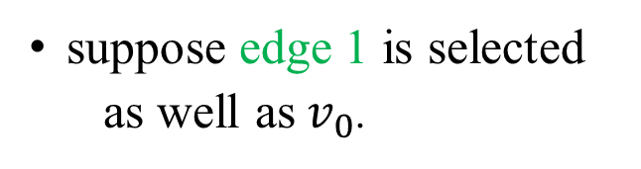
Another Oracle – how it works (2/5)
2
4
0
9
3
0
7
5
1
0 times：00
1 time ：10
2 times：01
1
suppose edge 1 is selected
as well as$v_{0}$.
6
8
4
3
5
2
$$v_{0a} \left|1\right\rangle$$
$$\left|0\right\rangle$$
$$v_{0b} \left|0\right\rangle$$
$$\left|1\right\rangle$$
$$ve_{01} \left|1\right\rangle$$
$$e_{1} \left|1\right\rangle$$

Slide 28





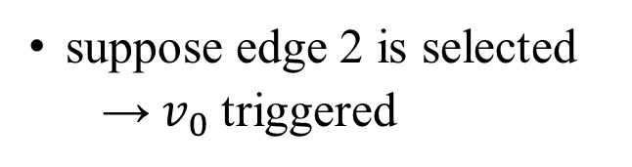
Another Oracle – how it works (3/5)
2
4
0
9
3
0
7
5
1
0 times：00
1 time ：10
2 times：01
3 times：11
1
suppose edge 2 is selected
→$v_{0}$triggered
6
8
4
3
5
2
$$v_{0a} \left|0\right\rangle$$
$$\left|1\right\rangle$$
$$v_{0b} \left|1\right\rangle$$
$$\left|1\right\rangle$$
$$ve_{02} \left|1\right\rangle$$
$$e_{2} \left|1\right\rangle$$

Slide 29


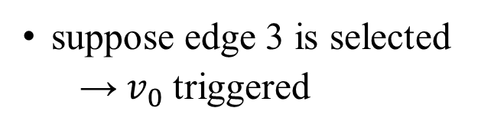


Another Oracle – how it works (4/5)
2
4
0
9
3
0
7
5
1
0 times：00
1 time ：10
2 times：01
3 times：11
more times：
keep 11
1
suppose edge 3 is selected
→$v_{0}$triggered
6
8
4
3
5
2
$$v_{0a} \left|1\right\rangle$$
$$\left|1\right\rangle$$
$$v_{0b} \left|1\right\rangle$$
$$\left|1\right\rangle$$
$$ve_{03} \left|1\right\rangle$$
$$\left|0\right\rangle$$
$$e_{3} \left|1\right\rangle$$
$$\left|0\right\rangle$$

Slide 30



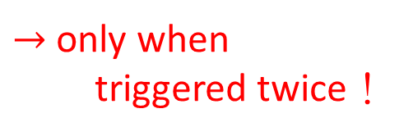

Another Oracle – how it works (5/5)
0 times：00
1 time ：10
2 times：01
3 times：11
more times…：11
$$needs 01$$
$$v_{0a} \left|1\right\rangle$$
$$v_{0b} \left|1\right\rangle$$
$$ve_{00} \left|1\right\rangle$$
$→$ only when triggered twice！

Slide 31




When Oracle Fails… (improved)
$$v_{0a} \left|1\right\rangle$$
$$v_{0b} \left|0\right\rangle$$
the possibilities of failure cases：
rotated 2 times：what we want
can still get wrong answers – unconnected graph multiple rings
rotated 0 times：never be mistaken
rotated 6, 10, … 4k+2 times：always be mistaken
others（once, 3, 5 … 2k+1 times）：sometimes be mistaken
the closer to the legal selection, the higher possibilities to be mistaken
needs more gates and ancillary qubits
but the asymptotic running time is the same
$$ve_{01} \left|1\right\rangle$$
$$e_{1} \left|1\right\rangle$$

Slide 32



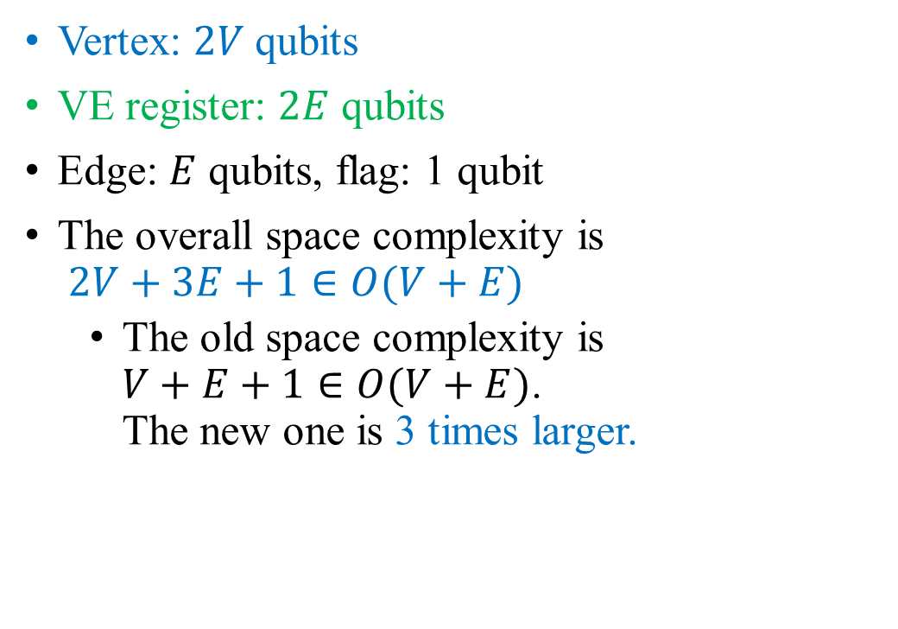






Space Complexity of Grover’s Circuit by the new Oracle
$$v_{0a} \left|1\right\rangle$$
$$v_{0b} \left|0\right\rangle$$
$$ve_{01} \left|1\right\rangle$$
Vertex: $2V$ qubits
VE register: $2E$ qubits
Edge: $E$ qubits, flag: 1 qubit
The overall space complexity is $2V+3E+1∈O(V+E)$
The old space complexity is $V+E+1∈O(V+E)$. The new one is 3 times larger.
$$e_{1} \left|1\right\rangle$$
G
v. qubits: ${\left|0\right\rangle }^{⊗2v}$
Oracle
VE qubits: ${\left|1\right\rangle }^{⊗2e}$
Diffusor
e. qubits: ${\left|+\right\rangle }^{⊗e}$
Flag bit: $\left|−\right\rangle$
Classical $n_{e}$ bits

Slide 33

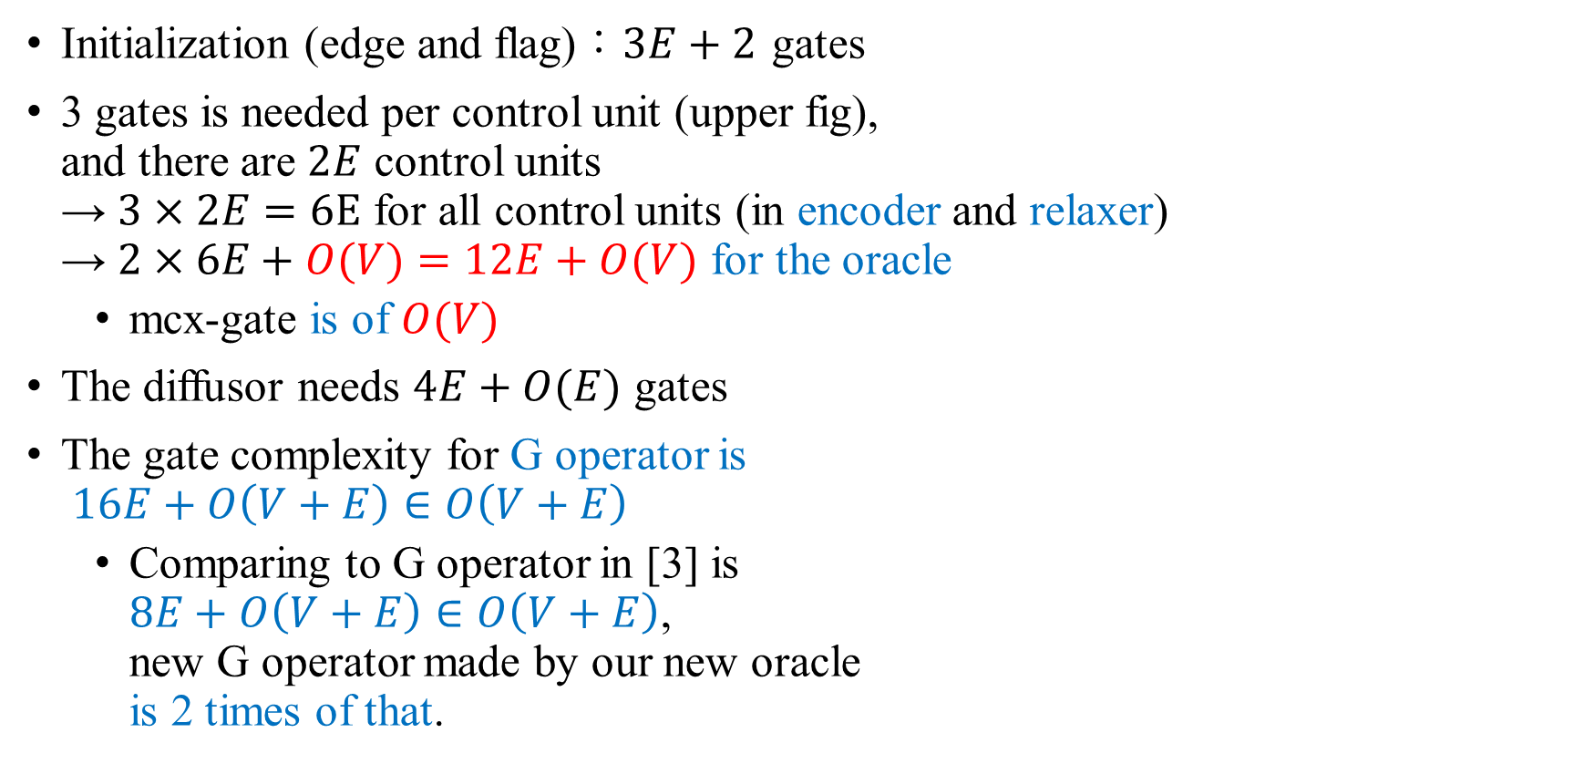








Gate Complexity of Grover’s Circuit by the new Oracle
$$v_{0a} \left|1\right\rangle$$
$$v_{0b} \left|0\right\rangle$$
$$ve_{01} \left|1\right\rangle$$
Initialization (edge and flag)：$3E+2$ gates
3 gates is needed per control unit (upper fig), and there are $2E$ control units → $3×2E=6E$ for all control units (in encoder and relaxer) → $2×6E+O(V)=12E+O(V)$ for the oracle
mcx-gate is of $O(V)$
The diffusor needs $4E+O(E)$ gates
The gate complexity for G operator is $16E+O\left(V+E\right)∈O\left(V+E\right)$
Comparing to G operator in [3] is $8E+O\left(V+E\right)∈O\left(V+E\right)$, new G operator made by our new oracle is 2 times of that.
$$e_{1} \left|1\right\rangle$$
G
v. qubits: ${\left|0\right\rangle }^{⊗2v}$
Oracle
VE qubits: ${\left|1\right\rangle }^{⊗2e}$
Diffusor
e. qubits: ${\left|+\right\rangle }^{⊗e}$
Flag bit: $\left|−\right\rangle$
Classical $n_{e}$ bits

Slide 34
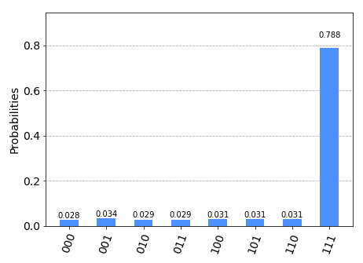
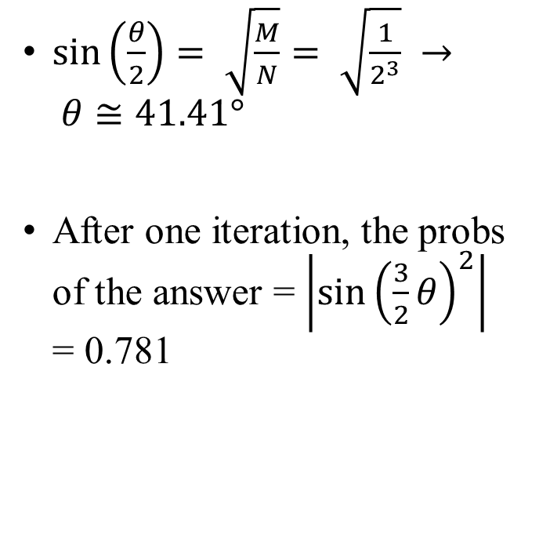
Example of counter oracle
0
0
2
1
2
$\sin\left(\frac{θ}{2}\right)= \sqrt{\frac{M}{N}}= \sqrt{\frac{1}{2^{3}}} → θ≅41.41°$
After one iteration, the probs of the answer = $\left|{\sin\left(\frac{3}{2}θ\right)}^{2}\right|$ = 0.781
1

Slide 35
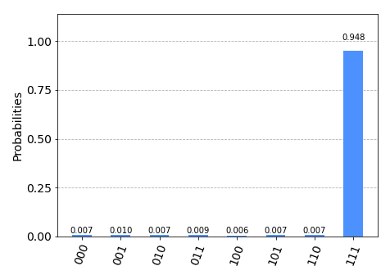

Example of counter oracle
0
0
2
1
2
After two iteration, the probs of the answer = $\left|{\sin\left(\frac{5}{2}θ\right)}^{2}\right|$ = 0.9453
The measurement can be explained by the theory
After each iteration, the vertex bits are relaxed properly.
1

Slide 36
Discussion
The Failure case of Oracle
The Necessity of Relaxation
報告: B08901136 劉承瀚

Slide 37
Why the relaxation is needed?
After mcx-gate, the negative phase store in the vertex qubits.
But actually, we input the edge qubits into the diffusor.
In the relaxation step, we transfer the negative phase information from vertex qubits to the edge qubits.
G
Oracle
v. qubits: ${\left|0\right\rangle }^{⊗v}$
Diffusor
e. qubits: ${\left|+\right\rangle }^{⊗e}$
Flag bit: $\left|−\right\rangle$
Classical $n_{e}$ bits

Slide 38


Does the relaxation really recover vertex qubits?
0
We take the simplest graph for example
$|0001000⟩$：edge bits + flag + vertex bits
0
2
1
2
1

Slide 39



Does the relaxation really recover vertex qubits? (1/4)
After initialization：
All vertices bit show $|0⟩$
$|0001000⟩$：edge bits + flag + vertex bits

Slide 40



Does the relaxation really recover vertex qubits? (2/4)
After oracle, mcx-gate and relaxation：
Vertices bits with $|101⟩$, $\left|011\right\rangle ,…$ show up
Relaxation failed
$|0001000⟩\text{：}$edge bits + flag + vertex bits

Slide 41


Does the relaxation really recover vertex qubits? (3/4)
But if mcx-gate is removed：
Everything goes well
mcx-gate causes the failure
$|0001000⟩\text{：}$edge bits + flag + vertex bits

Slide 42


Does the relaxation really recover vertex qubits? (4/4)
Although relaxation is incomplete…
After Amplification：
Two states have largest amplitude → edge bits= $\left|111\right\rangle has been amplified$
the Grover’s operator still works, but not working very normally
so it may fail after iterations
$|0001000⟩\text{：}$edge bits + flag + vertex bits

Slide 43









Quantum Counting for Hamiltonian Cycle
In order to find the possible number, we use the quantum counting circuit.
The quantum counting circuit is obtained by replacing the unitary operator $U$ with Grover’s operator $G$ in the QPE circuit.
The phase of the QPE circuit is the phase rotated by $G$
The number of the solutions can be obtained from the phase $θ$
$$|j⟩$$
QPE qubits: ${\left|+\right\rangle }^{⊗t}$
$$QFT^{†}$$
v. qubits: ${\left|0\right\rangle }^{⊗v}$
$$G^{|j⟩}$$
e. qubits: ${\left|+\right\rangle }^{⊗e}$
Flag bit: $\left|−\right\rangle$
Classical $n_{e}$ bits

Slide 44










Quantum Counting for Hamiltonian Cycle
$$|j⟩$$
QPE qubits: ${\left|+\right\rangle }^{⊗t}$
$$QFT^{†}$$
v. qubits: ${\left|0\right\rangle }^{⊗v}$
$${ G}^{2^{0}}$$
$${ G}^{2^{1}}$$
$${ G}^{2^{2}}$$
e. qubits: ${\left|+\right\rangle }^{⊗e}$
Flag bit: $\left|−\right\rangle$
Classical $n_{e}$ bits

Slide 45









The error of Q. Counting and required QPE bits
If there are $M$ acceptable solutions out of $N=2^{n_{e}}$, the error of Q. Counting is^{[4]} $err=\left[\sqrt{2\left(N−M\right)N}+\frac{N}{2^{t}}\right]×2^{−(t−1)}$
The number require of QPE qubits for $err≤1$ is $t≥n_{e}+2$ since $N−M$ is of the $N$ order
This causes multiple orders of $G^{|j⟩}$ gate
Too many QPE qubit $t$ may cause error in counting.
$$|j⟩$$
QPE qubits: ${\left|+\right\rangle }^{⊗t}$
$$QFT^{†}$$
v. qubits: ${\left|0\right\rangle }^{⊗v}$
$$G^{|j⟩}$$
e. qubits: ${\left|+\right\rangle }^{⊗e}$
Flag bit: $\left|−\right\rangle$
Classical $n_{e}$ bits

Slide 46


Example of Q. Counting
0
1
0
1
2
3
We choose $t=e+1=6$ bit for Q. counting
With 5120 tries
The measuring shows
100101 on QPE bits with 538 tries is the highest
It corresponds to $θ= 3.63247$ per G operation
The number of solutions is calculated to be $M=1.89$ with error $err≤1.39$
The actual number of HC is 1 route.
4
2
3

Slide 47


Another Example of Q. Counting (1/2)
1
3
0
7
2
There are 4 solutions of HC.
01367, 12345, 01456 and 02357
We choose $t=e+1=9$ bit for Q. counting
With 5120 tries
${\left(100111100\right)}_{2}=316$ on QPE bits with 1397 tries is the highest
It corresponds to $θ=3.8779$per G operation
The number of solutions is calculated to be $M=33.16$ with error $err≤1.36$
0
5
4
4
6
2
3
1

Slide 48



Another Example of Q. Counting (2/2)
1
3
0
7
2
The number of solutions is calculated to be $M=33.16$ with error $err≤1.36$
The number of HC is over-estimated. This is also due to the poor original oracle in [3].
To obtain the an HC in a Grover’s circuit. The number of iteration should be $iter≤\frac{π}{4}\sqrt{\frac{2^{8}}{33.16}}≃2.18$
Which is smaller than that given by correct $M=4$, $iter=\frac{π}{4}\sqrt{2^{8}/4}=6.28$
The best result come from $iter=2$, with the probability of accepted results are 2.5 times of that of non-accepted results
0
5
4
4
6
2
3
1

Slide 49


Example of Q. Counting (Counter form)
0
0
2
We choose $t=e+5=8$ bit for Q. counting
With 5120 tries
The measuring shows
01100011 on QPE bits with 1251 tries is the highest
It corresponds to $θ=2.42983$ per G operation
The number of solutions is calculated to be $M=0.97$ with error $err≤0.08$
The actual number of HC is 1 route.
The accuracy of large graph can’t test due to
limited available qubits.
1
2
1

Slide 50









Complexity Analysis of Q. Counting
Space complexity: $t+V+E+1≃2E+V+1$
Gate complexity:
Initialization needs $2E+1$ gates
A $G$ operator needs $8E+4$ gates
$|t_{0}⟩$ controls $G^{2^{0}}$ gate, which is $2^{0}$ gates $|t_{1}⟩$ controls $G^{2^{1}}$ gates, which is $2^{1}$ gates Therefore, $2^{0}+2^{1}+⋯+2^{t}=2^{t+1}−1$ $G$-gates are needed
If we choose $t≃E$, controlled-$G^{|j⟩}$ comprised of $O\left((V+E)⋅2^{E}\right)$ gates
The $QFT^{†}$ gate is of complexity $O\left(t^{2}\right)≃O(E^{2})$
Compared to classical DP method $O\left(V^{2}⋅2^{V}\right)$
there’s no too much speed up for sparse graph
If the graph is dense ($E∝V^{2}$), Q. counting is actually even slower $O\left(V^{2}⋅2^{V^{2}}\right)$
$$|j⟩$$
$$QFT^{†}$$
QPE qubits: ${\left|+\right\rangle }^{⊗t}$
v. qubits: ${\left|0\right\rangle }^{⊗v}$
$$G^{|j⟩}$$
e. qubits: ${\left|+\right\rangle }^{⊗e}$
Flag bit: $\left|−\right\rangle$
Classical $n_{e}$ bits

Slide 51





Conclusion
The oracle determines the quality of Grover’s circuit.
With classical computer simulation, we examined an oracle implemented by rotation of qubit in [3], and found some of its defect.
We proposed an oracle implemented as with counters. A counter counts how many times a vertex is selected as an edge is selected.
For a Grover’s operator $G$ with defect, the iteration (or cascade) of $G$ can be determined by quantum counting.
To note that, for a defect $G$, the number of solution given by Q. counting is wrong.
If Q. counting over estimate of the number of solutions, the upper bound in Grover’s search is tighter.
$$v_{0a} \left|1\right\rangle$$
$$v_{0b} \left|0\right\rangle$$
$$ve_{01} \left|1\right\rangle$$
$$e_{1} \left|1\right\rangle$$

Slide 52

Conclusion -The complexity of Grover’s Circuit and Q. Counting
Classical DP method $O\left(V^{2}⋅2^{V}\right)$
Find an HC (Grover)
G operator gate complexity (rotation form): $8E+4$
G operator gate complexity (counter form): $16E+4$
$\text{iteration} \text{times}\text{:} \sqrt{2^{E}/M}$ to get an HC with probs~1
Gate complexity: $O((V+E)⋅2^{E/2})$
Counting number of HC (Q. Counting)
Time complexity: $O\left((V+E)⋅2^{E}\right)$
error rate $=\left[\sqrt{2\left(N−M\right)N}+\frac{N}{2^{t}}\right]×2^{−(t−1)}$ → for $err≤1$ is $t≥n_{e}+2$

Slide 53
Reference
[1]. Wiki: TSP https://en.wikipedia.org/wiki/Travelling_salesman_problem
[2]. Wiki HCP https://en.wikipedia.org/wiki/Hamiltonian_path_problem
[3]. Hamiltonian_Cycle_Problem_with_QC https://github.com/ho0-kim/Hamiltonian_Cycle_Problem_with_QC
[4]. Quantum Counting - Qiskit https://qiskit.org/textbook/ch-algorithms/quantum-counting.html
[5]. 演算法筆記 – Dynamic Programming http://web.ntnu.edu.tw/~algo/DynamicProgramming.html
[6].演算法筆記 – Circuit http://web.ntnu.edu.tw/~algo/Circuit.html

