Slide 1
Multi-algorithmic approaches to mono and polyphonic pitch detection / estimation
Joseph Lincoln, Dr. Mangolika Bhattacharya, Dr. Roy Magnuson
~ Acknowledgements to the Illinois State University Schools of Information Technology and Music for their support and funding of necessary materials and printing costs ~

Slide 2


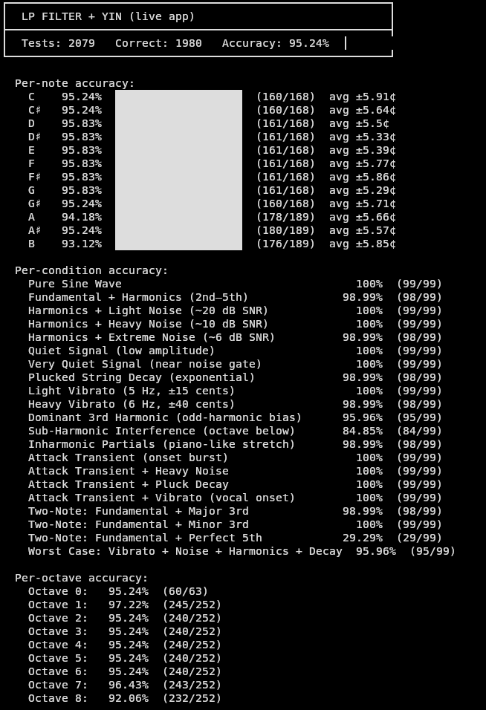

YIN Application Testing and Results
Controlled Test Suite x10
Controlled Test Suite
Controlled Test Suite Conditions
Controlled + Randomized Test Suite

Slide 3
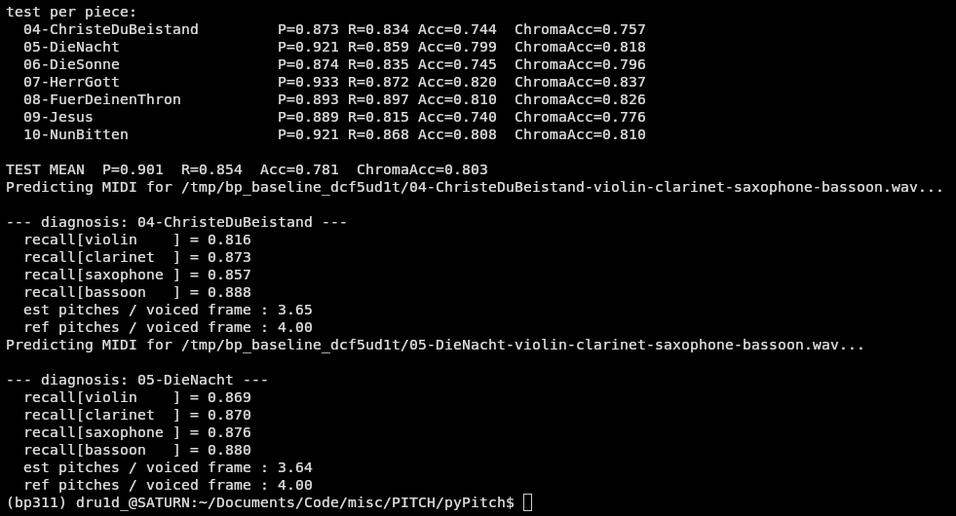
Spotify's Basic-Pitch Convolutional Neural Network Against Bach10, Quartet
External Baseline of Comparison

Slide 4
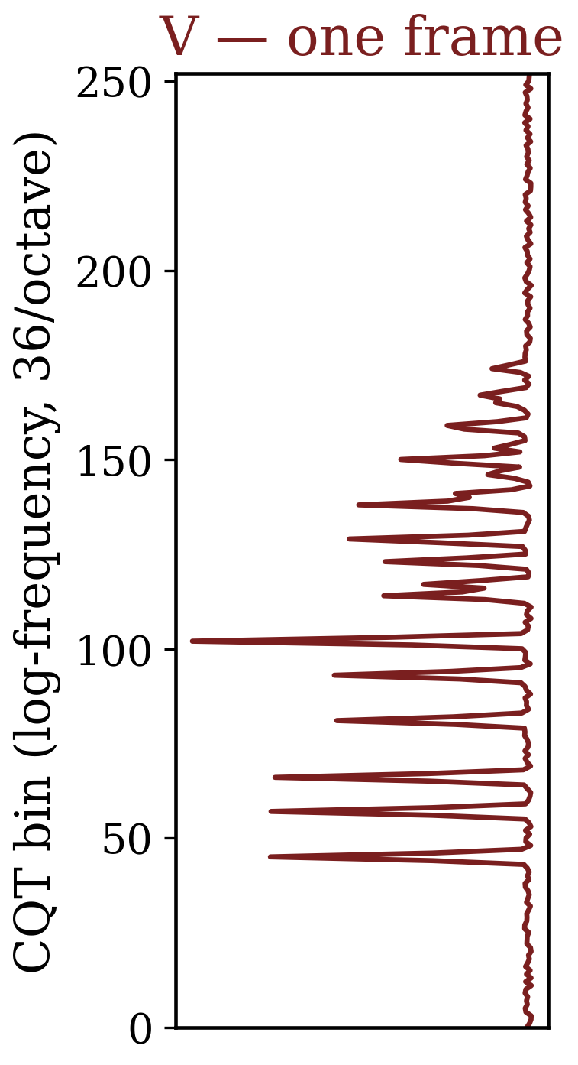
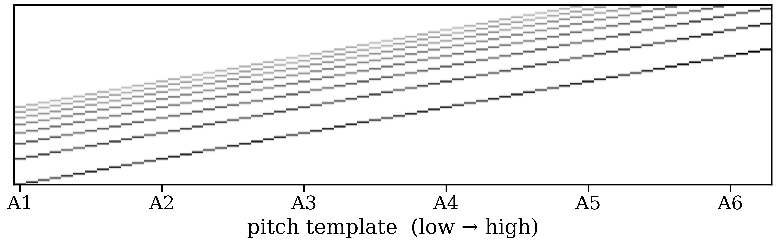
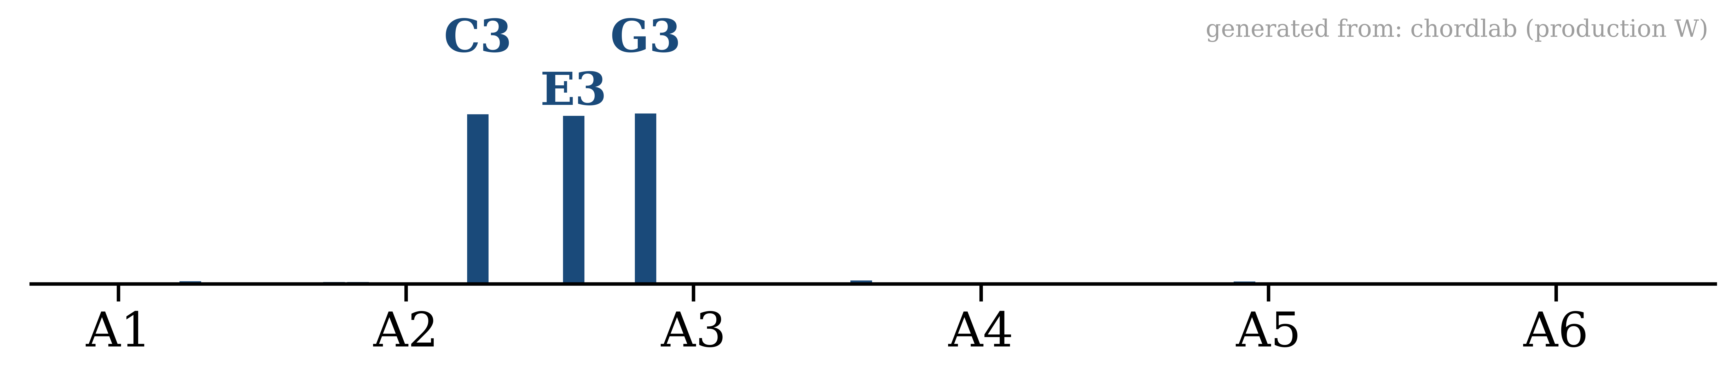
How NMF reads a chord: V ≈ W · H
one spectrogram frame, explained as a combination of harmonic templates
1
What we hear
2
What each note looks like
3
W — dictionary: one harmonic template per pitch
What NMF recovers
V — the observed spectrum
H — pitches present: C3 + E3 + G3 → C major

Slide 5
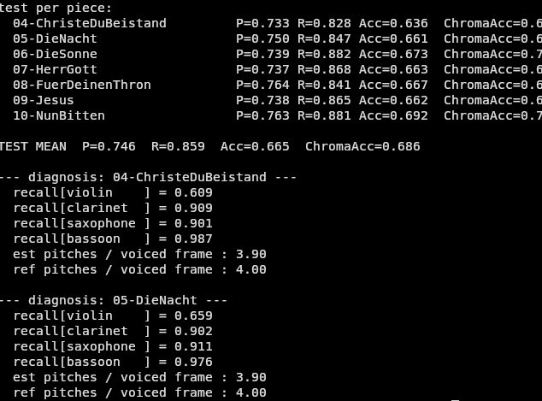
Frame- / Proxy-Level, Internal Baseline of Comparison

Slide 6
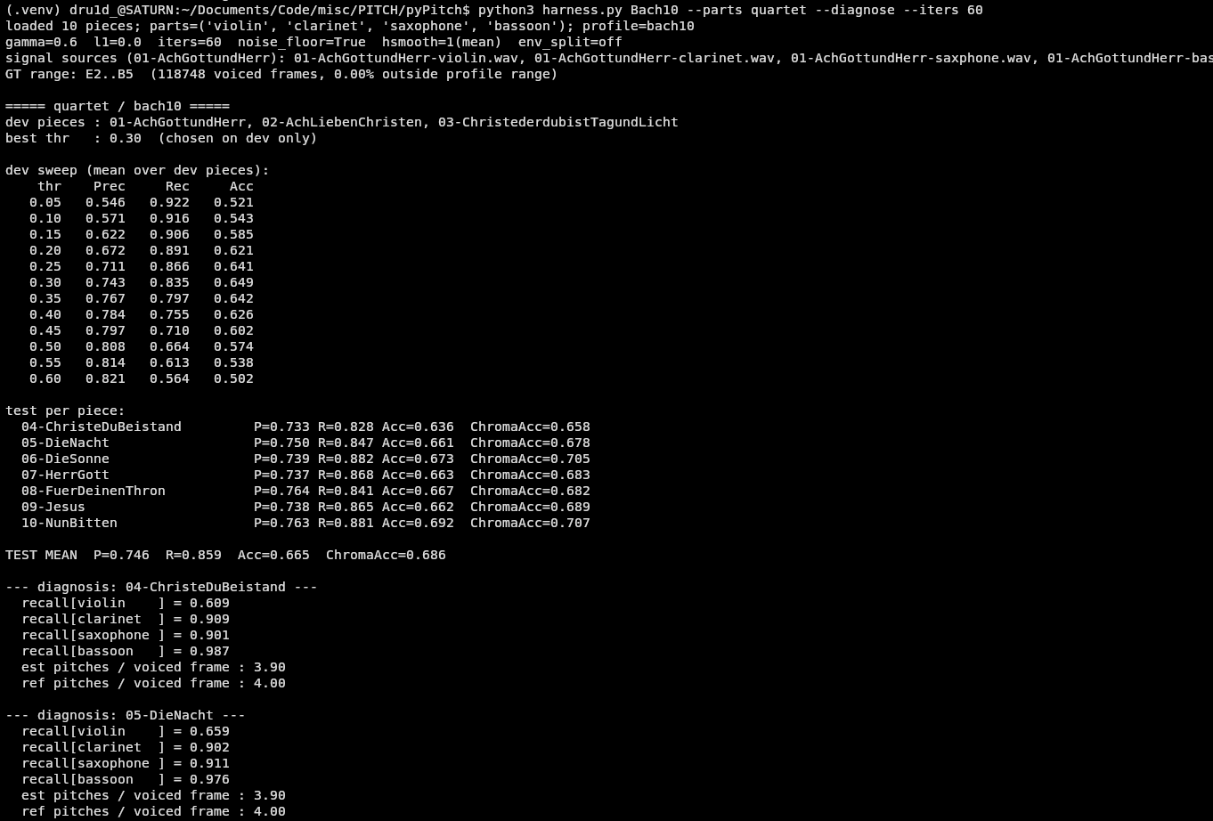

Frame- / Proxy-Level Evaluation
60 iterations
both 60 iterations and 300 iterations of Lee & Seung's [2] multiplicative update​ rule for finding activations within H converge at the same place!!
300 iterations
...
Acc = 0.665,
ChromaAcc = 0.686 / 0.687

Slide 7
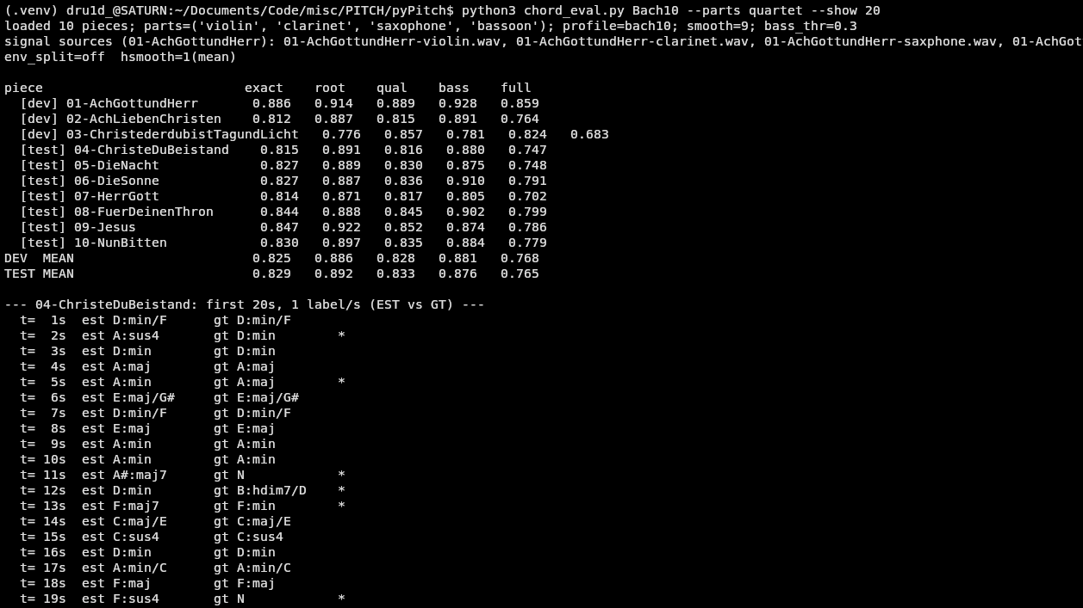
Chordal / Harmonic Agreement
exact (acc.) @
___
Task Domain Level Evaluation

Slide 8
What We Ruled Out
Falsified hypotheses, kept as findings, each tested and rejected by the benchmark and testing processes.
Measured envelopes: calibrating template shapes from real recordings made accuracy worse: frame 0.618 → 0.584, chord 0.564 → 0.502. The generic physics-based template generalized better than the fitted one.
Under-convergence: 300 NMF iterations gave output identical to 60. The problem is convex in H, so more iterations cannot and will not change the answer; there's only one right answer to converge on.
Median temporal smoothing: erases quieter voices when they're outnumbered; the mean actually carries it. Mean-of-5 adopted (+0.4).
The “quartet collapse”: ultimately traced not to the algorithm, but to a file-selection error: Bach10’s saxophone stem files are natively named “saxphone.wav” (whoops!).
A CQT octave-error advantage over the CNN: none found; neither system produces noticeably more octave-errors than the other. The gap is about the same ≈0.02 for both.

Slide 9
P.I.T.C.H. v0.1
Polyphonic Interpretation Tool for Chords and Harmony, version 0.1
real-time chord and harmonic labeling plus interpretation · modeling the physics of sound before layering on machine learning
Ask me about:
why interpretability beats a black box · the violin bottleneck · how NMF explains a chord · next steps for the project
Joseph Lincoln · Dr. Mangolika Bhattacharya · Dr. Roy Magnuson · Illinois State University Schools of Information Technology and Music

