Slide 1
ANALYZING ASSEMBLY:
A LOW LEVEL CONNECTION the gap between abstraction and actual
Microcomputers 2025 | Joseph Lincoln | Prof. Sparrow

Slide 2
Presentation
Assembly and Initial Ideas
There and Back Again (BASIC to ASM)
Tweaking and Optimizing
Code Breakdown
What I Learned / Wrap-up

Slide 3

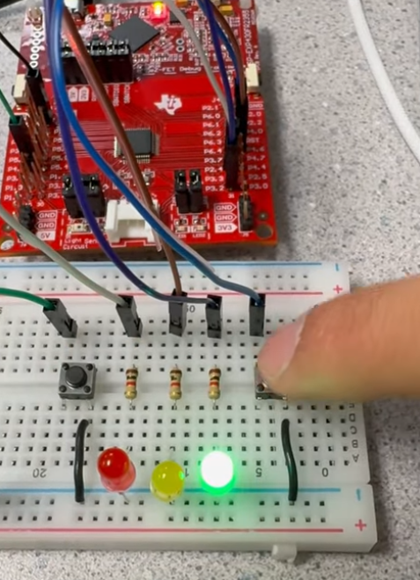



Assembly and initial ideas
Assembly is a family of programming languages used to interface directly with the CPU of any computer / controller, be it micro or otherwise. It is a low-level family of languages, as low as you can get before reaching binary and / or hex. The instruction set of an assembly language is tied closely to the machine code of the given architecture it is written for. These and other factors render assembly programming as very concrete, with little to no abstraction, and heavy importance placed upon the literal representation and operation of data.
How about some LCD road signs?
Traffic light simulator?

Slide 4


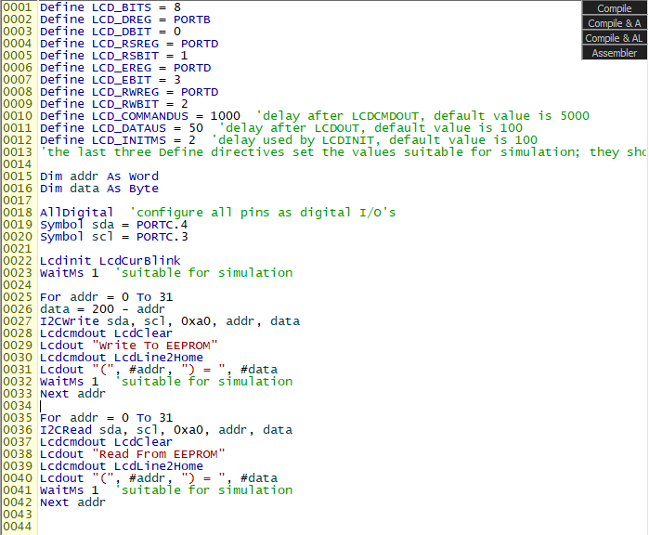
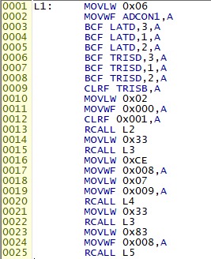
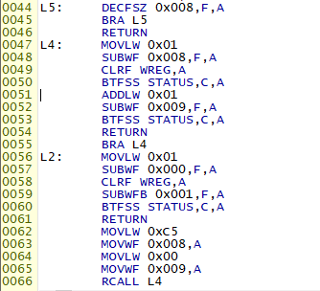
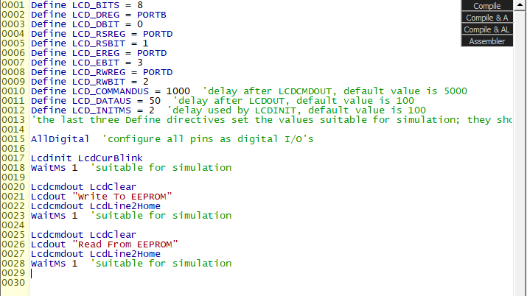
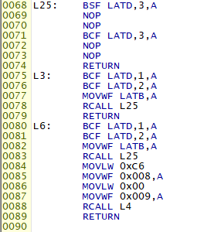
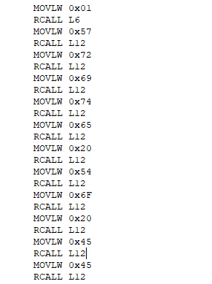
There and back again
BASIC
Assembly to BASIC and Back
To the right is the BASIC program provided by the PIC18 simulator IDE as a demo program. This one reads and writes from EEPROM memory 32 times each and displays a live status report of the EEPROM R / W process on the LCD module.
This was my starting off point, for figuring out how exactly you even write to the LCD module to begin with?!
After following the program flow and picking apart the disassembled code from the BASIC program, I found where the LCD rectangle "blink" effect occurred in the assembly code. This was my first breakthrough, as I could now pinpoint where and how a display of some kind was being written to the LCD module.
Next, it became about finding where the message write happens, and the disassembler gave some pretty good clues to that as well.
So, the built-in dissassembler is not the most intuitive, but neither is assembly as a language itself (for humans). Using what we've learned, how can we optimize and utilize the code for our purposes?

Slide 5
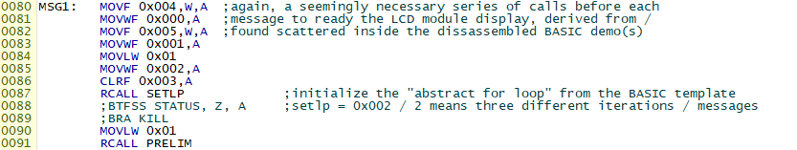
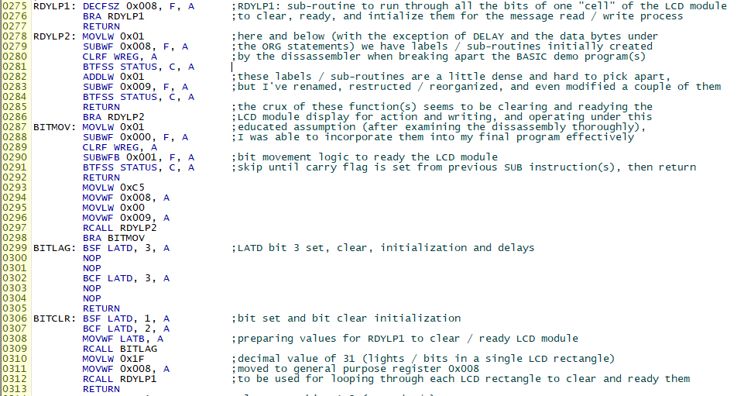
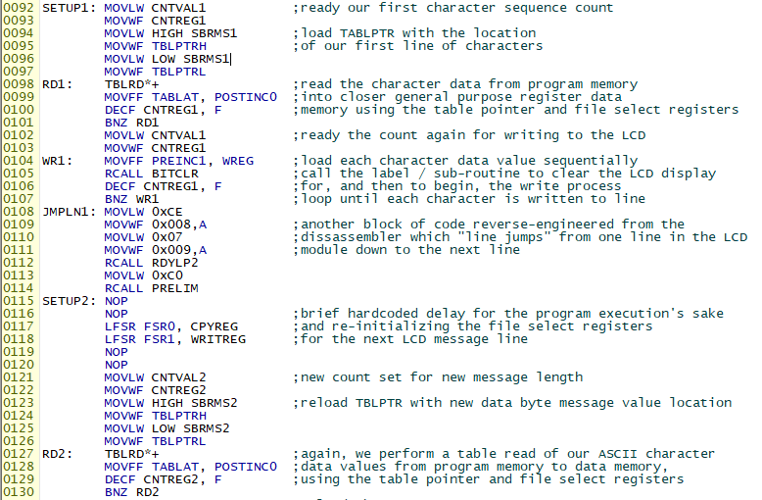
Tweaking and optimizing
Implemented Tweaks and Additions
  Reorganized and relabeled all labels and sub-routines necessary to ready and write to the LCD module display
  Added table pointers and file select registers to optimize LCD message writing process – this ultimately resulted in a little over 100 less lines of code!!
  Stored the characters for each message in program memory, to be accessed when needed with our table pointer
  Used file select registers and their associated operations to better control the display write out using loops
  Better utilization of arithmetic and bit operations to ready the LCD module and direct program flow

Slide 6
Code breakdown
1.) Some of this code had to be taken from the disassembled BASIC "as-is" (like Lcdinit, Lcdcmdout, and Lcdout). These BASIC commands had a, more or less, direct translation to assembly which can be pinpointed and restructured for our purposes.
2.) Renaming the sub-routines and labels to more "human readable" identifiers made rewriting and optimizing the code much easier.
3.) On top of renaming the sub-routines / labels, I made great efforts to refactor the linear disassembly into a more modular form which not only reduced the lines of code, but made it easier to understand.
4.) The addition of table pointer logic and my own implementation of file select registers / indirect addressing provided the greatest reduction in lines of assembly code, and therefore the greatest optimization in the program.

Slide 7
What I Learned / Wrap-Up
  The importance of not just clean, well-organized code, but well-documented and optimally structured code. Assembly is a language where this becomes crucial in both writing and understanding the code.
  How utilizing seemingly complicated concepts and data management techniques (table pointers, file select registers) can lead to better program control and code optimization.
  Refactoring the code into subroutines and modular structures improved comprehension and control of the program by introducing clearer naming conventions, promoting code reuse, and reducing the amount of disorganized, tedious spaghetti code.
  Experience with the disassembly process translating higher-level code into lower-level code, and back, through the lens of BASIC and assembly.
  The importance of data, bit, memory, and arithmetic operations at the low level.

Slide 8
THANK YOU!!
Questions, comments?

