Slide 1

Spotify Soundtrack
Analysis
Johnson Liang

Slide 2
Table of Contents
Introduction & Data Overview
Basic EDA
Hypotheses and Results
Ending Remarks

Slide 3
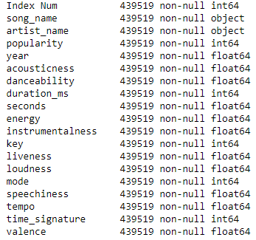
Introduction & Data Overview
Public dataset on kaggle
440,000 -> 439,519
19 attributes/columns

Slide 4
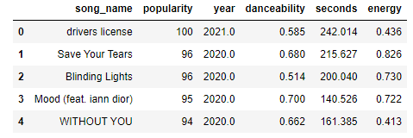
My Goal
Popularity (0-100)
Year released (1950 - 2021)
Duration (seconds)
Energy (0-1)
Danceability (0-1)

Slide 5
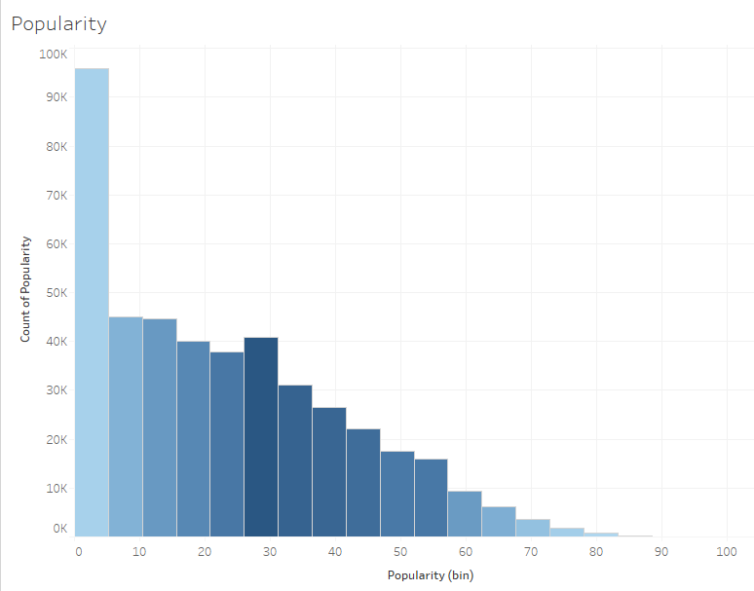
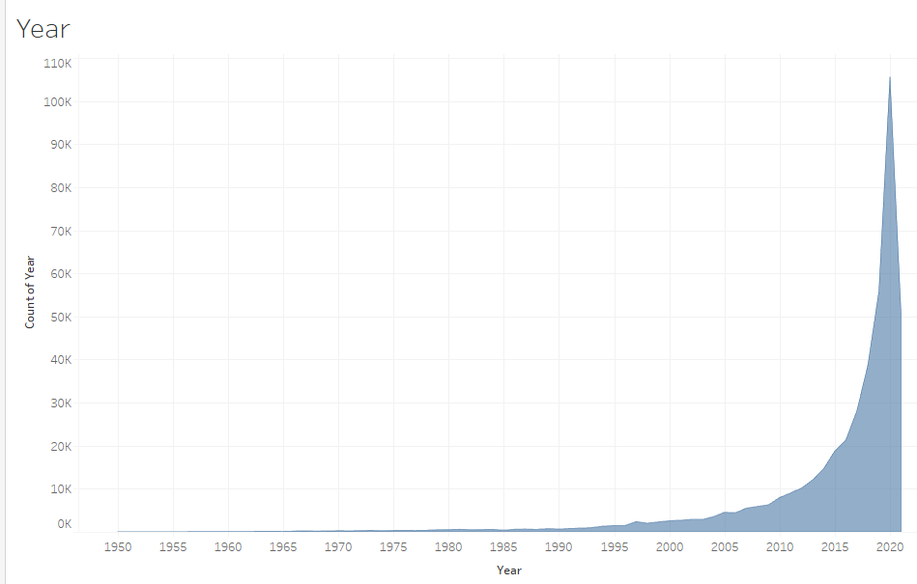
Basic EDA & Descriptives
Popularity (0-100)
Mean rating = 22
2. Year of Release (1950-2021)
85% released 2010 - 2021

Slide 6
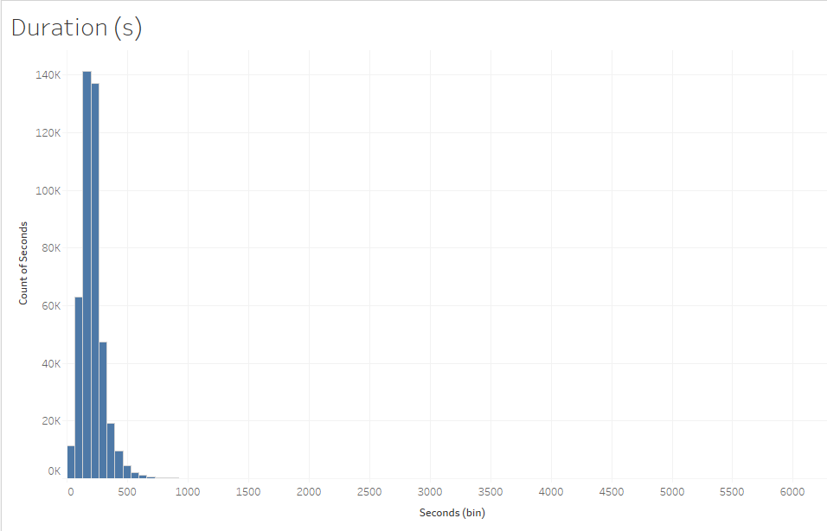
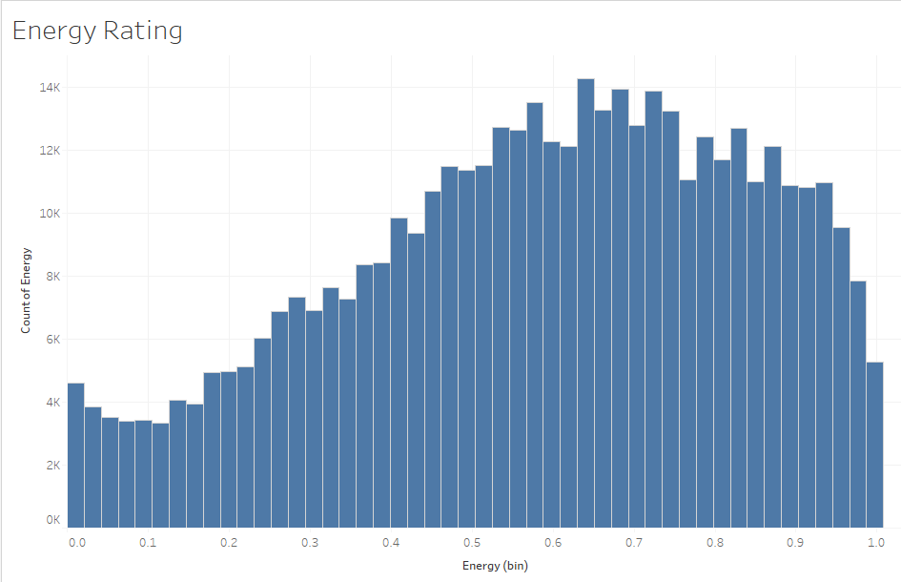
Basic EDA & Descriptives
3. Duration (seconds)
Mean duration of 213s
4. Energy Rating (0-1)
Mean rating = 0.58

Slide 7
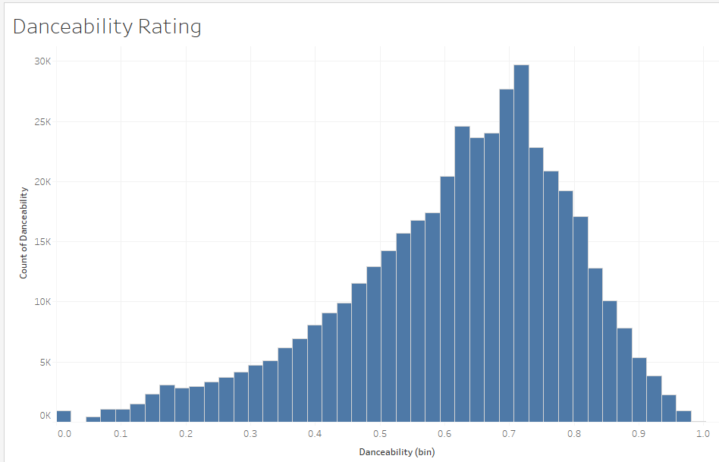
Basic EDA & Descriptives
5. Danceability Rating (0-1)
Mean rating of 0.62

Slide 8
Hypotheses Testing
Hypothesized Attributes in Soundtrack Popularity
Year of Release
Duration (s)
Energy Rating
Danceability Rating

Slide 9
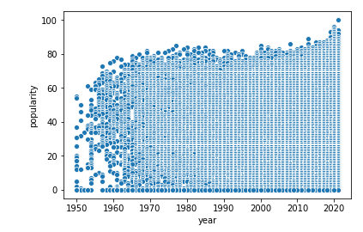
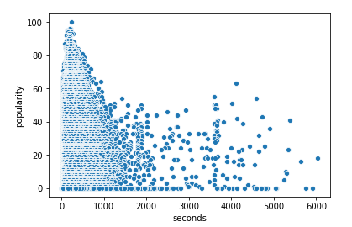
Results: Year of Release
Results: Duration (s)
Year >= 2010
Popularity was 3 -3.4 Higher
Duration >= 200
NO SIGNIFICANCE

Slide 10
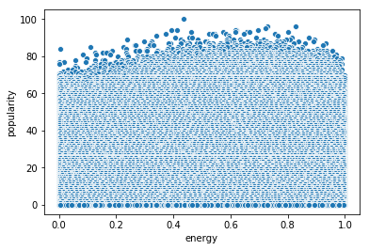
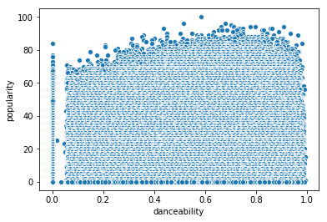
Results: Energy Rating
Results: Danceability Rating
Energy >= 0.6
Popularity was 2.9 - 3.2 Higher
Danceability >= 0.6
Popularity was .14 - .37 Higher

Slide 11
Ending Remarks
Pay attention to:
Songs released within the decade
High Energy rating
High Danceability rating

Slide 12
Thank You!

