Slide 1


What Influences Home Prices?
Johnson Liang

Slide 2
Contents
1
2
3
Introduction
Hypotheses
Data
4
5
6
Methods
Results
Ending Recommendations

Slide 3
Introduction
1
Investment firm allocation
Why home prices?

Slide 4

Hypotheses
2
Hypothesized Driving Factors in Home Price
Lot Area
Ground Living Area
Overall Quality
Overall Condition
Neighborhood
Total Basement Area
Garage Area

Slide 5
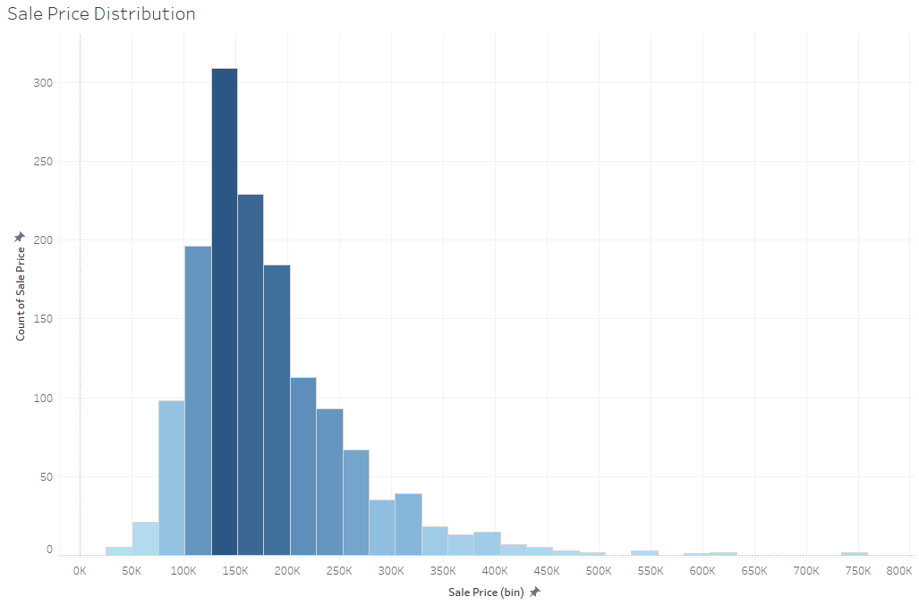
Data
3
1460 houses in Ames, Iowa
Houses sold 2006 - 2010
Over 50 variables, both categorical and numerical
Average Sale = $180,921
Data is skewed to the left

Slide 6

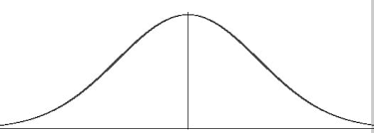
Methods
4
Excel Data Analysis Toolpak
AA Test
Data Visualization in Tableau
2-Sample t-tests with Toolpak
Find significance of my variables with t-tests

Slide 7
Results of Hypotheses Testing
5

Slide 8
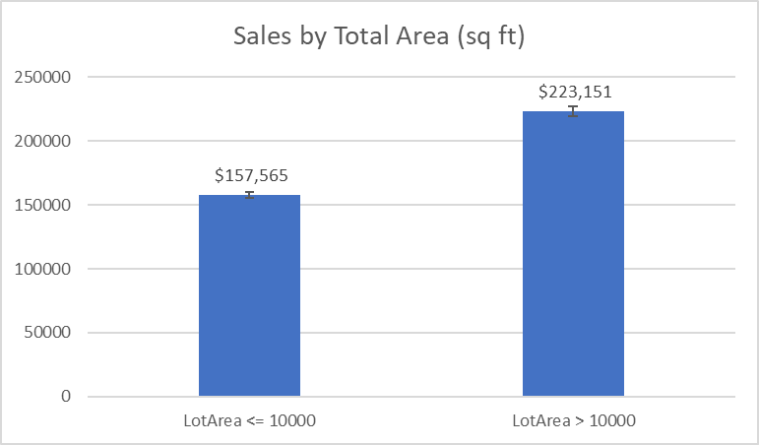
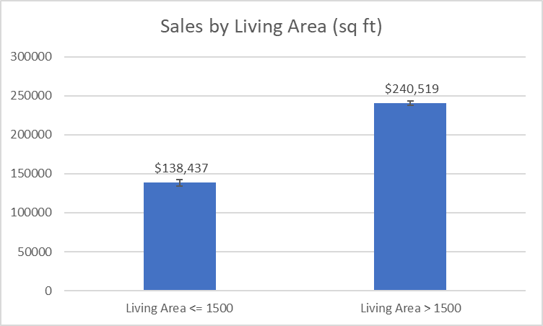
Results: Lot Area & Living Area
$56k - $75k
$93k - $111k
6

Slide 9
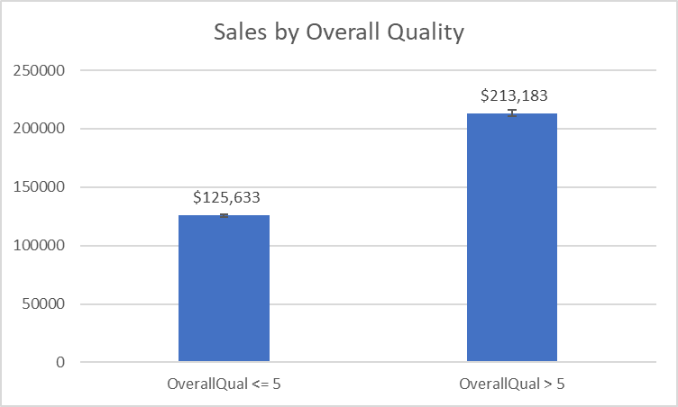
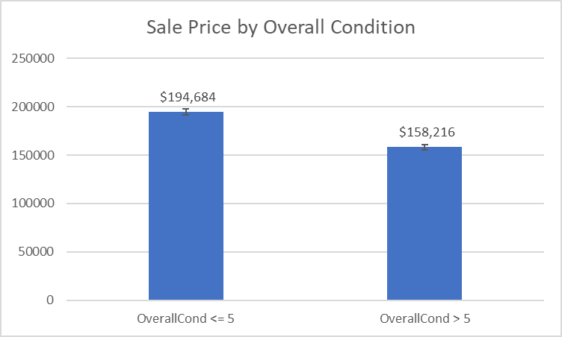
Results: Overall Quality & Overall Condition
$81k - $93k
$28k - $43k
7

Slide 10
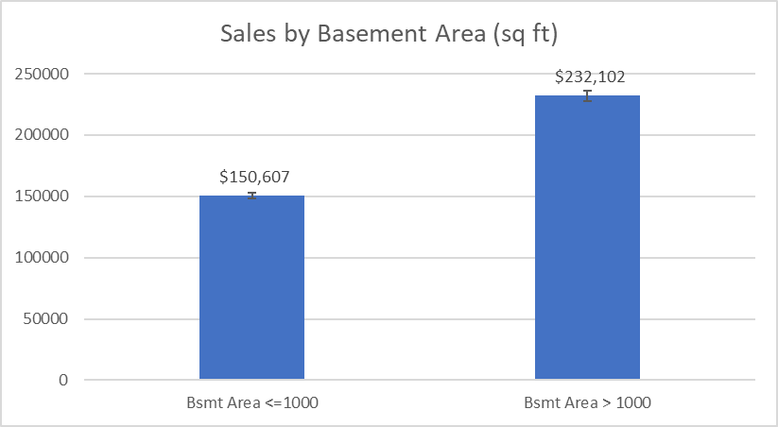
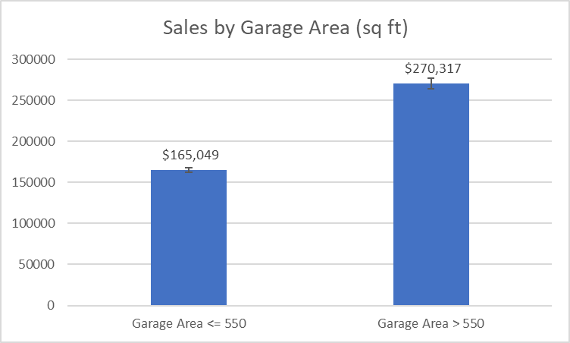
Results: Total Basement Area & Garage Area
$81k - $93K
$90k - $119K
8

Slide 11
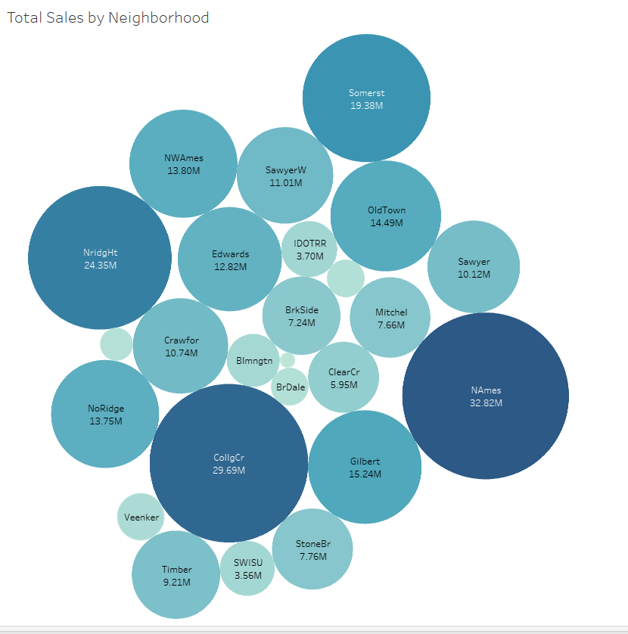
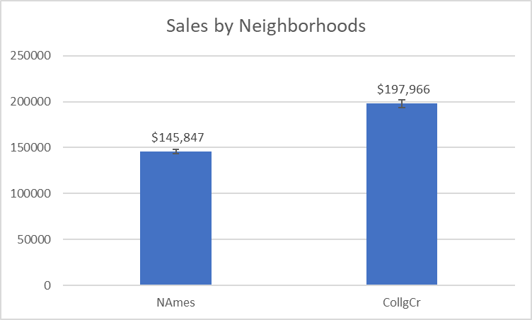
Results: Neighborhood
$43K - $61K
9

Slide 12
Final Recommendations
Recommended Factors
10
The larger the area, the better!
Higher quality!
Neighborhood matters!

Slide 13
Thank You!
11

