Slide 1
The Return of the Prompter
Notes:
Use this opener as a reset after a break or between sessions.
Welcome everyone back, then advance to the explicit session slide with the participation reminder.
---
Source: slides\marp\welcome-back.deck.md

Slide 2
Welcome Back to AI-Assisted Software Development
Ready to continue where we left off
Today's session builds on what we've covered
We're all in this together — participation welcome
Questions are always welcome — ask anytime!
Notes:
Duration ~00:02
Welcome everyone back to the session. Take a moment to let people settle in before diving into content. Acknowledge that it's great to see everyone back and express enthusiasm for the session ahead.
Key talking points:
- Remind attendees of the previous session's topics briefly
- Emphasize that questions are encouraged at any point — not just at the end
- Set a positive, inclusive tone for the session
- If this is after a break, give people 30 seconds to get re-focused
Transition: "Let's pick up right where we left off..."
---
Source: slides\marp\welcome-back.deck.md

Slide 3
Course Modules
Intro
▶ Specification Driven Software Development
Architecture Specification
Technology Specification
Implementation Specification
Implementation Planning
Implementation Prompts
Vertical Slice Implementation
Notes:
Auto-generated course navigation slide showing all modules with current section highlighted

Slide 4
Getting Started Checklist
The Recipe Before the Meal
Notes:
Source: slides\marp\getting-started-checklist.deck.md

Slide 5
High Level AI Assisted Workflow
From Requirements to a Solution
Stakeholders such as SMEs, architects, SREs, and DBAs define the requirements with AI assistance.
AI transforms the requirements into implementation instruction files that guide the work.
Stakeholders review, improve, and approve the instruction files.
AI uses those instruction files to create prompts that implement the business requirements.
Implementation prompts explain how the feature should be built and how acceptance criteria should be verified.
Stakeholders review, improve, and approve the implementation prompts.
Submitting the implementation prompts produces an implementation that conforms to the instruction files and meets the acceptance criteria.
Stakeholders review and approve the resulting implementation.
Notes:
Walk the audience through the lifecycle from left to right and keep the focus on the review gates between each AI-generated artifact. Stress that requirements are not handed directly to code generation; instead, they are refined into instruction files and then into implementation prompts, with stakeholder approval at each stage. Use the diagram to reinforce that this is a controlled pipeline where AI accelerates each step but humans still own correctness, safety, and acceptance. End by linking this workflow back to the checklist on the previous slides: foundation, automation, specialization, and integration all support this end-to-end model.
---
Source: slides\marp\getting-started-checklist.deck.md

Slide 6
Starting with Requirements
Build the Right Thing Before Building the Thing Right
Notes:
Shift to greenfield best practices: requirements, prompts, and verification workflows.
---
Source: slides\marp\starting-with-requirements.deck.md

Slide 7
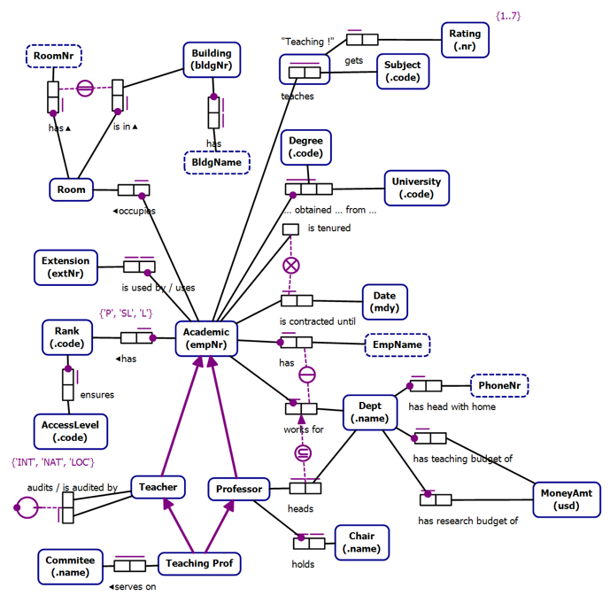
Business Rules as Requirements
Notes:
Source: slides\marp\starting-with-requirements.deck.md

Slide 8
Conceptual Models
Technology Agnostic
Transformable into Logical Models
Clarity
Expressive
Formal
Conceptual Models are not a requirement
Notes:
Source: slides\marp\starting-with-requirements.deck.md

Slide 9
Object Role Models
A type of conceptual model
Supported by a Visual Studio Extension (NORMA)
Object Role Models are textual and visual
Text can be visualized
Diagrams can be verbalized
Textual representation is in a formal natural language that can be validated by subject matter experts
Notes:
Source: slides\marp\starting-with-requirements.deck.md

Slide 10
Zeus.Academia.3b
Based on a publicly available model of a commonly understood domain
https://orm.net/pdf/ORMwhitePaper.pdf
Allows us to quickly move from requirements to implementation
https://github.com/johnmillerATcodemag-com/zeus.academia.3b
Why 3b?
Third Iteration in progress
If something is hard, do it often
Notes:
Source: slides\marp\starting-with-requirements.deck.md

Slide 11
Use Cases
Use cases are specific scenarios that guide data capture and processing in the application
Promote a Lecturer to Senior Lecturer
Promote a Senior Lecturer to Associate Professor
Promote an Associate Professor to Professor
Assign a Class to an Academic
Add a new Academic to the faculty capturing all required information and allowing the capture of optional information
Notes:
Source: slides\marp\starting-with-requirements.deck.md

Slide 12
Exercise: Business Requirements Generation
Let the AI Write the Requirements for Once
Notes:
Source: slides\marp\exercise\exercise-business-requirements-generation.deck.md

Slide 13
Exercise: Business Requirements Generation
Objectives
Create a business requirements document for the calculator project
Use the Product Manager agent with existing instruction files
Apply the expected branch and repository workflow for Greenfield work
Validate the requirements draft through review, clarification, and independent iteration
Activities
1. Create a personal branch from the Greenfield branch in the class repository.
2. Use the Product Manager agent to generate a calculator requirements document.
3. Apply the existing instruction files to improve scope, structure, and consistency.
4. Confirm repository choice, branching strategy, and how to handle any existing PRD content before continuing.
5. Work independently on the requirements document while the instructor provides check-ins and support.
Success Criteria
A calculator business requirements document exists on the correct personal branch
The Product Manager agent and instruction files are both used effectively
Repository and branching decisions are applied correctly and consistently
Participants can explain what changed after clarifications and independent refinement
Notes:
Duration ~00:17
**Prerequisites:** Access to the Greenfield branch, ability to create a personal branch, and access to the Product Manager agent plus the repository instruction files
Use this exercise to establish the Greenfield workflow discipline early. Start by making participants branch from Greenfield before they do any prompting so the requirements artifact has a clean ownership path and can be reviewed independently later. In the first few minutes, emphasize that the goal is not to produce a perfect PRD in one pass, but to create a usable calculator requirements document using the Product Manager agent together with repository guidance. During the clarification window, call out the common confusion points explicitly: correct repository, personal branch strategy, what to do with any existing PRD material, and that tooling differences between Visual Studio and VS Code are secondary to getting the requirements quality right. For the working block, let students operate independently, but use periodic check-ins to see whether instruction files improved the output and whether anyone is stuck on scope, branching, or prompt quality. Transition from this exercise by connecting the completed requirements document to the next Greenfield planning steps, especially technology instructions, slice planning, and implementation prompts.
---
Source: slides\marp\exercise\exercise-business-requirements-generation.deck.md

Slide 14
Course Modules
Intro
Specification Driven Software Development
▶ Architecture Specification
Technology Specification
Implementation Specification
Implementation Planning
Implementation Prompts
Vertical Slice Implementation
Notes:
Auto-generated course navigation slide showing all modules with current section highlighted

Slide 15
CQRS Architecture
Reads and Writes: Better Apart, Like Most Couples
Notes:
Source: slides\marp\cqrs-architecture.deck.md

Slide 16
CQRS Benefits
CQRS separates write (command) operations from read (query) operations
Enables independent scaling and optimization of each model
Useful when read and write workloads have very different characteristics
Notes:
Duration ~00:01
Welcome to the CQRS Architecture module. This session covers Command Query Responsibility Segregation — a pattern that separates read and write operations into distinct models to improve scalability and maintainability.
**Key Points**:
- CQRS separates write (command) operations from read (query) operations
- Enables independent scaling and optimization of each model
- Useful when read and write workloads have very different characteristics
**Delivery**: Begin by asking the audience about pain points with traditional CRUD APIs — high query complexity, slow writes due to query-optimized schemas, or contention between reads and writes.
**Transition**: "Let's start with when CQRS makes sense — and when it doesn't."
---
Source: slides\marp\cqrs-architecture.deck.md

Slide 17
When to Use CQRS
✅ Use CQRS when:
Read and write workloads scale differently
Read models need denormalization, caching, or projections
Write model needs strong invariants and task-focused workflows
Auditing or event sourcing is required
Query complexity slows transactional throughput
❌ Avoid CQRS when:
Domain is small and reads/writes are balanced
No clear boundary between commands and queries
Operational overhead is not justified
Notes:
Duration ~00:03
CQRS is a powerful pattern but it adds operational complexity. Use it only when the benefits outweigh the costs.
**Key Points**:
- The classic CRUD pattern couples reads and writes to the same model — fine for simple domains
- CQRS shines when the query model needs to be radically different from the write model
- Event sourcing almost always pairs with CQRS
- Small teams or simple domains should avoid CQRS due to added complexity
**Real-World Example**: An e-commerce order system where writes go through strict business validation but reads need highly denormalized views for catalog search, order history dashboards, and analytics.
**Audience Question**: "Has anyone implemented something like CQRS without knowing it had a name?"
**Transition**: "Let's look at the core principles that underpin CQRS."
---
Source: slides\marp\cqrs-architecture.deck.md

Slide 18
Core Principles
Principle | Detail
Separation | Commands change state; queries never change state
Invariants | Write model enforces all business rules
Optimization | Read model is shaped for query use cases
Independence | Models can evolve separately
Consistency | Eventual consistency between write and read
Notes:
Duration ~00:02
These five principles guide every CQRS implementation decision.
**Key Points**:
- The read/write separation is absolute — queries must be side-effect free
- Write model is where business logic lives — all invariants enforced here
- Read models are projections built from the write model's events
- Independence is key — you can evolve the read schema without touching write logic
- Eventual consistency is usually acceptable; design for it intentionally
**Common Misconception**: CQRS does not require separate databases. You can start with a single database and separate logical models before introducing physical separation.
**Transition**: "What are the actual architectural components we need to build?"
---
Source: slides\marp\cqrs-architecture.deck.md

Slide 19
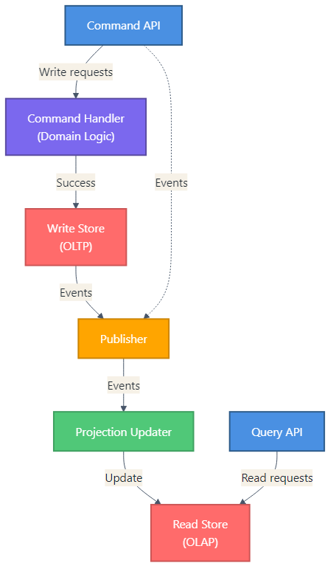
CQRS Architecture Components
Minimum components
Command API — receives write requests
Command Handler — enforces domain rules
Write Store — authoritative OLTP system
Publisher — emits events reliably
Projection Updater — rebuilds read models
Query API — serves optimized reads
Read Store — denormalized query model
Notes:
Duration ~00:03
This diagram shows the minimum components for a CQRS implementation.
**Walk Through the Diagram**:
1. Command API receives write requests and routes to handlers
2. Command Handler orchestrates domain logic and writes to the Write Store
3. Events are published after successful writes
4. Projection Updater subscribes to events and updates the Read Store
5. Query API serves the Read Store with fast, optimized queries
**Key Components**:
- **Command API**: Validates input, routes to appropriate handler
- **Command Handler**: Enforces invariants, orchestrates domain operations
- **Write Store**: OLTP database for aggregates and consistency
- **Event Publisher**: Reliable event emission (use outbox pattern)
- **Projection Updater**: Maintains read models from events
- **Query API**: Serves denormalized, query-optimized data
- **Read Store**: OLAP or document store optimized for reads
**Transition**: "Let's look at command model design in more detail."
---
Source: slides\marp\cqrs-architecture.deck.md

Slide 20
Consistency Strategy
Strong Consistency — needed for:
Payments and financial transactions
Inventory management
Security and access control
Eventual Consistency — acceptable for:
Activity feeds and notifications
Analytics dashboards
Search indexes and recommendations
Reliable Event Publication — use the Outbox Pattern:
Write event to database table atomically with domain change → background process publishes → idempotent consumers
Notes:
Duration ~00:03
Consistency is often the most debated aspect of CQRS implementations.
**Key Points**:
- Not all data requires strong consistency — choosing the right model reduces complexity
- The Outbox Pattern is the industry standard for reliable event publishing
- "Dual writes" (write to DB and publish in the same transaction) are dangerous — use the outbox
- Idempotent consumers handle duplicate event delivery gracefully
**The Outbox Pattern**:
1. Within the same database transaction: write the domain change AND an outbox event record
2. A background process reads unprocessed outbox events and publishes them to the message broker
3. Mark events as processed after successful publication
4. Consumers handle duplicates idempotently
**Transition**: "What common mistakes should we avoid?"
---
Source: slides\marp\cqrs-architecture.deck.md

Slide 21
Example: Order Approval Flow
Command flow (write):
1. API receives ApproveOrder command
2. Command handler loads Order aggregate
3. Aggregate validates approval rules
4. Transaction commits to write store
5. OrderApproved event published via outbox
Query flow (read):
1. UI requests order summary dashboard
2. Query API reads OrderSummary projection
3. Read store returns denormalized view
4. Response includes lastUpdatedUtc for freshness indicator
Notes:
Duration ~00:02
Tying the concepts together with a concrete example makes the pattern tangible.
**Key Points**:
- The command and query flows are completely independent paths
- The event bridges the write and read sides asynchronously
- `lastUpdatedUtc` in the query response lets the UI show freshness information
- The UI can display a "processing" indicator while the projection catches up after a command
**Discussion Question**: "What are the tradeoffs of showing the read model data vs. the command result directly after an approval?"
**Key Takeaway**: CQRS is not magic — it's a deliberate architectural choice that pays off when reads and writes truly have different requirements.
---
Source: slides\marp\cqrs-architecture.deck.md

Slide 22
Key Takeaways
Core reminders
Separate commands from queries at the architectural level
Use CQRS when read and write workloads differ materially
Use the outbox pattern for reliable event publication
Design for eventual consistency intentionally
Start small and migrate one context at a time
Further reading
Martin Fowler: martinfowler.com/bliki/CQRS.html
Transactional outbox: microservices.io/patterns/data/transactional-outbox.html
Greg Young's CQRS documents
Notes:
Duration ~00:02
Summarize the key points and provide resources for deeper learning.
**Summary**:
- CQRS separates write models (commands) from read models (queries)
- Use it when the complexity pays off — don't over-apply
- Reliable event publication requires the outbox pattern
- Eventual consistency is the norm — manage client expectations
- Incremental migration is the safe approach
**Call to Action**: Review the `cqrs-architecture.instructions.md` file in the repository for implementation checklists and code examples.
**Q&A**: Open the floor for architecture questions and real-world implementation challenges.
---
Source: slides\marp\cqrs-architecture.deck.md

Slide 23
Course Modules
Intro
Specification Driven Software Development
Architecture Specification
▶ Technology Specification
Implementation Specification
Implementation Planning
Implementation Prompts
Vertical Slice Implementation
Notes:
Auto-generated course navigation slide showing all modules with current section highlighted

Slide 24
Technology Stack Instruction Files
Teaching Your AI the House Rules for Every Room
Notes:
Source: slides\marp\technology-stack-instruction-files.deck.md

Slide 25
Technology Stack Instruction Files
Turning requirements into tech-specific guidance
Show how teams generate, review, and improve instruction files
Notes:
Duration ~00:17
Frame this section as part of the greenfield foundation work rather than a documentation side quest. Explain that instruction files help the AI and the team align on standards before implementation begins, which reduces drift and rework later. Transition by asking what should exist before anyone prompts for technology-specific instructions.
---
Source: slides\marp\technology-stack-instruction-files.deck.md

Slide 26
Start with the Requirements
Review the requirements document before generating any instruction file
Identify the front-end and implementation technologies explicitly in scope
Decide on the tech stack
Use the requirements to anchor standards, constraints, accessibility, and security expectations
Notes:
Duration ~00:02
Explain that instruction files are most valuable when they reflect the actual technology choices and constraints of the project. If the requirements are vague, the generated guidance will also be vague, so the stack definition has to come first. Transition by showing the simple prompting pattern used to produce the first draft.
---
Source: slides\marp\technology-stack-instruction-files.deck.md

Slide 27
Generate the First Draft Quickly
Use a direct prompt such as: Create instruction files for the following technologies
Name the stack clearly
Ask for guidance on:
semantic markup
accessibility
modern CSS practices
security
performance
Treat the first output as a draft, not as final policy
Notes:
Duration ~00:02
Make the point that the initial prompt does not need to be elaborate to be useful. What matters is that it clearly names the technologies and asks for standards that map to real development concerns like semantics, accessibility, and runtime performance. Transition by moving from prompt generation to what a good instruction file should contain.
---
Source: slides\marp\technology-stack-instruction-files.deck.md

Slide 28
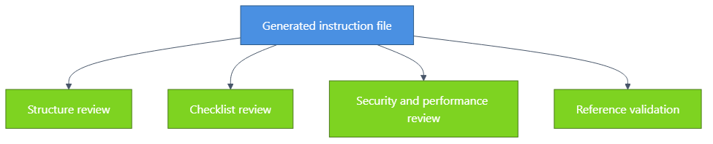
Review the Generated File Critically
Check the file structure, scope, and clarity
Ensure a validation checklist is included
Confirm the primary audience is AI assistants and the secondary audience is developers
Verify security and performance guidance is concrete
Confirm related documentation references are present and accurate
Notes:
Duration ~00:02
Explain that review is what turns an acceptable draft into a dependable working standard. Teams should inspect whether the file is actionable for the AI, readable for humans, and explicit enough to guide consistent output across sessions. Transition by introducing the role of multiple models in improving quality.
---
Source: slides\marp\technology-stack-instruction-files.deck.md

Slide 29
Use Multiple Models to Improve Quality
Model tendency | Practical takeaway
Claude Sonnet: more comprehensive | Good for broad first drafts
GPT-4: more variable | Good candidate for challenge and comparison
Notes:
Duration ~00:02
Position multi-model review as a quality-control tactic rather than a competition. Different models expose different blind spots, so having one model critique another often surfaces missing examples, incomplete checklists, or weakly stated rules. Transition by tying this evaluation loop back to the broader foundation phase of a new project.
---
Source: slides\marp\technology-stack-instruction-files.deck.md

Slide 30
Why This Matters in the Foundation Phase
1. Establish technology standards early
2. Reduce inconsistency before implementation begins
3. Give AI assistants reusable, repo-specific guidance
4. Create artifacts the team can iterate on and version-control
5. Build a stronger base for later slice planning and implementation prompts
Bottom line: better instruction files lead to more reliable implementation output.
Notes:
Duration ~00:02
Close by connecting technology instruction files to the larger greenfield workflow. These files are foundational because they shape the quality of later prompts, implementation plans, and generated code, especially when multiple people and multiple models are involved. End by suggesting that every new stack choice should trigger the question, what instruction file do we need before we start building?
---
Source: slides\marp\technology-stack-instruction-files.deck.md

Slide 31
Course Modules
Intro
Specification Driven Software Development
Architecture Specification
Technology Specification
▶ Implementation Specification
Implementation Planning
Implementation Prompts
Vertical Slice Implementation
Notes:
Auto-generated course navigation slide showing all modules with current section highlighted

Slide 32
Vertical Slicing Architecture Introduction
Features Go Vertical. Layers Go Home.
Notes:
Duration ~00:01
Welcome to the vertical slicing architecture introduction. This section explains why organizing code by feature can make complex systems easier to understand, extend, and maintain.
Open by asking how many people have had to change a feature by touching controllers, services, repositories, and models in four different folders.
Emphasize that vertical slicing is not just a folder rename. It changes how teams think about boundaries, ownership, and end-to-end feature delivery.
Transition with: "Let's define the pattern first, then compare it to the layered structure most teams already know."
---
Source: slides\marp\vertical-slicing-architecture-introduction.deck.md

Slide 33
What is a vertical slice?
A vertical slice organizes code by business feature, not by technical layer.
Each feature spans UI, validation, logic, and data access
Everything needed for the feature lives together
Slices are self-contained and intentionally independent
Features avoid direct references to other features
Changes stay localized, which improves maintainability
Think in complete user capabilities, not shared technical buckets.
Notes:
This is the core idea for the section, so spend roughly three minutes here. Explain that a slice is a full path through the system for one business capability, such as user registration or order checkout.
Point out that the goal is strong feature boundaries. A developer should be able to open one folder and understand most of what matters for that feature without navigating the whole solution.
Call out the independence rule explicitly: features should not directly reference each other. Shared abstractions can exist, but the feature itself should remain loosely coupled.
Transition with: "That definition becomes clearer when we compare the file structure side by side."
---
Source: slides\marp\vertical-slicing-architecture-introduction.deck.md

Slide 34
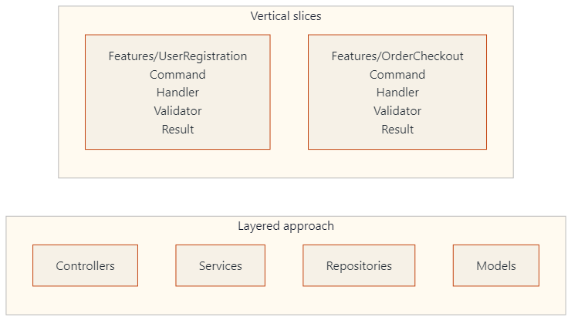
Layered folders vs. feature folders
Layered: related code is separated by technical type.
Vertical slices: all code for a feature is kept in one place.
Notes:
Duration ~00:03
Use about three minutes here and walk the audience through the diagram from left to right. In the layered view, explain that user registration logic is split across multiple folders, which creates navigation overhead and makes changes feel scattered.
Then move to the vertical slice view and show how each feature becomes a mini-application. The `Features/UserRegistration` folder contains the command, handler, validator, and any related response or data access pieces in one place.
This is a good moment to mention that enhancing one feature becomes easier because the impact area is much more visible. The file structure starts reflecting business capabilities instead of technical plumbing.
Transition with: "Once the structure changes, the day-to-day developer experience changes too."
---
Source: slides\marp\vertical-slicing-architecture-introduction.deck.md

Slide 35
Why developers like this approach
Developer experience
Faster feature development
All related code in one location
Less folder jumping during implementation
New features are less likely to disturb existing ones
Maintainability
Localized changes
Clear boundaries reduce accidental bugs
Refactoring happens inside the feature more often than across the whole app
Notes:
Duration ~00:03
Describe the common experience of implementing a new feature in a layered system, where developers bounce between folders just to follow one request from start to finish.
Contrast that with a vertical slice where the work stays mostly inside one feature folder. That reduces cognitive load and makes it easier for a developer to reason about the full behavior before they edit anything.
For maintainability, stress that the architecture makes the blast radius of a change smaller. When the boundary is clear, debugging and refactoring become safer and faster.
Transition with: "Those same boundaries also help teams collaborate and test more effectively."
---
Source: slides\marp\vertical-slicing-architecture-introduction.deck.md

Slide 36
Collaboration and testing benefits
Team collaboration
Teams can build features in parallel
Clear boundaries mean fewer merge conflicts
Ownership and responsibility are easier to assign
Testing approach
Test complete features, not isolated layers
Mock at feature boundaries
Integration becomes more straightforward
Independent development is easier with mocked dependencies
Notes:
Use about two to three minutes on this slide. Explain that feature folders create natural seams for parallel work, so two developers can often build different slices without changing the same files.
In testing, highlight that the unit of reasoning becomes the feature, not a service class in isolation. That leads to tests that better reflect user behavior and system outcomes.
You can also mention that mocking is still useful, but it tends to happen at boundaries instead of inside every technical layer. That usually produces simpler tests with clearer intent.
Transition with: "Vertical slices also pair naturally with another pattern many teams use: CQRS."
---
Source: slides\marp\vertical-slicing-architecture-introduction.deck.md

Slide 37
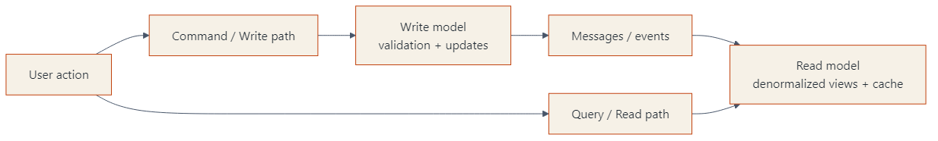
Why CQRS fits well with vertical slices
CQRS separates reads from writes
Read side can be optimized for display and performance
Write side can be optimized for business rules and updates
Messaging keeps the two stacks coordinated
A feature slice can implement both read and write concerns together
Notes:
Duration ~00:03
Explain that Command Query Responsibility Segregation separates the write path from the read path because those two concerns often want different models and optimizations.
On the read side, teams may denormalize data, cache aggressively, or build projections for fast display. On the write side, the focus is enforcing rules, validating intent, and updating authoritative data correctly.
Now connect it back to vertical slices: each feature can own both its command side and its query side. That makes CQRS feel less abstract because the pattern is implemented within a feature boundary rather than as a separate architectural island.
Transition with: "Let's close with the main ideas you want people to remember after this section."
---
Source: slides\marp\vertical-slicing-architecture-introduction.deck.md

Slide 38
Key takeaways
Organize by feature when you want stronger business boundaries
Keep everything needed for a feature in one place
Prefer independent slices over tightly coupled features
Use localized changes to improve maintainability
Consider CQRS when read and write paths have different needs
Bottom line: vertical slicing improves focus, flow, and long-term maintainability.
Notes:
Duration ~00:01
Use about one minute to close. Recap that vertical slicing is primarily about improving feature ownership and reducing the cost of change.
Reinforce that the architecture helps both individuals and teams: developers move faster, changes are easier to contain, and the codebase better reflects how the business thinks about work.
If you want an audience prompt, ask which current feature in their codebase would be easiest to convert into a first slice. That question helps bridge the presentation into practical adoption.
End by signaling that the next step is usually implementation guidance, where teams define commands, handlers, validators, and feature-level tests.
---
Source: slides\marp\vertical-slicing-architecture-introduction.deck.md

Slide 39
Course Modules
Intro
Specification Driven Software Development
Architecture Specification
Technology Specification
Implementation Specification
▶ Implementation Planning
Implementation Prompts
Vertical Slice Implementation
Notes:
Auto-generated course navigation slide showing all modules with current section highlighted

Slide 40
Vertical Slice Implementation Plans
The Blueprint Before the Blueprint
Notes:
Source: slides\marp\vertical-slice-implementation-plans.deck.md

Slide 41
Creating Vertical Slice Implementation Plans
Focus: how to plan before implementation
Goal: turn requirements into executable slices
Notes:
Open by framing this section as the bridge between architecture guidance and actual delivery planning.
Explain that vertical slices are not just a coding pattern; they are also a planning tool. The point of the section is to help the audience see how to move from requirements to a buildable roadmap.
Spend a few seconds previewing the three parts of the talk: reviewing the planning instruction file, generating implementation plans with AI, and improving those plans through multi-model evaluation.
---
Source: slides\marp\vertical-slice-implementation-plans.deck.md

Slide 42
What this section covers
Vertical slice planning instruction file
Slice identification strategies
Decomposition principles
AI-assisted implementation planning
Slice specifications and roadmaps
Notes:
Use this slide as a table of contents for the section. Keep the pace brisk and make it clear that each bullet corresponds to a practical planning step teams can repeat.
Emphasize that the section is intentionally operational. It is about making slices small enough to implement, complete enough to deliver value, and structured enough that AI can help generate plans instead of vague suggestions.
Transition by saying the first step is understanding the instruction file that defines the planning rules.
---
Source: slides\marp\vertical-slice-implementation-plans.deck.md

Slide 43
Review the planning instructions
Reference point:
.github/instructions/vertical-slice-planning.instructions.md
What it provides:
Strategy selection guidance
Decomposition rules
Dependency analysis prompts
Slice definition templates
Notes:
Introduce the instruction file as the planning playbook. It tells both humans and AI how to reason about a feature before code is written.
Call out that a strong instruction file improves consistency. Instead of every plan starting from scratch, the team gets a repeatable way to identify slices, document dependencies, and define an implementation sequence.
Mention that the file is valuable even when AI is not involved because it clarifies how the team wants work decomposed.
---
Source: slides\marp\vertical-slice-implementation-plans.deck.md

Slide 44
Slice identification strategies
Strategy | Best fit
User action decomposition | End-to-end user flows
Entity CRUD operations | Simple data management
Workflow stage decomposition | Multi-step processes
Business event decomposition | Event-driven behavior
CQRS-optimized slicing | Distinct read/write paths
Notes:
Walk the audience through the five strategies and explain that no single strategy is always correct. The right one depends on the kind of behavior being modeled.
For user action decomposition, use an example like "submit order" or "reset password." For CRUD, use admin maintenance screens. For workflow stages, mention onboarding or approvals. For business events, use order placed or payment failed. For CQRS, explain separating queries from commands when reads and writes differ significantly.
Stress that the planning file helps choose a strategy rather than forcing one pattern onto every feature.
---
Source: slides\marp\vertical-slice-implementation-plans.deck.md

Slide 45
Decomposition principles
Single responsibility per slice
Complete vertical stack from UI/API to data
No horizontal sharing as the unit of delivery
Minimize external dependencies
Size slices to be valuable and manageable
Rule of thumb
Avoid slices that are too big to finish or too small to matter.
Notes:
This slide defines the quality bar for a slice. Explain that a slice should deliver one meaningful capability and contain everything needed to implement that capability end to end.
Clarify "no horizontal sharing" by contrasting a real slice with a layer-based task such as "build all repositories first." Horizontal work may still exist, but it should not become the primary planning unit.
Use the phrase "valuable and manageable" more than once. That is the balance teams often miss when they either create giant epics or tiny technical chores that produce no user value.
---
Source: slides\marp\vertical-slice-implementation-plans.deck.md

Slide 46
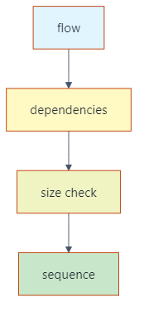
Analyze before you slice
Ask these questions first:
What data does this slice read or change?
What services or APIs does it depend on?
Can it be deployed independently?
Does a different strategy fit better?
Notes:
Explain that slicing is not just naming features. It requires examining data dependencies and service dependencies before locking in the plan.
Walk through the decision aid from left to right. Start with the flow, then look at dependency boundaries, then check whether the proposed slice is too large or too fragmented, and finally place it into an execution sequence.
This is a good moment to remind the audience that planning errors often come from ignoring dependencies until implementation begins.
---
Source: slides\marp\vertical-slice-implementation-plans.deck.md

Slide 47
Generate plans with AI
Example prompt:
Using vertical slice planning instructions and web calculator requirements, create implementation plan using vertical slices.
AI can generate:
Requirements summary
Slice decomposition
Dependency diagram
Implementation order
Sprint organization
Notes:
Explain that the prompt works because it combines two inputs: the planning instructions and the actual feature requirements. Without both, the output is usually too generic.
Point out that this is where AI becomes a planning accelerator. Instead of starting from a blank page, the team gets a draft plan containing slices, dependencies, sequencing, and potential sprint structure.
Also note that the prompt is intentionally simple. The quality comes from the instruction file and source requirements, not from a complicated prompt.
---
Source: slides\marp\vertical-slice-implementation-plans.deck.md

Slide 48
What a good AI plan should include
1. Clear summary of requirements
2. Identified slices with rationale
3. Dependency relationships
4. Proposed implementation sequence
5. Sprint or milestone grouping
Watch for model differences
More detail vs. more concise output
Different naming and grouping choices
Different sequencing assumptions
Notes:
Use this slide to define evaluation criteria for AI-generated plans. The audience should leave knowing what "good" looks like, not just that AI can produce something.
Explain that different models may emphasize different aspects. One might provide stronger rationale, another might produce cleaner sequencing, and another might be better at summarizing requirements.
Encourage the audience to compare outputs rather than assuming the first plan is correct. This leads naturally into the multi-model review exercise.
---
Source: slides\marp\vertical-slice-implementation-plans.deck.md

Slide 49
Example planning flow
Web calculator example
1. Summarize calculator requirements
2. Identify slices such as input, operations, history, validation
3. Map data and service dependencies
4. Sequence foundational slices before enhancements
5. Group slices into sprints
Notes:
Translate the abstract process into a concrete example. Use the calculator scenario because it is simple enough to understand quickly while still showing real decomposition choices.
Mention that one model may group input and validation together, while another may separate them. One may treat history as a later slice because it depends on completed calculations. These are exactly the kinds of planning differences worth discussing.
Reinforce that the output is not just a list of tasks. It is a roadmap with ordering logic.
---
Source: slides\marp\vertical-slice-implementation-plans.deck.md

Slide 50
Multi-model evaluation
Review planning file for gaps:
1. Missing task duration metadata
2. Incomplete decomposition examples
3. Incomplete dependency strategy examples
4. Unfinished implementation sequencing examples
5. Incomplete roadmap template
6. Incomplete slice specification template
Notes:
Present this as a quality-improvement exercise, not a competition between models. The value comes from using one model to review the blind spots of another.
Walk through the six findings quickly and frame them as practical improvements. These are not cosmetic issues; they affect whether teams can actually use the planning artifact consistently.
Highlight that evaluation uncovered missing completeness in examples and templates, which matters because templates are what guide future AI generations.
---
Source: slides\marp\vertical-slice-implementation-plans.deck.md

Slide 51
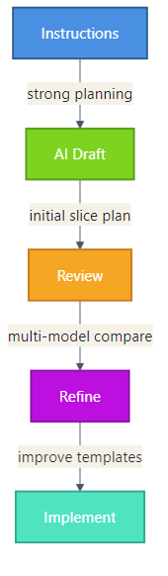
Key takeaway
Recommended workflow
Start with a strong planning instruction file
Generate an initial vertical slice plan
Compare outputs across models when useful
Improve templates and examples over time
Notes:
Close with the repeatable workflow. This gives the audience a practical method they can adopt immediately.
Emphasize that the instruction file is the stable asset, AI provides the first draft, and multi-model review improves quality. Over time, the planning assets themselves get better, which improves every future plan.
End by connecting this section to execution: once the slices and roadmap are solid, implementation becomes faster, safer, and easier to parallelize.
---
Source: slides\marp\vertical-slice-implementation-plans.deck.md

Slide 52
Dependency Analysis and Planning
Everything Depends on This Slide (Literally)
Notes:
Source: slides\marp\dependency-analysis-planning.deck.md

Slide 53
Dependency Analysis and Planning
Section focus: using dependency graphs to sequence vertical slice implementation
Outcome: show how teams identify prerequisites, parallel work, and the critical path
Notes:
Duration ~00:04
Introduce this section as the point where planning becomes executable rather than aspirational. Explain that dependency analysis helps the team decide what must be built first, what can safely wait, and what can happen in parallel without creating blockers. Transition by showing a simple dependency graph and explaining how to read it.
---
Source: slides\marp\dependency-analysis-planning.deck.md

Slide 54
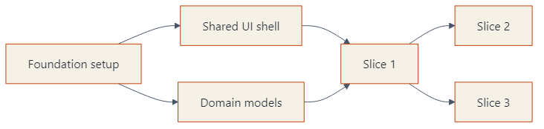
Read the Dependency Diagram
Nodes represent slices, features, or enabling work
Arrows show that one item depends on another being complete first
Read from left to right or top to bottom to understand sequencing
Look for root nodes with no prerequisites
Notes:
Duration ~00:01
Explain that a dependency graph is a visual map of implementation order, not just a picture of the system. Root nodes such as foundation setup are important because they unlock other work, while downstream nodes cannot start safely until their prerequisites exist. Transition by asking which path through the graph will determine overall progress.
---
Source: slides\marp\dependency-analysis-planning.deck.md

Slide 55
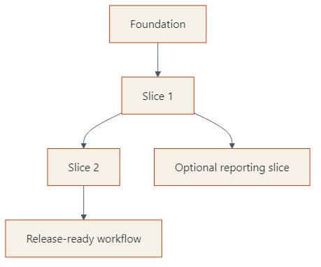
Find the Critical Path
The critical path is the longest chain of dependent work
Delays on that path delay the overall implementation plan
Independent branches matter, but they do not all block delivery equally
Focus coordination and risk management on the path that controls completion
Notes:
Duration ~00:01
Make the point that not every task has the same scheduling weight. The chain from foundation through Slice 1 and Slice 2 to release readiness is the critical path because a delay anywhere in that line affects the final delivery date. Transition by showing that some branches can still be parallelized once the right prerequisites are in place.
---
Source: slides\marp\dependency-analysis-planning.deck.md

Slide 56
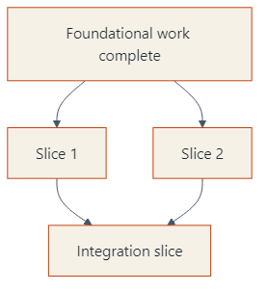
Sequence First, Parallelize Second
Some slices are strictly sequential because they share prerequisites
Other slices can run in parallel after the same foundation is done
Parallel work increases speed only when dependencies are already satisfied
Planning should prevent teams from starting blocked work too early
Notes:
Duration ~00:01
Explain that parallelization is useful, but only after the common enabling work is complete. In this example, Slice 1 and Slice 2 can move at the same time, yet the integration slice must wait until both are finished, so sequencing still matters. Transition by separating foundational work from dependent features so the audience can see how to prioritize the backlog.
---
Source: slides\marp\dependency-analysis-planning.deck.md

Slide 57
Distinguish Foundational and Dependent Features
Foundational work
environments, shared components, core models, base services
Dependent features
user-facing slices that rely on those shared capabilities
Planning rule
finish enabling work first when many later slices depend on it
Notes:
Duration ~00:01
Clarify that foundational work is valuable because it unlocks many downstream slices, not because it is glamorous. Dependent features usually deliver visible business value, but they become risky or inefficient if the core infrastructure they need is missing or unstable. Transition by summarizing a lightweight planning process the team can repeat for every implementation plan.
---
Source: slides\marp\dependency-analysis-planning.deck.md

Slide 58
Use Dependency Analysis to Plan the Roadmap
1. List slices and enabling work
2. Draw the dependency relationships
3. Identify the critical path
4. Mark which branches can run in parallel
5. Schedule foundational work before dependent features
Bottom line: dependency graphs turn a feature list into a realistic implementation sequence.
Notes:
Duration ~00:01
Close by turning the concept into a repeatable planning workflow. The audience should leave with the idea that dependency analysis is a small upfront investment that prevents scheduling confusion, blocked development, and unrealistic sequencing later. End by connecting this back to vertical slices, where smart sequencing makes incremental delivery much easier.
---
Source: slides\marp\dependency-analysis-planning.deck.md

Slide 59
Course Modules
Intro
Specification Driven Software Development
Architecture Specification
Technology Specification
Implementation Specification
Implementation Planning
▶ Implementation Prompts
Vertical Slice Implementation
Notes:
Auto-generated course navigation slide showing all modules with current section highlighted

Slide 60
Implementation Prompts and Verification
The Prompt That Does the Implementation (With a Checklist)
Notes:
Source: slides\marp\implementation-prompts-verification.deck.md

Slide 61
Implementation Prompts and Verification
Section focus: turning slice plans into actionable build prompts
Outcome: show how to generate slice-specific prompts, verify behavior, and prepare stakeholder demos
Notes:
Duration ~00:22
Introduce this section as the bridge between planning and actual implementation. The audience should understand that a slice plan becomes much more useful when it is converted into a precise prompt that tells the AI what to build, how to verify it, and how to demonstrate it. Transition by asking what information a good implementation prompt must capture before any code is generated.
---
Source: slides\marp\implementation-prompts-verification.deck.md

Slide 62
Start from a Single Slice
Choose one slice from the implementation plan
Example: Slice 1 - Display Current Value
Use the slice instructions plus the implementation plan as source context
Write one prompt file per slice so scope stays narrow and testable
Notes:
Duration ~00:02
Explain that the best implementation prompts are intentionally narrow. Rather than asking for an entire application, the team picks one slice from the plan and turns that into a focused request that can be reviewed and tested independently. Transition by showing what the actual prompt needs to contain once the slice is chosen.
---
Source: slides\marp\implementation-prompts-verification.deck.md

Slide 63
What the Implementation Prompt Should Say
Reference the slice instructions and the implementation plan directly
Ask the model to implement the selected slice
Require verification steps in the output
Require showcase instructions for stakeholder demonstration
Prompt pattern
Using slice X instructions and implementation plan, create a prompt file that implements slice 1. Include verification steps and showcase instructions that demonstrate the functionality to stakeholders.
Notes:
Duration ~00:03
Frame this slide around prompt construction, not just prompt wording. The important move is that the request names the slice, points to the governing instructions, and asks for more than code generation by explicitly requiring verification and demonstration guidance. Transition by breaking down the expected deliverables inside the generated prompt file.
---
Source: slides\marp\implementation-prompts-verification.deck.md

Slide 64
Expected Deliverables Inside the Prompt File
Files to create
index.html
styles.css
main.js
Specifications to include
HTML structure requirements
CSS colors, fonts, spacing, and layout
JavaScript behavior for current value, display object, and update function
File structure and component organization
Notes:
Duration ~00:03
Walk through the prompt output as if you are reviewing a generated file with the class. The goal is not merely to list filenames, but to show that the prompt should describe what each file is responsible for and how the pieces fit together. Transition by moving from implementation detail to the checks that prove the slice actually works.
---
Source: slides\marp\implementation-prompts-verification.deck.md

Slide 65
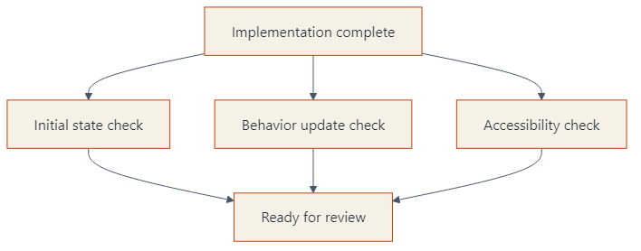
Build Verification into the Prompt
Initial state: calculator displays 0 on page load
State update: changing the value in the console updates the display
Accessibility: contrast ratio >= 4.5:1 and font size >= 2rem
Include both automated testing guidance and manual verification steps
Notes:
Duration ~00:04
Explain that verification should be authored before or alongside implementation, not after the fact. The checks on this slide are strong examples because they cover default state, observable behavior, and accessibility requirements in a way that reviewers and demonstrators can both understand. Transition by showing how showcase instructions differ from verification even though the two are related.
---
Source: slides\marp\implementation-prompts-verification.deck.md

Slide 66
Showcase Instructions Should Target Humans
Do more than paste a code snippet
Describe what users see and what they can do
Call out the behavior the demonstrator should point to
Provide an interactive demo path for stakeholders
Good showcase guidance includes
1. starting state on screen
2. action to take
3. visible result
4. why it matters to the audience
Notes:
Duration ~00:03
Make the distinction between proving correctness and presenting value. Verification asks whether the slice works; showcase guidance tells a human demonstrator how to walk stakeholders through what appears on screen, what changes, and why they should care. Transition by expanding from one slice to the broader roadmap of multiple prompts.
---
Source: slides\marp\implementation-prompts-verification.deck.md

Slide 67
Repeat the Pattern Across All Slices
Create additional prompt files for Slice 2, Slice 3, and so on
Version-control each prompt so changes stay traceable
Reuse prompts later for revisions or follow-on work
Execute slices sequentially and review each result before moving on
Build a complete implementation roadmap with systematic verification
Bottom line: slice-specific prompts create a repeatable path from plan to implementation to review.
Notes:
Duration ~00:03
Close by connecting the single-slice example to the full delivery workflow. Each prompt becomes a reusable unit of work that can be re-run, refined, and audited over time, which is especially useful when implementation spans multiple sessions or contributors. End by encouraging the audience to treat prompt files as versioned implementation assets, not disposable chat text.
---
Source: slides\marp\implementation-prompts-verification.deck.md

Slide 68
Course Modules
Intro
Specification Driven Software Development
Architecture Specification
Technology Specification
Implementation Specification
Implementation Planning
Implementation Prompts
▶ Vertical Slice Implementation
Notes:
Auto-generated course navigation slide showing all modules with current section highlighted

Slide 69
Basic Vertical Slice Workflow
Thin Slices, Big Results
Notes:
Source: slides\marp\basic-vertical-slice-workflow.deck.md

Slide 70
Basic Vertical Slice Implementation Workflow
Goal: deliver working software in thin, end-to-end slices
Pattern: plan dependencies first, then parallelize safe slices
Outcome: faster feedback and lower integration risk
Notes:
Introduce the deck as a practical delivery workflow, not just an architecture concept. Emphasize that each vertical slice includes API, domain logic, persistence, and tests. Mention that parallel work is possible only after dependency analysis confirms slice independence.
---
Source: slides\marp\basic-vertical-slice-workflow.deck.md

Slide 71
Step 1: Define Slice Boundaries
Start from user-visible use cases
Split by business capability, not technical layer
Keep each slice independently testable
Write a short definition for every slice:
Scope
Inputs/outputs
Done criteria
Notes:
Explain that teams should avoid horizontal tasks like build all repositories first. Reinforce that each slice should produce demonstrable value. Recommend a short template for each slice so implementation and review stay consistent.
---
Source: slides\marp\basic-vertical-slice-workflow.deck.md

Slide 72
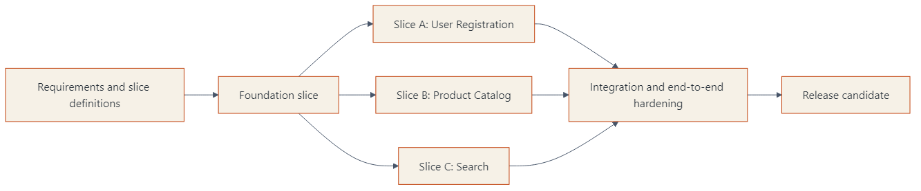
Step 2: Build the Implementation Plan
Identify dependency chain first
Mark slices as:
Foundation (must go first)
Parallel-ready (can run together)
Integration/cleanup (must go last)
Sequence by risk and coupling
Notes:
Walk left to right. Call out that Foundation might include authentication baseline, shared contracts, and CI setup. Then point to slices A, B, and C as intentionally parallel lanes. Close by explaining that integration hardening is a separate explicit phase.
---
Source: slides\marp\basic-vertical-slice-workflow.deck.md

Slide 73
Step 3: Execute Slices in Parallel
Assign owners per slice lane
Use trunk-based integration with short-lived branches
Keep contracts stable and versioned
Demo each slice as soon as done
Parallel execution guardrails:
No hidden cross-slice dependencies
Shared schema changes reviewed early
Contract tests required before merge
Notes:
Emphasize team coordination practices. Explain that parallel work fails when contracts are ambiguous. Recommend daily integration checks and a lightweight dependency board to catch collisions early.
---
Source: slides\marp\basic-vertical-slice-workflow.deck.md

Slide 74
Step 4: Integrate, Validate, and Stabilize
Run full end-to-end and regression tests
Validate non-functional requirements:
Performance
Security
Observability
Close documentation and operational runbooks
Freeze only when release criteria are met
Notes:
Describe this as controlled convergence, not a big bang merge. Point out that each slice already passed its own checks, so this phase focuses on system behavior and production readiness. Encourage using release checklists to avoid late surprises.
---
Source: slides\marp\basic-vertical-slice-workflow.deck.md

Slide 75
AI Practitioner Resources
AI-Generated Code in Regulated Industries: Compliance Risks and Auditable Controls
https://www.youtube.com/live/x2ol57f9pv8?si=O-v3rTNahDHM6Pl_
LinkedIn: www.linkedin.com/in/johnmichaelmiller
Email: john.miller@codegroup.io
Blogs:
codemag.com/blog/AIPractitioner
blog.pdata.com
https://blog.pdata.com/AIPR1/

Slide 76


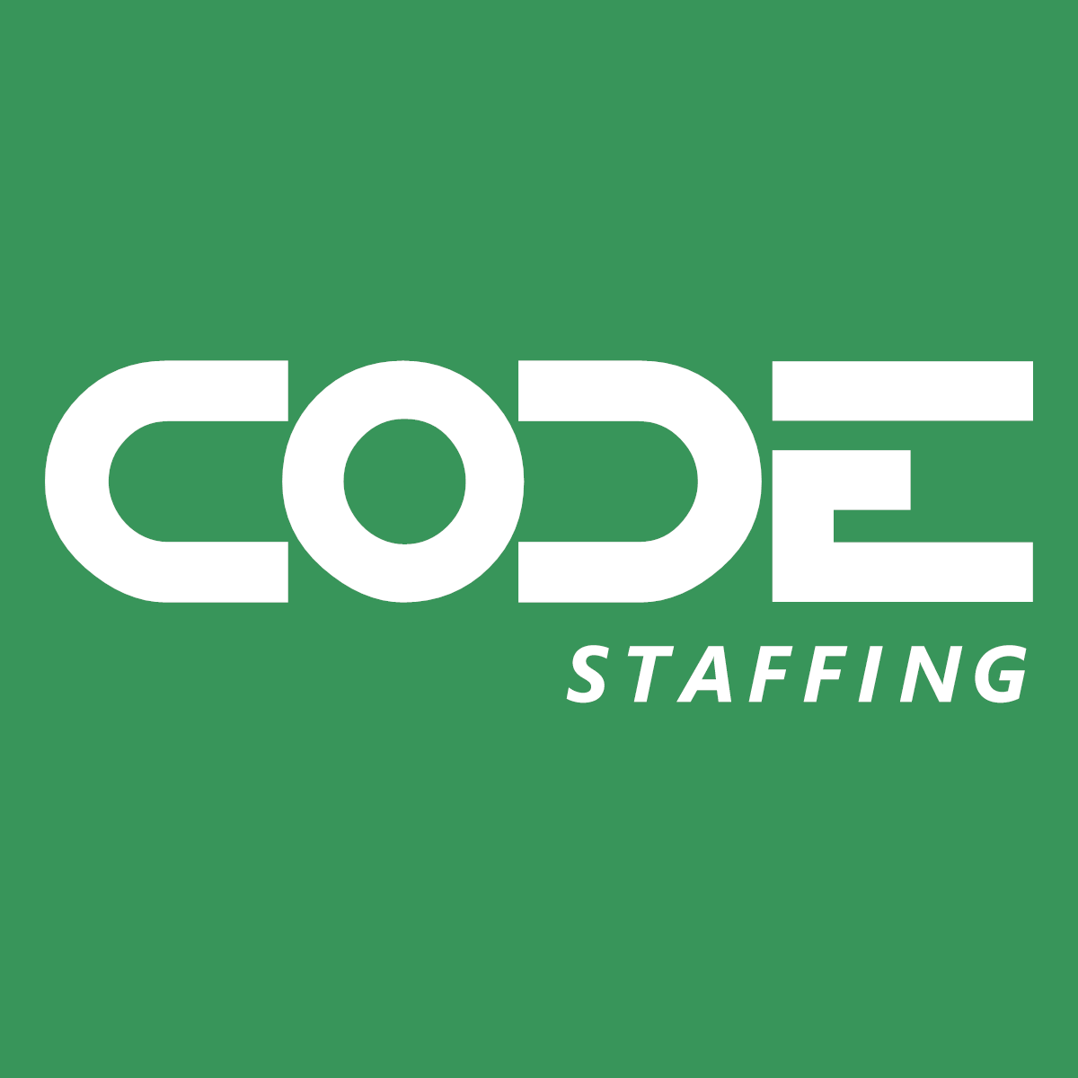

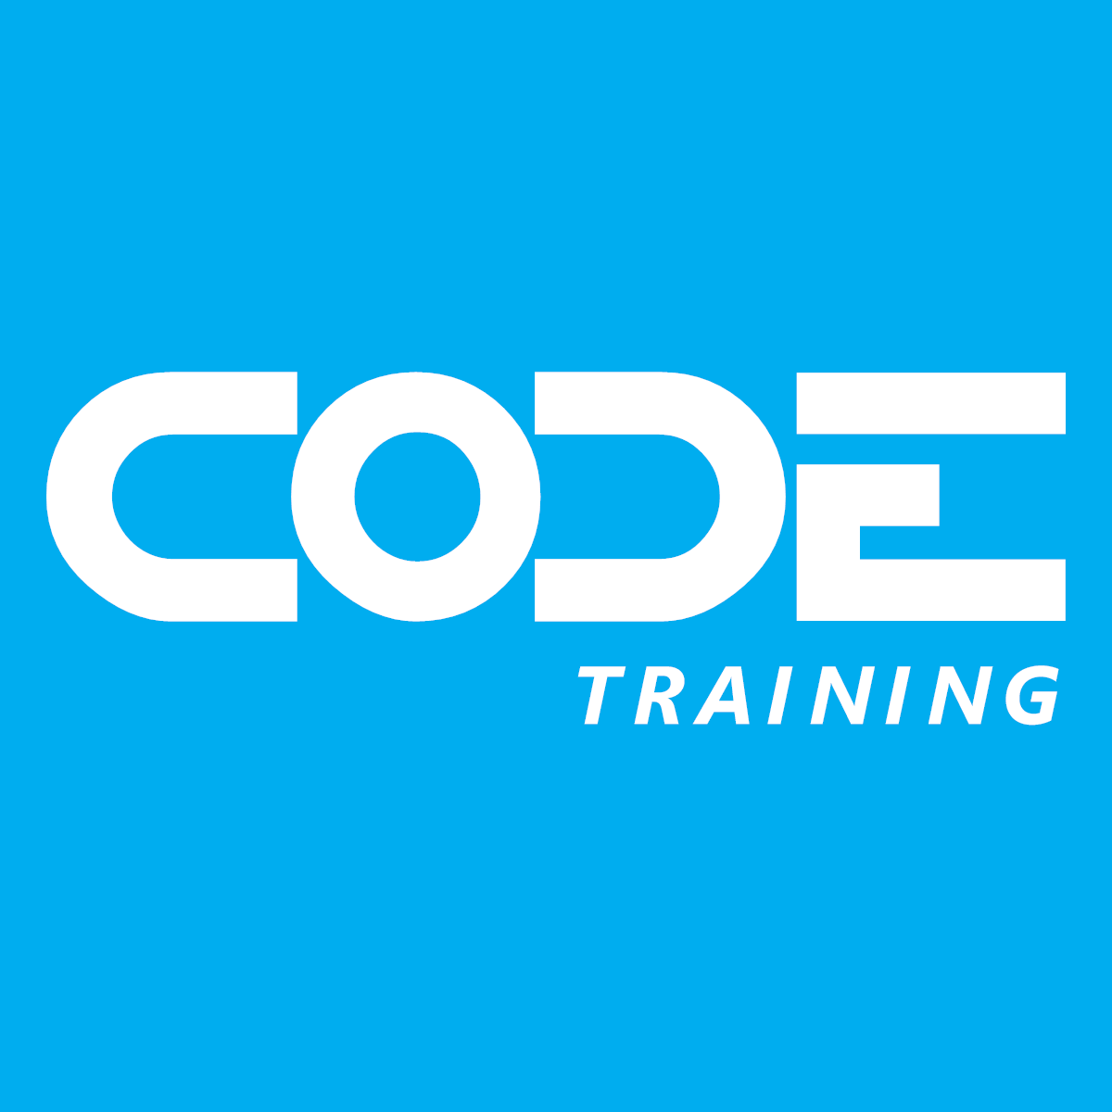
30 years of “Helping People Build Better Software”
Notes:
CODE is a custom software company, a staff augmentation company, CODE Magazine for software developers, and training like this webinar. We've been in business for 30 years and the magazine just hit its 25th anniversary. Visit the website at https://www.codemag.com/ for more details.

