Slide 1
Friday Finish Strong
Notes:
Frame this opener as a confident start to the final session segment.
Celebrate the week's progress and prepare the room for focused execution.
---
Source: slides\marp\welcome-back-friday.deck.md

Slide 2
Welcome Back to AI-Assisted Software Development
Happy to have everyone back and ready to close out the week
We will connect today's work to everything we have practiced so far
Your participation helps turn concepts into usable skills
Keep the questions coming throughout - curiosity drives the best outcomes.
Notes:
Duration ~00:02
Welcome the group and recognize cumulative effort from earlier sessions. Position the day as both reinforcement and completion of key learning goals. Encourage participants to ask practical questions tied to their own projects. Transition by highlighting the first activity and expected takeaway.
---
Source: slides\marp\welcome-back-friday.deck.md

Slide 3
Course Modules
Intro
▶ Specification Driven Software Development
Architecture Specification
Technology Specification
Implementation Specification
Implementation Planning
Implementation Prompts
Vertical Slice Implementation
Notes:
Auto-generated course navigation slide showing all modules with current section highlighted

Slide 4
But first…
https://github.com/j0hnnymiller/20260921-aiasd-green

Slide 5
Getting Started Checklist
The Recipe Before the Meal
Notes:
Source: slides\marp\getting-started-checklist.deck.md

Slide 6
High Level AI Assisted Workflow
From Requirements to a Solution
Stakeholders such as SMEs, architects, SREs, and DBAs define the requirements with AI assistance.
  AI transforms the requirements into implementation instruction files that guide the work.
Stakeholders review, improve, and approve the instruction files.
  AI uses those instruction files to create prompts that implement the business requirements.
  Implementation prompts explain how the feature should be built and how acceptance criteria should be verified.
Stakeholders review, improve, and approve the implementation prompts.
  Submitting the implementation prompts produces an implementation that conforms to the instruction files and meets the acceptance criteria.
Stakeholders review and approve the resulting implementation.
Notes:
Walk the audience through the lifecycle from left to right and keep the focus on the review gates between each AI-generated artifact. Stress that requirements are not handed directly to code generation; instead, they are refined into instruction files and then into implementation prompts, with stakeholder approval at each stage. Use the diagram to reinforce that this is a controlled pipeline where AI accelerates each step but humans still own correctness, safety, and acceptance. End by linking this workflow back to the checklist on the previous slides: foundation, automation, specialization, and integration all support this end-to-end model.
---
Source: slides\marp\getting-started-checklist.deck.md

Slide 7
AI-Assisted Business Requirement Specification
From Conversations to Verifiable Intent
The goal is not more documentation.
The goal is shared understanding that can guide design, implementation, and acceptance.
Notes:
Duration ~00:02
Open by asking participants where business requirements currently live: meeting notes, tickets, spreadsheets, email, or people's memories. Explain that AI can help turn this scattered input into a structured specification, but only the business can confirm whether the meaning is right. Set the central expectation for the session: AI accelerates analysis and drafting; stakeholders remain accountable for intent and decisions. Transition by distinguishing a useful specification from a polished document.
---
Source: slides\marp\ai-assisted-business-requirement-specification.deck.md

Slide 8
What Makes a Requirement Useful?
A useful requirement is:
Bounded — names the business capability and its scope
Observable — describes behavior someone can verify
Traceable — connects intent to rules, use cases, and acceptance criteria
Prioritized — makes value and tradeoffs visible
Owned — identifies who can confirm or change it
If two reasonable readers can implement different behaviors, the requirement is not finished.
Notes:
Duration ~00:03
Walk through the five qualities and emphasize observable behavior. A sentence such as “the system should be easy to use” may express a concern, but it does not yet define something a team can build or test. Ask the group to identify which quality is missing from one of their current requirements. Transition to the context that AI needs before it can help with this work.
---
Source: slides\marp\ai-assisted-business-requirement-specification.deck.md

Slide 9
Start With Business Context, Not a Blank Prompt
Before asking AI to draft requirements, collect:
Outcome — what business result should improve?
Actors — who performs, receives, approves, or is affected?
Current state — how does the work happen today?
Constraints — policy, legal, timing, budget, technology, or organizational limits
Evidence — source documents, examples, measures, decisions, and open questions
Context packet
purpose + domain vocabulary + current workflow + known constraints + questions
Notes:
Duration ~00:03
Explain that a blank prompt invites the model to fill gaps with plausible but invented assumptions. A context packet gives the model material to organize and challenge instead. Demonstrate the difference between “write requirements for a promotion system” and a prompt containing the actors, existing workflow, policy constraints, and real examples. Make clear that source material should be labeled by authority and that sensitive information should be minimized before it reaches an AI system.
---
Source: slides\marp\ai-assisted-business-requirement-specification.deck.md

Slide 10
From Narrative to Requirement Model
AI can accelerate each transformation, but every arrow needs review.
Notes:
Duration ~00:03
Use this flow as the backbone of the session. Explain that the transformations are connected: a use case without its governing rule can be incomplete, and acceptance criteria without a business outcome can optimize the wrong thing. AI is useful for extracting candidates, grouping related statements, finding contradictions, and proposing questions. It should not silently decide which interpretation is authoritative. Transition by looking at the individual building blocks.
---
Source: slides\marp\ai-assisted-business-requirement-specification.deck.md

Slide 11
Extract Business Rules Explicitly
Rule type | Example | Review question
Eligibility | An academic must complete probation before promotion | What evidence proves eligibility?
Calculation | Promotion review uses the current academic year | Which dates and exceptions apply?
Authorization | A department chair approves the recommendation | Who may approve, reject, or delegate?
Timing | An appeal must be submitted within 10 working days | What counts as a working day?
Integrity | A submitted review cannot be changed without an audit trail | What must be retained?
Notes:
Duration ~00:04
Explain that rules are more durable than screen descriptions because they express domain decisions. Invite participants to notice the review questions in the last column; these expose hidden assumptions that a draft requirement often misses. Ask AI to extract candidate rules with a source reference and confidence note rather than asking it to invent a complete rule set. Stress that a rule becomes implementation guidance only after the responsible subject matter expert confirms its wording and exceptions.
---
Source: slides\marp\ai-assisted-business-requirement-specification.deck.md

Slide 12
Identify Actors and Use Cases
Actors
Initiator: starts the business activity
Participant: supplies information or performs a step
Approver: makes a governed decision
Recipient: consumes the outcome
System or external service: exchanges information at a boundary
Use-case shape
As a [actor], I need to [capability], so that [business outcome].
Add: trigger, preconditions, main flow, alternatives, exceptions, and result.
Notes:
Duration ~00:04
Clarify that an actor is a role in the business interaction, not necessarily a software user account. Use “submit a promotion recommendation” as a quick example and ask who initiates it, who supplies evidence, who approves it, and who receives the decision. The use-case sentence captures value, while the detailed flow captures behavior and exceptions. Have AI propose missing actors and alternate flows, then ask stakeholders to confirm whether those roles and outcomes exist in the real process.
---
Source: slides\marp\ai-assisted-business-requirement-specification.deck.md

Slide 13
Prompt AI to Analyze, Not to Pretend
A strong analysis prompt assigns bounded work:
You are a business analyst supporting a domain expert.
Using only the supplied context:
1. Extract candidate business rules and cite each source.
2. Identify actors, triggers, outcomes, and exceptions.
3. Separate facts, interpretations, and open questions.
4. Flag contradictions and missing decisions.
5. Do not invent policy. Mark unknowns as [NEEDS DECISION].
Return a structured draft for stakeholder review.
The discipline: ground, label, challenge
Notes:
Duration ~00:04
Read the prompt pattern aloud and point out the guardrails: supplied context, source citations, explicit unknowns, and a request to challenge contradictions. This changes AI from an answer generator into a structured analysis assistant. Explain that “do not invent policy” is necessary but not sufficient; reviewers still need to inspect the result against authoritative sources. Encourage teams to save prompts alongside the resulting specification when reproducibility matters.
---
Source: slides\marp\ai-assisted-business-requirement-specification.deck.md

Slide 14
Make Requirements Testable
Convert intent into acceptance criteria that describe observable outcomes.
Example
Vague: The coordinator can manage promotion reviews easily.
Testable: Given an eligible academic and a complete evidence set, when the coordinator submits a promotion recommendation, then the system records the submitter, timestamp, evidence references, and review status, and displays the next responsible role.
Check for
Given / when / then conditions
Success and rejection paths
Boundary values and timing rules
Authorization and audit behavior
Notes:
Duration ~04:00
Contrast the vague and testable statements carefully. The second statement exposes preconditions, the action, stored facts, the resulting state, and the next responsibility. Ask participants which additional acceptance criteria are needed for an incomplete evidence set, an unauthorized submitter, and a late submission. AI can generate scenario variations, but the business owner must confirm that each scenario represents an intended outcome rather than a model-generated edge case.
---
Source: slides\marp\ai-assisted-business-requirement-specification.deck.md

Slide 15
Review the Draft Like a Skeptic
Use an evidence-based review pass:
1. Completeness — what important actor, rule, flow, or exception is absent?
2. Consistency — do terms, states, dates, and rules agree?
3. Ambiguity — which words permit multiple interpretations?
4. Feasibility — can the organization provide the data, authority, and process?
5. Traceability — can every requirement point back to intent and forward to validation?
6. Risk — what could harm people, policy compliance, privacy, or operations?
A confident draft is not evidence of a correct draft.
Notes:
Duration ~03:00
Frame review as a separate activity from drafting. Ask one reviewer to look for omissions, another for contradictions and ambiguous language, and a domain owner for policy and feasibility. AI is particularly helpful as a second-pass critic when given a defined checklist and the original sources. Require every finding to include the affected statement, the reason it is a problem, and a proposed question or resolution path.
---
Source: slides\marp\ai-assisted-business-requirement-specification.deck.md

Slide 16
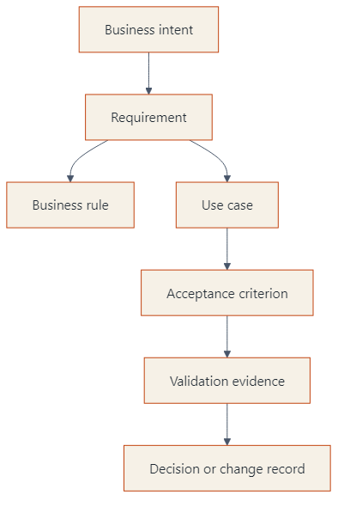
Keep a Traceability Chain
Useful identifiers
BR-004 · UC-012 · AC-012-03 · DEC-007
Traceability makes change impact and review gaps visible.
Notes:
Duration ~03:00
Explain that identifiers are lightweight handles, not bureaucracy for its own sake. When a policy changes, the chain helps the team find affected use cases, criteria, tests, and decisions. Ask participants to imagine changing the appeal window from 10 to 15 working days and identify what should be reviewed. AI can help maintain cross-references and detect orphaned criteria, but the source of truth must remain a controlled repository or approved requirements system.
---
Source: slides\marp\ai-assisted-business-requirement-specification.deck.md

Slide 17
A Repeatable AI-Assisted Workflow
Stage | Human responsibility | AI assistance
Discover | Provide context and identify authorities | Organize notes and extract vocabulary
Model | Confirm actors, rules, and boundaries | Propose structure and relationships
Draft | Decide intended behavior | Write candidate requirements and scenarios
Challenge | Resolve ambiguity and contradictions | Run review checklists and find gaps
Validate | Approve acceptance criteria | Generate scenario variations and trace links
Baseline | Own the version and decisions | Summarize changes and impacted artifacts
Notes:
Duration ~04:00
Walk down the table and emphasize the alternating pattern of AI assistance and human decision. The workflow is intentionally iterative: discovery can reveal new context, and validation can expose a requirement that needs to be redrafted. Explain that approval should be explicit, with named owners and versioned decisions. This approach keeps acceleration without outsourcing accountability.
---
Source: slides\marp\ai-assisted-business-requirement-specification.deck.md

Slide 18
Practice: Turn a Request Into a Specification Seed
Request
“We need to improve the way faculty promotion reviews are handled.”
Ask AI to produce
Five clarifying questions, prioritized by risk
Candidate actors and one end-to-end use case
Candidate rules, each labeled FACT, INTERPRETATION, or NEEDS DECISION
Three acceptance criteria, including one rejection path
A list of evidence still required from stakeholders
Deliverable
A one-page draft that a domain expert can correct.
Notes:
Duration ~04:00
Give participants a short timebox to use the request and the prompt pattern from the earlier slide. Tell them not to ask for a finished requirements document; ask for a specification seed that makes uncertainty visible. During the debrief, compare which questions were prioritized and whether the proposed rules were grounded or invented. Close the exercise by having the group identify the smallest decision that would unlock the next slice of work.
---
Source: slides\marp\ai-assisted-business-requirement-specification.deck.md

Slide 19
The Specification Readiness Check
Before implementation, can the team answer yes?
Do we know the business outcome and scope?
Are actors, rules, states, and exceptions explicit?
Are unknowns and decisions clearly labeled?
Can each requirement be validated by observable evidence?
Can we trace it to source intent and forward to acceptance?
Has the accountable domain owner approved the behavior?
Are privacy, security, accessibility, and operational risks addressed?
Notes:
Duration ~02:00
Use this as a closing self-assessment rather than a lecture. Ask participants to choose one current requirement and score it against the checklist. Any “no” is useful: it identifies the next question or decision, not a failure of the process. Emphasize that readiness is about shared understanding and evidence, not document length.
---
Source: slides\marp\ai-assisted-business-requirement-specification.deck.md

Slide 20
Exercise: Business Requirements Generation
Let the AI Write the Requirements for Once
Notes:
Source: slides\marp\exercise\exercise-business-requirements-generation.deck.md

Slide 21
Exercise: Business Requirements Generation
Objectives
  Create a business requirements document for the calculator project
  Use the Product Manager agent with existing instruction files
  Apply the expected branch and repository workflow for Greenfield work
  Validate the requirements draft through review, clarification, and independent iteration
Activities
  1. Create a personal branch from the main branch in the Greenfield class repository.
  2. Use the Product Manager agent to generate a calculator requirements document.
  3. Apply the existing instruction files to improve scope, structure, and consistency.
4. Confirm repository choice, branching strategy, and how to handle any existing PRD content before continuing.
5. Work independently on the requirements document while the instructor provides check-ins and support.
Success Criteria
  A calculator business requirements document exists on the correct personal branch
  The Product Manager agent and instruction files are both used effectively
  Repository and branching decisions are applied correctly and consistently
  Participants can explain what changed after clarifications and independent refinement
Notes:
Duration ~00:17
**Prerequisites:** Access to the Greenfield branch, ability to create a personal branch, and access to the Product Manager agent plus the repository instruction files
Use this exercise to establish the Greenfield workflow discipline early. Start by making participants branch from Greenfield before they do any prompting so the requirements artifact has a clean ownership path and can be reviewed independently later. In the first few minutes, emphasize that the goal is not to produce a perfect PRD in one pass, but to create a usable calculator requirements document using the Product Manager agent together with repository guidance. During the clarification window, call out the common confusion points explicitly: correct repository, personal branch strategy, what to do with any existing PRD material, and that tooling differences between Visual Studio and VS Code are secondary to getting the requirements quality right. For the working block, let students operate independently, but use periodic check-ins to see whether instruction files improved the output and whether anyone is stuck on scope, branching, or prompt quality. Transition from this exercise by connecting the completed requirements document to the next Greenfield planning steps, especially technology instructions, slice planning, and implementation prompts.
---
Source: slides\marp\exercise\exercise-business-requirements-generation.deck.md

Slide 22
Course Modules
Intro
Specification Driven Software Development
▶ Architecture Specification
Technology Specification
Implementation Specification
Implementation Planning
Implementation Prompts
Vertical Slice Implementation
Notes:
Auto-generated course navigation slide showing all modules with current section highlighted

Slide 23
AI-Assisted Software Architecture
Designing Systems with an AI Co-Architect
Notes:
Source: slides\marp\ai-assisted-software-architecture.deck.md

Slide 24
What Is AI-Assisted Software Architecture?
Using AI as a collaborator across architectural decision-making, not just code generation
AI participates in requirements analysis, pattern selection, tradeoff evaluation, and diagramming
Human architects remain accountable for final decisions and system integrity
Distinct from AI writing code: this is AI reasoning about structure, boundaries, and quality attributes
Notes:
Duration ~00:02
Open by framing the difference between AI-assisted coding (which most attendees already know) and AI-assisted architecture, which is a less familiar but rapidly growing practice.
**Key Points**:
- Architecture decisions have longer-lasting impact than individual code changes, so AI involvement here carries more risk and more value
- AI can rapidly explore tradeoff spaces (e.g., CQRS vs. CRUD, monolith vs. microservices) that would take a human hours to research
- The architect's role shifts from sole author to reviewer/curator of AI-proposed options
**Delivery**: Ask the audience how many currently use AI only for code completion vs. design discussions. Use their answer to set expectations for this module.
**Transition**: "Let's look at exactly where in the architecture lifecycle AI adds value."
---
Source: slides\marp\ai-assisted-software-architecture.deck.md

Slide 25
Where AI Fits in the Architecture Lifecycle
Lifecycle Stage | AI Contribution
Requirements analysis | Extracts business rules, identifies ambiguity, drafts acceptance criteria
Pattern selection | Proposes candidate patterns (CQRS, event-driven, layered) with tradeoffs
Decision records | Drafts ADRs, documents alternatives considered and rejected
Diagramming | Generates C4/Mermaid diagrams from code or descriptions
Validation | Flags inconsistencies between docs, diagrams, and implementation
Notes:
Duration ~00:03
This table is the backbone of the module — refer back to it as later slides go deeper on each row.
**Key Points**:
- AI contribution scales with how well-specified the input is; vague requirements produce vague architecture proposals
- Diagramming and ADR drafting are the fastest wins because they are largely mechanical once a decision is made
- Validation (catching drift between docs and code) is an underused but high-value use case
**Delivery**: Walk through each row briefly, noting that later slides expand on ADRs, tradeoff analysis, and diagramming specifically.
**Transition**: "Let's start with architecture decision records, since that's where most teams get immediate value."
---
Source: slides\marp\ai-assisted-software-architecture.deck.md

Slide 26
AI for Architecture Decision Records (ADRs)
AI drafts the standard ADR sections: Context, Decision, Consequences, Alternatives Considered
Prompts can pull directly from instruction files, requirements docs, or existing code
Human architect reviews and edits before the ADR is merged — AI drafts, humans decide
Consistent ADR format makes AI-assisted history mining possible later (e.g., "why did we choose X?")
Notes:
Duration ~00:03
ADRs are one of the highest-leverage places to introduce AI because the format is repetitive and well-defined.
**Key Points**:
- Emphasize the "AI drafts, humans decide" principle — this recurs throughout the module and is core to governance
- A consistent ADR template lets AI later answer questions like "why did we choose CQRS over CRUD in the billing service?"
- Encourage teams to store ADRs in version control alongside code so AI tooling can reference them during future design work
**Delivery**: Show a short example ADR title/decision pair if time allows, or reference the CQRS Architecture deck as a related example.
**Transition**: "Once a decision is on the table, AI can also help evaluate the tradeoffs before you commit to an ADR."
---
Source: slides\marp\ai-assisted-software-architecture.deck.md

Slide 27
AI-Assisted Tradeoff Analysis
Where AI Helps
Enumerating pros/cons for competing patterns
Surfacing non-functional requirements (scalability, consistency, latency)
Identifying hidden coupling or shared-state risks
Estimating relative implementation complexity
Where Humans Must Lead
Weighing business priorities and organizational constraints
Final risk tolerance decisions (e.g., eventual consistency acceptable?)
Judging team skill and operational maturity
Approving irreversible or costly architectural commitments
Notes:
Duration ~00:03
Tradeoff analysis is where AI is most useful as a research assistant, not a decision-maker.
**Key Points**:
- AI is good at breadth — listing many options and their known tradeoffs quickly
- Humans are needed for depth — judging which tradeoffs matter most in this specific organizational context
- A common failure mode is accepting an AI-proposed tradeoff table without validating it against real constraints (team size, budget, compliance)
**Delivery**: Use a live example if possible — ask Copilot to compare two patterns relevant to the audience's domain and critique the output together.
**Transition**: "Let's ground this in a pattern most of you already know: vertical slice architecture."
---
Source: slides\marp\ai-assisted-software-architecture.deck.md

Slide 28
Vertical Slice Architecture + AI
AI-assisted architecture pairs naturally with vertical slices: each slice is a self-contained unit AI can reason about end-to-end
AI can scaffold a new slice (command, handler, validation, tests) from a single feature description
Slice boundaries constrain AI's blast radius — changes stay contained to one feature at a time
Reduces the risk of AI introducing cross-cutting architectural drift
Notes:
Duration ~00:03
Connect this back to the repository's own vertical-slice.instructions.md conventions so the audience sees the pattern applied consistently.
**Key Points**:
- Vertical slices give AI a bounded context, which produces more accurate and less risky suggestions than open-ended "add a feature" prompts
- Each slice can be independently tested and reviewed, which fits well with AI-generated scaffolding
- This is a good pattern to introduce AI-assisted architecture gradually, one slice at a time, rather than all at once
**Delivery**: If the audience has seen the CQRS Architecture deck, reference it directly — CQRS and vertical slices are frequently combined.
**Transition**: "Speaking of CQRS, let's look at how AI assists with event-driven and CQRS-style architectures specifically."
---
Source: slides\marp\ai-assisted-software-architecture.deck.md

Slide 29
Generating and Validating Architecture Diagrams with AI
AI generates C4 and Mermaid diagrams directly from code, requirements, or verbal descriptions
Diagrams can be regenerated on demand, keeping documentation closer to the current state of the system
AI can compare a diagram against the actual codebase and flag drift (missing components, stale relationships)
Diagrams-as-code (Mermaid in Markdown) keep architecture visuals version-controlled alongside source
Notes:
Duration ~00:03
This is a highly visual, easy-to-demo capability — use it to re-energize the room if attendee attention is fading.
**Key Points**:
- Diagrams-as-code means architecture diagrams are reviewed in pull requests just like code, catching drift early
- AI-generated diagrams are a starting point, not a final artifact — always have an architect confirm accuracy
- Regenerating diagrams from code is far cheaper than manually maintaining hand-drawn diagrams that go stale
**Delivery**: If time allows, live-generate a small Mermaid C4 diagram from a snippet of repository code.
**Transition**: "All of this AI involvement in architecture only works safely with proper governance — let's cover that next."
---
Source: slides\marp\ai-assisted-software-architecture.deck.md

Slide 30
Governance: Provenance, Guardrails, and Human-in-the-Loop
Every AI-assisted architecture artifact (ADR, diagram, tradeoff analysis) should carry provenance metadata
Instruction files and chat modes constrain how AI proposes architecture changes (see .github/instructions/)
Human-in-the-loop review is mandatory before any AI-proposed architecture decision is merged
Architecture review boards should treat AI-authored ADRs the same as human-authored ones — same scrutiny, same sign-off
Notes:
Duration ~00:03
This slide ties the module back to the repository's broader AI governance policies.
**Key Points**:
- Provenance metadata (model, operator, chat log) makes AI-assisted architecture decisions auditable later
- Instruction files act as guardrails — they encode organizational architecture standards the AI must follow
- Emphasize that "AI-authored" does not mean "lower scrutiny" — if anything, architecture decisions warrant more review, not less
**Delivery**: Reference this repository's own `ai-assisted-output.instructions.md` and `copilot-instructions.md` as a working example of governance in practice.
**Transition**: "Governance exists because AI-assisted architecture has real failure modes — let's name them directly."
---
Source: slides\marp\ai-assisted-software-architecture.deck.md

Slide 31
Practical Workflow: From Requirements to Architecture
1. Capture requirements and constraints in a structured document (business rules, NFRs, constraints)
2. Ask AI to propose 2-3 candidate architecture patterns with tradeoffs, not a single answer
3. Human architect selects a direction and asks AI to draft the ADR and initial diagram
4. Review ADR and diagram against real constraints (team skill, budget, compliance, timeline)
5. Use AI to scaffold the first vertical slice implementing the chosen pattern
6. Validate the implementation against the ADR and diagram; regenerate diagrams as the system evolves
Notes:
Duration ~00:03
This is the actionable takeaway slide — attendees should be able to follow this sequence directly after the session.
**Key Points**:
- Step 2 is critical: always ask for multiple options, never accept a single AI-proposed answer as the only path
- Step 4 is where governance and human judgment are non-negotiable
- Step 6 closes the loop — architecture artifacts should never be "write once, never touch again"
**Delivery**: Encourage attendees to try this workflow on a small, low-risk feature first before applying it to critical systems.
**Transition**: "Let's wrap up with a concise checklist you can take back to your team."
---
Source: slides\marp\ai-assisted-software-architecture.deck.md

Slide 32
Best Practices Checklist
[ ] Always request multiple architecture options from AI, not a single recommendation
[ ] Store ADRs, diagrams, and tradeoff analyses in version control with provenance metadata
[ ] Require human sign-off on every AI-proposed architecture decision
[ ] Validate AI-generated diagrams against the actual codebase before publishing
[ ] Prefer vertical slices to bound AI's reasoning and limit blast radius
[ ] Regenerate diagrams and ADRs as the system evolves — treat them as living artifacts
[ ] Watch for over-engineering; ask AI to justify complexity, not just propose it
Notes:
Duration ~00:02
Use this as a leave-behind slide — attendees should be able to screenshot or reference this list after the session.
**Key Points**:
- This checklist consolidates every principle covered in the module into actionable items
- Encourage teams to adapt this checklist into their own architecture review templates
- Reinforce that the goal is faster, better-documented architecture decisions — not fewer human decisions
**Delivery**: Give the audience a moment to read the list, then ask which item they think their team is weakest on today.
**Transition**: "Let's close with the key takeaways from this module."
---
Source: slides\marp\ai-assisted-software-architecture.deck.md

Slide 33
Exercise: AI-Assisted Architecture Specification
Notes:
Duration ~00:02. Frame this exercise as the next step after requirements specification: the team is choosing a structure that can satisfy explicit business behavior and quality attributes. Explain that AI should generate options, expose tradeoffs, and draft architecture artifacts, while the humans choose the direction and accept the consequences. Remind participants to bring the requirements document from the preceding exercise, including its unresolved questions.
---
Source: slides\marp\exercise\exercise-ai-assisted-architecture-specification.deck.md

Slide 34
Exercise: From Requirements to an Architecture Decision
Setup and Objectives
Prerequisites
A reviewed requirements specification from the preceding exercise
Repository technology constraints and any architecture instruction files
An AI assistant and a Mermaid-capable Markdown preview
Objectives
Translate requirements into quality attributes, boundaries, and constraints
Compare multiple architecture options instead of accepting a single AI answer
Produce a reviewable ADR and an architecture diagram grounded in the requirements
Activities and Success Criteria
Activities
1. Ask AI to extract quality attributes, architectural drivers, constraints, and measurable risks from the requirements document; flag anything unsupported.
2. Ask for two or three candidate architectures for the calculator project, with explicit tradeoffs for simplicity, testability, change isolation, observability, and deployment.
3. Challenge the options: ask which requirement each option satisfies, what it makes harder, and what assumption could invalidate it.
4. Select an option with the team, then ask AI to draft an ADR containing context, decision, alternatives considered, consequences, and rejected assumptions.
5. Ask AI to create a Mermaid container or component diagram from the selected ADR; compare every node and relationship with the requirements and repository constraints.
6. Revise the ADR and diagram until another reviewer can trace the design back to the requirements.
Success Criteria
At least two architecture options are compared against named quality attributes
The selected decision has a human owner and records consequences and rejected alternatives
The Mermaid diagram renders and matches the chosen boundaries and relationships
Every major component or dependency has a stated responsibility and reason to exist
At least one risk, one validation approach, and one future change pressure are documented
Notes:
Duration ~00:30. Have participants begin with the requirements artifact and make the AI show its evidence for every architectural driver; this catches invented constraints early. Encourage simple options such as a modular monolith to remain in the comparison so complexity has to earn its place. During ADR review, inspect consequences and rejected alternatives because those sections reveal whether a real decision occurred. Finish by rendering the diagram and tracing its boundaries back to requirements identifiers, then record any open architecture questions instead of hiding them in the diagram.
---
Source: slides\marp\exercise\exercise-ai-assisted-architecture-specification.deck.md

Slide 35
Architecture Review Gate
Grounded: drivers and constraints trace to approved requirements or evidence
Proportional: complexity is justified by business and quality needs
Explicit: alternatives, consequences, risks, and ownership are recorded
Coherent: ADR, diagram, terminology, and requirements agree
Verifiable: the design names tests, measurements, or experiments for risky claims
Notes:
Duration ~00:05. Ask participants to perform a short peer review using the five checks on this slide. The most important question is whether the architecture is a response to the requirements or merely a familiar pattern selected by the model. Require reviewers to point to a concrete requirement, decision, or consequence when they raise an issue. Close by explaining that the ADR and diagram are living specification artifacts that should be updated when requirements or implementation evidence changes.
---
Source: slides\marp\exercise\exercise-ai-assisted-architecture-specification.deck.md

Slide 36
Course Modules
Intro
Specification Driven Software Development
Architecture Specification
▶ Technology Specification
Implementation Specification
Implementation Planning
Implementation Prompts
Vertical Slice Implementation
Notes:
Auto-generated course navigation slide showing all modules with current section highlighted

Slide 37
Technology Stack Instruction Files
Teaching Your AI the House Rules for Every Room
Notes:
Source: slides\marp\technology-stack-instruction-files.deck.md

Slide 38
Technology Stack Instruction Files
Turning requirements into tech-specific guidance
Show how teams generate, review, and improve instruction files
Notes:
Duration ~00:17
Frame this section as part of the greenfield foundation work rather than a documentation side quest. Explain that instruction files help the AI and the team align on standards before implementation begins, which reduces drift and rework later. Transition by asking what should exist before anyone prompts for technology-specific instructions.
---
Source: slides\marp\technology-stack-instruction-files.deck.md

Slide 39
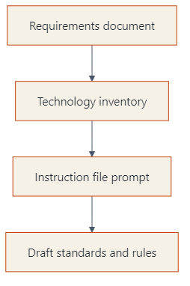
Start with the Requirements
Review the requirements document before generating any instruction file
Identify the front-end and implementation technologies explicitly in scope
Decide on the tech stack
Use the requirements to anchor standards, constraints, accessibility, and security expectations
Notes:
Duration ~00:02
Explain that instruction files are most valuable when they reflect the actual technology choices and constraints of the project. If the requirements are vague, the generated guidance will also be vague, so the stack definition has to come first. Transition by showing the simple prompting pattern used to produce the first draft.
---
Source: slides\marp\technology-stack-instruction-files.deck.md

Slide 40
Generate the First Draft Quickly
Use a direct prompt such as: Create instruction files for the following technologies
Name the stack clearly
Ask for guidance on:
  semantic markup
  accessibility
  modern CSS practices
  security
  performance
Treat the first output as a draft, not as final policy
Notes:
Duration ~00:02
Make the point that the initial prompt does not need to be elaborate to be useful. What matters is that it clearly names the technologies and asks for standards that map to real development concerns like semantics, accessibility, and runtime performance. Transition by moving from prompt generation to what a good instruction file should contain.
---
Source: slides\marp\technology-stack-instruction-files.deck.md

Slide 41
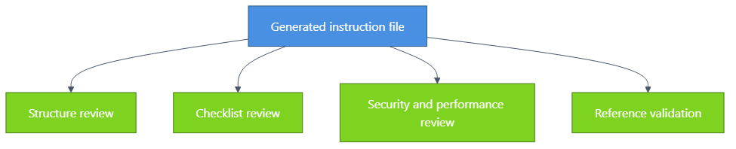
Review the Generated File Critically
Check the file structure, scope, and clarity
Ensure a validation checklist is included
Confirm the primary audience is AI assistants and the secondary audience is developers
Verify security and performance guidance is concrete
Confirm related documentation references are present and accurate
Notes:
Duration ~00:02
Explain that review is what turns an acceptable draft into a dependable working standard. Teams should inspect whether the file is actionable for the AI, readable for humans, and explicit enough to guide consistent output across sessions. Transition by introducing the role of multiple models in improving quality.
---
Source: slides\marp\technology-stack-instruction-files.deck.md

Slide 42
Why This Matters in the Foundation Phase
1. Establish technology standards early
2. Reduce inconsistency before implementation begins
3. Give AI assistants reusable, repo-specific guidance
4. Create artifacts the team can iterate on and version-control
5. Build a stronger base for later slice planning and implementation prompts
Bottom line: better instruction files lead to more reliable implementation output.
Notes:
Duration ~00:02
Close by connecting technology instruction files to the larger greenfield workflow. These files are foundational because they shape the quality of later prompts, implementation plans, and generated code, especially when multiple people and multiple models are involved. End by suggesting that every new stack choice should trigger the question, what instruction file do we need before we start building?
---
Source: slides\marp\technology-stack-instruction-files.deck.md

Slide 43
Course Modules
Intro
Specification Driven Software Development
Architecture Specification
Technology Specification
▶ Implementation Specification
Implementation Planning
Implementation Prompts
Vertical Slice Implementation
Notes:
Auto-generated course navigation slide showing all modules with current section highlighted

Slide 44
Vertical Slicing Architecture Introduction
Features Go Vertical. Layers Go Home.
Notes:
Duration ~00:01
Welcome to the vertical slicing architecture introduction. This section explains why organizing code by feature can make complex systems easier to understand, extend, and maintain.
Open by asking how many people have had to change a feature by touching controllers, services, repositories, and models in four different folders.
Emphasize that vertical slicing is not just a folder rename. It changes how teams think about boundaries, ownership, and end-to-end feature delivery.
Transition with: "Let's define the pattern first, then compare it to the layered structure most teams already know."
---
Source: slides\marp\vertical-slicing-architecture-introduction.deck.md

Slide 45
What is a vertical slice?
A vertical slice organizes code by business feature, not by technical layer.
Each feature spans UI, validation, logic, and data access
Everything needed for the feature lives together
Slices are self-contained and intentionally independent
Features avoid direct references to other features
Changes stay localized, which improves maintainability
Think in complete user capabilities, not shared technical buckets.
Notes:
This is the core idea for the section, so spend roughly three minutes here. Explain that a slice is a full path through the system for one business capability, such as user registration or order checkout.
Point out that the goal is strong feature boundaries. A developer should be able to open one folder and understand most of what matters for that feature without navigating the whole solution.
Call out the independence rule explicitly: features should not directly reference each other. Shared abstractions can exist, but the feature itself should remain loosely coupled.
Transition with: "That definition becomes clearer when we compare the file structure side by side."
---
Source: slides\marp\vertical-slicing-architecture-introduction.deck.md

Slide 46
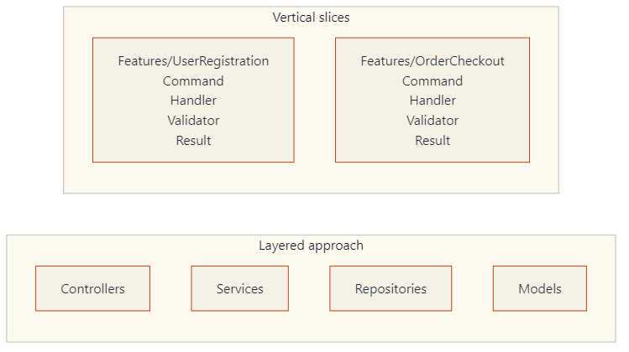
Layered folders vs. feature folders
Layered: related code is separated by technical type.
Vertical slices: all code for a feature is kept in one place.
Notes:
Duration ~00:03
Use about three minutes here and walk the audience through the diagram from left to right. In the layered view, explain that user registration logic is split across multiple folders, which creates navigation overhead and makes changes feel scattered.
Then move to the vertical slice view and show how each feature becomes a mini-application. The `Features/UserRegistration` folder contains the command, handler, validator, and any related response or data access pieces in one place.
This is a good moment to mention that enhancing one feature becomes easier because the impact area is much more visible. The file structure starts reflecting business capabilities instead of technical plumbing.
Transition with: "Once the structure changes, the day-to-day developer experience changes too."
---
Source: slides\marp\vertical-slicing-architecture-introduction.deck.md

Slide 47
Why developers like this approach
Developer experience
  Faster feature development
  All related code in one location
  Less folder jumping during implementation
  New features are less likely to disturb existing ones
Maintainability
  Localized changes
  Clear boundaries reduce accidental bugs
  Refactoring happens inside the feature more often than across the whole app
Notes:
Duration ~00:03
Describe the common experience of implementing a new feature in a layered system, where developers bounce between folders just to follow one request from start to finish.
Contrast that with a vertical slice where the work stays mostly inside one feature folder. That reduces cognitive load and makes it easier for a developer to reason about the full behavior before they edit anything.
For maintainability, stress that the architecture makes the blast radius of a change smaller. When the boundary is clear, debugging and refactoring become safer and faster.
Transition with: "Those same boundaries also help teams collaborate and test more effectively."
---
Source: slides\marp\vertical-slicing-architecture-introduction.deck.md

Slide 48
Collaboration and testing benefits
Team collaboration
  Teams can build features in parallel
  Clear boundaries mean fewer merge conflicts
  Ownership and responsibility are easier to assign
Testing approach
  Test complete features, not isolated layers
  Mock at feature boundaries
  Integration becomes more straightforward
  Independent development is easier with mocked dependencies
Notes:
Use about two to three minutes on this slide. Explain that feature folders create natural seams for parallel work, so two developers can often build different slices without changing the same files.
In testing, highlight that the unit of reasoning becomes the feature, not a service class in isolation. That leads to tests that better reflect user behavior and system outcomes.
You can also mention that mocking is still useful, but it tends to happen at boundaries instead of inside every technical layer. That usually produces simpler tests with clearer intent.
Transition with: "Vertical slices also pair naturally with another pattern many teams use: CQRS."
---
Source: slides\marp\vertical-slicing-architecture-introduction.deck.md

Slide 49
Course Modules
Intro
Specification Driven Software Development
Architecture Specification
Technology Specification
Implementation Specification
▶ Implementation Planning
Implementation Prompts
Vertical Slice Implementation
Notes:
Auto-generated course navigation slide showing all modules with current section highlighted

Slide 50
Vertical Slice Implementation Plans
The Blueprint Before the Blueprint
Notes:
Source: slides\marp\vertical-slice-implementation-plans.deck.md

Slide 51
Creating Vertical Slice Implementation Plans
Focus: how to plan before implementation
Goal: turn requirements into executable slices
Notes:
Open by framing this section as the bridge between architecture guidance and actual delivery planning.
Explain that vertical slices are not just a coding pattern; they are also a planning tool. The point of the section is to help the audience see how to move from requirements to a buildable roadmap.
Spend a few seconds previewing the three parts of the talk: reviewing the planning instruction file, generating implementation plans with AI, and improving those plans through multi-model evaluation.
---
Source: slides\marp\vertical-slice-implementation-plans.deck.md

Slide 52
Review the planning instructions
Reference point:
.github/instructions/vertical-slice-planning.instructions.md
What it provides:
Strategy selection guidance
Decomposition rules
Dependency analysis prompts
Slice definition templates
Notes:
Introduce the instruction file as the planning playbook. It tells both humans and AI how to reason about a feature before code is written.
Call out that a strong instruction file improves consistency. Instead of every plan starting from scratch, the team gets a repeatable way to identify slices, document dependencies, and define an implementation sequence.
Mention that the file is valuable even when AI is not involved because it clarifies how the team wants work decomposed.
---
Source: slides\marp\vertical-slice-implementation-plans.deck.md

Slide 53
Slice identification strategies
Strategy | Best fit
User action decomposition | End-to-end user flows
Entity CRUD operations | Simple data management
Workflow stage decomposition | Multi-step processes
Business event decomposition | Event-driven behavior
CQRS-optimized slicing | Distinct read/write paths
Notes:
Walk the audience through the five strategies and explain that no single strategy is always correct. The right one depends on the kind of behavior being modeled.
For user action decomposition, use an example like "submit order" or "reset password." For CRUD, use admin maintenance screens. For workflow stages, mention onboarding or approvals. For business events, use order placed or payment failed. For CQRS, explain separating queries from commands when reads and writes differ significantly.
Stress that the planning file helps choose a strategy rather than forcing one pattern onto every feature.
---
Source: slides\marp\vertical-slice-implementation-plans.deck.md

Slide 54
Decomposition principles
Single responsibility per slice
Complete vertical stack from UI/API to data
No horizontal sharing as the unit of delivery
Minimize external dependencies
Size slices to be valuable and manageable
Rule of thumb
Avoid slices that are too big to finish or too small to matter.
Notes:
This slide defines the quality bar for a slice. Explain that a slice should deliver one meaningful capability and contain everything needed to implement that capability end to end.
Clarify "no horizontal sharing" by contrasting a real slice with a layer-based task such as "build all repositories first." Horizontal work may still exist, but it should not become the primary planning unit.
Use the phrase "valuable and manageable" more than once. That is the balance teams often miss when they either create giant epics or tiny technical chores that produce no user value.
---
Source: slides\marp\vertical-slice-implementation-plans.deck.md

Slide 55
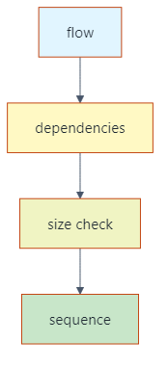
Analyze before you slice
Ask these questions first:
What data does this slice read or change?
What services or APIs does it depend on?
Can it be deployed independently?
Does a different strategy fit better?
Notes:
Explain that slicing is not just naming features. It requires examining data dependencies and service dependencies before locking in the plan.
Walk through the decision aid from left to right. Start with the flow, then look at dependency boundaries, then check whether the proposed slice is too large or too fragmented, and finally place it into an execution sequence.
This is a good moment to remind the audience that planning errors often come from ignoring dependencies until implementation begins.
---
Source: slides\marp\vertical-slice-implementation-plans.deck.md

Slide 56
Generate plans with AI
Example prompt:
Using vertical slice planning instructions and web calculator requirements, create implementation plan using vertical slices.
AI can generate:
  Requirements summary
  Slice decomposition
  Dependency diagram
  Implementation order
  Sprint organization
Notes:
Explain that the prompt works because it combines two inputs: the planning instructions and the actual feature requirements. Without both, the output is usually too generic.
Point out that this is where AI becomes a planning accelerator. Instead of starting from a blank page, the team gets a draft plan containing slices, dependencies, sequencing, and potential sprint structure.
Also note that the prompt is intentionally simple. The quality comes from the instruction file and source requirements, not from a complicated prompt.
---
Source: slides\marp\vertical-slice-implementation-plans.deck.md

Slide 57
What a good AI plan should include
1. Clear summary of requirements
2. Identified slices with rationale
3. Dependency relationships
4. Proposed implementation sequence
5. Sprint or milestone grouping
Watch for model differences
  More detail vs. more concise output
  Different naming and grouping choices
  Different sequencing assumptions
Notes:
Use this slide to define evaluation criteria for AI-generated plans. The audience should leave knowing what "good" looks like, not just that AI can produce something.
Explain that different models may emphasize different aspects. One might provide stronger rationale, another might produce cleaner sequencing, and another might be better at summarizing requirements.
Encourage the audience to compare outputs rather than assuming the first plan is correct. This leads naturally into the multi-model review exercise.
---
Source: slides\marp\vertical-slice-implementation-plans.deck.md

Slide 58
Example planning flow
Web calculator example
  1. Summarize calculator requirements
  2. Identify slices such as input, operations, history, validation
  3. Map data and service dependencies
  4. Sequence foundational slices before enhancements
  5. Group slices into sprints
Notes:
Translate the abstract process into a concrete example. Use the calculator scenario because it is simple enough to understand quickly while still showing real decomposition choices.
Mention that one model may group input and validation together, while another may separate them. One may treat history as a later slice because it depends on completed calculations. These are exactly the kinds of planning differences worth discussing.
Reinforce that the output is not just a list of tasks. It is a roadmap with ordering logic.
---
Source: slides\marp\vertical-slice-implementation-plans.deck.md

Slide 59
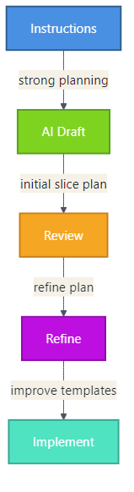
Key takeaway
Start with a strong planning instruction file
Generate an initial vertical slice plan
Compare outputs across models when useful
Improve templates and examples over time
Notes:
Close with the repeatable workflow. This gives the audience a practical method they can adopt immediately.
Emphasize that the instruction file is the stable asset, AI provides the first draft, and multi-model review improves quality. Over time, the planning assets themselves get better, which improves every future plan.
End by connecting this section to execution: once the slices and roadmap are solid, implementation becomes faster, safer, and easier to parallelize.
---
Source: slides\marp\vertical-slice-implementation-plans.deck.md

Slide 60
Dependency Analysis and Planning
Everything Depends on This Slide (Literally)
Notes:
Source: slides\marp\dependency-analysis-planning.deck.md

Slide 61
Dependency Analysis and Planning
Section focus: using dependency graphs to sequence vertical slice implementation
Outcome: show how teams identify prerequisites, parallel work, and the critical path
Notes:
Duration ~00:04
Introduce this section as the point where planning becomes executable rather than aspirational. Explain that dependency analysis helps the team decide what must be built first, what can safely wait, and what can happen in parallel without creating blockers. Transition by showing a simple dependency graph and explaining how to read it.
---
Source: slides\marp\dependency-analysis-planning.deck.md

Slide 62
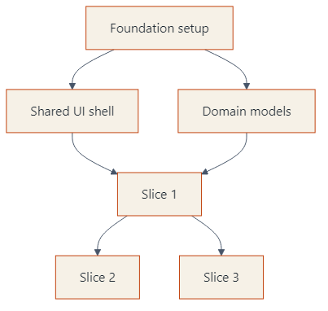
Read the Dependency Diagram
Nodes represent slices, features, or enabling work
Arrows show that one item depends on another being complete first
Read from left to right or top to bottom to understand sequencing
Look for root nodes with no prerequisites
Notes:
Duration ~00:01
Explain that a dependency graph is a visual map of implementation order, not just a picture of the system. Root nodes such as foundation setup are important because they unlock other work, while downstream nodes cannot start safely until their prerequisites exist. Transition by asking which path through the graph will determine overall progress.
---
Source: slides\marp\dependency-analysis-planning.deck.md

Slide 63
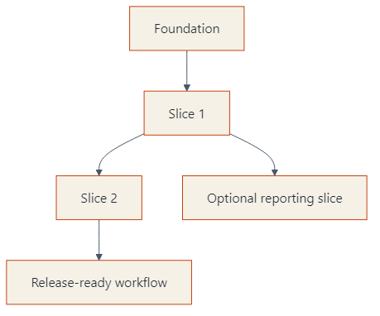
Find the Critical Path
The critical path is the longest chain of dependent work
Delays on that path delay the overall implementation plan
Independent branches matter, but they do not all block delivery equally
Focus coordination and risk management on the path that controls completion
Notes:
Duration ~00:01
Make the point that not every task has the same scheduling weight. The chain from foundation through Slice 1 and Slice 2 to release readiness is the critical path because a delay anywhere in that line affects the final delivery date. Transition by showing that some branches can still be parallelized once the right prerequisites are in place.
---
Source: slides\marp\dependency-analysis-planning.deck.md

Slide 64
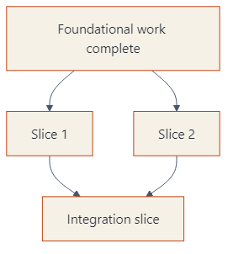
Sequence First, Parallelize Second
Some slices are strictly sequential because they share prerequisites
Other slices can run in parallel after the same foundation is done
Parallel work increases speed only when dependencies are already satisfied
Planning should prevent teams from starting blocked work too early
Notes:
Duration ~00:01
Explain that parallelization is useful, but only after the common enabling work is complete. In this example, Slice 1 and Slice 2 can move at the same time, yet the integration slice must wait until both are finished, so sequencing still matters. Transition by separating foundational work from dependent features so the audience can see how to prioritize the backlog.
---
Source: slides\marp\dependency-analysis-planning.deck.md

Slide 65
Distinguish Foundational and Dependent Features
Foundational work
  environments, shared components, core models, base services
Dependent features
  user-facing slices that rely on those shared capabilities
Planning rule
  finish enabling work first when many later slices depend on it
Notes:
Duration ~00:01
Clarify that foundational work is valuable because it unlocks many downstream slices, not because it is glamorous. Dependent features usually deliver visible business value, but they become risky or inefficient if the core infrastructure they need is missing or unstable. Transition by summarizing a lightweight planning process the team can repeat for every implementation plan.
---
Source: slides\marp\dependency-analysis-planning.deck.md

Slide 66
Use Dependency Analysis to Plan the Roadmap
1. List slices and enabling work
2. Draw the dependency relationships
3. Identify the critical path
4. Mark which branches can run in parallel
5. Schedule foundational work before dependent features
Bottom line: dependency graphs turn a feature list into a realistic implementation sequence.
Notes:
Duration ~00:01
Close by turning the concept into a repeatable planning workflow. The audience should leave with the idea that dependency analysis is a small upfront investment that prevents scheduling confusion, blocked development, and unrealistic sequencing later. End by connecting this back to vertical slices, where smart sequencing makes incremental delivery much easier.
---
Source: slides\marp\dependency-analysis-planning.deck.md

Slide 67
Course Modules
Intro
Specification Driven Software Development
Architecture Specification
Technology Specification
Implementation Specification
Implementation Planning
▶ Implementation Prompts
Vertical Slice Implementation
Notes:
Auto-generated course navigation slide showing all modules with current section highlighted

Slide 68
Implementation Prompts and Verification
The Prompt That Does the Implementation (With a Checklist)
Notes:
Source: slides\marp\implementation-prompts-verification.deck.md

Slide 69
Implementation Prompts and Verification
Section focus: turning slice plans into actionable build prompts
Outcome: show how to generate slice-specific prompts, verify behavior, and prepare stakeholder demos
Notes:
Duration ~00:22
Introduce this section as the bridge between planning and actual implementation. The audience should understand that a slice plan becomes much more useful when it is converted into a precise prompt that tells the AI what to build, how to verify it, and how to demonstrate it. Transition by asking what information a good implementation prompt must capture before any code is generated.
---
Source: slides\marp\implementation-prompts-verification.deck.md

Slide 70
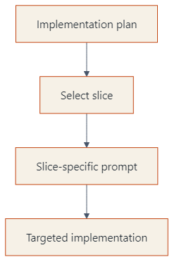
Start from a Single Slice
Choose one slice from the implementation plan
Example: Slice 1 - Display Current Value
Use the slice instructions plus the implementation plan as source context
Write one prompt file per slice so scope stays narrow and testable
Notes:
Duration ~00:02
Explain that the best implementation prompts are intentionally narrow. Rather than asking for an entire application, the team picks one slice from the plan and turns that into a focused request that can be reviewed and tested independently. Transition by showing what the actual prompt needs to contain once the slice is chosen.
---
Source: slides\marp\implementation-prompts-verification.deck.md

Slide 71
What the Implementation Prompt Should Say
Reference the slice instructions and the implementation plan directly
Ask the model to implement the selected slice
Require verification steps in the output
Require showcase instructions for stakeholder demonstration
Prompt pattern
Using slice X instructions and implementation plan, create a prompt file that implements slice 1. Include verification steps and showcase instructions that demonstrate the functionality to stakeholders.
Notes:
Duration ~00:03
Frame this slide around prompt construction, not just prompt wording. The important move is that the request names the slice, points to the governing instructions, and asks for more than code generation by explicitly requiring verification and demonstration guidance. Transition by breaking down the expected deliverables inside the generated prompt file.
---
Source: slides\marp\implementation-prompts-verification.deck.md

Slide 72
Expected Deliverables Inside the Prompt File
Files to create
index.html
styles.css
main.js
Specifications to include
HTML structure requirements
CSS colors, fonts, spacing, and layout
JavaScript behavior for current value, display object, and update function
File structure and component organization
Notes:
Duration ~00:03
Walk through the prompt output as if you are reviewing a generated file with the class. The goal is not merely to list filenames, but to show that the prompt should describe what each file is responsible for and how the pieces fit together. Transition by moving from implementation detail to the checks that prove the slice actually works.
---
Source: slides\marp\implementation-prompts-verification.deck.md

Slide 73
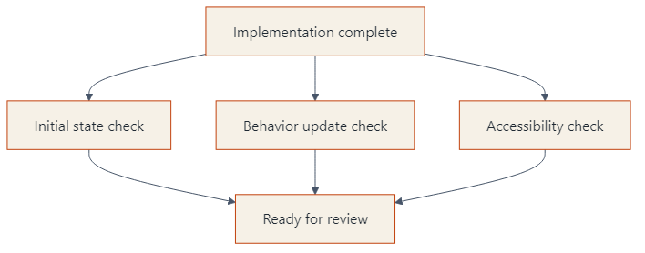
Build Verification into the Prompt
Initial state: calculator displays 0 on page load
State update: changing the value in the console updates the display
Accessibility: contrast ratio >= 4.5:1 and font size >= 2rem
Include both automated testing guidance and manual verification steps
Notes:
Duration ~00:04
Explain that verification should be authored before or alongside implementation, not after the fact. The checks on this slide are strong examples because they cover default state, observable behavior, and accessibility requirements in a way that reviewers and demonstrators can both understand. Transition by showing how showcase instructions differ from verification even though the two are related.
---
Source: slides\marp\implementation-prompts-verification.deck.md

Slide 74
Showcase Instructions Should Target Humans
Do more than paste a code snippet
Describe what users see and what they can do
Call out the behavior the demonstrator should point to
Provide an interactive demo path for stakeholders
Good showcase guidance includes
1. starting state on screen
2. action to take
3. visible result
4. why it matters to the audience
Notes:
Duration ~00:03
Make the distinction between proving correctness and presenting value. Verification asks whether the slice works; showcase guidance tells a human demonstrator how to walk stakeholders through what appears on screen, what changes, and why they should care. Transition by expanding from one slice to the broader roadmap of multiple prompts.
---
Source: slides\marp\implementation-prompts-verification.deck.md

Slide 75
Repeat the Pattern Across All Slices
Create additional prompt files for Slice 2, Slice 3, and so on
Version-control each prompt so changes stay traceable
Reuse prompts later for revisions or follow-on work
Execute slices sequentially and review each result before moving on
Build a complete implementation roadmap with systematic verification
Bottom line: slice-specific prompts create a repeatable path from plan to implementation to review.
Notes:
Duration ~00:03
Close by connecting the single-slice example to the full delivery workflow. Each prompt becomes a reusable unit of work that can be re-run, refined, and audited over time, which is especially useful when implementation spans multiple sessions or contributors. End by encouraging the audience to treat prompt files as versioned implementation assets, not disposable chat text.
---
Source: slides\marp\implementation-prompts-verification.deck.md

Slide 76
Course Modules
Intro
Specification Driven Software Development
Architecture Specification
Technology Specification
Implementation Specification
Implementation Planning
Implementation Prompts
▶ Vertical Slice Implementation
Notes:
Auto-generated course navigation slide showing all modules with current section highlighted

Slide 77
Basic Vertical Slice Workflow
Thin Slices, Big Results
Notes:
Source: slides\marp\basic-vertical-slice-workflow.deck.md

Slide 78
Basic Vertical Slice Implementation Workflow
Goal: deliver working software in thin, end-to-end slices
Pattern: plan dependencies first, then parallelize safe slices
Outcome: faster feedback and lower integration risk
Notes:
Introduce the deck as a practical delivery workflow, not just an architecture concept. Emphasize that each vertical slice includes API, domain logic, persistence, and tests. Mention that parallel work is possible only after dependency analysis confirms slice independence.
---
Source: slides\marp\basic-vertical-slice-workflow.deck.md

Slide 79
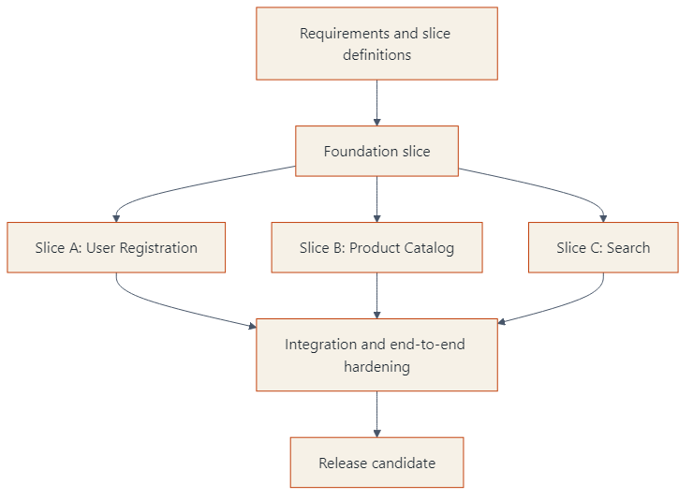
Follow the Implementation Plan
Use dependency chain
Implement slices:
  Foundation (must go first)
  Parallel-ready (can run together)
  Integration/cleanup (must go last)
Notes:
Walk left to right. Call out that Foundation might include authentication baseline, shared contracts, and CI setup. Then point to slices A, B, and C as intentionally parallel lanes. Close by explaining that integration hardening is a separate explicit phase.
---
Source: slides\marp\basic-vertical-slice-workflow.deck.md

Slide 80
Execute Slices in Parallel
Assign owners per slice lane
Use trunk-based integration with short-lived branches
Keep contracts stable and versioned
Demo each slice as soon as done
Parallel execution guardrails:
No hidden cross-slice dependencies
Shared schema changes reviewed early
Contract tests required before merge
Notes:
Emphasize team coordination practices. Explain that parallel work fails when contracts are ambiguous. Recommend daily integration checks and a lightweight dependency board to catch collisions early.
---
Source: slides\marp\basic-vertical-slice-workflow.deck.md

Slide 81
Integrate, Validate, and Stabilize
Run full end-to-end and regression tests
Validate non-functional requirements:
  Performance
  Security
  Observability
Close documentation and operational runbooks
Freeze only when release criteria are met
Notes:
Describe this as controlled convergence, not a big bang merge. Point out that each slice already passed its own checks, so this phase focuses on system behavior and production readiness. Encourage using release checklists to avoid late surprises.
---
Source: slides\marp\basic-vertical-slice-workflow.deck.md

Slide 82

John Michael Miller
Principal Software Archaeologist/Architect/Engineer
Played roles of developer, architect, devops engineer, platform engineer, test architect, release manager
AI Practitioner and advocate for effectively using AI to write code
LinkedIn: www.linkedin.com/in/johnmichaelmiller
Email: john.miller@codegroup.io
Blog: codemag.com/blog/AIPractitioner
Notes:
OBS: Slides
John Michael Miller is a Principal Software Engineer at CODE with over 15 years of experience in software development. He has held various roles including developer, architect, DevOps engineer, platform engineer, test architect, and release manager. John is an AI/ML enthusiast and advocates for effectively using AI to write code. You can connect with him on LinkedIn, reach out via email, or read his blog posts on AI-assisted software development.
- [AI Practitioner Resources](codemag.com/aipractitioner)
---
Source: slides\marp\instructors\jMM-Software-Archaeologist.deck.md

