Slide 1
The Return of the Prompter
Ready to continue where we left off
Today's session builds on what we've covered
We're all in this together — participation welcome
Questions are always welcome — ask anytime!
Notes:
Duration ~00:02
Welcome everyone back to the session. Take a moment to let people settle in before diving into content. Acknowledge that it's great to see everyone back and express enthusiasm for the session ahead.
Key talking points:
- Remind attendees of the previous session's topics briefly
- Emphasize that questions are encouraged at any point — not just at the end
- Set a positive, inclusive tone for the session
- If this is after a break, give people 30 seconds to get re-focused
Transition: "Let's pick up right where we left off..."
---
Source: slides\marp\welcome-back.deck.md

Slide 2
Course Modules
Intro
▶ Specification Driven Software Development
Architecture Specification
Technology Specification
Implementation Specification
Implementation Planning
Implementation Prompts
Vertical Slice Implementation
Code Review with GitHub Copilot
Notes:
Auto-generated course navigation slide showing all modules with current section highlighted

Slide 3
Getting Started Checklist
The Recipe Before the Meal
Notes:
Source: slides\marp\getting-started-checklist.deck.md

Slide 4
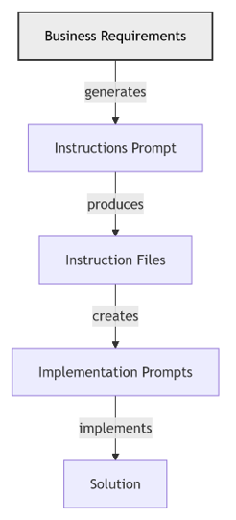
High Level AI Assisted Workflow
From Requirements to a Solution
Stakeholders such as SMEs, architects, SREs, and DBAs define the requirements with AI assistance.
AI transforms the requirements into implementation instruction files that guide the work.
Stakeholders review, improve, and approve the instruction files.
AI uses those instruction files to create prompts that implement the business requirements.
Implementation prompts explain how the feature should be built and how acceptance criteria should be verified.
Stakeholders review, improve, and approve the implementation prompts.
Submitting the implementation prompts produces an implementation that conforms to the instruction files and meets the acceptance criteria.
Stakeholders review and approve the resulting implementation.
Notes:
Walk the audience through the lifecycle from left to right and keep the focus on the review gates between each AI-generated artifact. Stress that requirements are not handed directly to code generation; instead, they are refined into instruction files and then into implementation prompts, with stakeholder approval at each stage. Use the diagram to reinforce that this is a controlled pipeline where AI accelerates each step but humans still own correctness, safety, and acceptance. End by linking this workflow back to the checklist on the previous slides: foundation, automation, specialization, and integration all support this end-to-end model.
---
Source: slides\marp\getting-started-checklist.deck.md

Slide 5
Starting with Requirements
Build the Right Thing Before Building the Thing Right
Notes:
Shift to greenfield best practices: requirements, prompts, and verification workflows.
---
Source: slides\marp\starting-with-requirements.deck.md

Slide 6
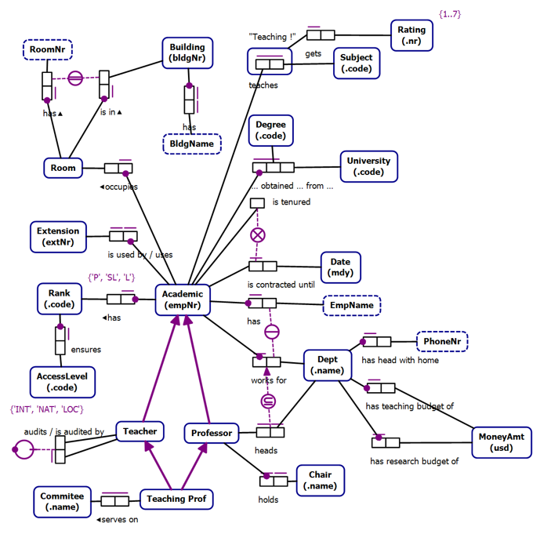
Business Rules as Requirements
Notes:
Source: slides\marp\starting-with-requirements.deck.md

Slide 7
Conceptual Models
Technology Agnostic
Transformable into Logical Models
Clarity
Expressive
Formal
Conceptual Models are not a requirement
Notes:
Source: slides\marp\starting-with-requirements.deck.md

Slide 8
Object Role Models
A type of conceptual model
Supported by a Visual Studio Extension (NORMA)
Object Role Models are textual and visual
Text can be visualized
Diagrams can be verbalized
Textual representation is in a formal natural language that can be validated by subject matter experts
Notes:
Source: slides\marp\starting-with-requirements.deck.md

Slide 9
Zeus.Academia.3b
Based on a publicly available model of a commonly understood domain
https://orm.net/pdf/ORMwhitePaper.pdf
Allows us to quickly move from requirements to implementation
https://github.com/johnmillerATcodemag-com/zeus.academia.3b
Why 3b?
Third Iteration in progress
If something is hard, do it often
Notes:
Source: slides\marp\starting-with-requirements.deck.md

Slide 10
Use Cases
Use cases are specific scenarios that guide data capture and processing in the application
Promote a Lecturer to Senior Lecturer
Promote a Senior Lecturer to Associate Professor
Promote an Associate Professor to Professor
Assign a Class to an Academic
Add a new Academic to the faculty capturing all required information and allowing the capture of optional information
Notes:
Source: slides\marp\starting-with-requirements.deck.md

Slide 11
Exercise: Generate Business Requirements
Objectives:
Use the Product Manager chat mode to create a requirements document for a calculator
Activities:
1. Activate the Product Manager chat mode
2. Prompt the AI to create a requirements document
3. Review the requirements
4. Add an implementation plan using vertical slices
5. Review the changes
6. Add a diagram showing the relationship between Phases, Slices, and User Stories
Success Criteria
The requirements document exists and passes review
Notes:
Duration ~00:20
Author requirement docs, then use Copilot to generate scaffolding and validate alignment.
Prompt: create a requirements document for a simple calculator application
---
Source: slides\marp\exercise\exercise-generate-business-requirements.deck.md

Slide 12
Exercise: Generate Business Requirements
Objectives:
Use the Product Manager chat mode to update the requirements document to implement using vertical slices
Activities:
1. Activate the Product Manager chat mode
2. Prompt the AI to add a vertical slices implementation plan
3. Review the changes
4. Add a diagram showing the relationship between Phases, Slices, and User Stories
Success Criteria
The implementation plan passes review
Notes:
Duration ~00:20
Prompts:
using #file:business-rules-to-slices.instructions.md update the #file:calculator-app-requirements.md implementation plan to implement using vertical slices
what is the difference between the phases and vertical slices?
update the plan to make this distinction clear
add a diagram that shows the phases -> slices -> use cases
which of the slices can be implemented in parallel and which have a dependancy on another slice
---
Source: slides\marp\exercise\exercise-generate-business-requirements-2.deck.md

Slide 13
Exercise: Business Requirements Generation
Let the AI Write the Requirements for Once
Notes:
Source: slides\marp\exercise\exercise-business-requirements-generation.deck.md

Slide 14
Exercise: Business Requirements Generation
Objectives
Create a business requirements document for the calculator project
Use the Product Manager agent with existing instruction files
Apply the expected branch and repository workflow for Greenfield work
Validate the requirements draft through review, clarification, and independent iteration
Activities
1. Create a personal branch from the Greenfield branch in the class repository.
2. Use the Product Manager agent to generate a calculator requirements document.
3. Apply the existing instruction files to improve scope, structure, and consistency.
4. Confirm repository choice, branching strategy, and how to handle any existing PRD content before continuing.
5. Work independently on the requirements document while the instructor provides check-ins and support.
Success Criteria
A calculator business requirements document exists on the correct personal branch
The Product Manager agent and instruction files are both used effectively
Repository and branching decisions are applied correctly and consistently
Participants can explain what changed after clarifications and independent refinement
Notes:
Duration ~00:17
**Prerequisites:** Access to the Greenfield branch, ability to create a personal branch, and access to the Product Manager agent plus the repository instruction files
Use this exercise to establish the Greenfield workflow discipline early. Start by making participants branch from Greenfield before they do any prompting so the requirements artifact has a clean ownership path and can be reviewed independently later. In the first few minutes, emphasize that the goal is not to produce a perfect PRD in one pass, but to create a usable calculator requirements document using the Product Manager agent together with repository guidance. During the clarification window, call out the common confusion points explicitly: correct repository, personal branch strategy, what to do with any existing PRD material, and that tooling differences between Visual Studio and VS Code are secondary to getting the requirements quality right. For the working block, let students operate independently, but use periodic check-ins to see whether instruction files improved the output and whether anyone is stuck on scope, branching, or prompt quality. Transition from this exercise by connecting the completed requirements document to the next Greenfield planning steps, especially technology instructions, slice planning, and implementation prompts.
---
Source: slides\marp\exercise\exercise-business-requirements-generation.deck.md

Slide 15
Course Modules
Intro
Specification Driven Software Development
▶ Architecture Specification
Technology Specification
Implementation Specification
Implementation Planning
Implementation Prompts
Vertical Slice Implementation
Code Review with GitHub Copilot
Notes:
Auto-generated course navigation slide showing all modules with current section highlighted

Slide 16
CQRS Architecture
Reads and Writes: Better Apart, Like Most Couples
Notes:
Source: slides\marp\cqrs-architecture.deck.md

Slide 17
Command Query Responsibility Segregation Architecture
AI-Assisted Software Development
Notes:
Duration ~00:01
Welcome to the CQRS Architecture module. This session covers Command Query Responsibility Segregation — a pattern that separates read and write operations into distinct models to improve scalability and maintainability.
**Key Points**:
- CQRS separates write (command) operations from read (query) operations
- Enables independent scaling and optimization of each model
- Useful when read and write workloads have very different characteristics
**Delivery**: Begin by asking the audience about pain points with traditional CRUD APIs — high query complexity, slow writes due to query-optimized schemas, or contention between reads and writes.
**Transition**: "Let's start with when CQRS makes sense — and when it doesn't."
---
Source: slides\marp\cqrs-architecture.deck.md

Slide 18
When to Use CQRS
✅ Use CQRS when:
Read and write workloads scale differently
Read models need denormalization, caching, or projections
Write model needs strong invariants and task-focused workflows
Auditing or event sourcing is required
Query complexity slows transactional throughput
❌ Avoid CQRS when:
Domain is small and reads/writes are balanced
No clear boundary between commands and queries
Operational overhead is not justified
Notes:
Duration ~00:03
CQRS is a powerful pattern but it adds operational complexity. Use it only when the benefits outweigh the costs.
**Key Points**:
- The classic CRUD pattern couples reads and writes to the same model — fine for simple domains
- CQRS shines when the query model needs to be radically different from the write model
- Event sourcing almost always pairs with CQRS
- Small teams or simple domains should avoid CQRS due to added complexity
**Real-World Example**: An e-commerce order system where writes go through strict business validation but reads need highly denormalized views for catalog search, order history dashboards, and analytics.
**Audience Question**: "Has anyone implemented something like CQRS without knowing it had a name?"
**Transition**: "Let's look at the core principles that underpin CQRS."
---
Source: slides\marp\cqrs-architecture.deck.md

Slide 19
Core Principles
Principle | Detail
Separation | Commands change state; queries never change state
Invariants | Write model enforces all business rules
Optimization | Read model is shaped for query use cases
Independence | Models can evolve separately
Consistency | Eventual consistency between write and read
Notes:
Duration ~00:02
These five principles guide every CQRS implementation decision.
**Key Points**:
- The read/write separation is absolute — queries must be side-effect free
- Write model is where business logic lives — all invariants enforced here
- Read models are projections built from the write model's events
- Independence is key — you can evolve the read schema without touching write logic
- Eventual consistency is usually acceptable; design for it intentionally
**Common Misconception**: CQRS does not require separate databases. You can start with a single database and separate logical models before introducing physical separation.
**Transition**: "What are the actual architectural components we need to build?"
---
Source: slides\marp\cqrs-architecture.deck.md

Slide 20
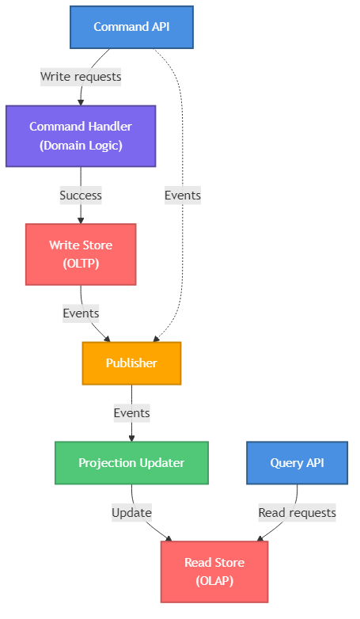
CQRS Architecture Components
Minimum components
Command API — receives write requests
Command Handler — enforces domain rules
Write Store — authoritative OLTP system
Publisher — emits events reliably
Projection Updater — rebuilds read models
Query API — serves optimized reads
Read Store — denormalized query model
Notes:
Duration ~00:03
This diagram shows the minimum components for a CQRS implementation.
**Walk Through the Diagram**:
1. Command API receives write requests and routes to handlers
2. Command Handler orchestrates domain logic and writes to the Write Store
3. Events are published after successful writes
4. Projection Updater subscribes to events and updates the Read Store
5. Query API serves the Read Store with fast, optimized queries
**Key Components**:
- **Command API**: Validates input, routes to appropriate handler
- **Command Handler**: Enforces invariants, orchestrates domain operations
- **Write Store**: OLTP database for aggregates and consistency
- **Event Publisher**: Reliable event emission (use outbox pattern)
- **Projection Updater**: Maintains read models from events
- **Query API**: Serves denormalized, query-optimized data
- **Read Store**: OLAP or document store optimized for reads
**Transition**: "Let's look at command model design in more detail."
---
Source: slides\marp\cqrs-architecture.deck.md

Slide 21
Consistency Strategy
Strong Consistency — needed for:
Payments and financial transactions
Inventory management
Security and access control
Eventual Consistency — acceptable for:
Activity feeds and notifications
Analytics dashboards
Search indexes and recommendations
Reliable Event Publication — use the Outbox Pattern:
Write event to database table atomically with domain change → background process publishes → idempotent consumers
Notes:
Duration ~00:03
Consistency is often the most debated aspect of CQRS implementations.
**Key Points**:
- Not all data requires strong consistency — choosing the right model reduces complexity
- The Outbox Pattern is the industry standard for reliable event publishing
- "Dual writes" (write to DB and publish in the same transaction) are dangerous — use the outbox
- Idempotent consumers handle duplicate event delivery gracefully
**The Outbox Pattern**:
1. Within the same database transaction: write the domain change AND an outbox event record
2. A background process reads unprocessed outbox events and publishes them to the message broker
3. Mark events as processed after successful publication
4. Consumers handle duplicates idempotently
**Transition**: "What common mistakes should we avoid?"
---
Source: slides\marp\cqrs-architecture.deck.md

Slide 22
Example: Order Approval Flow
Command flow (write):
1. API receives ApproveOrder command
2. Command handler loads Order aggregate
3. Aggregate validates approval rules
4. Transaction commits to write store
5. OrderApproved event published via outbox
Query flow (read):
1. UI requests order summary dashboard
2. Query API reads OrderSummary projection
3. Read store returns denormalized view
4. Response includes lastUpdatedUtc for freshness indicator
Notes:
Duration ~00:02
Tying the concepts together with a concrete example makes the pattern tangible.
**Key Points**:
- The command and query flows are completely independent paths
- The event bridges the write and read sides asynchronously
- `lastUpdatedUtc` in the query response lets the UI show freshness information
- The UI can display a "processing" indicator while the projection catches up after a command
**Discussion Question**: "What are the tradeoffs of showing the read model data vs. the command result directly after an approval?"
**Key Takeaway**: CQRS is not magic — it's a deliberate architectural choice that pays off when reads and writes truly have different requirements.
---
Source: slides\marp\cqrs-architecture.deck.md

Slide 23
Key Takeaways
Core reminders
Separate commands from queries at the architectural level
Use CQRS when read and write workloads differ materially
Use the outbox pattern for reliable event publication
Design for eventual consistency intentionally
Start small and migrate one context at a time
Further reading
Martin Fowler: martinfowler.com/bliki/CQRS.html
Transactional outbox: microservices.io/patterns/data/transactional-outbox.html
Greg Young's CQRS documents
Notes:
Duration ~00:02
Summarize the key points and provide resources for deeper learning.
**Summary**:
- CQRS separates write models (commands) from read models (queries)
- Use it when the complexity pays off — don't over-apply
- Reliable event publication requires the outbox pattern
- Eventual consistency is the norm — manage client expectations
- Incremental migration is the safe approach
**Call to Action**: Review the `cqrs-architecture.instructions.md` file in the repository for implementation checklists and code examples.
**Q&A**: Open the floor for architecture questions and real-world implementation challenges.
---
Source: slides\marp\cqrs-architecture.deck.md

Slide 24
Course Modules
Intro
Specification Driven Software Development
Architecture Specification
▶ Technology Specification
Implementation Specification
Implementation Planning
Implementation Prompts
Vertical Slice Implementation
Code Review with GitHub Copilot
Notes:
Auto-generated course navigation slide showing all modules with current section highlighted

Slide 25
Technology Stack Instruction Files
Teaching Your AI the House Rules for Every Room
Notes:
Source: slides\marp\technology-stack-instruction-files.deck.md

Slide 26
Technology Stack Instruction Files
Turning requirements into tech-specific guidance
Show how teams generate, review, and improve instruction files
Notes:
Duration ~00:17
Frame this section as part of the greenfield foundation work rather than a documentation side quest. Explain that instruction files help the AI and the team align on standards before implementation begins, which reduces drift and rework later. Transition by asking what should exist before anyone prompts for technology-specific instructions.
---
Source: slides\marp\technology-stack-instruction-files.deck.md

Slide 27
Start with the Requirements
Review the requirements document before generating any instruction file
Identify the front-end and implementation technologies explicitly in scope
Decide on the tech stack
Use the requirements to anchor standards, constraints, accessibility, and security expectations
Notes:
Duration ~00:02
Explain that instruction files are most valuable when they reflect the actual technology choices and constraints of the project. If the requirements are vague, the generated guidance will also be vague, so the stack definition has to come first. Transition by showing the simple prompting pattern used to produce the first draft.
---
Source: slides\marp\technology-stack-instruction-files.deck.md

Slide 28
Generate the First Draft Quickly
Use a direct prompt such as: Create instruction files for the following technologies
Name the stack clearly
Ask for guidance on:
semantic markup
accessibility
modern CSS practices
security
performance
Treat the first output as a draft, not as final policy
Notes:
Duration ~00:02
Make the point that the initial prompt does not need to be elaborate to be useful. What matters is that it clearly names the technologies and asks for standards that map to real development concerns like semantics, accessibility, and runtime performance. Transition by moving from prompt generation to what a good instruction file should contain.
---
Source: slides\marp\technology-stack-instruction-files.deck.md

Slide 29
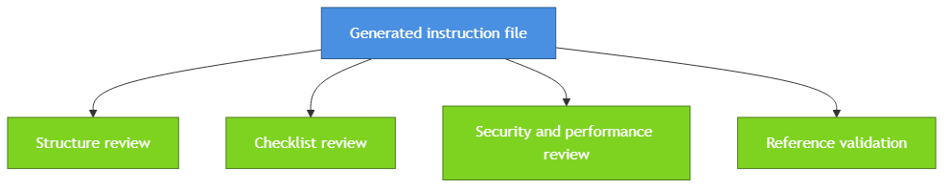
Review the Generated File Critically
Check the file structure, scope, and clarity
Ensure a validation checklist is included
Confirm the primary audience is AI assistants and the secondary audience is developers
Verify security and performance guidance is concrete
Confirm related documentation references are present and accurate
Notes:
Duration ~00:02
Explain that review is what turns an acceptable draft into a dependable working standard. Teams should inspect whether the file is actionable for the AI, readable for humans, and explicit enough to guide consistent output across sessions. Transition by introducing the role of multiple models in improving quality.
---
Source: slides\marp\technology-stack-instruction-files.deck.md

Slide 30
Use Multiple Models to Improve Quality
Model tendency | Practical takeaway
Claude Sonnet: more comprehensive | Good for broad first drafts
GPT-4: more variable | Good candidate for challenge and comparison
Notes:
Duration ~00:02
Position multi-model review as a quality-control tactic rather than a competition. Different models expose different blind spots, so having one model critique another often surfaces missing examples, incomplete checklists, or weakly stated rules. Transition by tying this evaluation loop back to the broader foundation phase of a new project.
---
Source: slides\marp\technology-stack-instruction-files.deck.md

Slide 31
Why This Matters in the Foundation Phase
1. Establish technology standards early
2. Reduce inconsistency before implementation begins
3. Give AI assistants reusable, repo-specific guidance
4. Create artifacts the team can iterate on and version-control
5. Build a stronger base for later slice planning and implementation prompts
Bottom line: better instruction files lead to more reliable implementation output.
Notes:
Duration ~00:02
Close by connecting technology instruction files to the larger greenfield workflow. These files are foundational because they shape the quality of later prompts, implementation plans, and generated code, especially when multiple people and multiple models are involved. End by suggesting that every new stack choice should trigger the question, what instruction file do we need before we start building?
---
Source: slides\marp\technology-stack-instruction-files.deck.md

Slide 32
Course Modules
Intro
Specification Driven Software Development
Architecture Specification
Technology Specification
▶ Implementation Specification
Implementation Planning
Implementation Prompts
Vertical Slice Implementation
Code Review with GitHub Copilot
Notes:
Auto-generated course navigation slide showing all modules with current section highlighted

Slide 33
Features Go Vertical. Layers Go Home.
Organizing software around features instead of layers
AI-Assisted Software Development
Notes:
Duration ~00:01
Welcome to the vertical slicing architecture introduction. This section explains why organizing code by feature can make complex systems easier to understand, extend, and maintain.
Open by asking how many people have had to change a feature by touching controllers, services, repositories, and models in four different folders.
Emphasize that vertical slicing is not just a folder rename. It changes how teams think about boundaries, ownership, and end-to-end feature delivery.
Transition with: "Let's define the pattern first, then compare it to the layered structure most teams already know."
---
Source: slides\marp\vertical-slicing-architecture-introduction.deck.md

Slide 34
What is a vertical slice?
A vertical slice organizes code by business feature, not by technical layer.
Each feature spans UI, validation, logic, and data access
Everything needed for the feature lives together
Slices are self-contained and intentionally independent
Features avoid direct references to other features
Changes stay localized, which improves maintainability
Think in complete user capabilities, not shared technical buckets.
Notes:
This is the core idea for the section, so spend roughly three minutes here. Explain that a slice is a full path through the system for one business capability, such as user registration or order checkout.
Point out that the goal is strong feature boundaries. A developer should be able to open one folder and understand most of what matters for that feature without navigating the whole solution.
Call out the independence rule explicitly: features should not directly reference each other. Shared abstractions can exist, but the feature itself should remain loosely coupled.
Transition with: "That definition becomes clearer when we compare the file structure side by side."
---
Source: slides\marp\vertical-slicing-architecture-introduction.deck.md

Slide 35
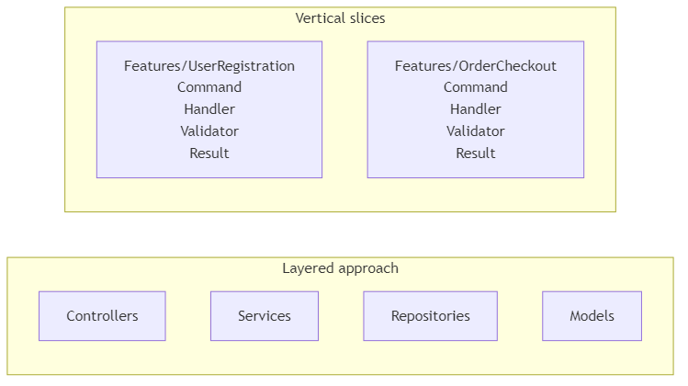
Layered folders vs. feature folders
Layered: related code is separated by technical type.
Vertical slices: all code for a feature is kept in one place.
Notes:
Duration ~00:03
Use about three minutes here and walk the audience through the diagram from left to right. In the layered view, explain that user registration logic is split across multiple folders, which creates navigation overhead and makes changes feel scattered.
Then move to the vertical slice view and show how each feature becomes a mini-application. The `Features/UserRegistration` folder contains the command, handler, validator, and any related response or data access pieces in one place.
This is a good moment to mention that enhancing one feature becomes easier because the impact area is much more visible. The file structure starts reflecting business capabilities instead of technical plumbing.
Transition with: "Once the structure changes, the day-to-day developer experience changes too."
---
Source: slides\marp\vertical-slicing-architecture-introduction.deck.md

Slide 36
Why developers like this approach
Developer experience
Faster feature development
All related code in one location
Less folder jumping during implementation
New features are less likely to disturb existing ones
Maintainability
Localized changes
Clear boundaries reduce accidental bugs
Refactoring happens inside the feature more often than across the whole app
Notes:
Duration ~00:03
Describe the common experience of implementing a new feature in a layered system, where developers bounce between folders just to follow one request from start to finish.
Contrast that with a vertical slice where the work stays mostly inside one feature folder. That reduces cognitive load and makes it easier for a developer to reason about the full behavior before they edit anything.
For maintainability, stress that the architecture makes the blast radius of a change smaller. When the boundary is clear, debugging and refactoring become safer and faster.
Transition with: "Those same boundaries also help teams collaborate and test more effectively."
---
Source: slides\marp\vertical-slicing-architecture-introduction.deck.md

Slide 37
Collaboration and testing benefits
Team collaboration
Teams can build features in parallel
Clear boundaries mean fewer merge conflicts
Ownership and responsibility are easier to assign
Testing approach
Test complete features, not isolated layers
Mock at feature boundaries
Integration becomes more straightforward
Independent development is easier with mocked dependencies
Notes:
Use about two to three minutes on this slide. Explain that feature folders create natural seams for parallel work, so two developers can often build different slices without changing the same files.
In testing, highlight that the unit of reasoning becomes the feature, not a service class in isolation. That leads to tests that better reflect user behavior and system outcomes.
You can also mention that mocking is still useful, but it tends to happen at boundaries instead of inside every technical layer. That usually produces simpler tests with clearer intent.
Transition with: "Vertical slices also pair naturally with another pattern many teams use: CQRS."
---
Source: slides\marp\vertical-slicing-architecture-introduction.deck.md

Slide 38
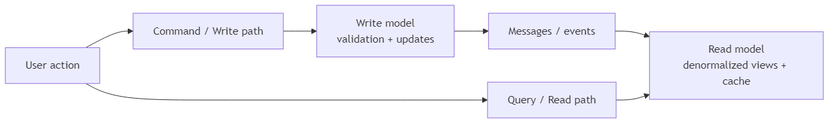
Why CQRS fits well with vertical slices
CQRS separates reads from writes
Read side can be optimized for display and performance
Write side can be optimized for business rules and updates
Messaging keeps the two stacks coordinated
A feature slice can implement both read and write concerns together
Notes:
Duration ~00:03
Explain that Command Query Responsibility Segregation separates the write path from the read path because those two concerns often want different models and optimizations.
On the read side, teams may denormalize data, cache aggressively, or build projections for fast display. On the write side, the focus is enforcing rules, validating intent, and updating authoritative data correctly.
Now connect it back to vertical slices: each feature can own both its command side and its query side. That makes CQRS feel less abstract because the pattern is implemented within a feature boundary rather than as a separate architectural island.
Transition with: "Let's close with the main ideas you want people to remember after this section."
---
Source: slides\marp\vertical-slicing-architecture-introduction.deck.md

Slide 39
Key takeaways
Organize by feature when you want stronger business boundaries
Keep everything needed for a feature in one place
Prefer independent slices over tightly coupled features
Use localized changes to improve maintainability
Consider CQRS when read and write paths have different needs
Bottom line: vertical slicing improves focus, flow, and long-term maintainability.
Notes:
Duration ~00:01
Use about one minute to close. Recap that vertical slicing is primarily about improving feature ownership and reducing the cost of change.
Reinforce that the architecture helps both individuals and teams: developers move faster, changes are easier to contain, and the codebase better reflects how the business thinks about work.
If you want an audience prompt, ask which current feature in their codebase would be easiest to convert into a first slice. That question helps bridge the presentation into practical adoption.
End by signaling that the next step is usually implementation guidance, where teams define commands, handlers, validators, and feature-level tests.
---
Source: slides\marp\vertical-slicing-architecture-introduction.deck.md

Slide 40
Course Modules
Intro
Specification Driven Software Development
Architecture Specification
Technology Specification
Implementation Specification
▶ Implementation Planning
Implementation Prompts
Vertical Slice Implementation
Code Review with GitHub Copilot
Notes:
Auto-generated course navigation slide showing all modules with current section highlighted

Slide 41
The Blueprint Before the Blueprint
16-minute teaching segment
Focus: how to plan before implementation
Goal: turn requirements into executable slices
Notes:
Open by framing this section as the bridge between architecture guidance and actual delivery planning.
Explain that vertical slices are not just a coding pattern; they are also a planning tool. The point of the section is to help the audience see how to move from requirements to a buildable roadmap.
Spend a few seconds previewing the three parts of the talk: reviewing the planning instruction file, generating implementation plans with AI, and improving those plans through multi-model evaluation.
---
Source: slides\marp\vertical-slice-implementation-plans.deck.md

Slide 42
What this section covers
Vertical slice planning instruction file
Slice identification strategies
Decomposition principles
AI-assisted implementation planning
Slice specifications and roadmaps
Notes:
Use this slide as a table of contents for the section. Keep the pace brisk and make it clear that each bullet corresponds to a practical planning step teams can repeat.
Emphasize that the section is intentionally operational. It is about making slices small enough to implement, complete enough to deliver value, and structured enough that AI can help generate plans instead of vague suggestions.
Transition by saying the first step is understanding the instruction file that defines the planning rules.
---
Source: slides\marp\vertical-slice-implementation-plans.deck.md

Slide 43
7.1 Review the planning instructions
Reference point:
.github/instructions/vertical-slice-planning.instructions.md
What it provides:
Strategy selection guidance
Decomposition rules
Dependency analysis prompts
Slice definition templates
Notes:
Introduce the instruction file as the planning playbook. It tells both humans and AI how to reason about a feature before code is written.
Call out that a strong instruction file improves consistency. Instead of every plan starting from scratch, the team gets a repeatable way to identify slices, document dependencies, and define an implementation sequence.
Mention that the file is valuable even when AI is not involved because it clarifies how the team wants work decomposed.
---
Source: slides\marp\vertical-slice-implementation-plans.deck.md

Slide 44
Slice identification strategies
Strategy | Best fit
User action decomposition | End-to-end user flows
Entity CRUD operations | Simple data management
Workflow stage decomposition | Multi-step processes
Business event decomposition | Event-driven behavior
CQRS-optimized slicing | Distinct read/write paths
Notes:
Walk the audience through the five strategies and explain that no single strategy is always correct. The right one depends on the kind of behavior being modeled.
For user action decomposition, use an example like "submit order" or "reset password." For CRUD, use admin maintenance screens. For workflow stages, mention onboarding or approvals. For business events, use order placed or payment failed. For CQRS, explain separating queries from commands when reads and writes differ significantly.
Stress that the planning file helps choose a strategy rather than forcing one pattern onto every feature.
---
Source: slides\marp\vertical-slice-implementation-plans.deck.md

Slide 45
Decomposition principles
Single responsibility per slice
Complete vertical stack from UI/API to data
No horizontal sharing as the unit of delivery
Minimize external dependencies
Size slices to be valuable and manageable
Rule of thumb
Avoid slices that are too big to finish or too small to matter.
Notes:
This slide defines the quality bar for a slice. Explain that a slice should deliver one meaningful capability and contain everything needed to implement that capability end to end.
Clarify "no horizontal sharing" by contrasting a real slice with a layer-based task such as "build all repositories first." Horizontal work may still exist, but it should not become the primary planning unit.
Use the phrase "valuable and manageable" more than once. That is the balance teams often miss when they either create giant epics or tiny technical chores that produce no user value.
---
Source: slides\marp\vertical-slice-implementation-plans.deck.md

Slide 46
Analyze before you slice
Ask these questions first:
What data does this slice read or change?
What services or APIs does it depend on?
Can it be deployed independently?
Does a different strategy fit better?
Decision aid:
flow -> dependencies -> size check -> sequence
Notes:
Explain that slicing is not just naming features. It requires examining data dependencies and service dependencies before locking in the plan.
Walk through the decision aid from left to right. Start with the flow, then look at dependency boundaries, then check whether the proposed slice is too large or too fragmented, and finally place it into an execution sequence.
This is a good moment to remind the audience that planning errors often come from ignoring dependencies until implementation begins.
---
Source: slides\marp\vertical-slice-implementation-plans.deck.md

Slide 47
7.2 Generate plans with AI
Example prompt:
Using vertical slice planning instructions and web calculator requirements, create implementation plan using vertical slices.
AI can generate:
Requirements summary
Slice decomposition
Dependency diagram
Implementation order
Sprint organization
Notes:
Explain that the prompt works because it combines two inputs: the planning instructions and the actual feature requirements. Without both, the output is usually too generic.
Point out that this is where AI becomes a planning accelerator. Instead of starting from a blank page, the team gets a draft plan containing slices, dependencies, sequencing, and potential sprint structure.
Also note that the prompt is intentionally simple. The quality comes from the instruction file and source requirements, not from a complicated prompt.
---
Source: slides\marp\vertical-slice-implementation-plans.deck.md

Slide 48
What a good AI plan should include
1. Clear summary of requirements
2. Identified slices with rationale
3. Dependency relationships
4. Proposed implementation sequence
5. Sprint or milestone grouping
Watch for model differences
More detail vs. more concise output
Different naming and grouping choices
Different sequencing assumptions
Notes:
Use this slide to define evaluation criteria for AI-generated plans. The audience should leave knowing what "good" looks like, not just that AI can produce something.
Explain that different models may emphasize different aspects. One might provide stronger rationale, another might produce cleaner sequencing, and another might be better at summarizing requirements.
Encourage the audience to compare outputs rather than assuming the first plan is correct. This leads naturally into the multi-model review exercise.
---
Source: slides\marp\vertical-slice-implementation-plans.deck.md

Slide 49
Example planning flow
Web calculator example
1. Summarize calculator requirements
2. Identify slices such as input, operations, history, validation
3. Map data and service dependencies
4. Sequence foundational slices before enhancements
5. Group slices into sprints
Notes:
Translate the abstract process into a concrete example. Use the calculator scenario because it is simple enough to understand quickly while still showing real decomposition choices.
Mention that one model may group input and validation together, while another may separate them. One may treat history as a later slice because it depends on completed calculations. These are exactly the kinds of planning differences worth discussing.
Reinforce that the output is not just a list of tasks. It is a roadmap with ordering logic.
---
Source: slides\marp\vertical-slice-implementation-plans.deck.md

Slide 50
7.3 Multi-model evaluation
Gemini 2.5 Pro reviewed Claude Sonnet's planning file and found six gaps:
1. Missing task duration metadata
2. Incomplete decomposition examples
3. Incomplete dependency strategy examples
4. Unfinished implementation sequencing examples
5. Incomplete roadmap template
6. Incomplete slice specification template
Notes:
Present this as a quality-improvement exercise, not a competition between models. The value comes from using one model to review the blind spots of another.
Walk through the six findings quickly and frame them as practical improvements. These are not cosmetic issues; they affect whether teams can actually use the planning artifact consistently.
Highlight that evaluation uncovered missing completeness in examples and templates, which matters because templates are what guide future AI generations.
---
Source: slides\marp\vertical-slice-implementation-plans.deck.md

Slide 51
Key takeaway
Recommended workflow
instructions -> AI draft -> review -> refine -> implement
Start with a strong planning instruction file
Generate an initial vertical slice plan
Compare outputs across models when useful
Improve templates and examples over time
Notes:
Close with the repeatable workflow. This gives the audience a practical method they can adopt immediately.
Emphasize that the instruction file is the stable asset, AI provides the first draft, and multi-model review improves quality. Over time, the planning assets themselves get better, which improves every future plan.
End by connecting this section to execution: once the slices and roadmap are solid, implementation becomes faster, safer, and easier to parallelize.
---
Source: slides\marp\vertical-slice-implementation-plans.deck.md

Slide 52
Everything Depends on This Slide (Literally)
Section focus: using dependency graphs to sequence vertical slice implementation
Outcome: show how teams identify prerequisites, parallel work, and the critical path
Notes:
Duration ~00:04
Introduce this section as the point where planning becomes executable rather than aspirational. Explain that dependency analysis helps the team decide what must be built first, what can safely wait, and what can happen in parallel without creating blockers. Transition by showing a simple dependency graph and explaining how to read it.
---
Source: slides\marp\dependency-analysis-planning.deck.md

Slide 53
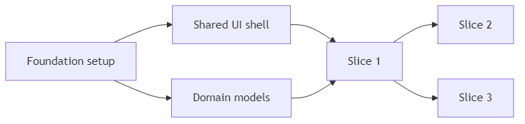
Read the Dependency Diagram
Nodes represent slices, features, or enabling work
Arrows show that one item depends on another being complete first
Read from left to right or top to bottom to understand sequencing
Look for root nodes with no prerequisites
Notes:
Duration ~00:01
Explain that a dependency graph is a visual map of implementation order, not just a picture of the system. Root nodes such as foundation setup are important because they unlock other work, while downstream nodes cannot start safely until their prerequisites exist. Transition by asking which path through the graph will determine overall progress.
---
Source: slides\marp\dependency-analysis-planning.deck.md

Slide 54
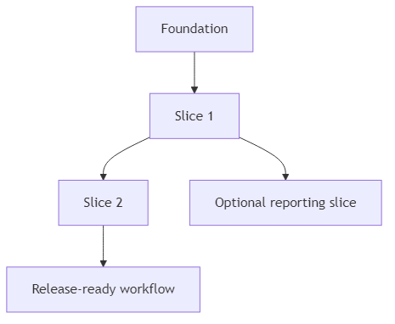
Find the Critical Path
The critical path is the longest chain of dependent work
Delays on that path delay the overall implementation plan
Independent branches matter, but they do not all block delivery equally
Focus coordination and risk management on the path that controls completion
Notes:
Duration ~00:01
Make the point that not every task has the same scheduling weight. The chain from foundation through Slice 1 and Slice 2 to release readiness is the critical path because a delay anywhere in that line affects the final delivery date. Transition by showing that some branches can still be parallelized once the right prerequisites are in place.
---
Source: slides\marp\dependency-analysis-planning.deck.md

Slide 55
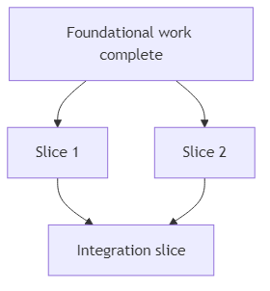
Sequence First, Parallelize Second
Some slices are strictly sequential because they share prerequisites
Other slices can run in parallel after the same foundation is done
Parallel work increases speed only when dependencies are already satisfied
Planning should prevent teams from starting blocked work too early
Notes:
Duration ~00:01
Explain that parallelization is useful, but only after the common enabling work is complete. In this example, Slice 1 and Slice 2 can move at the same time, yet the integration slice must wait until both are finished, so sequencing still matters. Transition by separating foundational work from dependent features so the audience can see how to prioritize the backlog.
---
Source: slides\marp\dependency-analysis-planning.deck.md

Slide 56
Distinguish Foundational and Dependent Features
Foundational work
environments, shared components, core models, base services
Dependent features
user-facing slices that rely on those shared capabilities
Planning rule
finish enabling work first when many later slices depend on it
Notes:
Duration ~00:01
Clarify that foundational work is valuable because it unlocks many downstream slices, not because it is glamorous. Dependent features usually deliver visible business value, but they become risky or inefficient if the core infrastructure they need is missing or unstable. Transition by summarizing a lightweight planning process the team can repeat for every implementation plan.
---
Source: slides\marp\dependency-analysis-planning.deck.md

Slide 57
Use Dependency Analysis to Plan the Roadmap
1. List slices and enabling work
2. Draw the dependency relationships
3. Identify the critical path
4. Mark which branches can run in parallel
5. Schedule foundational work before dependent features
Bottom line: dependency graphs turn a feature list into a realistic implementation sequence.
Notes:
Duration ~00:01
Close by turning the concept into a repeatable planning workflow. The audience should leave with the idea that dependency analysis is a small upfront investment that prevents scheduling confusion, blocked development, and unrealistic sequencing later. End by connecting this back to vertical slices, where smart sequencing makes incremental delivery much easier.
---
Source: slides\marp\dependency-analysis-planning.deck.md

Slide 58
Course Modules
Intro
Specification Driven Software Development
Architecture Specification
Technology Specification
Implementation Specification
Implementation Planning
▶ Implementation Prompts
Vertical Slice Implementation
Code Review with GitHub Copilot
Notes:
Auto-generated course navigation slide showing all modules with current section highlighted

Slide 59
The Prompt That Does the Implementation (With a Checklist)
Section focus: turning slice plans into actionable build prompts
Outcome: show how to generate slice-specific prompts, verify behavior, and prepare stakeholder demos
Notes:
Duration ~00:22
Introduce this section as the bridge between planning and actual implementation. The audience should understand that a slice plan becomes much more useful when it is converted into a precise prompt that tells the AI what to build, how to verify it, and how to demonstrate it. Transition by asking what information a good implementation prompt must capture before any code is generated.
---
Source: slides\marp\implementation-prompts-verification.deck.md

Slide 60
Start from a Single Slice
Choose one slice from the implementation plan
Example: Slice 1 - Display Current Value
Use the slice instructions plus the implementation plan as source context
Write one prompt file per slice so scope stays narrow and testable
Notes:
Duration ~00:02
Explain that the best implementation prompts are intentionally narrow. Rather than asking for an entire application, the team picks one slice from the plan and turns that into a focused request that can be reviewed and tested independently. Transition by showing what the actual prompt needs to contain once the slice is chosen.
---
Source: slides\marp\implementation-prompts-verification.deck.md

Slide 61
What the Implementation Prompt Should Say
Reference the slice instructions and the implementation plan directly
Ask the model to implement the selected slice
Require verification steps in the output
Require showcase instructions for stakeholder demonstration
Prompt pattern
Using slice X instructions and implementation plan, create a prompt file that implements slice 1. Include verification steps and showcase instructions that demonstrate the functionality to stakeholders.
Notes:
Duration ~00:03
Frame this slide around prompt construction, not just prompt wording. The important move is that the request names the slice, points to the governing instructions, and asks for more than code generation by explicitly requiring verification and demonstration guidance. Transition by breaking down the expected deliverables inside the generated prompt file.
---
Source: slides\marp\implementation-prompts-verification.deck.md

Slide 62
Expected Deliverables Inside the Prompt File
Files to create
index.html
styles.css
main.js
Specifications to include
HTML structure requirements
CSS colors, fonts, spacing, and layout
JavaScript behavior for current value, display object, and update function
File structure and component organization
Notes:
Duration ~00:03
Walk through the prompt output as if you are reviewing a generated file with the class. The goal is not merely to list filenames, but to show that the prompt should describe what each file is responsible for and how the pieces fit together. Transition by moving from implementation detail to the checks that prove the slice actually works.
---
Source: slides\marp\implementation-prompts-verification.deck.md

Slide 63
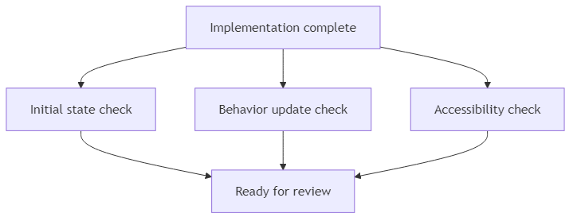
Build Verification into the Prompt
Initial state: calculator displays 0 on page load
State update: changing the value in the console updates the display
Accessibility: contrast ratio >= 4.5:1 and font size >= 2rem
Include both automated testing guidance and manual verification steps
Notes:
Duration ~00:04
Explain that verification should be authored before or alongside implementation, not after the fact. The checks on this slide are strong examples because they cover default state, observable behavior, and accessibility requirements in a way that reviewers and demonstrators can both understand. Transition by showing how showcase instructions differ from verification even though the two are related.
---
Source: slides\marp\implementation-prompts-verification.deck.md

Slide 64
Showcase Instructions Should Target Humans
Do more than paste a code snippet
Describe what users see and what they can do
Call out the behavior the demonstrator should point to
Provide an interactive demo path for stakeholders
Good showcase guidance includes
1. starting state on screen
2. action to take
3. visible result
4. why it matters to the audience
Notes:
Duration ~00:03
Make the distinction between proving correctness and presenting value. Verification asks whether the slice works; showcase guidance tells a human demonstrator how to walk stakeholders through what appears on screen, what changes, and why they should care. Transition by expanding from one slice to the broader roadmap of multiple prompts.
---
Source: slides\marp\implementation-prompts-verification.deck.md

Slide 65
Repeat the Pattern Across All Slices
Create additional prompt files for Slice 2, Slice 3, and so on
Version-control each prompt so changes stay traceable
Reuse prompts later for revisions or follow-on work
Execute slices sequentially and review each result before moving on
Build a complete implementation roadmap with systematic verification
Bottom line: slice-specific prompts create a repeatable path from plan to implementation to review.
Notes:
Duration ~00:03
Close by connecting the single-slice example to the full delivery workflow. Each prompt becomes a reusable unit of work that can be re-run, refined, and audited over time, which is especially useful when implementation spans multiple sessions or contributors. End by encouraging the audience to treat prompt files as versioned implementation assets, not disposable chat text.
---
Source: slides\marp\implementation-prompts-verification.deck.md

Slide 66
Course Modules
Intro
Specification Driven Software Development
Architecture Specification
Technology Specification
Implementation Specification
Implementation Planning
Implementation Prompts
▶ Vertical Slice Implementation
Code Review with GitHub Copilot
Notes:
Auto-generated course navigation slide showing all modules with current section highlighted

Slide 67
Thin Slices, Big Results
Goal: deliver working software in thin, end-to-end slices
Pattern: plan dependencies first, then parallelize safe slices
Outcome: faster feedback and lower integration risk
Notes:
Introduce the deck as a practical delivery workflow, not just an architecture concept. Emphasize that each vertical slice includes API, domain logic, persistence, and tests. Mention that parallel work is possible only after dependency analysis confirms slice independence.
---
Source: slides\marp\basic-vertical-slice-workflow.deck.md

Slide 68
Step 1: Define Slice Boundaries
Start from user-visible use cases
Split by business capability, not technical layer
Keep each slice independently testable
Write a short definition for every slice:
Scope
Inputs/outputs
Done criteria
Notes:
Explain that teams should avoid horizontal tasks like build all repositories first. Reinforce that each slice should produce demonstrable value. Recommend a short template for each slice so implementation and review stay consistent.
---
Source: slides\marp\basic-vertical-slice-workflow.deck.md

Slide 69
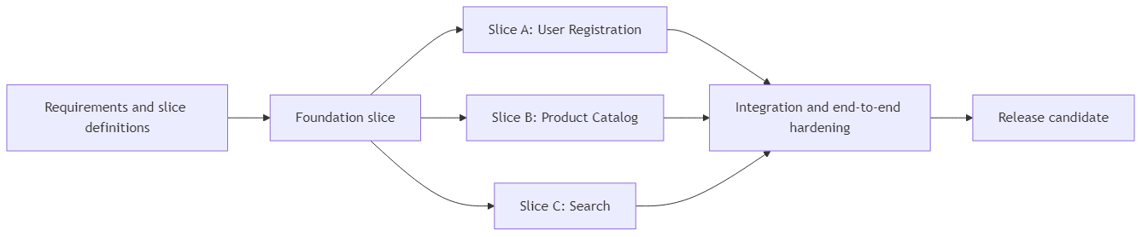
Step 2: Build the Implementation Plan
Identify dependency chain first
Mark slices as:
Foundation (must go first)
Parallel-ready (can run together)
Integration/cleanup (must go last)
Sequence by risk and coupling
Notes:
Walk left to right. Call out that Foundation might include authentication baseline, shared contracts, and CI setup. Then point to slices A, B, and C as intentionally parallel lanes. Close by explaining that integration hardening is a separate explicit phase.
---
Source: slides\marp\basic-vertical-slice-workflow.deck.md

Slide 70
Step 3: Execute Slices in Parallel
Assign owners per slice lane
Use trunk-based integration with short-lived branches
Keep contracts stable and versioned
Demo each slice as soon as done
Parallel execution guardrails:
No hidden cross-slice dependencies
Shared schema changes reviewed early
Contract tests required before merge
Notes:
Emphasize team coordination practices. Explain that parallel work fails when contracts are ambiguous. Recommend daily integration checks and a lightweight dependency board to catch collisions early.
---
Source: slides\marp\basic-vertical-slice-workflow.deck.md

Slide 71
Step 4: Integrate, Validate, and Stabilize
Run full end-to-end and regression tests
Validate non-functional requirements:
Performance
Security
Observability
Close documentation and operational runbooks
Freeze only when release criteria are met
Notes:
Describe this as controlled convergence, not a big bang merge. Point out that each slice already passed its own checks, so this phase focuses on system behavior and production readiness. Encourage using release checklists to avoid late surprises.
---
Source: slides\marp\basic-vertical-slice-workflow.deck.md

Slide 72
Practical Starter Plan (Example)
Week 1
Foundation slice
Finalize contracts
Week 2
Slice A and Slice B in parallel
Slice C starts mid-week after shared dependency lands
Week 3
Integration hardening
UAT and release prep
Notes:
Use this final slide as a reusable planning pattern. Mention that exact durations vary, but the structure remains stable: foundation, parallel execution, then hardening. Invite participants to adapt this pattern to their own project backlog.
---
Source: slides\marp\basic-vertical-slice-workflow.deck.md

Slide 73
Course Modules
Intro
Specification Driven Software Development
Architecture Specification
Technology Specification
Implementation Specification
Implementation Planning
Implementation Prompts
Vertical Slice Implementation
▶ Code Review with GitHub Copilot
Notes:
Auto-generated course navigation slide showing all modules with current section highlighted

Slide 74
The Code Review That Doesn't Ghost You
Section focus: moving from implementation into PR creation, review, and comment resolution
Outcome: show how teams combine human and AI review to improve a slice before merge
Notes:
Duration ~00:12
Introduce this section as the quality gate that turns implementation work into team-reviewed delivery. Explain that the goal is not only to open a pull request, but to create a workflow where human reviewers and AI reviewers can both contribute useful feedback before the slice is merged. Transition by starting with the mechanics of creating the pull request itself.
---
Source: slides\marp\pull-request-code-review.deck.md

Slide 75
Create the Pull Request Cleanly
Use a focused branch name such as slice-1
Follow the normal Git flow: commit, push, and create the PR
Link the pull request to its issue in the development section
Keep the PR scoped to one slice so review stays clear and actionable
Notes:
Duration ~00:02
Explain that a clean review starts with a clean pull request. Branch naming, a narrow slice-focused scope, and issue linkage all make it easier for both humans and AI to understand what the change is supposed to accomplish and what context it belongs to. Transition by showing what happens once the PR is open and reviewers are assigned.
---
Source: slides\marp\pull-request-code-review.deck.md

Slide 76
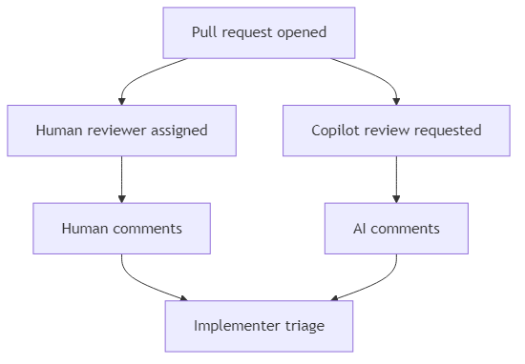
Run Human and AI Review in Parallel
Assign a human reviewer such as Christopher
Initiate GitHub Copilot code review on the pull request
Wait a few minutes for AI-generated comments to arrive
Route implementation work clearly by assigning the issue to the implementer
Use parallel review to shorten feedback time without sacrificing judgment
Notes:
Duration ~00:02
Make the point that human review and AI review are complementary rather than competitive. The human reviewer brings context, intent, and domain judgment, while Copilot can scan for policy violations, code smells, and other issues that might be easy to miss in a first pass. Transition by looking at the kinds of issues the AI reviewer surfaced.
---
Source: slides\marp\pull-request-code-review.deck.md

Slide 77
What the AI Review Flagged
Missing AI provenance metadata in Markdown files
DOM element access patterns that could be improved
Multiple additional code quality concerns across the change set
Why this matters
1. metadata gaps break traceability requirements
2. DOM patterns affect maintainability and clarity
3. mixed quality issues show the value of automated review breadth
Notes:
Duration ~00:02
Use this slide to summarize the review findings before going into comment-handling mechanics. The key takeaway is that the AI review did not focus on one narrow category of defects; it found documentation compliance issues, implementation-pattern concerns, and general quality problems in the same run. Transition by focusing on how the team should interpret and respond to the comments.
---
Source: slides\marp\pull-request-code-review.deck.md

Slide 78
Review Comments Still Require Judgment
Some comments should be fixed immediately
Some suggestions may depend on project context
Not every AI recommendation is automatically correct or worth implementing
Teams need to decide whether to implement, defer, or ignore each point
Good reviewer questions
Does this comment identify a real defect?
Does the suggestion fit repository conventions?
Is the proposed fix worth the churn right now?
Notes:
Duration ~00:02
Stress that AI review produces input, not orders. Review comments can be helpful, but the team still has to evaluate whether a suggestion is accurate, relevant to the slice, and worth making before merge, especially when recommendations touch patterns or style rather than outright defects. Transition by showing practical ways to handle comments once the team decides to act.
---
Source: slides\marp\pull-request-code-review.deck.md

Slide 79
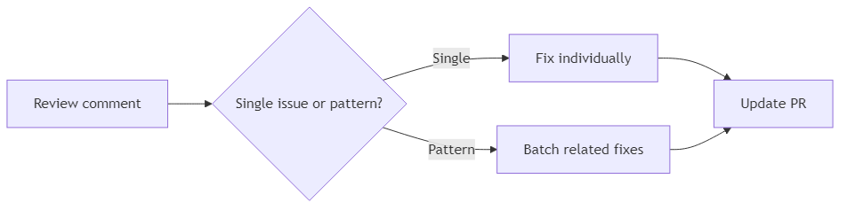
Address Comments One by One or in Batches
Reference specific review comments when preparing fixes
Handle comments individually when the issues are distinct or risky
Batch fixes when several comments point to the same underlying problem
Use copy-paste or direct AI interaction with comments depending on the workflow
Typical fixes here included metadata updates and code-pattern adjustments
Notes:
Duration ~00:02
Explain that comment resolution is partly a coordination problem. If comments are unrelated, it is safer to handle them one at a time so the reasoning stays clear, but if several comments all stem from the same root cause, batching them can reduce churn and speed up the next review pass. Transition by ending with the broader workflow lessons the team should keep using.
---
Source: slides\marp\pull-request-code-review.deck.md

Slide 80
Process Takeaways for Future PRs
GitHub Copilot can participate as a code reviewer alongside humans
AI review usually takes a few minutes, so plan for that latency
Review comments can be handled individually or in grouped passes
Manual reviewers and AI reviewers are strongest when used together
Better prompts and instructions can reduce recurring review findings
Bottom line: strong PR workflow is not just about opening the review, but about turning feedback into better code and better guidance.
Notes:
Duration ~00:02
Close by tying the mechanics back to team process. The audience should leave with the idea that a pull request is a collaborative checkpoint where both human judgment and AI-assisted review improve quality, and where recurring feedback should eventually drive updates to instructions, prompts, and testing standards. End by suggesting that every repeated review comment is a candidate for strengthening the guidance upstream.
---
Source: slides\marp\pull-request-code-review.deck.md

Slide 81
The AI Reviewer Who Never Says "Looks Good to Me"
Section focus: using Copilot review feedback to improve code, tests, and instructions
Outcome: show what Copilot found in PR #4, how humans resolved it, and how review findings feed better standards
Notes:
Duration ~00:18
Introduce this section as a practical demonstration of Copilot acting as a review assistant rather than a code generator. Explain that the value is not just in the comments themselves, but in how the review surfaces patterns such as correctness issues, compliance gaps, and recurring quality risks. Transition by showing the review workflow from pull request to human action.
---
Source: slides\marp\github-code-review-with-copilot.deck.md

Slide 82
How the Review Flow Worked
Open the pull request and request Copilot review
Copilot analyzes changed files and leaves review comments
Review findings are grouped around correctness, maintainability, and compliance
Humans still decide what to fix, how to fix it, and when to close comments
Commit suggestions can accelerate straightforward cleanups
Notes:
Duration ~00:02
Walk through the process as a collaboration loop rather than an automated approval gate. Copilot can inspect the diff quickly and highlight issues, but the team still has to evaluate the feedback, decide which comments are valid, and implement the actual fixes. Transition by summarizing the kinds of issues the review identified.
---
Source: slides\marp\github-code-review-with-copilot.deck.md

Slide 83
What Copilot Found in PR #4
Finding area | Example issue | Why it matters
Unicode usage | non-standard minus sign in comparisons | can cause subtle behavior or readability issues
State management | clearing errors leaves expression tokens behind | UI state becomes inconsistent
Compliance | AI provenance header missing | repository policy violation
Dead code | unused constants and functions | noise, confusion, and maintenance cost
Testing gaps | subtraction coverage called out | bugs can slip through
Notes:
Duration ~00:02
Use this slide to give the audience a fast inventory of the feedback categories before you zoom in on individual examples. The important takeaway is that one review surfaced both code-level problems and process-level issues, which shows why review is valuable even when the code appears to work. Transition by taking the two most concrete implementation findings first.
---
Source: slides\marp\github-code-review-with-copilot.deck.md

Slide 84
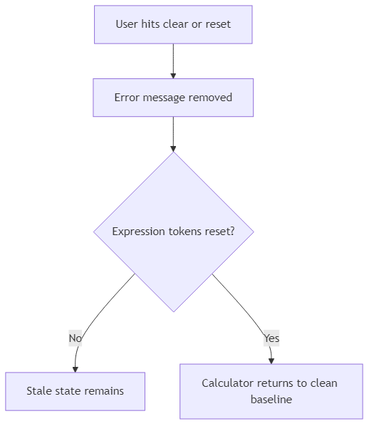
Code Review Findings: Correctness Problems
Unicode comparison issue
review recommended replacing a Unicode minus character with the standard ASCII -
consistent character usage improves safety and maintainability
State management issue
clearing the error state did not fully reset expression tokens
partial reset behavior can leave stale calculation state behind
Notes:
Duration ~00:03
Explain that these two findings are especially useful because they highlight different kinds of correctness risk. The Unicode issue is small but important because unusual characters can be hard to spot and may behave differently across tools, while the state-reset issue is a deeper logic problem because the UI looks reset even when internal state is not. Transition by moving from correctness to the policy and cleanup findings.
---
Source: slides\marp\github-code-review-with-copilot.deck.md

Slide 85
Code Review Findings: Compliance and Cleanup
Previously compliant files were missing required AI provenance headers
Unused constants and helper functions were identified as dead code
Review also noted subtraction test coverage gaps
Together, these findings show that review should check policy, clarity, and verification, not just functionality
Review lens
1. Does the code work?
2. Does it follow repository rules?
3. Is there unnecessary code left behind?
4. Do tests prove the risky behavior?
Notes:
Duration ~00:03
Frame this slide as the broader quality story behind the pull request. Missing provenance metadata is not just a formatting issue in this repository, because it breaks traceability requirements, while dead code and testing gaps both increase the chance of future confusion or regressions. Transition by describing what the review experience looked like for the humans involved.
---
Source: slides\marp\github-code-review-with-copilot.deck.md

Slide 86
What We Observed About the Review Process
Copilot's visible "thinking process" helped explain why comments were being made
Review output still required manual interpretation and manual resolution
The review became a teaching tool, not just a defect list
Some feedback suggested improvements to instruction files, not only to source files
Important point: AI review assists judgment, but it does not replace reviewer accountability.
Notes:
Duration ~00:03
Explain that part of the educational value came from seeing how the review reasoned about the diff. Even when the comments were useful, someone still had to verify the issue, choose the right fix, and decide whether the underlying instructions or prompts should change to prevent the same mistake next time. Transition by showing how the team can use those findings to strengthen the instruction layer.
---
Source: slides\marp\github-code-review-with-copilot.deck.md

Slide 87
Use Review Output to Improve the Instructions
Tighten instruction files so recurring issues are prevented earlier
Add explicit rules for ASCII-safe operators and character usage
Clarify state reset expectations for error handling and token cleanup
Reinforce provenance requirements where generated files are expected
Expand tests around risky operations such as subtraction and clear-state behavior
Bottom line: the best outcome is not only fixing the PR, but improving the prompts and instructions that shape future PRs.
Notes:
Duration ~00:03
Close by connecting review feedback to process improvement instead of treating comments as isolated repairs. If the same issues can recur, the right move is to update the instruction files, prompt guidance, or test expectations so future generated code starts from a stronger baseline. End by summarizing that Copilot review is most valuable when it improves both the current change and the next one.
---
Source: slides\marp\github-code-review-with-copilot.deck.md

Slide 88
gh pr merge --squash (and Mean It)
Section focus: managing pull requests with GitHub settings, IDE tooling, and the gh CLI
Outcome: show how merge policy, review tools, and token permissions shape the day-to-day PR workflow
Notes:
Duration ~00:11
Introduce this section as the operational layer around pull requests rather than a pure coding topic. Explain that teams need to understand not only how to create and review PRs, but also how repository settings, IDE integrations, and CLI permissions determine what they can do efficiently. Transition by starting with the merge strategy decision that affects every PR.
---
Source: slides\marp\github-cli-pr-management.deck.md

Slide 89
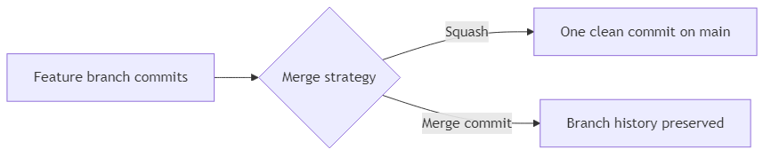
Start with the Merge Strategy
Decide whether the repository defaults to squash merge or merge commit
Squash merge keeps history compact and easier to scan
Merge commits preserve the exact branch history and commit grouping
This choice lives in GitHub repository pull request settings
Notes:
Duration ~00:02
Explain that merge strategy is a governance decision, not just a button choice at the end of a pull request. Squash merges can make the main branch easier to read, while merge commits retain more detail about how work evolved, so teams should choose based on their review and history preferences. Transition by moving from repository settings into the tools people use to work with PRs day to day.
---
Source: slides\marp\github-cli-pr-management.deck.md

Slide 90
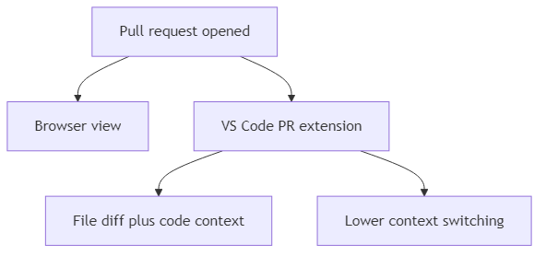
Use the Right PR Tools for Context
The GitHub Pull Requests extension for VS Code keeps PR context inside the IDE
Viewing PRs in the editor reduces browser switching
Local code, review comments, and changed files are easier to compare side by side
IDE-based review is especially helpful when debugging comment context
Notes:
Duration ~00:02
Make the point that tooling choice affects reviewer efficiency. When developers can see the PR, the code, and their local workspace in one environment, they spend less time reconstructing context and more time evaluating the actual change. Transition by showing how the CLI fits into that same workflow.
---
Source: slides\marp\github-cli-pr-management.deck.md

Slide 91
Use the CLI for PR Comment Work
The gh CLI can support PR comment and review workflows from the terminal
Team members explored gh pr comment commands for practical resolution workflows
CLI-based actions are useful when scripting or avoiding extra UI navigation
Not every review action is equally convenient or permitted through the CLI
Typical CLI goal
inspect PR status
add comments
help coordinate comment resolution
Notes:
Duration ~00:02
Frame this slide around exploration and experimentation rather than a promise that every review action is frictionless. The CLI is powerful because it lets developers stay in terminal-first workflows and script repeated actions, but there are still limits depending on permissions, command support, and token setup. Transition by showing that Copilot review itself still often starts in the GitHub web interface.
---
Source: slides\marp\github-cli-pr-management.deck.md

Slide 92
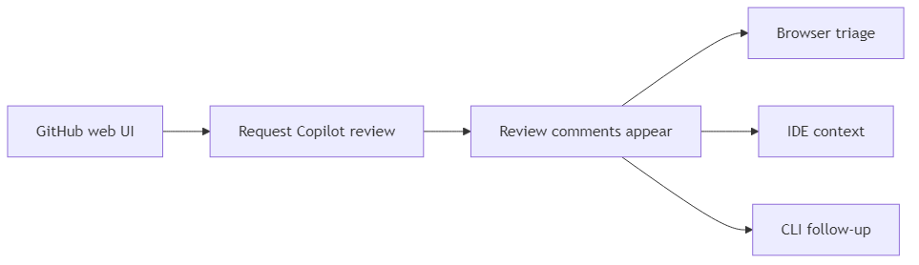
Request Copilot Review and Then Triage the Output
Copilot code review can be requested from the GitHub web interface
After review arrives, teams can use browser, IDE, or CLI tools to manage follow-up work
Good workflow means choosing the best tool for each step, not forcing one interface for everything
Review handling still depends on repository settings and auth permissions
Notes:
Duration ~00:02
Explain that PR management is often multi-surface by nature. A team may request the Copilot review in the web UI, inspect the comments in the IDE for better context, and then use the CLI for quick status checks or scripted follow-up actions, so the workflow is hybrid rather than exclusive. Transition by focusing on why permissions often become the limiting factor.
---
Source: slides\marp\github-cli-pr-management.deck.md

Slide 93
Permissions Can Block the Best Workflow
Personal access token scopes determine what CLI operations are allowed
Insufficient permissions can prevent review-related commands from working
Teams discussed classic tokens versus fine-grained tokens
Proper permissions are required before CLI review features become reliable
Common friction points
1. token lacks needed repo or review scope
2. command works in theory but fails in practice
3. workflow changes depending on auth model
Notes:
Duration ~00:02
Stress that many workflow frustrations are really authentication problems in disguise. Developers may assume a CLI command is broken when the actual issue is that the token does not have permission to read, comment on, or manage the review workflow the way they expect. Transition by ending with the operational lessons teams should carry forward.
---
Source: slides\marp\github-cli-pr-management.deck.md

Slide 94
Practical Takeaways for PR Management
Choose a merge strategy intentionally and document it
Use the VS Code PR extension when local code context matters
Use gh where it reduces repetitive PR management work
Expect some Copilot review steps to begin in the web interface
Verify token permissions early when CLI features do not behave as expected
Bottom line: strong PR management is a combination of repository settings, tool selection, and the right access model.
Notes:
Duration ~00:02
Close by summarizing that effective PR management is never just about knowing commands. Teams need a clear merge policy, the right interface for the task at hand, and authentication that supports the workflow they want to use, or else the process becomes slower and more confusing than it needs to be. End by encouraging the audience to audit both their tools and their permissions before they need them under pressure.
---
Source: slides\marp\github-cli-pr-management.deck.md

