Slide 1
AI Assisted Software Development
From Code to Copilot

Slide 2
John Michael Miller
Principal Software Engineer at CODE
Played roles of developer, architect, devops engineer, platform engineer, test architect, release manager
AI/ML Enthusiast and advocate for Effectively using AI to write code
LinkedIn: www.linkedin.com/in/johnmichaelmiller
Email: john.miller@codemag.com
Blog: https://codemag.com/blog/AIPractitioner
AI Practitioner Resources

Slide 3


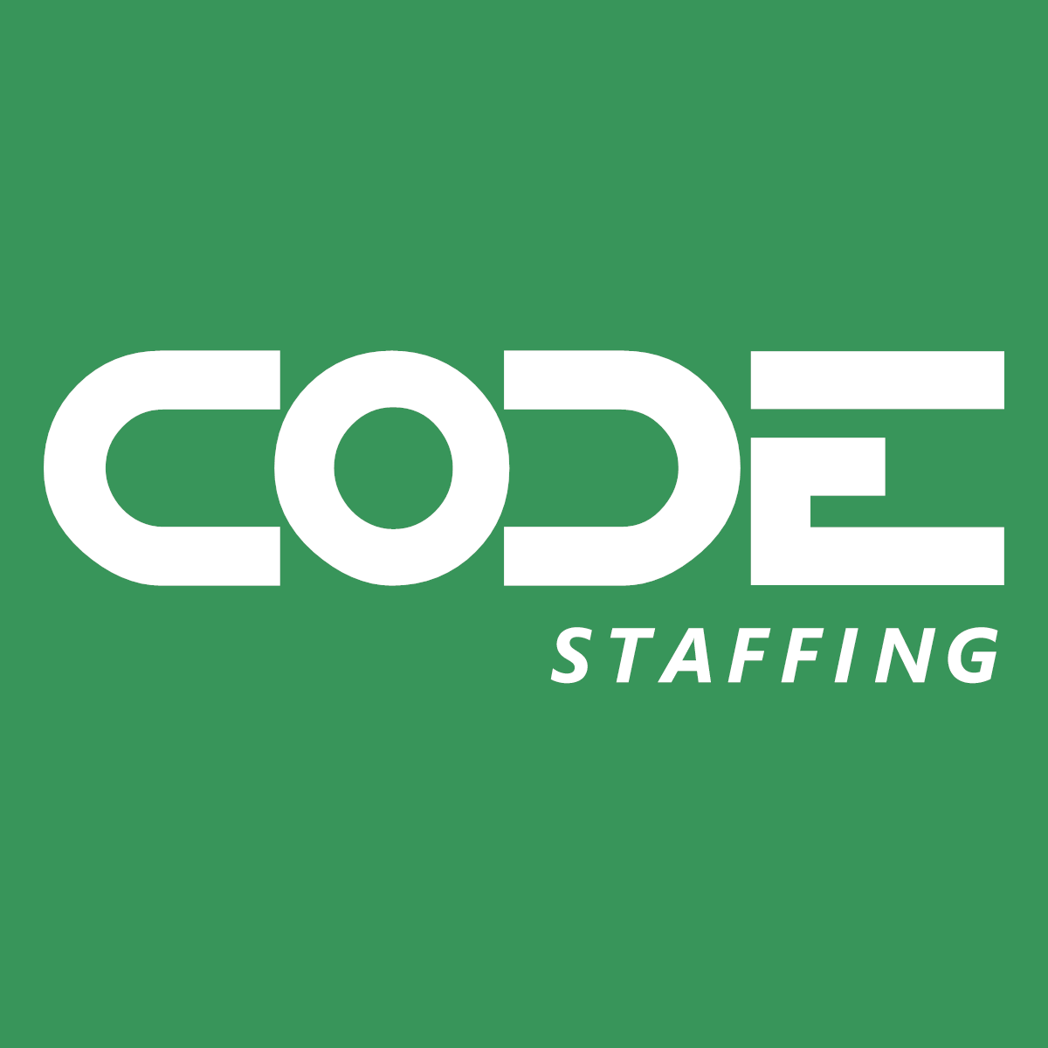

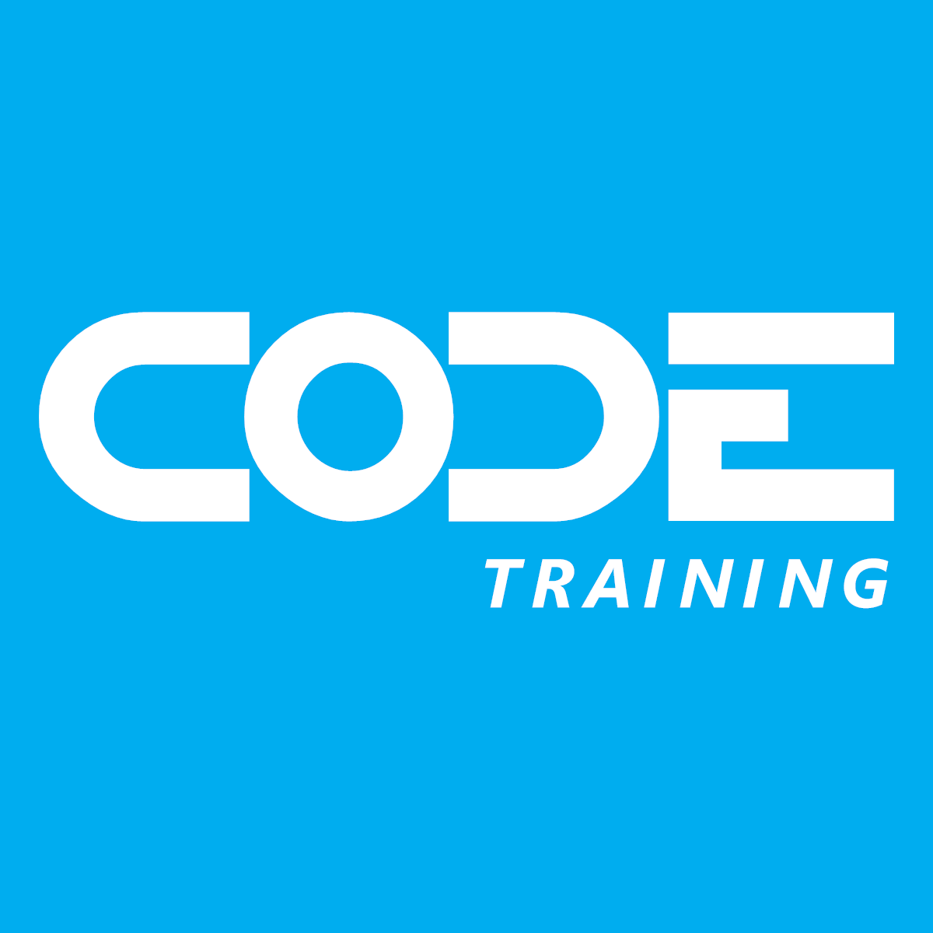
CODE
30 years of “Helping People Build Better Software”
Notes:
CODE is a custom software company, a staff augmentation company, CODE Magazine for software developers, and training like this webinar. We've been in business for 30 years and the magazine just hit its 25th anniversary. Visit the website at https://www.codemag.com/ for more details.

Slide 4
AI Assisted Software Development
Welcome
Introductions
Who you are
Who do you work for
What you do
What you’ve done with AI tools
What you want to learn
Notes:
Day One: Outline the day’s goals and emphasize participation and hands-on exercises.

