Slide 1
AI Assisted Software Development
Requirements → Code

Slide 2
John Michael Miller
Senior Software Engineer at Code Staffing
Played roles of developer, architect, devops engineer, platform engineer, test architect, release manager
AI/ML Enthusiast and advocate for Effectively using AI to write code
LinkedIn: www.linkedin.com/in/johnmichaelmiller
Email: john.miller@codestaffing.com
Blog: https://codemag.com/blog/AIPractitioner

Slide 3
Agenda
AI Assisted Workflow
Project Requirements
  What requirements?
  Conceptual Models
  Workflows
Project Instructions
Implementation Prompts
  Implementation Verification
  Executing Implementation Prompts
Lessons Learned
Iteration 3
Tips and Tricks

Slide 4
Exercise: Fork the repos
Objective: Fork the course repos
Search GitHub for
  AI-Assisted-Software-Development
  zeus.academia.3b
Fork the repos
  This will create a personal copy under your GitHub account
  You can make changes without affecting the original repo

Slide 5
New Development
Creating Custom Chat Modes for Greenfield development
Generating Implementation Prompts & Verification
Wrap-Up and Open Q&A

Slide 6
Greenfield Chat Modes
Business Analyst
  Generate and review requirements

Slide 7
Exercise: Generate Instruction Files
Objective: Create instruction files, some project-specific, some generic, using both manual and Copilot-assisted methods.
Manually create a copilot-instructions.md file and add:
  Business rules
  Workflows
  Purpose
  Tech stack
  Architecture
Use Copilot to generate instruction files using the copilot-instructions.md and the codebase for context.
Bonus:
Review instruction files for errors and omissions.
Ask Copilot to suggest changes based on evolving tech and practices.
Notes:
Generate both project-specific and generic instructions; review and iterate.

Slide 8
Creating Custom Chat Modes
Personas
Workflows
Examples
Agents
Allowing agents to take autonomous action
agent.json
  Safe commands
  Unsafe commands
Notes:
Discuss persona design, safe command lists, and agent.json structure for safe automation.

Slide 9
Exercise: Creating Custom Chat Modes
Objective: Create custom chat modes for the project.
Define personas and workflows for each chat mode.
Implement chat modes using Copilot assistance.
Create an agent.json file with safe commands.
Test the agent’s ability to execute safe commands.
Notes:
Practical steps: define personas, implement agent.json, and test allowed actions in a sandbox.

Slide 10
Starting with Project Requirements
Business rules
Workflows
Tech stack
Architecture
Notes:
Shift to greenfield best practices: requirements, prompts, and verification workflows.

Slide 11
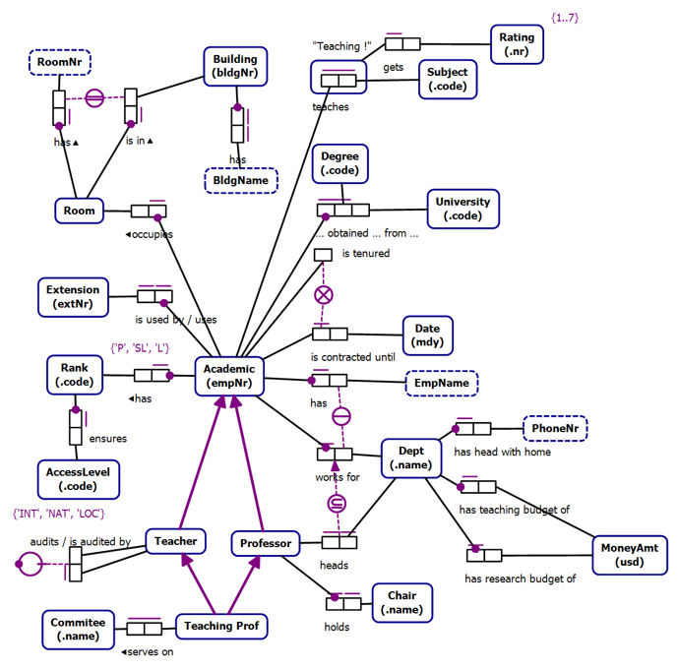
Business Rules as Requirements

Slide 12
Conceptual Models
Technology Agnostic
  Transformable into Logical Models
Clarity
Expressive
Formal
Conceptual Models are not a requirement

Slide 13
Object Role Models
A type of conceptual model
Supported by a Visual Studio Extension (NORMA)
Object Role Models are textual and visual
  Text can be visualized
  Diagrams can be verbalized
Textual representation is in a formal natural language that can be validated by subject matter experts

Slide 14
Zeus.Academia.3b
Based on a publicly available model of a commonly understood domain
  https://orm.net/pdf/ORMwhitePaper.pdf
Allows us to quickly move from requirements to implementation
  https://github.com/johnmillerATcodemag-com/zeus.academia.3b
Why 3b?
  Third Iteration in progress
  If something is hard, do it often

Slide 15
Use Cases
Use cases are specific scenarios that guide data capture and processing in the application
  Promote a Lecturer to Senior Lecturer
  Promote a Senior Lecturer to Associate Professor
  Promote an Associate Professor to Professor
  Assign a Class to an Academic
  Add a new Academic to the faculty capturing all required information and allowing the capture of optional information

Slide 16
Exercise: Create Business Analyst Chat Mode
Duration: 20 minutes
Objectives:
Create a chat mode with the expertise need to define business requirements
Activities:
Prompt AI to create a chat mode with the expertise to effectively write a business requirements document
Review and approve the chat mode
Success Criteria
The new chat mode appears in the Copilot Chat Agent dropdown
Notes:
Author requirement docs, then use Copilot to generate scaffolding and validate alignment.

Slide 17
Exercise: Create Business Analyst Chat Mode
Duration: 20 minutes
Objectives:
Create a chat mode with the expertise need to define business requirements
Activities:
Prompt AI to create a chat mode with the expertise to effectively write a business requirements document
Review and approve the chat mode
Success Criteria
The new chat mode appears in the Copilot Chat Agent dropdown
Notes:
Author requirement docs, then use Copilot to generate scaffolding and validate alignment.

Slide 18
Exercise: Generate Business Requirements
Duration: 20 minutes
Objectives:
Create a chat mode with the expertise need to define business requirements
Activities:
Prompt AI to create a chat mode with the expertise to effectively write a business requirements document
Review and approve the chat mode
Success Criteria
The new chat mode appears in the Copilot Chat Agent dropdown
Notes:
Author requirement docs, then use Copilot to generate scaffolding and validate alignment.

Slide 19
Exercise: Create Project Requirement
Objective: Create project requirement instructions, some project-specific, some generic, using both manual and Copilot-assisted methods.
Manually create a business requirements.md file and add:
  Business rules
  Workflows
  Purpose
  Tech stack
  Architecture
Use Copilot to generate instruction files using the copilot-instructions.md and the codebase for context.
Bonus:
Review instruction files for errors and omissions.
Ask Copilot to suggest changes based on evolving tech and practices.
Notes:
Author requirement docs, then use Copilot to generate scaffolding and validate alignment.

Slide 20
Getting Started Checklist
Phase 1: Foundation
☐ Create core instruction files for your tech stack
☐ Establish coding standards and quality gates
☐ Define security and compliance requirements
☐ Test instruction file effectiveness
Phase 2: Automation
☐ Identify repeatable development tasks
☐ Create prompt files for common workflows
☐ Build task-specific execution templates
☐ Validate prompt file outputs

Slide 21
Getting Started Checklist (Continued)
Phase 3: Specialization
☐ Identify domain expertise needs
☐ Create custom chat modes for key roles
☐ Test conversational effectiveness
☐ Document mode usage guidelines
Phase 4: Integration
☐ Combine approaches for complex workflows
☐ Establish team usage standards
☐ Create training materials
☐ Monitor and iterate on effectiveness

Slide 22
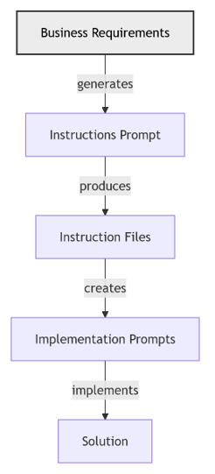
High Level AI Assisted Workflow
From Requirements to a Solution
Stakeholders (SMEs, Architects, SREs, DBAs, etc.) define the requirements with AI assistance
AI transforms the requirements into implementation instructions files that guide the implementation
  Stakeholders review, improve, and approve the instruction files
AI uses instruction files to create prompts to implement the business requirements
  Implementation prompts tell AI how to implement a feature and how to verify that the feature meets the acceptance criteria
  Stakeholders review, improve, and approve the implementation prompts
Submitting the implementation prompts
  Generates an implementation that conforms to the implementation instructions and meets the acceptance criteria
  Stakeholders review and approve implementation

Slide 23
Generating Implementation Prompts & Verification
Implementation prompts
Implementation verification
Notes:
Teach how to craft reproducible prompts and verification checks to validate generated code.

Slide 24
Exercise #12 – Executing Prompts
Objective: Execute implementation prompts using custom chat modes.
Review the implementation prompts created earlier.
Use prompts to guide agent actions.
Test agent responses to prompts.
Verify implementation passes verification checks.
Notes:
Execute prompts in custom modes, verify outputs, and refine prompts based on failures.

Slide 25
Wrap-Up and Open Q&A
Review the day’s learning outcomes.
Address questions or concerns.
Discuss next steps and future learning opportunities.
Notes:
Summarize key takeaways, next steps, and open the floor for questions and feedback.

Slide 26
Decision Framework
Use Instruction Files When:
✅ Need consistent behavior across all AI interactions
✅ Enforcing organizational standards/policies
✅ Setting up coding conventions and quality gates
✅ Defining security or compliance requirements
Use Prompt Files When:
✅ Have repeatable, structured tasks
✅ Need detailed step-by-step execution
✅ Want to standardize complex workflows
✅ Building reusable automation templates

Slide 27
Decision Framework (Continued)
Use Custom Chat Modes When:
✅ Need specialized domain expertise
✅ Want AI to act as specific professional role
✅ Exploring problems from different perspectives
✅ Learning or getting advice in specific areas
Combine Approaches When:
✅ Building comprehensive AI-assisted workflows
✅ Need both consistency AND specialization
✅ Managing complex, multi-phase projects

Slide 28
Layered Integration Approach
┌─────────────────────────────────────┐
│ Custom Chat Mode │ ← Conversational Context
│ (Security Architect Persona) │
├─────────────────────────────────────┤
│ Prompt Files │ ← Task Execution
│ (Security Audit Template) │
├─────────────────────────────────────┤
│ Instruction Files │ ← Base Behavior
│ (Security Standards, Coding Rules) │
└─────────────────────────────────────┘
Result: Specialized security expert using standardized processes with consistent quality standards

Slide 29
Real-World Integration Example
Scenario: Implementing User Authentication
Instruction Files provide:
  Security coding standards
  Testing requirements
  Documentation standards
Prompt File executes:
  “Implement OAuth2 Authentication System”
  Step-by-step implementation guide
Custom Chat Mode offers:
  Security Architect expertise
  Best practice recommendations
  Threat modeling insights

Slide 30
Instruction Files Best Practices
✅ Do This:
Keep instructions clear and actionable
Use file patterns (applyTo: '**') for broad scope
Version control and document changes
Test instruction effectiveness regularly
❌ Avoid This:
Overly complex or contradictory rules
Too many instructions (cognitive overload)
Instructions that conflict with prompt files
Hardcoded values instead of parameters

Slide 31
Prompt Files Best Practices
✅ Do This:
Include comprehensive metadata
Provide clear context and requirements
Specify expected deliverables
Include verification steps
❌ Avoid This:
Vague or ambiguous instructions
Missing prerequisite information
No success criteria defined
Overly complex single prompts (break them down)

Slide 32
Custom Chat Modes Best Practices
✅ Do This:
Define clear expertise boundaries
Provide rich contextual background
Establish consistent personality/voice
Include relevant constraints and preferences
❌ Avoid This:
Conflicting expertise claims
Too broad or unfocused roles
Personality that conflicts with task needs
Missing essential domain knowledge

Slide 33
Key Takeaways

Slide 34
Summary: Three Complementary Approaches
🏗️ Instruction Files
Foundation layer that ensures consistent, quality AI behavior
⚡ Prompt Files
Execution layer that provides repeatable, structured task automation
🎯 Custom Chat Modes
Expertise layer that delivers specialized knowledge and perspectives

Slide 35
The Integration Advantage
When Used Together:
Higher Quality: Consistent standards + structured execution + expert knowledge
Greater Efficiency: Automated workflows with specialized guidance
Better Outcomes: Comprehensive approach covers all development aspects
Reduced Risk: Multiple layers of validation and expertise
Result: AI becomes a true development partner, not just a code generator

Slide 36
Resources & References
Implementation Templates:
Instruction Files: .github/instructions/*.instructions.md
Prompt Files: .github/prompts/*.prompt.md
Chat Mode Configs: Custom mode documentation
Documentation:
AI-Assisted Output Instructions
Copilot Integration Guidelines
Best Practices Repository
Contact: john.miller@codestaffing.com

Slide 37
Creating Custom Chat Modes
Generating Implementation Prompts & Verification
Exercises
Wrap-Up and Open Q&A
Notes:
Final day: custom chat modes, verification prompts, and wrap-up exercises.

