Slide 1
ACA Final Project

Slide 2
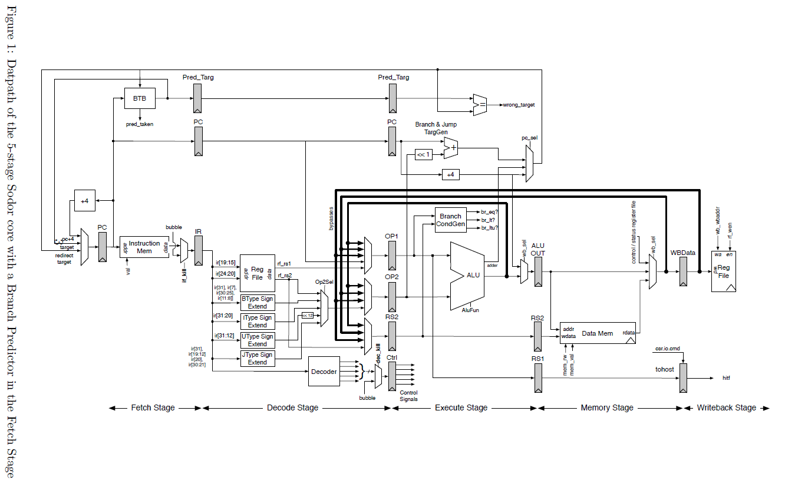
Improving memory subsystem performance of RISC-V Sodor processor
Cache
50 cycles per read/write

Slide 3
Overview
Baseline: No cache
Each team could decide what features to add to improve memory system performance
E.g., non-blocking cache, victim cache, multi-level cache, prefetch etc.
Projects will be judged based on
what features you add to enhance the baseline, and
Miss rate & overall performance
3-person team

Slide 4
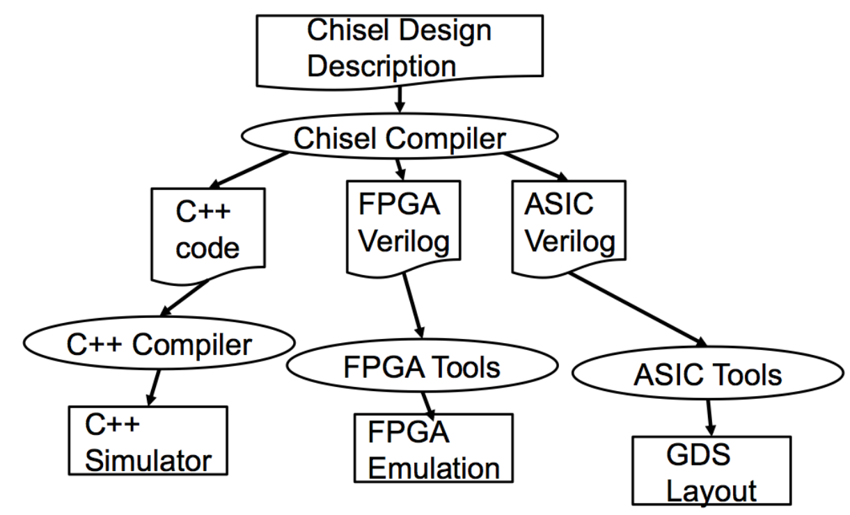

Slide 5
Compile & Run Emulator (1/2)
Please clone the repo again!!
Clone repo
git clone https://github.com/chenchc/riscv-sodor.git
cd riscv-sodor
git submodule update --init --recursive
Compiling front-end server (will install RISC-V front-end server library under ${RISCV_FESV})
cd riscv-fesvr
./configure --prefix=/usr/local
make install

Slide 6
Compile & Run Emulator (2/2)
Build the sodor emulators
$cd ..
$ ./configure --with-riscv=/usr/local
$ make
All processors are installed under the directory “riscv-sodor/emulator”
Run all processors
make run-emulator
Run a specific processor
cd emulator/${PROCESSOR_NAME}
make run

Slide 7
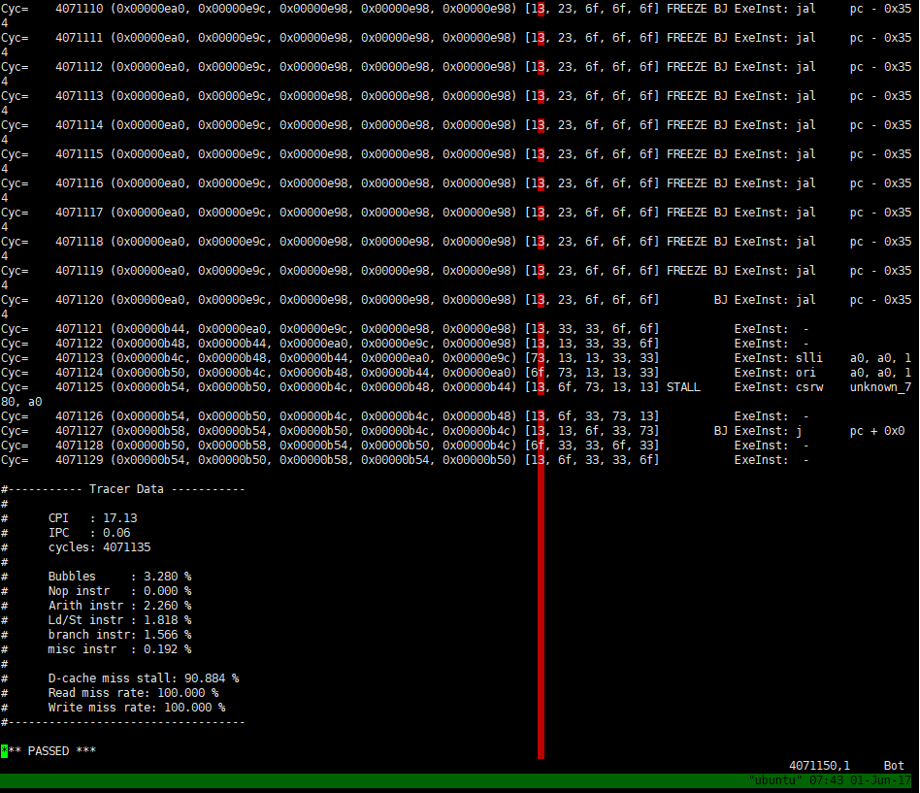
Profiling Results
When you type “make run” in riscv-sodor/emulator/rv32_5stage, you should see:
FREEZE: Pipeline stall due to cache miss
Extended metrics you can use to evaluate your cache

Slide 8
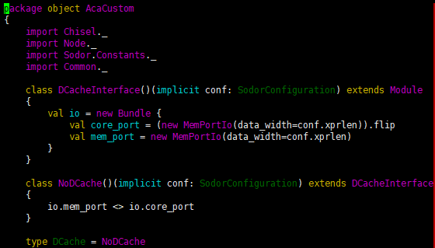
Baseline
See riscv-sodor/src/rv32_5stage/dcache.scala
Baseline: Just pass through…
Modify this line to integrate your own cache

Slide 9
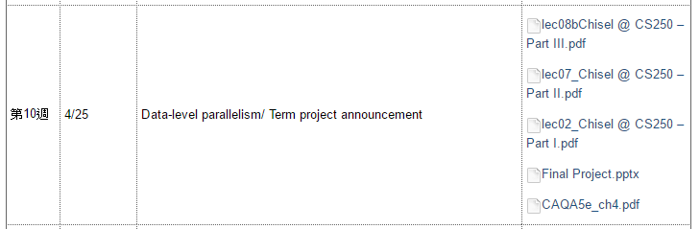
Reference
Chisel tutorial
Provided on ceiba
Must-see codes in sodor:
riscv-sodor/src/common/memory.scala

Slide 10
Update (6/11)

Slide 11
Changelog
Tons of bugs fixed (see commit logs)
Burst Read/Write with 64 byte data width
Please run git pull to update the repo (or simply clone it again…)

Slide 12

Burst Read
In src/common/memory.scala
The memory reply interface MemResp now contains burst_data which is a 16-element vector with words (4 byte) filled
burst_data will be well aligned to 64 bytes and contain the desired data.
Request address doesn’t need to be aligned.
The desired data may be somewhere in the burst_data vector, depending on the address.
Fully compatible with previous mechanism (Single data read)

Slide 13
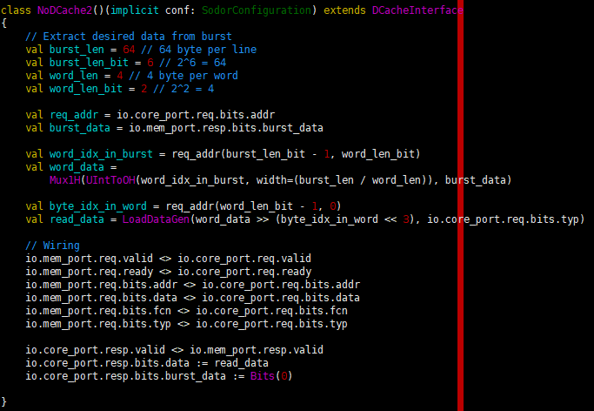
Example to leverage burst read
In src/rv32_5stage/dcache.scala
Read burst data
Calculate the position of the requested data
Extract the word out
Use LoadDataGen helper function to perform byte, half load or padding
(LoadDataGen and other useful functions are provided in src/common/memory.scala)

Slide 14
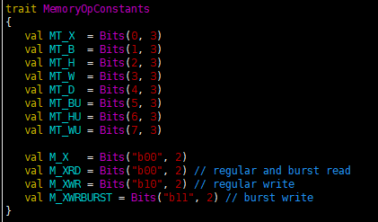
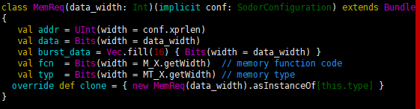
Burst Write
In src/common/memory.scala
Add a new memory operation - M_XWRBURST
Add a new datapath burst_data in memory request interface
Usage: Assign appropriate arguments on MemReq with typ=M_XWRBURST and burst_data.

Slide 15
Any question? Or bugs?
You can raise an issue on Github: https://github.com/chenchc/riscv-sodor
Or send mails to: bryan830401@gmail.com

