Slide 1

RAG Framework for Effective Video query and Understanding
Bridging video analytics and semantic reasoning through natural language understanding

Slide 2

Agenda
The Problem & The Need
Current Gap
Our Contribution
Architecture
Hierarchical Multimodal Evidence Selection
Image-Based Query Support
Evaluation Strategy & Results

Slide 3


The Problem & The Need
The Problem We Address
Manual surveillance video analysis is slow, error-prone, and non-scalable.
The Need for an Intelligent Solution
Need a system that can retrieve, reason, and explain — not just detect
Key challenges:
CCTV systems generate thousands of hours of video
Analysts must manually scan footage, identify anomalies, and correlate events across time
Limitations of existing systems:
Detect anomalies but cannot explain them
Do not support natural language search
Fail on long, untrimmed videos
Result: High operational cost and delayed incident response
Real-World Pain Points:
5+ hours to locate a single incident in large CCTV archives
Missed events due to: Sparse anomalies, Weak temporal reasoning, Fragmented retrieval
Existing VLMs: Perform poorly on surveillance data, Lack temporal and causal understanding
Experimental Evidence:
Even strong video models fail on cause & result-based questions
This indicates: Retrieval is the bottleneck, not model size
Conclusion: Need a system that can retrieve, reason, and explain — not just detect

Slide 4

Current Gap
Weak Integration Between Detection and Generation
Lack of Surveillance-Oriented Video RAG Systems
Insufficient Support for Image-Based Queries
Absence of Multi-Stage Retrieval Mechanisms
Limited Temporal Awareness
Notes:
Lack of Surveillance-Oriented VideoRAG Systems
Current VideoRAG approaches are designed for open-domain videos and do not account for the characteristics of surveillance data such as long duration, sparse events, and subtle anomalies.
Absence of Multi-Stage Retrieval Mechanisms
Most systems rely on a single retrieval step, which often leads to irrelevant or incomplete results.
Limited Temporal Awareness
Existing methods do not explicitly exploit temporal continuity or neighborhood consistency across video segments.
Insufficient Support for Image-Based Queries
Retrieval performance significantly degrades for cropped or partial image inputs, which are common in forensic investigations.
Weak Integration Between Detection and Generation
Anomaly detection and language-based reasoning are typically treated as separate tasks, limiting the system's interpretability and usability.

Slide 5
Our Contribution
1
2
Dual-Embedding Multimodal Architecture
The system employs separate yet aligned visual and textual embedding spaces, enabling flexible and accurate multimodal retrieval.
Hierarchical Multi-Stage Retrieval Pipeline
A three-stage retrieval framework is introduced: Stage 1: Visual similarity search with HNSW indexing; Stage 2: Textual relevance using BM25 and semantic similarity; Stage 3: Temporal reranking to enforce event continuity.
3
4
Temporal Context Aggregation Mechanism
A temporal aggregation strategy leverages neighboring video segments to improve coherence and reduce retrieval noise.
Robust Image-Based Query Handling
By combining CLIP embeddings with LLaVA-generated semantic descriptions, the system effectively handles cropped or partial image queries.

Slide 6
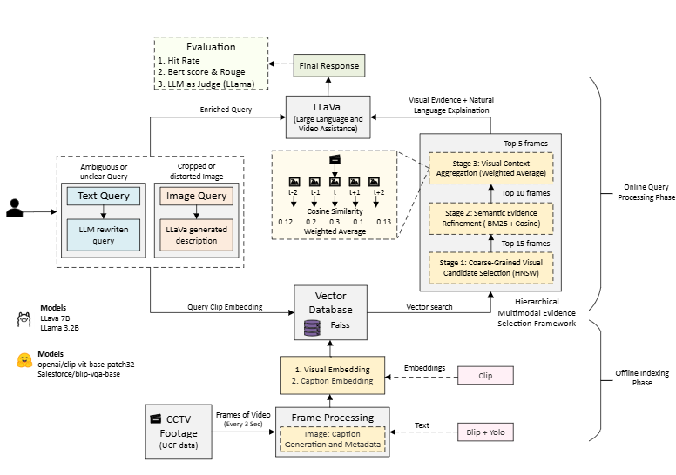
Architecture

Slide 7
Hierarchical Multimodal Evidence Selection
The framework employs a multi-stage retrieval strategy that progressively narrows candidate video segments, improving precision while maintaining high recall and minimizing false positives.
Coarse-Grained Visual Similarity
Semantic Relevance Filtering
Temporal Context Aggregation
Initial matching using visual embeddings to identify potentially relevant segments
Textual representation refine candidates based on semantic content alignment
Event continuity analysis ensures coherent retrieval across time boundaries

Slide 8
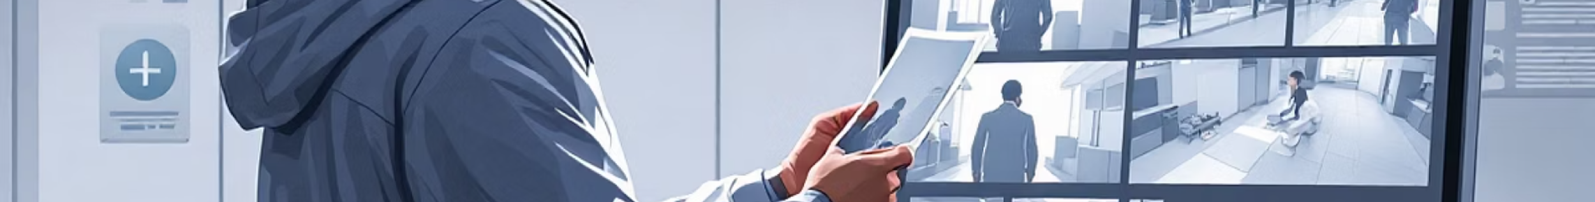
Image-Based Query Support
This capability is critical for forensic scenarios where investigators possess only partial visual evidence—such as a cropped suspect photo or low-quality witness image—and need to locate relevant surveillance footage.
Partial Image Input
LLaVA Description
Hybrid Retrieval
Accept cropped or incomplete visual evidence from investigations
Generate rich semantic descriptions from visual inputs
Combine visual and textual embeddings for robust matching

Slide 9

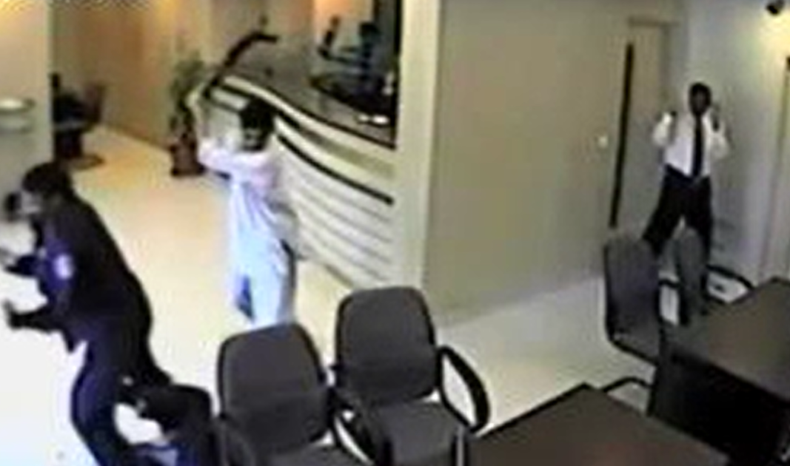
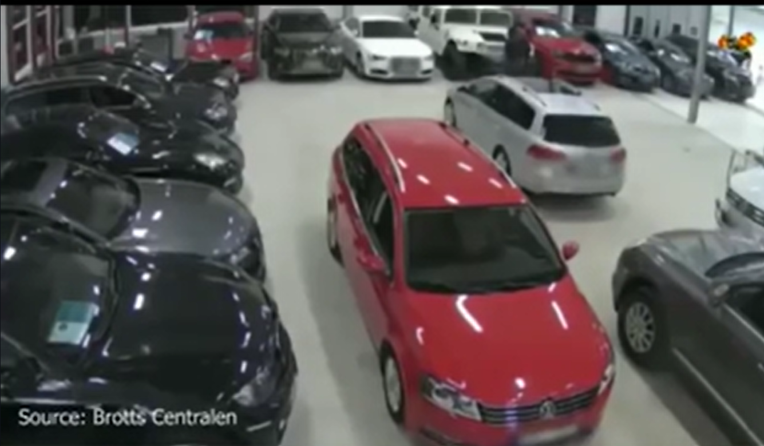
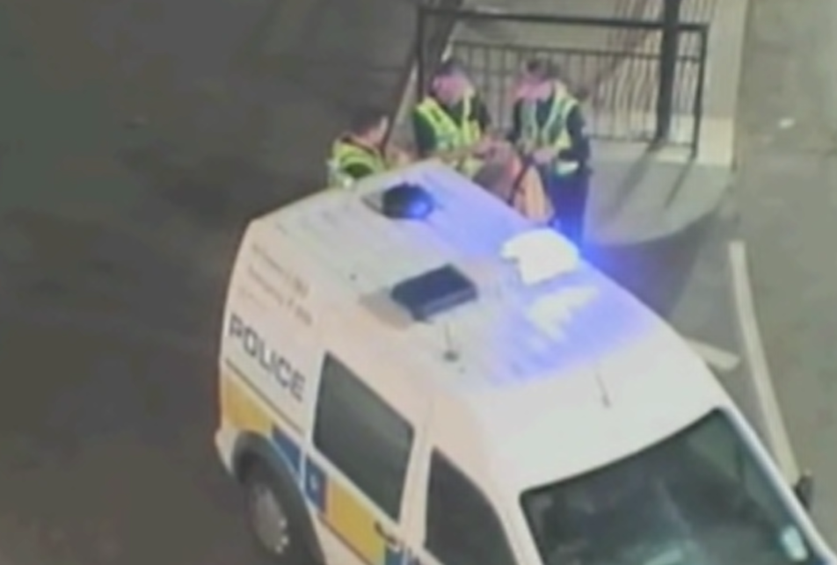
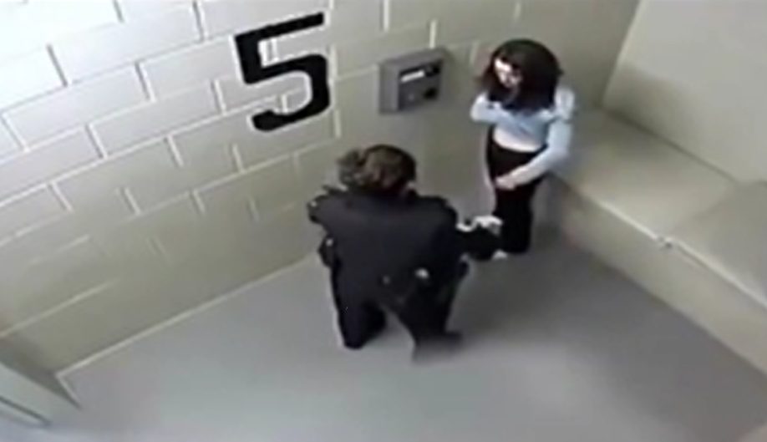
Some Visual Results
Text Query: Show me the abuse incident video
Image Query
Retrieved Result
Retrieved Result

Slide 10
Evaluation Strategies
Evaluation Task 1: Abnormality Detection Accuracy
Evaluates whether the system correctly identifies the core abnormal event
Tested only on event-dependent QA pairs
Metric: Abnormality Hit Rate = Correct predictions / Total abnormality queries
Compared across: Visual-only retrieval vs Full VideoRAG (multi-stage retrieval)
Dataset & Setup
Dataset: SurveillanceVQA-589K (Hugging Face)
Events: Abuse, Robbery, Accident, Shooting, Explosion, Normal
Evaluation Task 2: LLM-as-Judge Answer Evaluation
Assesses reasoning quality beyond correctness
Scoring Dimensions (0–5)
Final Score: Avg = (CI + DO + CU + TU) / 4
Judge Setup: Local LLM (LLaMA 3.2 via Ollama), Deterministic scoring (temperature = 0)
Contextual Integration (CI), Detail Orientation (DO), Contextual Understanding (CU), Temporal Understanding (TU)
Notes:
Contextual Integration (CI) - Factual correctness w.r.t. video
Detail Orientation (DO) - Completeness and specificity
Contextual Understanding (CU) - Alignment with scene intent
Temporal Understanding (TU) - Correct ordering and causality

Slide 11
Evaluation Results
Task 1: Abnormality Detection Accuracy
Task 2: LLM-as-Judge Answer Evaluation
Metric | Visual-Only | Video RAG (HMESF)
Hit@1 | 6.8% | 24.3%
Hit@3 | 18.6% | 36.2%
Hit@5 | 29.9% | 45.2%
Model | Description | Cause | Result
LLaVA-NeXT | 2.11 | 1.96 | 1.65
LLaVA-OV | 2.54 | 1.46 | 1.55
LLaVA-Video | 2.76 | 1.52 | 1.81
VideoLLaMA3 | 2.01 | 1.75 | 1.27
Video RAG (HMESF) | 2.65 | 2.84 | 2.61
Key Takeaways -
+15.3% absolute gain at Hit@5 3.6× improvement at Hit@1
Pushes correct evidence higher in ranking Hierarchical retrieval
Confirms effectiveness of:
Multimodal reranking
Temporal aggregation
Evidence filtering
Key Takeaways -
SurveillanceVQA-589K: Best Overall Performance Across All Question Types
+0.80 over strongest baseline
+1.34 on Result-based reasoning
Strong Gains in Temporal & Causal Reasoning, Excels at:
Event progression
Cause → effect understanding
Multi-segment reasoning

Slide 12



Expected Impact and Applications
Forensic Investigation
Real-Time Surveillance
Smart City Analytics
Accelerate evidence discovery in criminal investigations through semantic search of archived surveillance footage
Enable rapid incident detection and response in security operations centers managing large camera networks
Support urban planning and traffic management through queryable video intelligence infrastructure

Slide 13
Thank You
Prepared by
Mehul Jain (2023AD05022)

