Slide 1
Matlab 教學3-影像顯示
多媒體實習 助教：王泓權

Slide 2
3.1 Introduction
We take a closer look at the use of the imshow function
We look at image quality and how that may be affected by various image attributes
For human vision in general, the preference is for images to be sharp and detailed
Ch3-p.41

Slide 3
3.2 Basics of Image Display
There are many factors that will affect the display
ambient lighting,
the monitor type and settings,
the graphics card, and
monitor resolution
Ch3-p.41

Slide 4
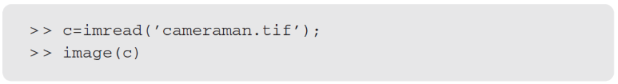
3.2 Basics of Image Display
This function image simply displays a matrix as an image
Ch3-p.42

Slide 5


3.2 Basics of Image Display
We may to adjust the color map to use fewer or more colors; however, this can have a dramatic effect on the result
Ch3-p.43

Slide 6
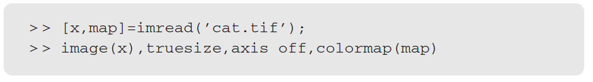

3.2 Basics of Image Display
use imread to pick up the color map
map is <256×3 double> in the workspace
Ch3-p.43

Slide 7
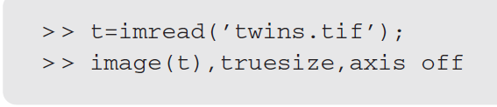
3.2 Basics of Image Display
True color image will be read (by imread) as a three-dimensional array
In such a case, image will ignore the current color map and assign colors to the display based on the values in the array
Ch3-p.43

Slide 8
3.3 The imshow Function
We have two choices with a matrix of type double:
Convert to type uint8 and then display
Display the matrix directly
imshow will display a matrix of type double as a grayscale image (matrix elements are between 0 and 1)
Ch3-p.44

Slide 9

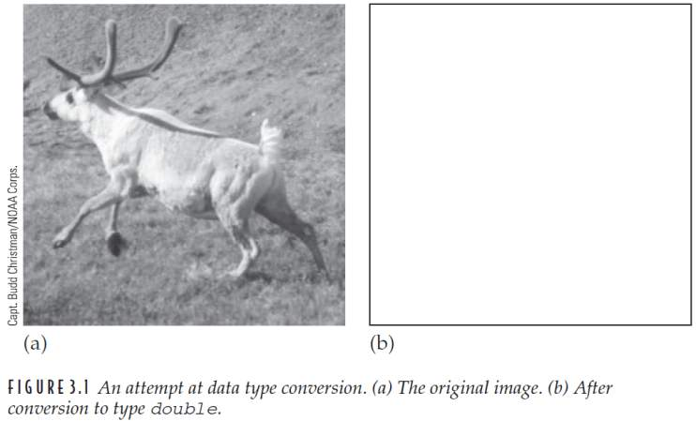
FIGURE 3.1
Ch3-p.44

Slide 10

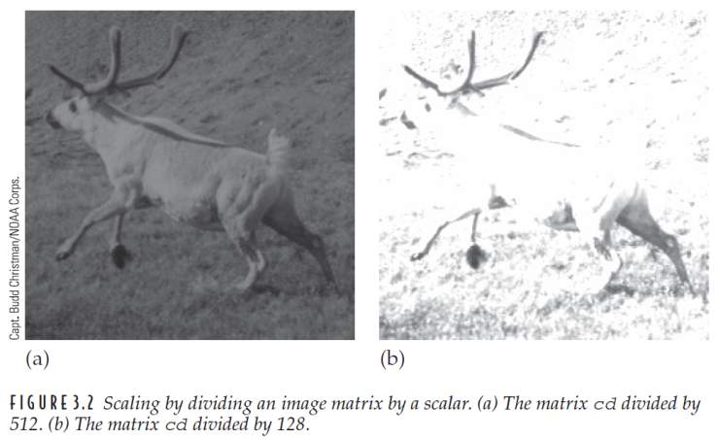
FIGURE 3.2
Ch3-p.45

Slide 11
3.3 The imshow Function
We can convert the original image to double more properly using the function im2double
If we take cd of type double, properly scaled so that all elements are between 0 and 1, we can convert it back to an image of type uint8 in two ways:
Ch3-p.46

Slide 12
3.3 The imshow Function
BINARY IMAGES MATLAB have a logical flag, where uint8 values 0 and 1 can be interpreted as logical data
Check c1 with whos
Ch3-p.46

Slide 13


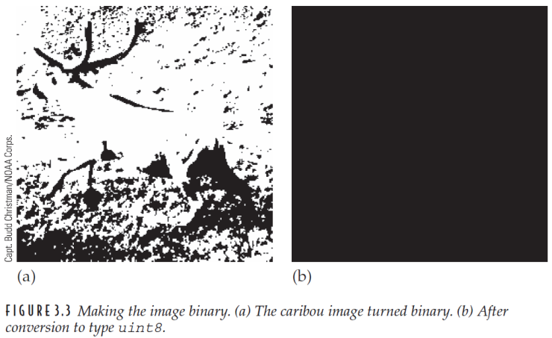
FIGURE 3.3
>> imshow(cl)
>> imshow(uint8(cl))
Ch3-p.47

Slide 14
exp00

Slide 15
3.4 Bit Planes
Grayscale images can be transformed into a sequence of binary images by breaking them up into their bitplanes
The zeroth bit plane
the least significant bit plane
The seventh bit plane
the most significant bit plane
Ch3-p.48

Slide 16
3.4 Bit Planes
We start by making it a matrix of type double; this means we can perform arithmetic on the values
Ch3-p.48

Slide 17
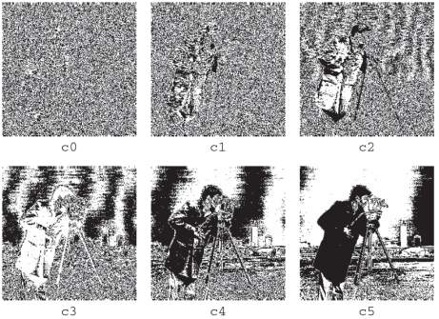
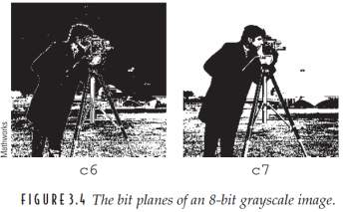
FIGURE 3.4
Ch3-p.49

Slide 18
exp01
請實作上述所提到的各個位元顯示圖。
嵌入一張所要隱藏的圖片。
嵌入的圖片可以使用小畫家編輯。

Slide 19
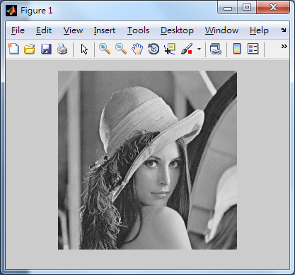
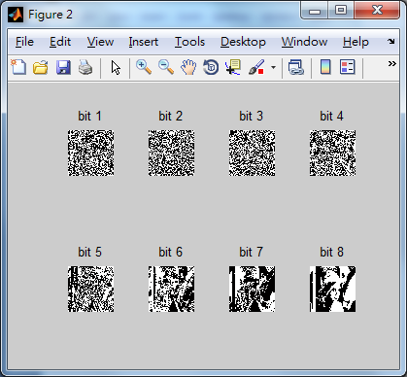
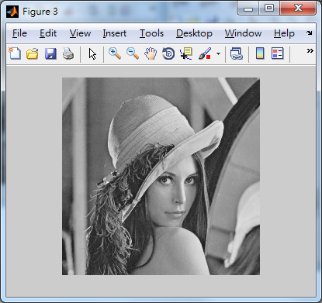
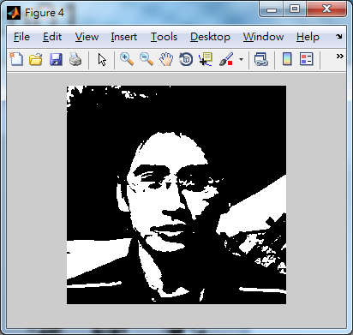
exp01

Slide 20
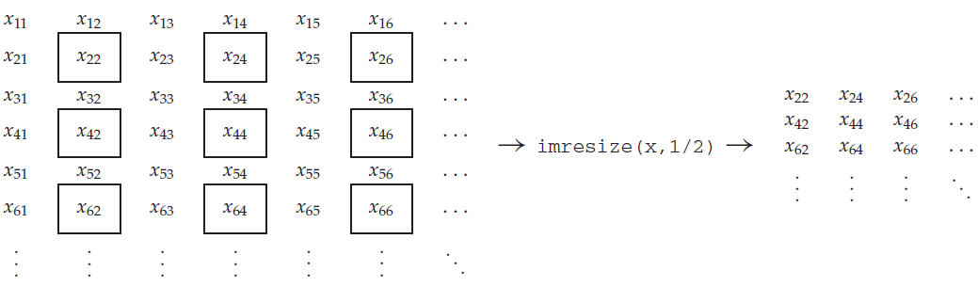
3.5 Spatial Resolution
The greater the spatial resolution, the more pixels are used to display the image
Ch3-p.50

Slide 21
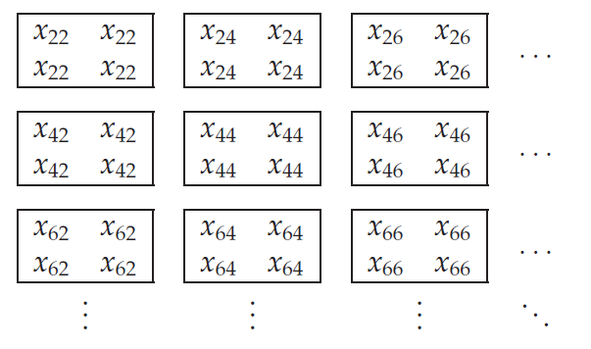
3.5 Spatial Resolution
Ch3-p.50-51

Slide 22
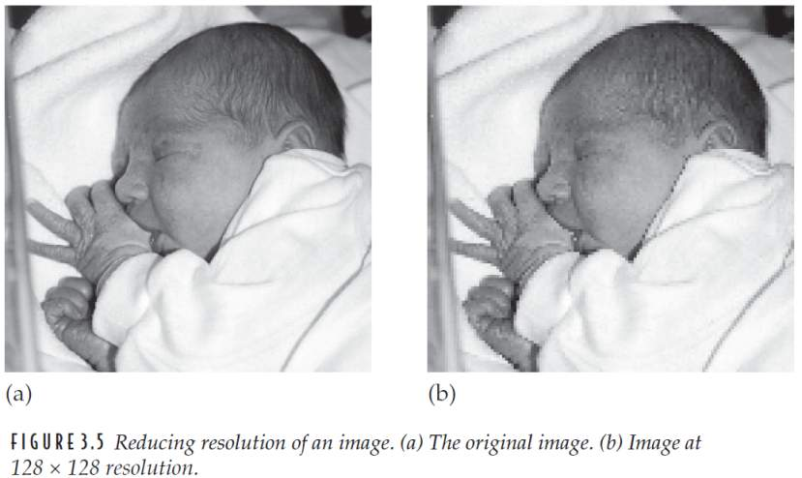
FIGURE 3.5
Ch3-p.51

Slide 23
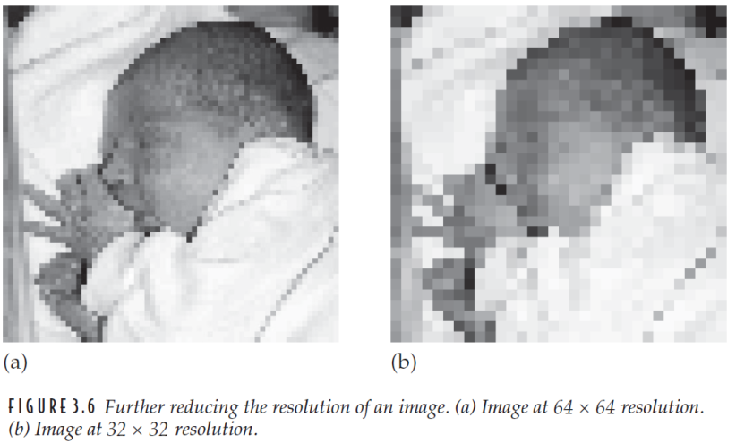
FIGURE 3.6
Ch3-p.52

Slide 24
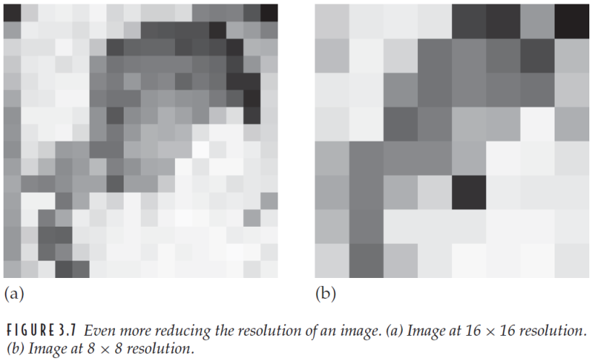
FIGURE 3.7
Ch3-p.52

Slide 25
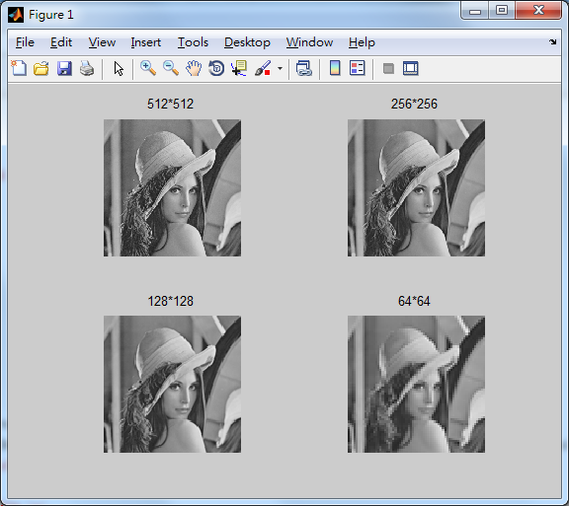
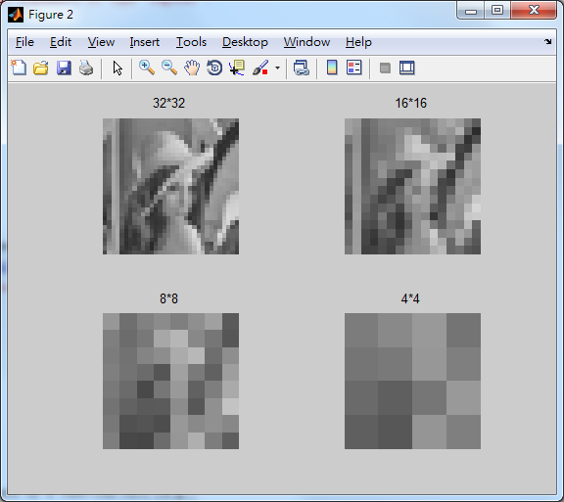
exp02
請實作上述所提到的各個解析度顯示圖。

Slide 26
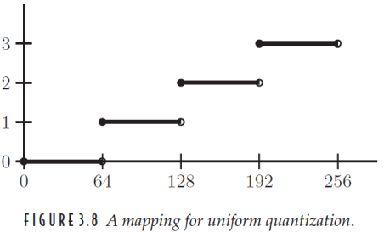
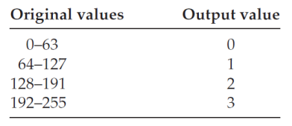
3.6 Quantization and Dithering
Uniform quantization
Ch3-p.52

Slide 27
3.6 Quantization and Dithering
To perform such a mapping in MATLAB, we can perform the following operations, supposing x to be a matrix of type uint8
There is, a more elegant method of reducing the grayscales in an image, and it involves using the grayslice function
Ch3-p.53

Slide 28
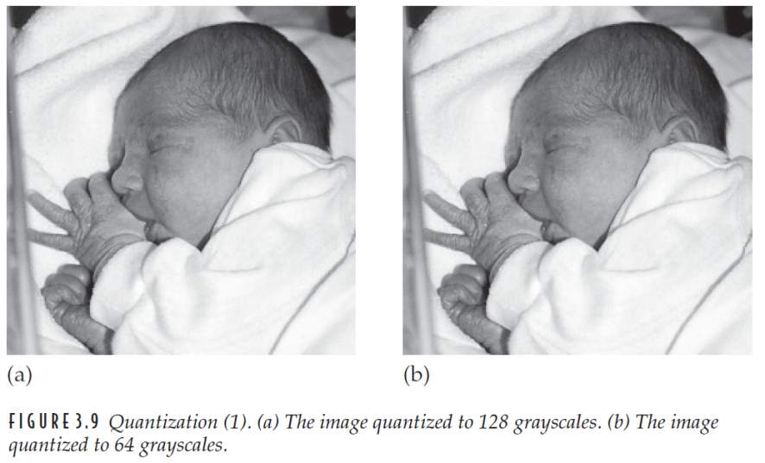
FIGURE 3.9
Ch3-p.54

Slide 29
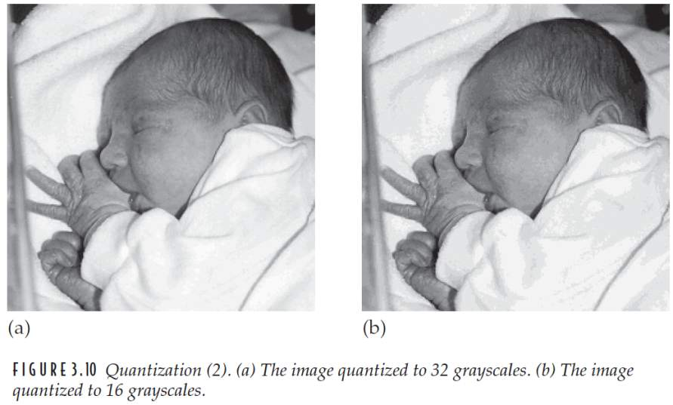
FIGURE 3.10
Ch3-p.55

Slide 30
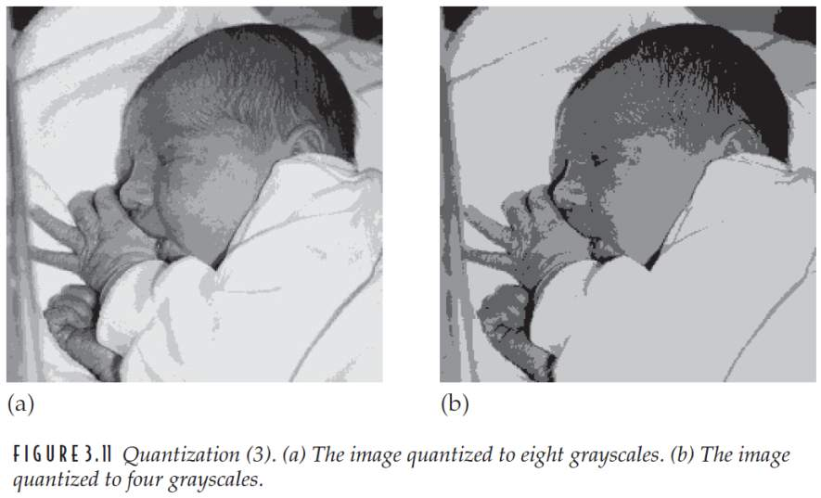
FIGURE 3.11
Ch3-p.55

Slide 31
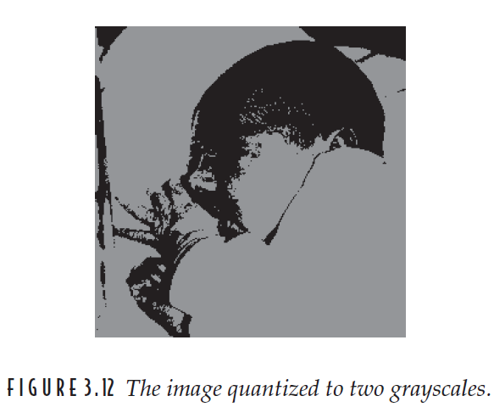
FIGURE 3.12
Ch3-p.56

Slide 32
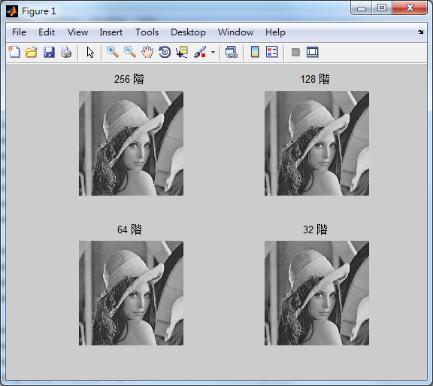
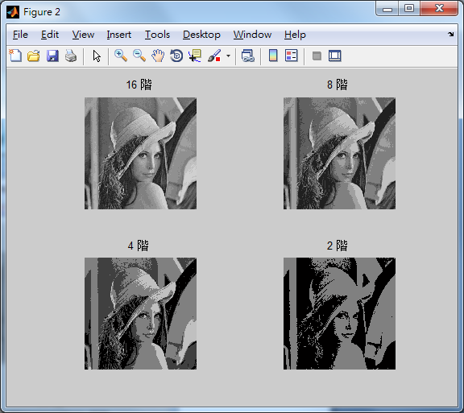
exp03
請實作上述所提到的各個灰階顯示圖。

Slide 33
3.6 Quantization and Dithering
DITHERING In general terms, refers to the process of reducing the number of colors in an image
Representing an image with only two tones is also known as halftoning
Ch3-p.56

Slide 34
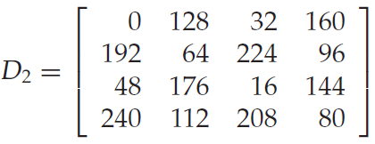

3.6 Quantization and Dithering
Dithering matrix
D or D₂ is repeated until it is as big as the image matrix, when the two are compared
Ch3-p.56

Slide 35

3.6 Quantization and Dithering
Suppose d(i, j) is the matrix obtain by replicating the dithering matrix, then an output pixel p(i, j) is defined by
Ch3-p.56

Slide 36
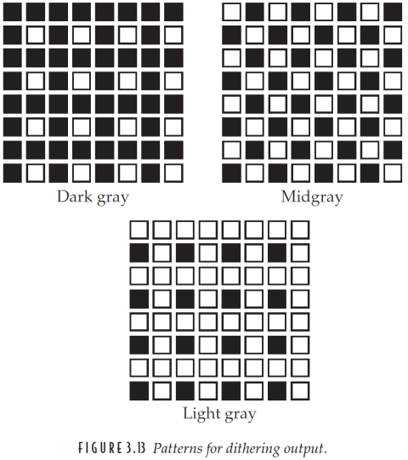
FIGURE 3.13
Ch3-p.57

Slide 37
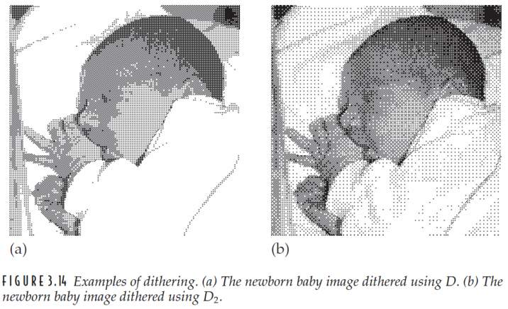
FIGURE 3.14
D
D2
Ch3-p.58

Slide 38
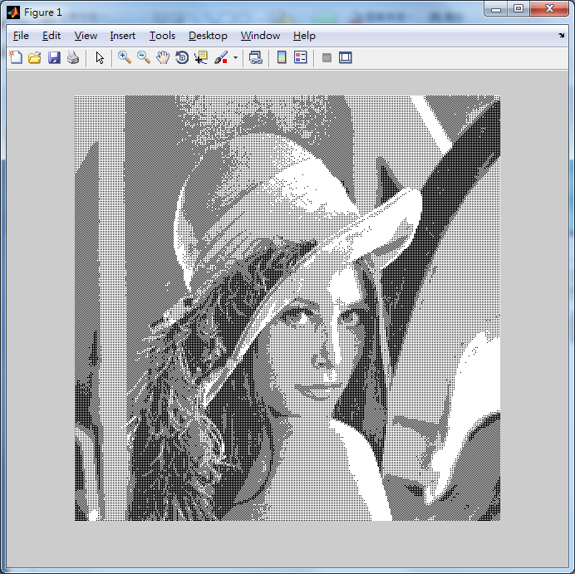
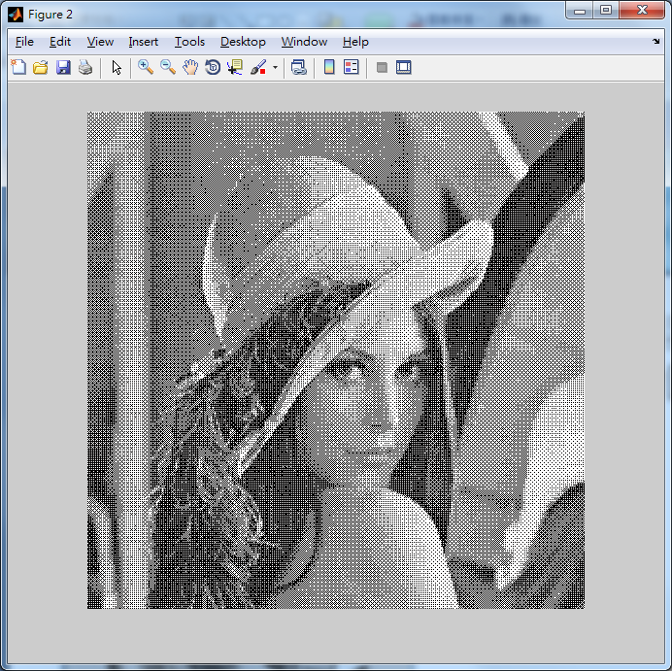
exp04
請實作上述所提到的矩陣，利用黑與白兩種顏色混合成一張類似灰階影像的圖片。

Slide 39

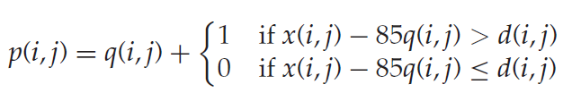
3.6 Quantization and Dithering
Dithering can be extended easily to more than two output gray values
For example, we wish to quantize to four output levels 0, 1, 2, and 3
(Since 255/3 = 85)
Ch3-p.57

Slide 40
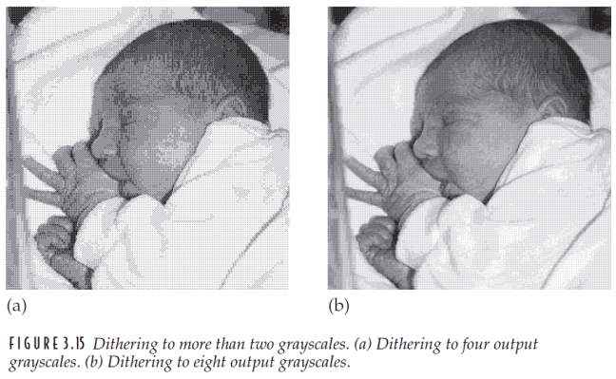
FIGURE 3.15
Ch3-p.58

Slide 41
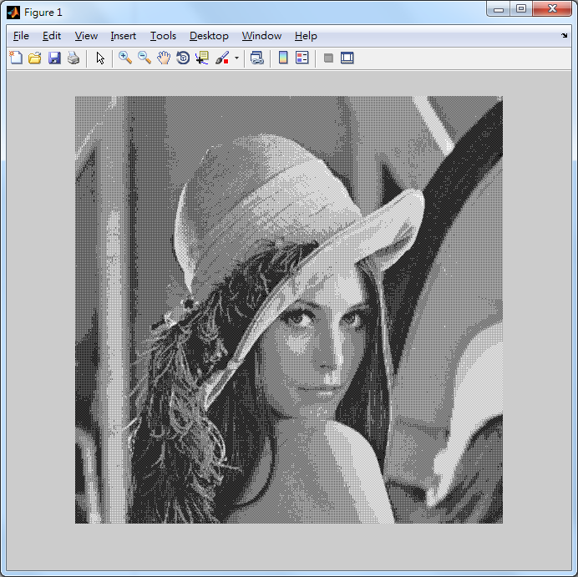
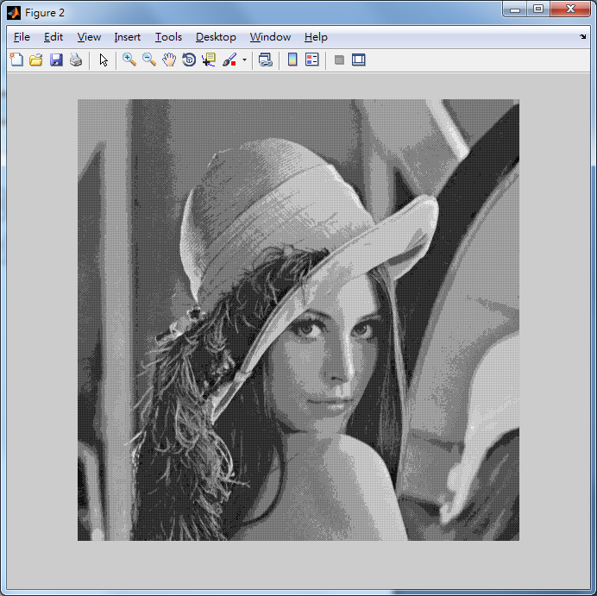
exp05
請實作上述所提到的矩陣，利用4階灰階與8階灰階混合成一張影像圖片。
(Since 255/3 = 85)
D = [0 56;84 28];
D = [0 24;36 12];

Slide 42
3.6 Quantization and Dithering
ERROR DIFFUSION
The image is quantized at two levels
For each pixel we take into account the error between its gray value and its quantized value
The idea is to spread this error over neighboring pixels
Ch3-p.59

Slide 43
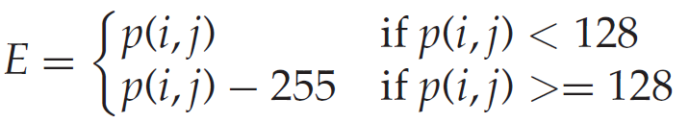
3.6 Quantization and Dithering
Floyd and Steinberg method
For each pixel p(i, j) in the image we perform the following sequence of steps:
1. Perform the quantization
2. Calculate the quantization error
Ch3-p.59

Slide 44
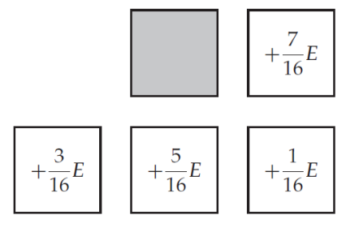
3.6 Quantization and Dithering
3. Spread this error E over pixels to the right and below according to this table
Ch3-p.59

Slide 45
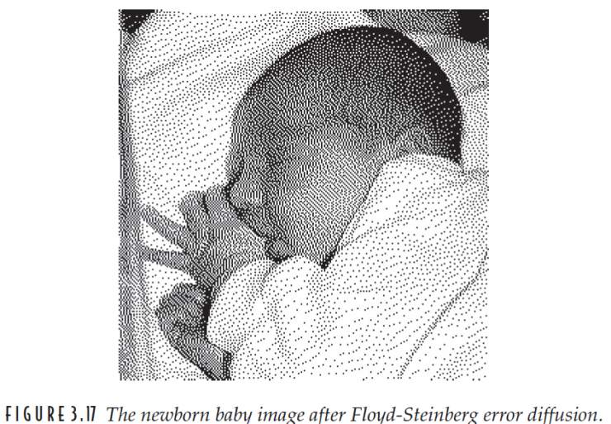
FIGURE 3.17
Ch3-p.61

Slide 46
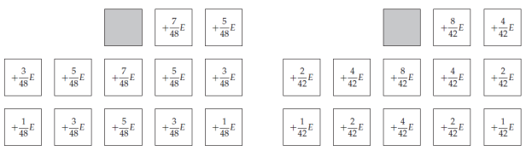
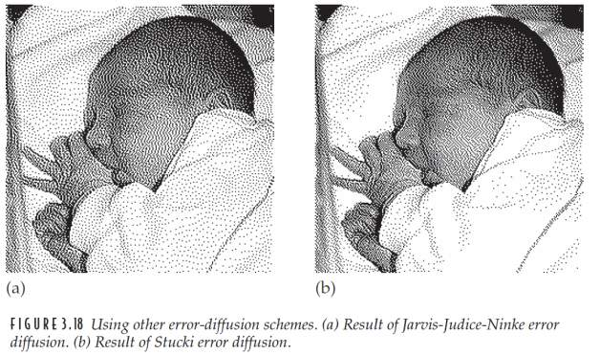
FIGURE 3.18
Ch3-p.61

Slide 47
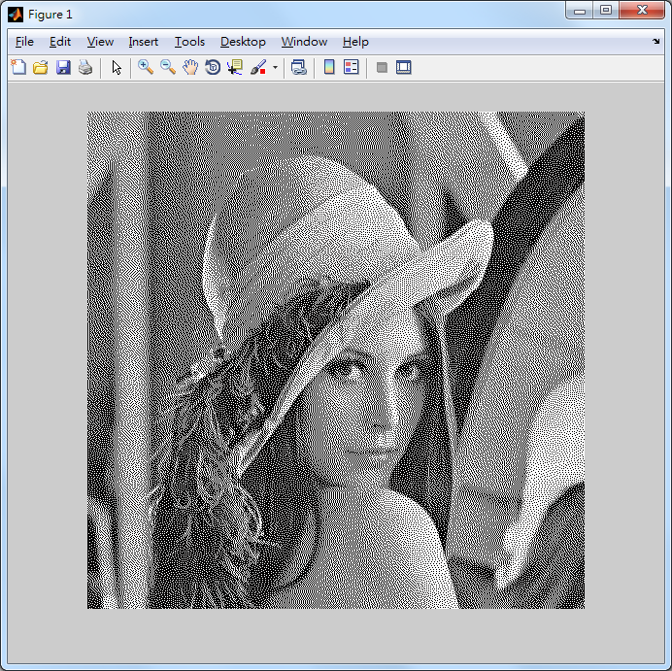
exp06
請實作上述所提到的誤差擴散法，利用黑白顏色混合成一張影像圖片。

