Slide 1

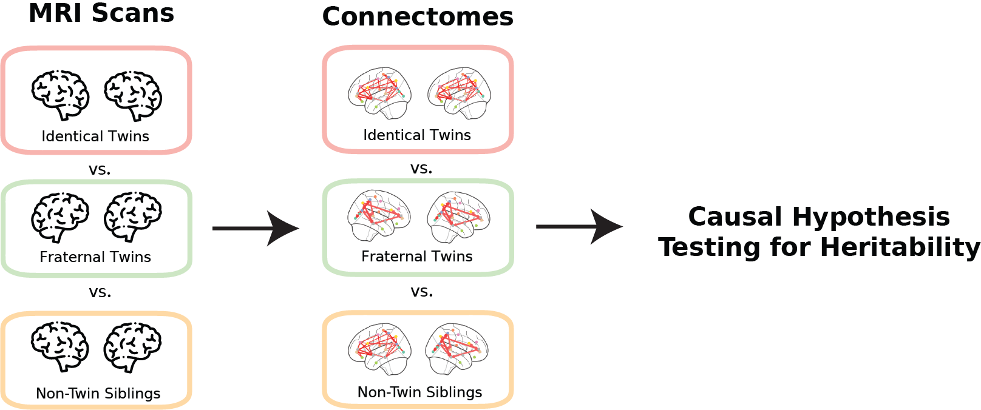







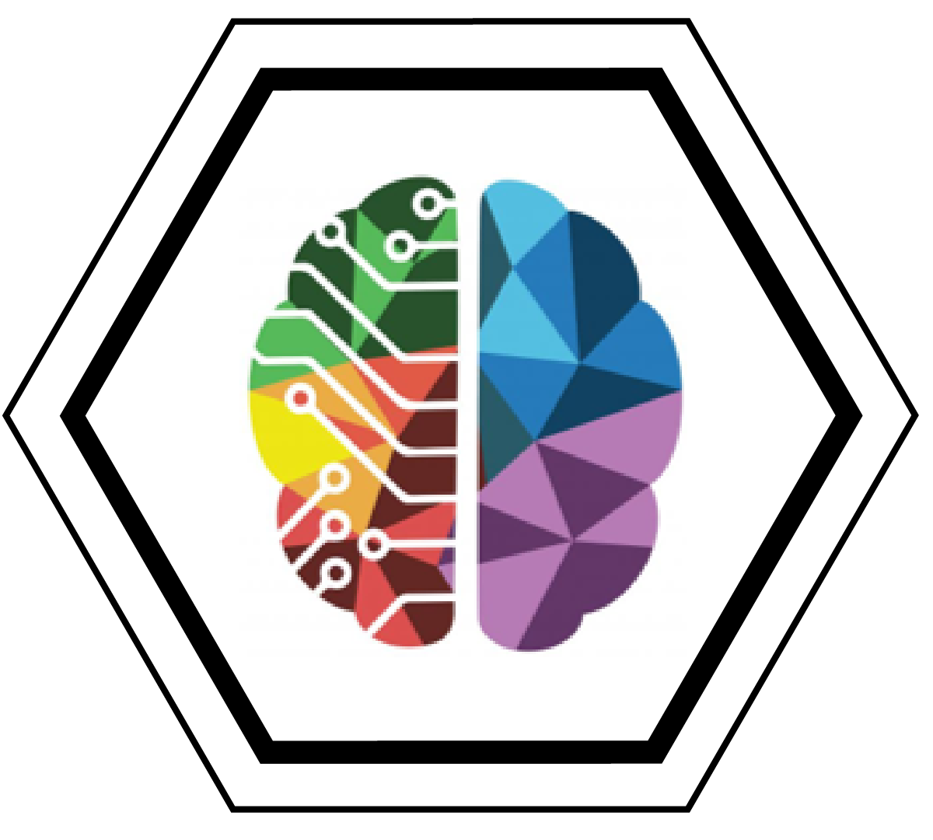
Jaewon Chung
The Heritability of Human Connectomes: a Causal Modeling Analysis
BRAIN Initiative Cell Census
Connectomes are maps of the structural connections between brain regions.
Do changes in genome cause changes in connectomes?
Connectomes are highly heritable even after accounting for confounding and common structures across connectomes.
[PhD Student, Advisor: Joshua T. Vogelstein]
Human Neuroscience, Poster 8003

