Slide 1

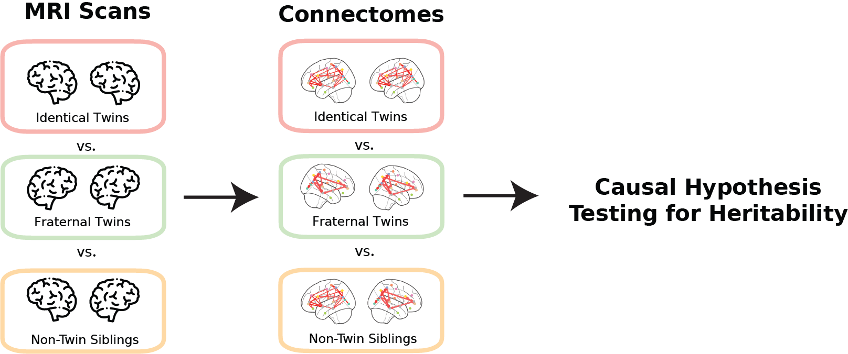








Jaewon Chung
The Heritability of Human Connectomes: a Causal Modeling Analysis
BRAIN Initiative Cell Census
Blah 1
Blah 2
Blah 3
[PhD Student, Advisor: Joshua T. Vogelstein]
Human Neuroscience, Poster 8003

