Slide 1
Israeli–Palestinian UN General Debates
Group Members: Haihan Tian, Jeffrey Feng, Zhexu Li

Slide 2
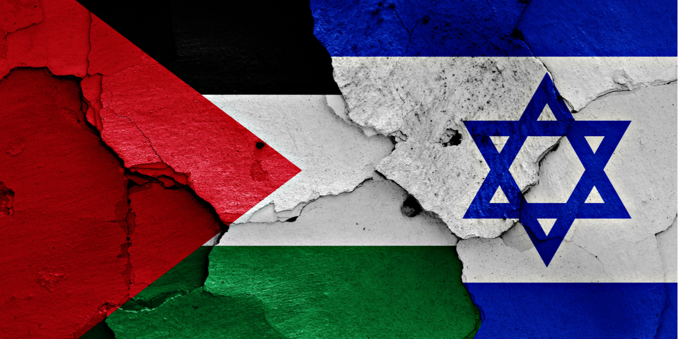
Research Question and Motivation
Could the General Debates reflect the conflicts between Israel and Palestine? Is there a dramatic shift after Palestine was able to speak at the UN in 1998? How did the policy preferences in UNGD of Israel change overtime?
Previous Study: Pressman studied the General Debate of both Israel and Palestine from 1998 to 2016 and he found the leaders of both countries covered similar issues. And both countries argued that they are the ones committing for peace, while accusing the other country of invasion.
Just two weeks ago, Israel and Palestine had serious conflicts including missile attacks. The continuing conflicts made our group wonder whether the conflicts were already embedded in their General Debates at the United Nation and whether their policy preferences changed over time. If we can find patterns in their speeches, we may understand their conflicts in another perspective.

Slide 3
Overview of The Data
UN General Debate corpus includes 8093 country statements from 1970-2018.
This corpus is great for our research questions because the nature of UNGD could allow smaller states to raise issues that they believe are important but received less attention. While other states could use GD as a way to influence international perceptions of their states and other states. Thus, we can observe the fairly accurate policy preferences of Israel and Palestine.
We can compare the Israeli statements before and after Palestinian could speak at the UN.

Slide 4
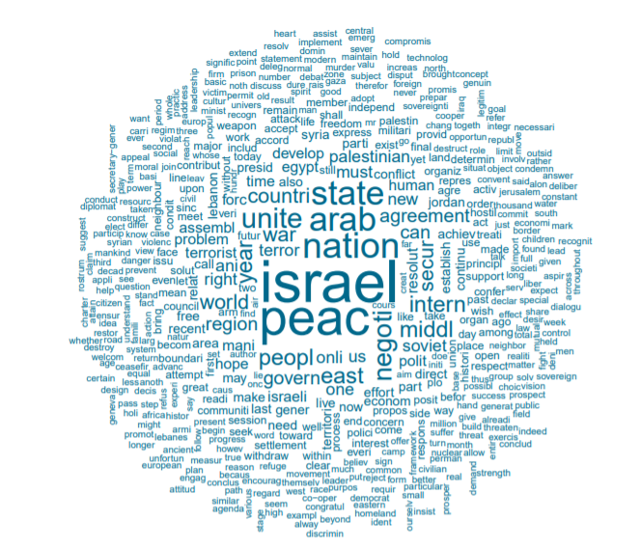
Research Methods
Explore the dataset
Bag of Words Pre-Processing
Find distinctive words
Topic Modelling
LDA
STM
Label Topics
Visualization
Interpret the results
Fig1. Word Cloud of only Israel before 1998, when Palestine was not in the UNGB. Word “Iran” and “Palestine” appeared less frequently than after 1998..

Slide 5
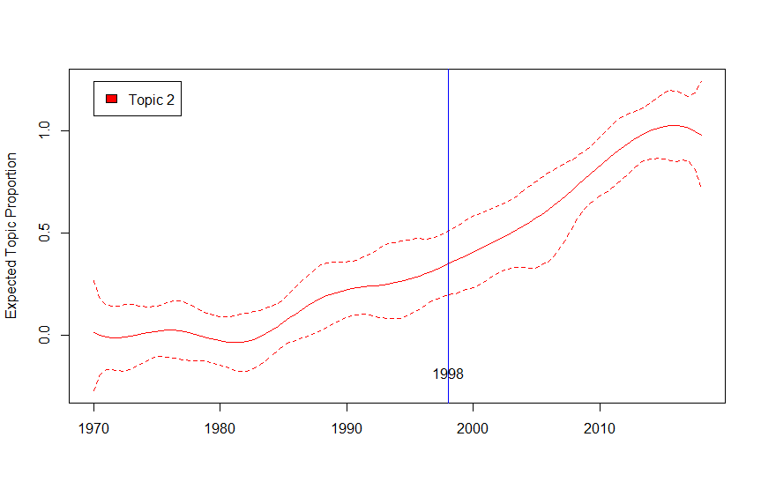
Results: initial model - STM on Israel
The mention of Palestine in Israeli speeches increased rapidly after 1998, the year when Palestine first participated at UNGD.
Which indicates the change Israel’s policy preference might be associated with Palestine’s participation at UNGD.
Fig2. Model with only ISR: topic 2 proportion over the years
Notes:
Only include I’s 49 statements, starting at 80’s because conflicts between Iran and P.

Slide 6
Result: Final Model - ISR <1998, ISR >= 1998, PSE
1 | palestinian, peac, peopl, state, intern, will, israel | Calling attention to the Nakba and refugees, Palestine seeks right and justice, with commitment to peace, and calls out threats from Israel.
2 | israel, iran, will, peac, year, peopl, nation | Israel points out Iran’s military threats, calling for ending its nuclear program.
3 | peac, peopl, will, nation, new, can, palestinian | Post-cold-war Israel’s promise to spread democratic values, build friendship with neighboring states, and more importantly, resolve the Palestine issue.
4 | israel, arab, peac, state, nation, unit, agreement | Israel was seeking agreement with Arab countries about peace and Jews refugees, wanted to work with UN and other members to solve world problems,
5 | israel, peac, nation, will, unit, state, countri | Pre-1998 Israel addressed its responsibility to secure regional and world peace.
Notes:
Notes: tell reader to look at #1: only Palestine topic:
#3 and #5 difference! #5 does not mention “Palestine” as frequently as topic #3, because #3 includes document after 1998.

Slide 7
Limitation and Validation
The limitation of our approach is that we can’t tell if Palestine was able to speak at UNGD is the causal effect of the changes in Israeli statements, or there were other confounding political changes. For example, geopolitical reasons behind Palestine’s allowance to participation could be one of the reasons that caused Israel’s change in speech topics.
Our results on the topic of Palenstinian statements were consistent with Pressman’s findings. We found the metadata corresponding to the topic covered the same topics to Pressman’s description of Palenstinian statements. On the other hand, we found the Israeli statements after 1998 also heavily focused on Iran nuclear issues, which was not mentioned in Pressman’s paper.
Notes:
Possible confounding: international interest on mid-east region over time increased, as incidents of conflicts /terriorism continue after 2000.

