Slide 1
TEAM 03
Motion Controlled Lamp
Ian Tarleton
Kainoa Kekahuna
Grant Cazinha
James Schiffer
12/08/2015
ECE 411

Slide 2
Problem/Need
Create a low cost lamp that requires no physical contact to turn on/off, or to adjust the level of illumination.

Slide 3
Motivation
We thought this would be a cool novelty device. It could be a fabulous gift, and even a conversation piece in the home.

Slide 4
Objective
Complete a new product introduction using the processes and methods introduced in ECE 411 with the ultimate goal of creating a working prototype of our touch-free lamp

Slide 5
Alternatives
Based on our research, there is nothing that functions like the lamp that we designed and constructed.

Slide 6
Requirements
Lamp Features
Approximately 40W incandescent equivalent (300 Lumens) illumination.
The device will be turned on and off using motion detection.
Accuracy within 12" beyond the minimum distance for the sensor.
Illumination variability control based on distance from sensor.
Adjustable based on distance measurements in a 12" range starting from the minimum distance of the sensor.
Decreasing distance decreases illumination down to 0% of maximum.
Increasing distance increases illumination up to 100% of maximum.
Uses standard 120V outlet for power.
Cost
Cost for a single prototype will be less than $100.
Operational Environment
Standard Residential usage.
Manufacturing
PCB
Have ≥ 2 layers, with solder mask and at least a top-side silk screen.
Have an area between > 9 cm2 and < 900 cm2.
Have no linear dimension < 2 cm or > 30 cm.

Slide 7
Approach
We implemented the Waterfall design process
This matched well with course requirements
Better for hardware based projects (compared to SCRUM, AGILE, etc.)

Slide 8
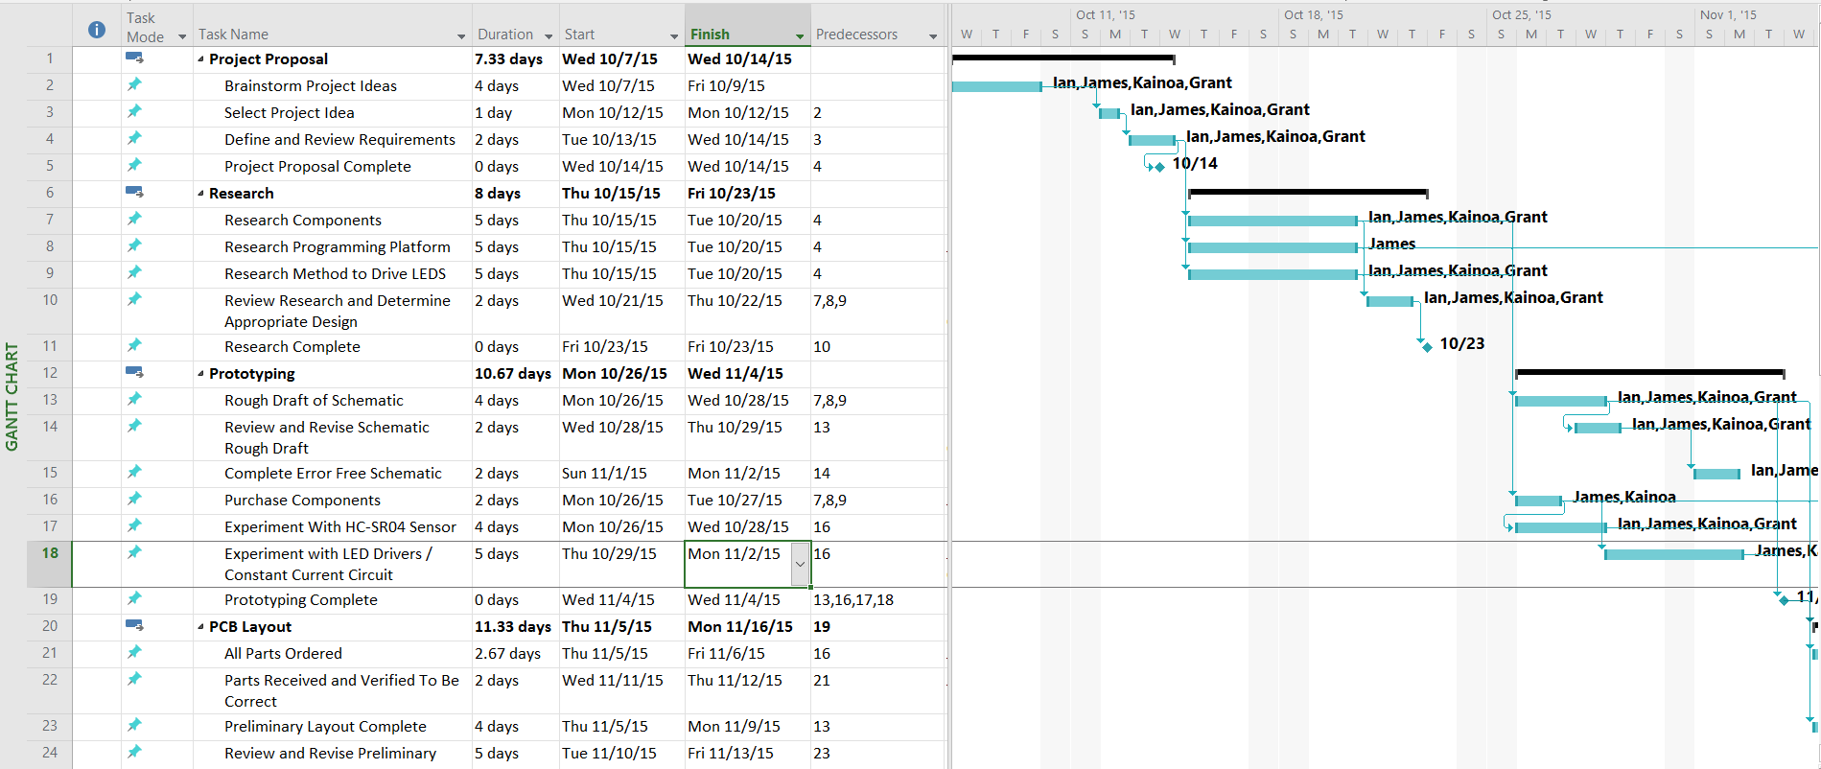
Schedule
Full Schedule available on our Github repo:
https://github.com/j1mb0/ECE411/tree/master/T03_Schedule

Slide 9
Level 0 Block Diagram
Power
12 Volts DC
Motion
Controlled
Lamp
Light
Emission 300 Lumens
Motion
Sensor
Module | Motion Controlled Lamp
Inputs | Motion: Object distance, range 2”-14” 12 V DC
Outputs | Light (300 Lumens)
Functionality | Converts proximity based motion controls into light emission

Slide 10
Physical View (UML)
User
Micro Controller
LED Array
Ultrasonic Range Finder
Distance
(2”-14” from sensor)
Hand
Processor Continuously
Sampling and Averaging 2 samples every 4 ms
PWM Signal
CCCS

Slide 11
Design - Hardware Considerations
Sensor
IR
Susceptible to interference
Unsure of interface with hand due to body heat at close distances
Ultrasonic
Less susceptible to interference
Functions within distance specified in requirements
Illumination
LEDs
Low cost
Low power requirements
Long life span
Low heat dissipation
Power
5V Micro USB (standard phone charging cable and wall wart)
Not enough voltage
12V Wall Wart
Delivers enough voltage

Slide 12
Design - Hardware
PCB
Have ≥ 2 layers, with solder mask and at least a top-side silk screen.
Have an area between > 9 cm2 and < 900 cm2.
Have no linear dimension < 2 cm or > 30 cm.
Sensor
Ultrasonic Range Finder
Illumination
Array of 1W LEDs
Power
12V Wall Wart

Slide 13
Design - Software
Used Atmel Studio
Code Written in AVR Baremetal C
Used AVR Dude to load software onto ATMega328-MU

Slide 14
Implementation – Major Components
ATMega328-MU
L7805 Voltage Regulator
DMN3024LSD NFET
ZDT694 NPN Transistor
1W LED
HC-SR04 Ultrasonic Range Finder
12V Wall Wart
LED Heat Sink

Slide 15
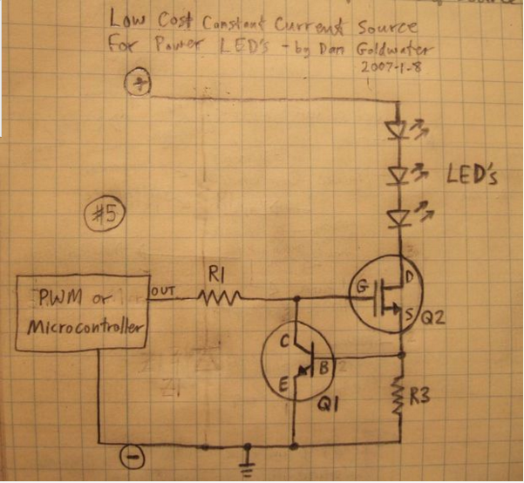
Constant Current Source

Slide 16
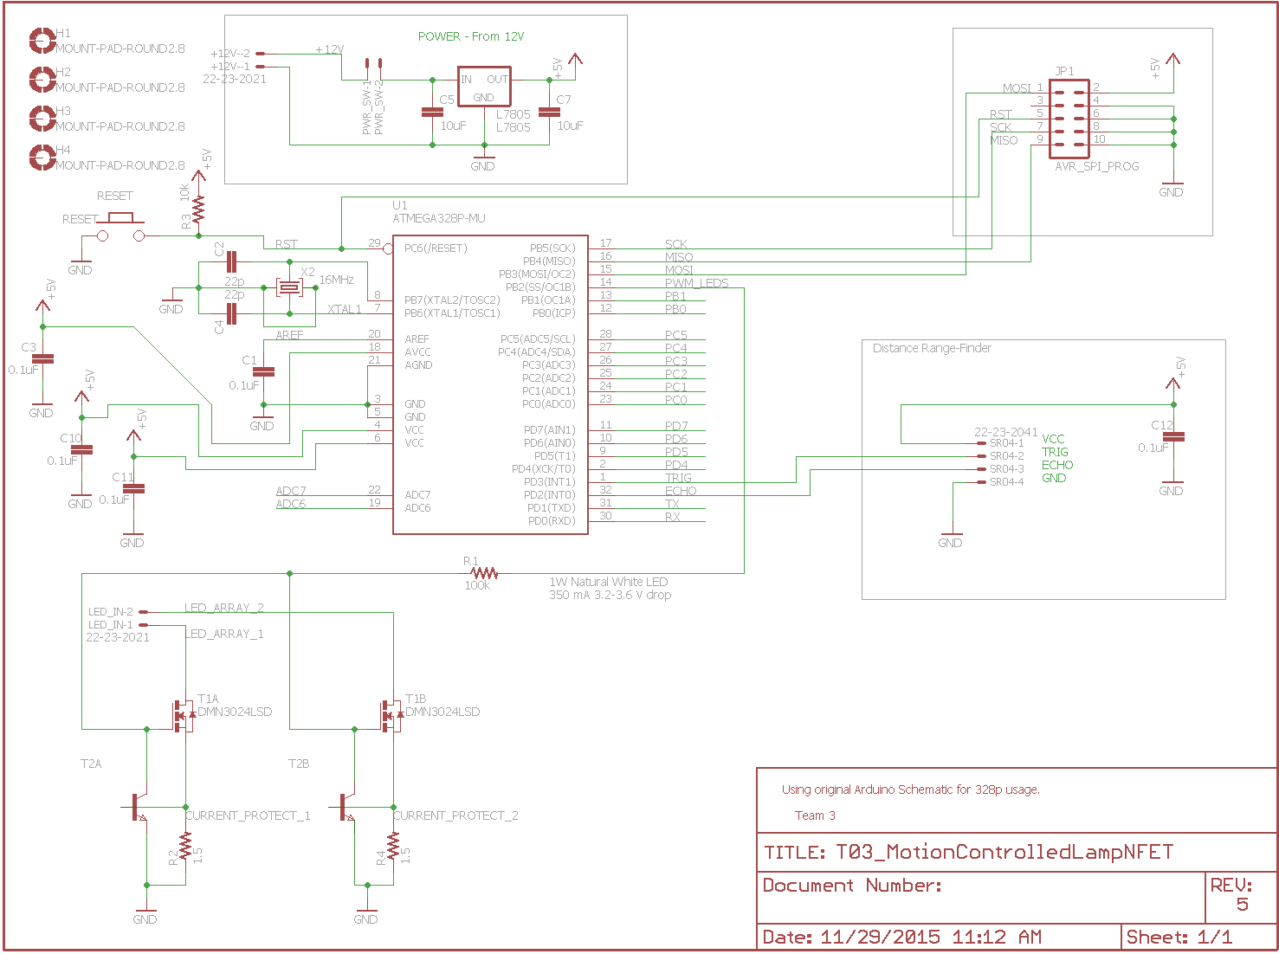
Implementation - Schematic

Slide 17
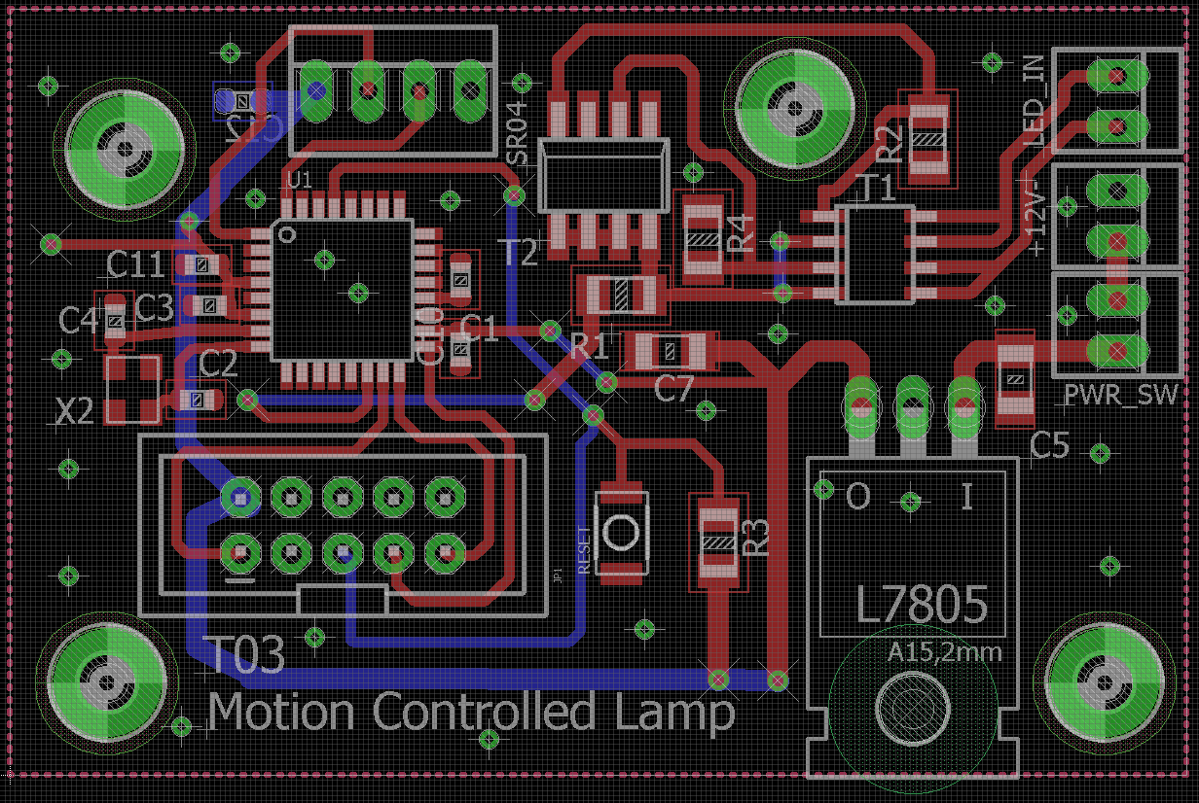
Implementation - Board

Slide 18
Implementation - Tools Employed
EagleCAD
Atmel Studio
AVR Dude
Microsoft Project

Slide 19
IP and Prior Work
PWM code concept from Arduino website
High Power LED Driver Circuit Design from Dan Goldwater – Cofounder of Instructables.com
Base schematic design was structured around the Arduino Tiny schematic
We did not knowingly use any IP from external sources

Slide 20
Testing – Test Plan
System Tests
Software:
Test Input data. Send test data equivalent to the sensor data. Confirm that data was received and compare with test input data.
Test sensor input data conversion. Send input test data. Allow conversion to pulse width modulation values. Compare with expected pulse width modulation values.
Test output data. Send output data. Was output data sent and was that data equivalent to the data given.
Hardware:
Test 12V wall wart to ensure the 12V DC is the proper output.
Test voltage regulator from 12V DC to 5V DC with oscilloscope.
Test ultrasonic range module input and output signals using function generator and oscilloscope.
Test processor inputs and outputs using oscilloscope and function generator.
Test Led array range of illumination using power supply.

Slide 21
Testing – Detailed Test Descriptions
Test Writer: |  | Grant Cazinha
Test Case Name: |  | LED Array Illumination Test |  |  |  | Test ID #: | MCL-LA-01
Description: |  | Test Led array range of illumination using power supply increasing current from 0 to 100% of max current rating for LEDs in 10 steps. This is a measure of the brightness level of the LEDs. |  |  |  | Type: | White Box
Tester Information
Name of Tester: |  | James Schiffer |  |  |  | Date: | 11/15/2015
Hardware Ver: |  | 2.0 |  |  |  | Time: | 6:17 PM
Setup: |  | Attach power supply leads to LED board.
Step | Action | Expected Result | Pass | Fail | N/A | Comments
1 | 10% | 35mA | x |  |  | +- 1mA
2 | 20% | 70mA | x |  |  | +- 1mA
3 | 30% | 105mA | x |  |  | +- 1mA
4 | 40% | 140mA | x |  |  | +- 1mA
5 | 50% | 175mA | x |  |  | +- 1mA
6 | 60% | 210mA | x |  |  | +- 1mA
7 | 70% | 245mA | x |  |  | +- 1mA
8 | 80% | 270mA | x |  |  | +- 1mA
9 | 90% | 315mA | x |  |  | +- 1mA
10 | 100% | 350mA | x |  |  | +- 1mA
Overall test result: |  |  | x |  |  | Well within range of expected current

Slide 22
Testing – Detailed Test Descriptions
Test Writer: |  | Grant Cazinha
Test Case Name: |  | 12V Wall Wart Voltage Verification |  |  |  | Test ID #: | MCL-WW-01
Description: |  | Test 12V wall wart to ensure the 12V DC is the proper output. |  |  |  | Type: | Black Box
Tester Information
Name of Tester: |  | James Schiffer / Kainoa Kekahuna |  |  |  | Date: | 11/30/2015
Hardware Ver: |  | 2.0 |  |  |  | Time: | 3:00 PM
Setup: |  | Wall wart plugged into board and wall electrical socket
Step | Action | Expected Result | Pass | Fail | N/A | Comments
1 | Plug wall wart into wall electrical socket | N/A |  |  | x
2 | Plug wall wart into board | N/A |  |  | x
3 | Check voltage using oscilloscope | 12V +- 30% | x |  |  | 11.9V- 12.2V Fluctuating. Well within tolerance.
Overall test result: |  |  | x

Slide 23
Testing – Detailed Test Descriptions
Test Writer: |  | Kainoa Kekahuna
Test Case Name: |  | Voltage Regulation Verification |  |  |  | Test ID #: | MCL-VR-01
Description: |  | Test voltage regulator from 12V DC to 5V DC with oscilloscope. |  |  |  | Type: | White Box
Tester Information
Name of Tester: |  | James Schiffer, Ian Tarleton |  |  |  | Date: | 11/30/2015
Hardware Ver: |  | 2.0 |  |  |  | Time: | 3:15 PM
Setup: |  | Plug wall wart into eletrical wall socket and plug voltage regulator into board
Step | Action | Expected Result | Pass | Fail | N/A | Comments
1 | Turn on board | n/a |  |  | x
2 | Test output of voltage regulator with oscilloscope | 5V output from voltage regulator | x |  |  | Oscilloscope read ~5.017V on voltage regulator output
Overall test result: |  |  | x

Slide 24
Testing – Detailed Test Descriptions
Test Writer: |  | Grant Cazinha
Test Case Name: |  | Input Signal to Pulse Width Modulation Conversion |  |  |  | Test ID #: | MCL-PWM-01
Description: |  | Test sensor input data conversion. Send input test data. Allow conversion to pulse width modulation values. Compare with expected pulse width modulation values. |  |  |  | Type: | White Box
Tester Information
Name of Tester: |  | James Schiffer, Kainoa Kekahuna |  |  |  | Date: | 11/30/2015
Hardware Ver: |  | 2.0 |  |  |  | Time: | 4:00 PM
Setup: |  | PWM code is configured to set the PWM signal to high after 16 microseconds once loaded onto the board. Connect TinyUSB AVR to board and load code from Atmel Studio.
Step | Action | Expected Result | Pass | Fail | N/A | Comments
1 | Setup Oscilloscope to Read PWM Line | n/a |  |  | x
2 | Run test by loading PWM code into board | n/a |  |  | x
3 | Compare output data with expected | PWM signal set to high after 16 microseconds | x |  |  | AVR fuses are factory set to divide run with an internal clock of 1 MHz.. Oscillator was acting with a 1 MHz pulse instead of expected 16MHz pulse. Fixed.
Overall test result: |  |  | x |  |  | Successful after adjusting fuse bits.

Slide 25
Results
Did Not Work
Initial design included LED driver chip. Chip was either faulty or implementation was poor.
Ordering parts was complicated. We received a few parts that were not what was desired.
Original power supply concept was not sufficient for the types of LEDs chosen for the lamp.
Worked
Constant current source design using NFETs was simple and elegant and worked sufficiently.
Solder stencil and oven for soldering the surface mount components.
The Lamp

Slide 26
Contributions
Ian Tarleton
Designed and Constructed Enclosure
Documentation
Quality Assurance / Review
Component Research
Debugging
Grant Cazinha
PCB Design
Board Construction and Troubleshooting
Component Research
Documentation
Quality Assurance / Review
Kainoa Kekahuna
Scheduling
Documentation
Component Research
Quality Assurance / Review
Debugging
James Schiffer
PCB Design
Schematic Design
Component Research
Debugging
Coding
Quality Assurance / Review

Slide 27
Bill of Materials
Bill of Materials To Construct One Motion Controlled Lamp
Quantity | Part List | Cost
2 | 10uF Capacitor | $0.30
5 | 0.1uF Capacitor | $0.06
2 | 22pF Capacitor | $0.06
1 | 100k Resistor | $0.32
1 | 10k Resistor | $0.15
1 | 1.5 Resistor | $0.92
1 | ATMEGA328P-MU Processor | $3.38
1 | L7805 Voltage Regulator | $0.62
1 | 16 MHz Crystal Oscillator | $0.79
1 | DMN3024LSD NFET | $0.63
1 | ZDT694CT NPN | $1.16
1 | 12V Wall Wart | $8.93
1 | PCB Manufacturing | $5.00
6 | 1W LED | $1.20
1 | LED Heat Sink | $7.59
1 | Transistor Heat Sink | $0.50
1 | HC-SR04 Ultrasonic Range Finder | $2.47
1 | Power Connection | $1.00
5 | Headers | $0.60
1 | Acrylic With Custom Cuts | $12.00
 | Total Cost of Raw Materials | $47.68
One Time Purchases / Bulk Purchases
1 | Acrylic Cement | $5.00
1 | Waterproof Sealant | $4.00
1 | TinyUSB (Necessary to Program Board) | $15.00
 | Total Cost With One Time Purchases | $71.68

Slide 28
Repository
Full documentation, code, design process, research, etc. available at https://github.com/j1mb0/ECE411/wiki

Slide 29
Lessons Learned

