Slide 1
Dissecting Reinforcement Learning
Mechanisms Behind Compositional Reasoning in LLMs
Gyeongwon James Kim
Advisor: Chenyan Xiong
Carnegie Mellon University · May 2026

Slide 2
The Rise of Large Reasoning Models
LLMs can now solve problems once considered far beyond reach
RLVR Training Loop
Competition mathematics
Graduate-level science questions
Complex multi-step code generation
1
Model generates
candidate solutions
2
Verifier checks
The key ingredient: Reinforcement Learning with Verifiable Rewards (RLVR)
correctness (no human labels)
Result: Models produce extended chains of reasoning that scale inference-time compute and tackle increasingly complex problems
3
Model updates
to produce better solutions
Gyeongwon James Kim · CMU · May 2026
Motivation

Slide 3
The Open Question: Why Does RL Work?
RL training is bundled with many ingredients — which one actually drives reasoning?
Sharpening
On-Policy Data
Negative Feedback
RL concentrates probability mass on outputs already latent in the base model — improving pass@1 without fundamentally expanding capabilities
The key is alignment between training data and the model's current distribution — RL avoids off-policy bias of static supervised datasets
Unlike SFT, RL explicitly penalizes incorrect outputs — this negative signal drives the model to avoid failure modes and explore new solutions
Yue et al., 2025
Chen et al., 2025
Tian et al., 2026
Modern RL pipelines bundle all three effects — making it impossible to attribute gains to any single cause
Gyeongwon James Kim · CMU · May 2026
Motivation

Slide 4
Our Approach: Controlled Decomposition
We isolate the contributions of individual RL components under a single controlled task
Axis 1: Data Source
Axis 2: Loss Function
Off-policy → On-policy
Teacher → Bootstrap → Iterative → On-policy rollouts
How does data source affect compositional performance?
SFT → GRPO
SFT → POS+NEG → REINFORCE+ → GRPO
What does adding negative gradients and normalization buy us?
Unified 2×2 Framework
 | Positive Samples Only | Positive + Negative Samples
Off-policy | SFT | DPO
On-policy | On-policy SFT | GRPO ★
Gyeongwon James Kim · CMU · May 2026
Approach

Slide 5
Our Lens: Compositional Generalization
What is compositional generalization?
Composition depth controls difficulty
The ability to combine known atomic skills to solve harder problems — a key ingredient of general reasoning.
Level 1
One atomic function
f(x)
Level 2
Compose 2 functions
f(g(x))
Why use it as our lens?
The SFT–RL gap is especially pronounced here
SFT plateaus sharply as composition depth increases
RL continues to improve — creating a clean, measurable separation
Difficulty is precisely controlled by composition depth
Level 4
Compose 4 functions
f(g(h(i(x))))
Level 8
Compose 8 functions
f¹∘f²∘…∘f⁸(x)
Gyeongwon James Kim · CMU · May 2026
Background

Slide 6
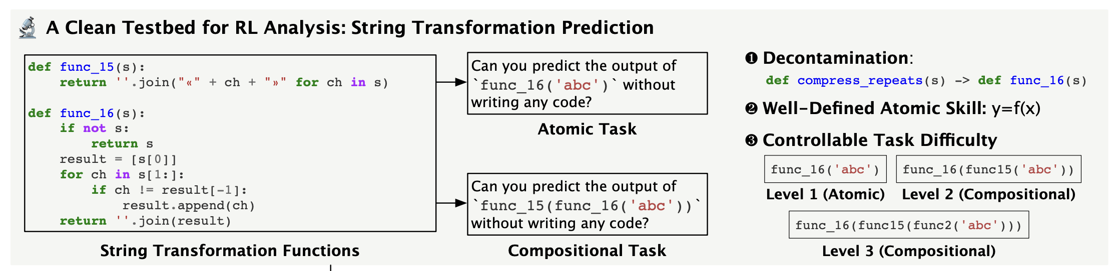
Task: String-Function Composition
Setup
25 unique string functions (13 train / 12 eval)
Model receives function definitions + input
Must predict output of composed programs
Training Protocol
1
Stage 1 (Level-1)
Learn all atomic functions → checkpoint 'Base'
2
Stage 2 (Level-2)
Train on composed tasks with different methods
★
Evaluation
Measure accuracy on levels 1–8 (extrapolation)
Gyeongwon James Kim · CMU · May 2026
Background

Slide 7
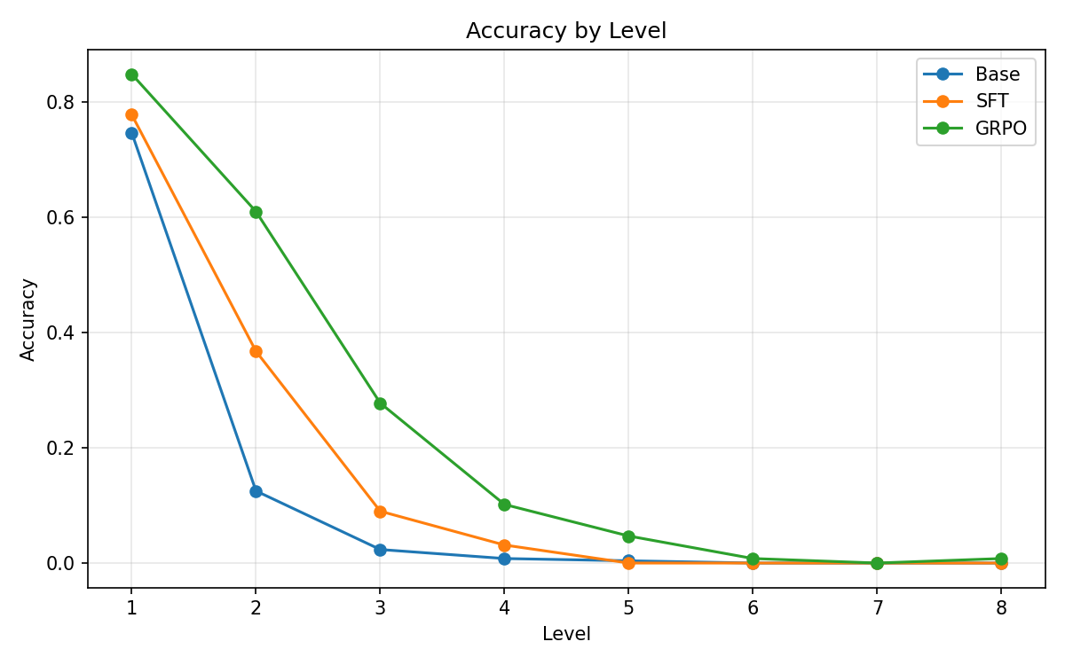
The Gap: SFT vs. GRPO
Key Observation
GRPO substantially outperforms SFT at higher composition levels (levels 3–8), creating a large and measurable gap.
What this tells us
Standard off-policy SFT (lower bound)
On-policy GRPO (upper bound)
Both trained on Level-2 tasks — difference is purely the training method
Goal: understand what inside GRPO drives this gap
Gyeongwon James Kim · CMU · May 2026
Results: Baseline

Slide 8
Loss Function Decomposition: SFT → GRPO
Key insight: loss functions differ only in how they weight positive and negative samples
Loss Function | Positive Weight | Negative Weight | Negative Samples?
SFT | 1 | 0 | No
GRPOMask | (1 − μ) / σ | 0 | No
POS+NEG | 1 | −1 | Yes
REINFORCE+ | 1 − μ | −μ | Yes
GRPO ★ | (1 − μ) / σ | −μ / σ | Yes
Progression: add negative samples, then group baseline (μ), then variance normalization (σ)
Question: Is it the negative samples or the normalization that matters most for compositional generalization?
Gyeongwon James Kim · CMU · May 2026
Framework: Loss Axis

Slide 9
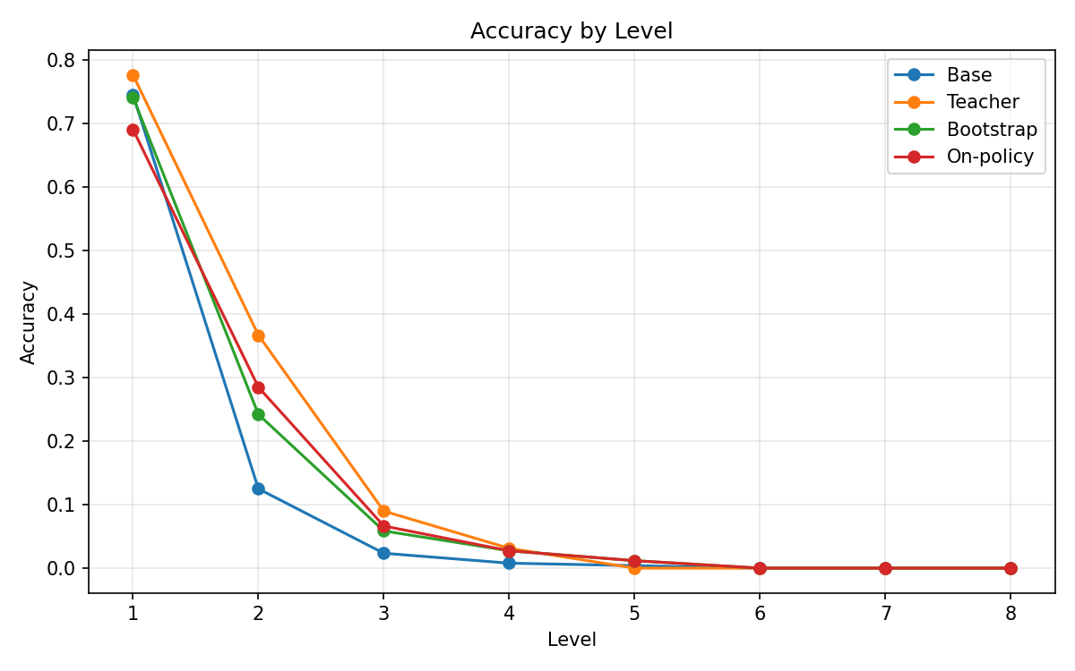
Results: Role of Data Source
Surprising finding
On-policy SFT performs worse than off-policy teacher-generated SFT — data quality matters!
Interpretation
Teacher model generates far more correct solutions than base model
On-policy data alone is not sufficient — need negative learning signal too
Filtering strategies tested: correctness ratio, trajectory length
Gyeongwon James Kim · CMU · May 2026
Results: Data Axis

Slide 10
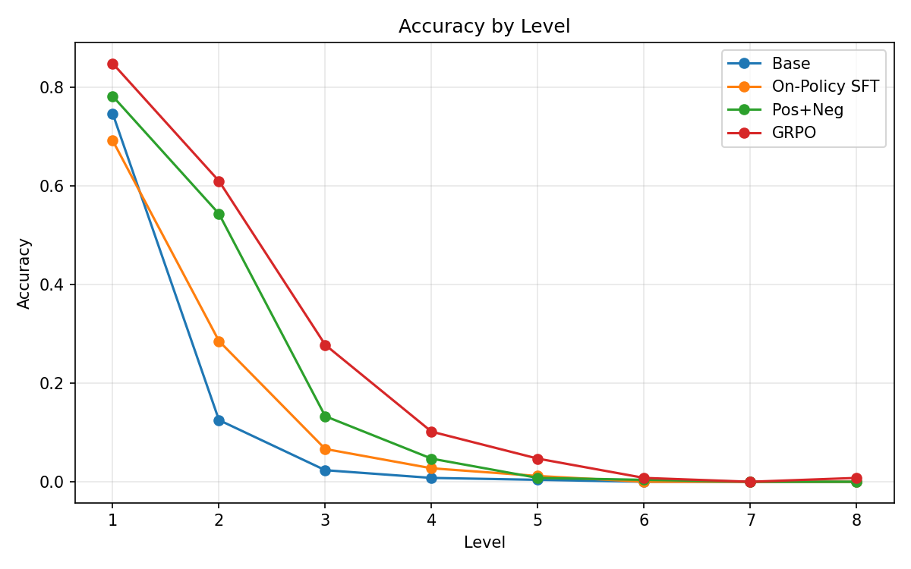
Results: Role of Negative Samples
Key finding
Adding negative samples (POS+NEG) under on-policy training recovers the bulk of the gap between on-policy SFT and full GRPO.
What this means
Negative gradients are a critical component of GRPO
Group normalization (σ, μ) has relatively smaller impact
Both on-policy data AND negative samples are essential for compositional generalization
Gyeongwon James Kim · CMU · May 2026
Results: Loss Axis

Slide 11
Conclusion & Contributions
1
Unified Decomposition Framework
SFT and RL variants organized under a 2-axis grid (data × loss). Enables controlled ablations.
2
Large SFT–GRPO Gap Demonstrated
RL substantially outperforms off-policy SFT on compositional generalization; filtering does not close the gap.
3
On-Policy Data is Critical
Data quality and on-policy nature both matter; teacher-generated data outperforms base-model rollouts under SFT.
4
Negative Gradients are Critical
Adding negative samples under on-policy training recovers the bulk of the GRPO gap. Normalization is secondary.
Gyeongwon James Kim · Carnegie Mellon University · May 2026

