Slide 1
project’s title: - holy_tokyo.db
name: - Jim Liero
GitHub usernames: - j1ml1n
edX usernames: - jili_248
city and country: - Uetersen, Germany
(prior Leipzig, Germany)
date of video record: - 04.03.2026
Notes:
"Hi, I'm Jim Liero from Uetersen, Germany, and this is my project holy_tokyo.db – a SQLite database for planning and tracking visits to Tokyo's temples and shrines."

Slide 2

Lost in goshuin collection? ‘holy_tokyo.db’ helps
Images created with Gemini AI, module Nano Banana 2 on 03.03.2026
Notes:
THE PROBLEM & SCOPE
If you're planning multiple trips to Tokyo's holy sites, things get messy fast.
Which temples offer goshuin stamps?
Which shrines have you actually visited and what's planned for tomorrows trip?

Slide 3
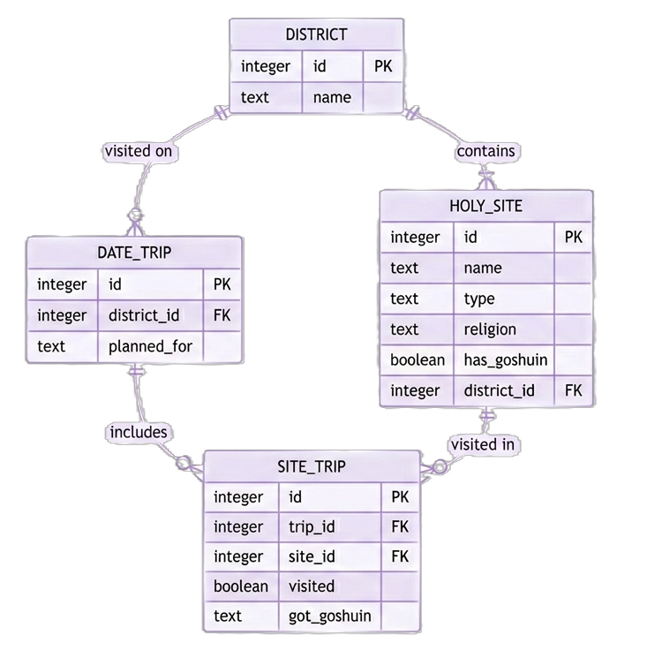
What is holy_Tokyo.db?
It is a database with four tables.
Tracking holy sites, districts,
date trips and site visits.
It focuses specifically on Tokyo’s temples and shrines.
This should help the dedicated traveler to keep an overview.
Notes:
It's a database with four tables. Tracking holy sites, districts, date trips, and site visits.
It focuses specifically on Tokyo's temples and shrines.
This helps the dedicated traveler keep an overview.

Slide 4
What is holy_Tokyo.db?
Basic idea:
Each holy site belongs to a
District.
Each trip is planned for one district on a specific date.
The junction table connects everything.
Notes:
The basic idea: each holy site belongs to a district.
Each trip is planned for one district on a specific date.
And a junction table connects everything together.

Slide 5


What is holy_Tokyo.db?
Basic design:
INTEGER for Primary Keys (PK)
BOOLEAN for binary status
TEXT* for everything else for flexibility.
*ternary approach for ‘got_goshuin’
(‘yes’, ‘no’, ‘has no goshuin’)
so, it’s also TEXT not BOOLEAN
Notes:
For the design, I used INTEGER for primary keys.
BOOLEAN for binary status.
And TEXT for everything else – including dates.
The 'got_goshuin' field uses three text values: 'yes', 'no', or 'has no goshuin'.

Slide 6


How was it optimized?
Indexes on Foreign Keys (FK) for fast queries:
  - trip_districtId
  - holySite_districtId
  - siteTrip_tripId
  - siteTrip_siteId
Notes:
For optimization, I added indexes on all foreign keys.
This makes queries much faster when joining tables.

Slide 7
How was it optimized?
Views for common queries:
- trips_to_district
  - planned_not_visited
  - not_planned_for_trip
  - collected_goshuin
  - holy_sites_has_goshuin
Notes:
I also created views for common queries.
Like 'planned_not_visited' for upcoming trips.
Or 'collected_goshuin' to track your stamp collection.

Slide 8

What’s with data integrity?
We have triggers for that!
Trigger 1
check_date_format_insert:
Insert Validation by
Trigger 2
check_date_format_update:
Update Validation
Trigger 3
check_gotGoshuin_visitedTrue:
Validation with AND
value
inserted
value
updated
is visited true ?
got_goshuin
updated to yes
Update got_goshuin
to yes
Error:
Cannot set got_goshuin
to ‘yes’ when visited
is FALSE
Error:
Value must
have format
YYYY-MM-DD
Error:
Value must
have format
YYYY-MM-DD
insert value
update value
Trigger 4 - update_hasGoshuin_gotGoshuin:
Update holy_site first, then site_trip
Trigger 5 - default_goshuin_on_insert:
Insert row in site_trip,
Update value in ref. to data in holy_site
HOLY_SITE – update one row
Old: has_goshuin = FALSE
new: has_goshuin = TRUE
SITE_TRIP – update many rows
old: got_goshuin = has no goshuin
new: got_goshuin = FALSE
SITE_TRIP – insert rows
got_goshuin = has no goshuin
SITE_TRIP – update rows
got_goshuin = FALSE
HOLY_SITE
has_goshuin = TRUE
Notes:
Data integrity is handled by triggers.
The first two check that dates are formatted correctly.
The third prevents you from marking a stamp as collected if you haven't actually visited the site.
Trigger four automatically updates trip records when a site starts offering goshuin.
Trigger five sets the correct default value when adding new site visits.

Slide 9
What's the catch?
Some Limitations are:
No user accounts – it’s built for single user
No time planning or tracking
Not additional feature tracking for holy sites
No goshuin design tracking
No comment column in site_trip
Notes:
There are some limitations.
No user accounts – it's built for one person.
No time tracking, just dates. And no way to comment on your visits yet
Just to name a few.

Slide 10
What’s next?
Some future improvements could be:
biggest future improvement would be an interface (e.g. with Flask) making this accessible for non-technical users.
gradual time planning and tracking features
Feature tracker for sites (pagodas, fountains, guardians …)
Notes:
Future improvements could be
time planning, and tracking additional site features like pagodas or fountains.
The biggest improvement by far would be an interface for non-technical users.

Slide 11

Thanks for watching!
Images created with Gemini AI, module Nano Banana 2 on 04.03.2026

