Slide 1
staffEnglish()
Read NAME
Read ID
Read SEMESTER
SEMESTER = 1
Read noOfCourse
SEMESTER = 2
Read noOfCourse
Read COURSE_CODE
SEMESTER = 3
Read COURSE_CODE
Read noOfCourse
Read GRADE
Read GRADE
Read COURSE_CODE
Read CREDIT_HOURS
Read CREDIT_HOURS
Read GRADE
Final course?
Final course?
Read CREDIT_HOURS
Calculate GPAS1 & CGPAS1
Calculate GPAS2 & CGPAS2
Final course?
Display GPAS1 & CGPAS1
Display GPAS2 & CGPAS2

Slide 2
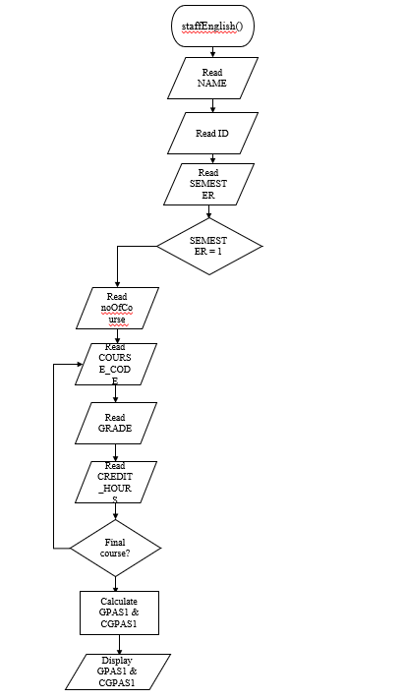

Slide 3
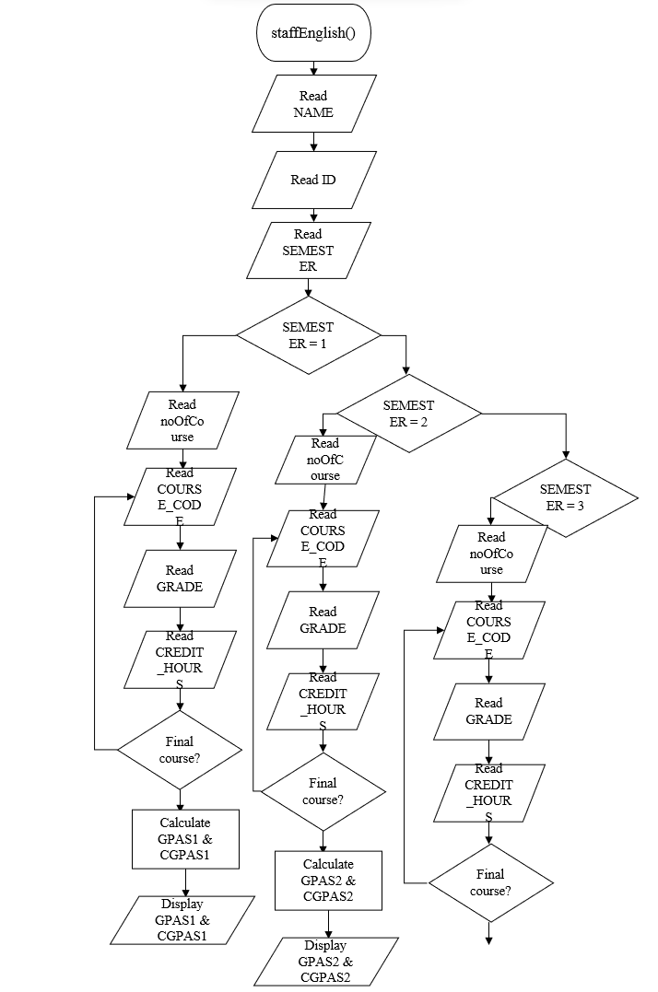
Display “Invalid semester”
Calculate GPAS3 & CGPAS3
Display GPAS3 & CGPAS3
SEMESTER != 0

Slide 4
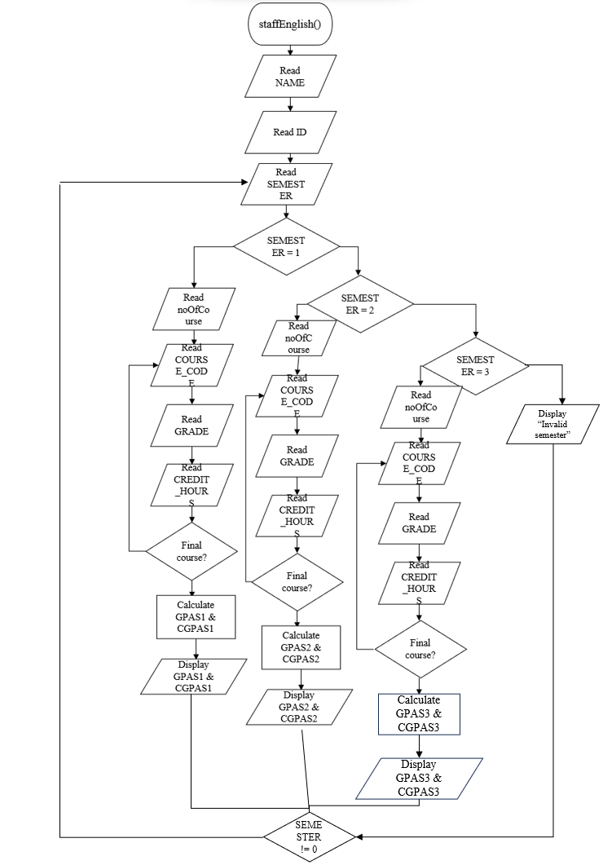
staffMalay()
true
false
true
true
false
false
true
true
false
RETURN

