Slide 1
Record Room
For Archival of physical files, tracing physical files

Slide 2
Record Room MODULE & DATA ENTRY PROCESS
  To guide Codal life completion of files and assist with graphical notifications to discard such records with ease and minimal documentation
  To enable barcode based indexing for reading/marking for easy finding for issue by operators
  Integrate all record rooms in one – and provide joint search of records using keywords of file name / name of employee / description tags, etc.
  To assist and guide in proper sorting & arrangement of records
  Integrated system to guide to user on file search – across the system / departments

Slide 3
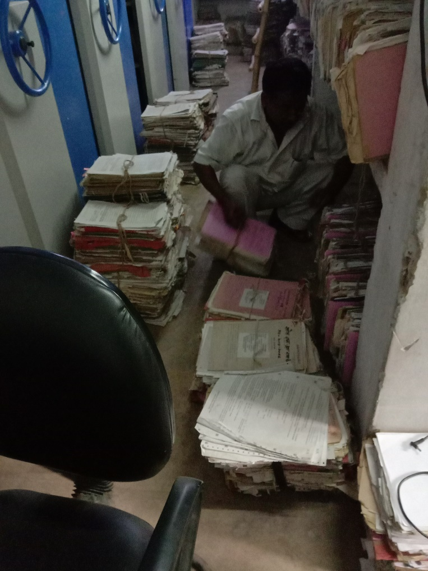
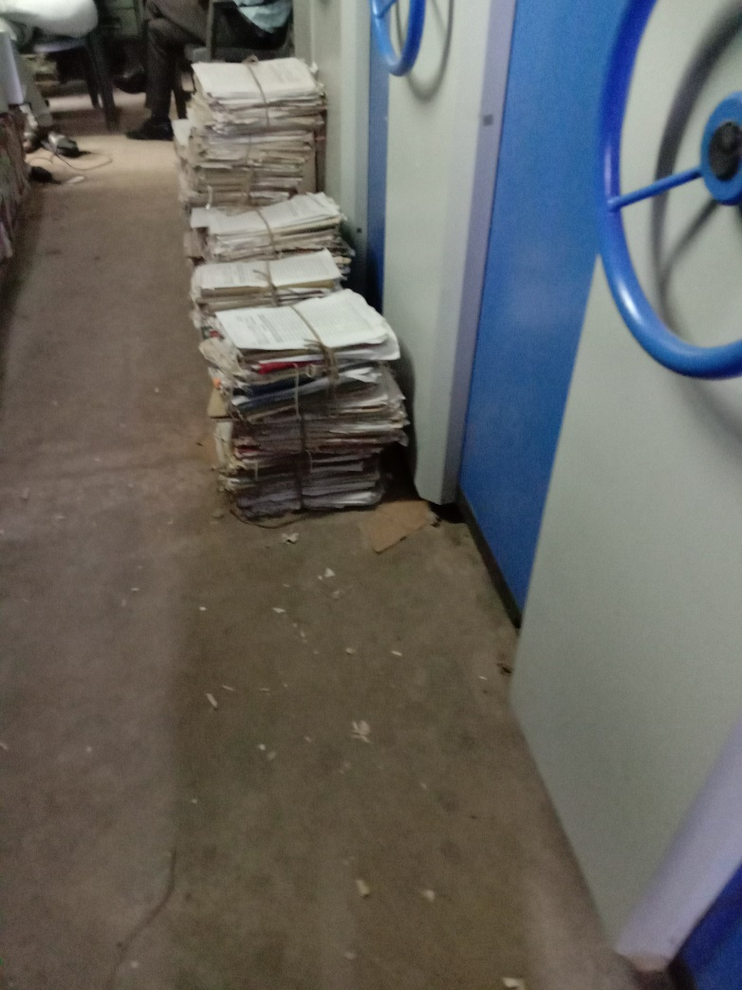
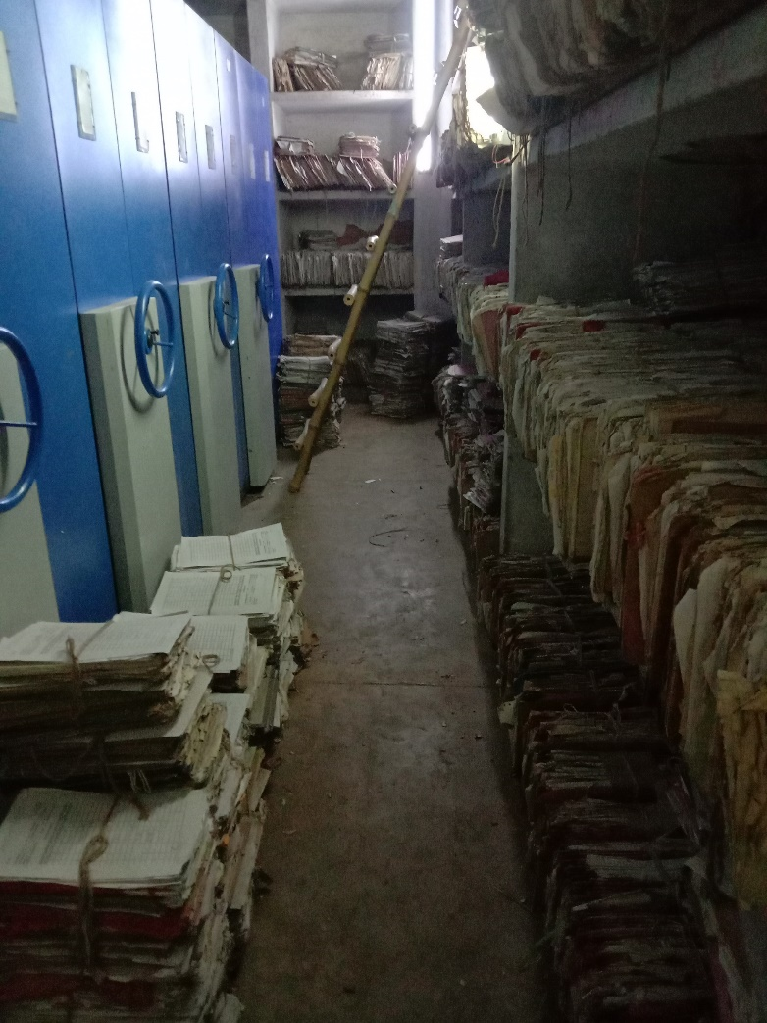
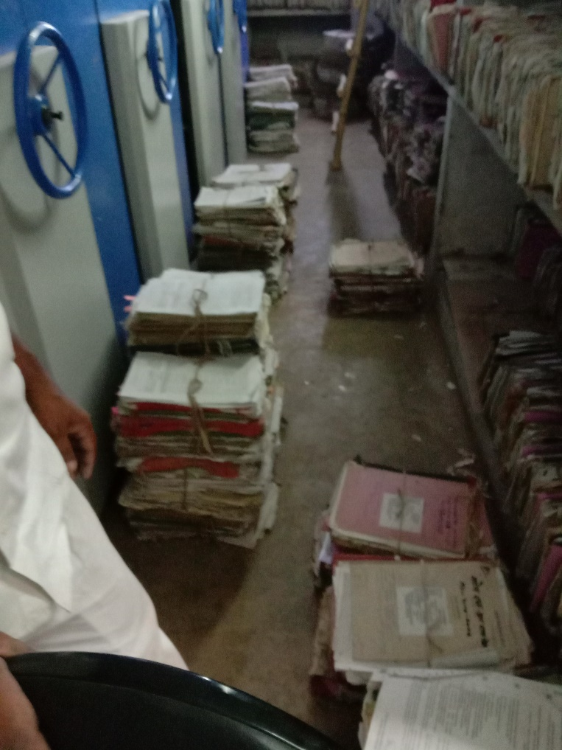
Files are often found scattered – pitiable situation
To facilitate ease of access, picking and stacking

Slide 4



Physical – record room digitization process
Supervisor/Project Manager
Operator 1
Operator 2
Team 02
Operator 3
Operator 4
Team 01
Picker/Stacker
Picker/Stacker
4 – 6 laptops for data entry
4-6 barcode guns for mapping of files
Upto 3 lac barcode stickers for files and almirah shelves

Slide 5
Methodology
Bar Coding and Affixing of stickers on individual Almirahs, subsequent same procedure for individual shelves of each almirah.
Designated R.L.s of each team would stack up files from Cabinet/Almirah racks hierarchically in batches of 50 and provide to each D.E.O.
Data entry of the files, generate and affix bar coded stickers on individual files with assistance of R.L.
Handing over of Data Captured and Bar Coded files to R.L. for placing back in requisite Bar coded Cabinet/Almirah Shelves
After completion of work in the Room with the lesser files, both teams would work in the next room cohesively.
Targets provided to each D.E.O. and R.L. to be monitored and reviewed by the Supervisor on ad-hoc basis.

Slide 6
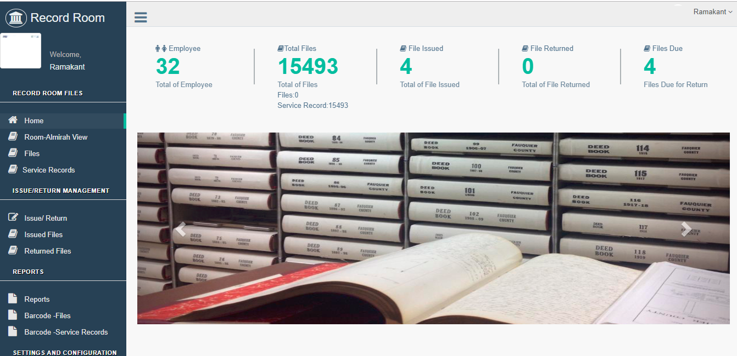
record room system: centralized access
Manage Record Rooms
Manage Issue/Return of Files
Search Files using –
Bar Codes
File Names
File Numbers
File Description Keytags

Slide 7
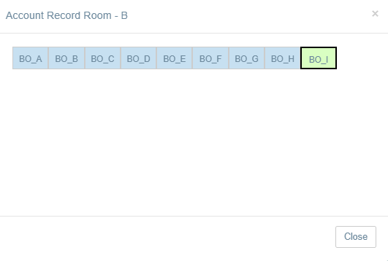
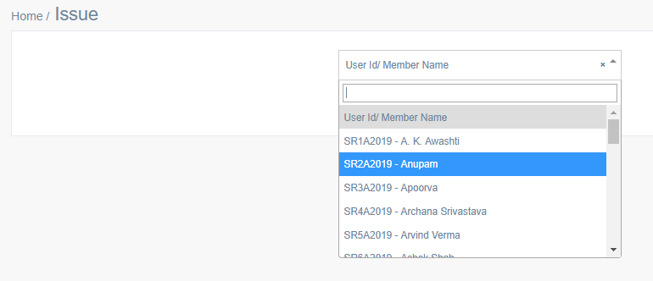
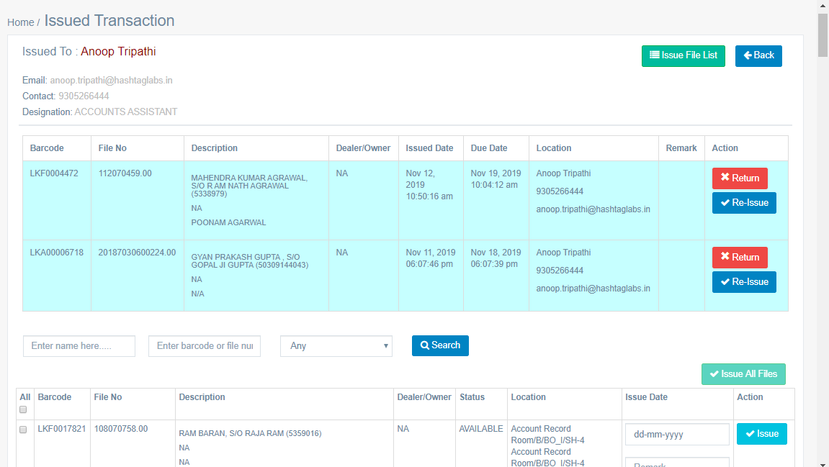
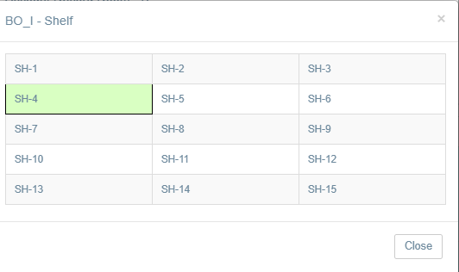
Issue to user and return process
Shows which Almirah Section you will
find the file…

Slide 8
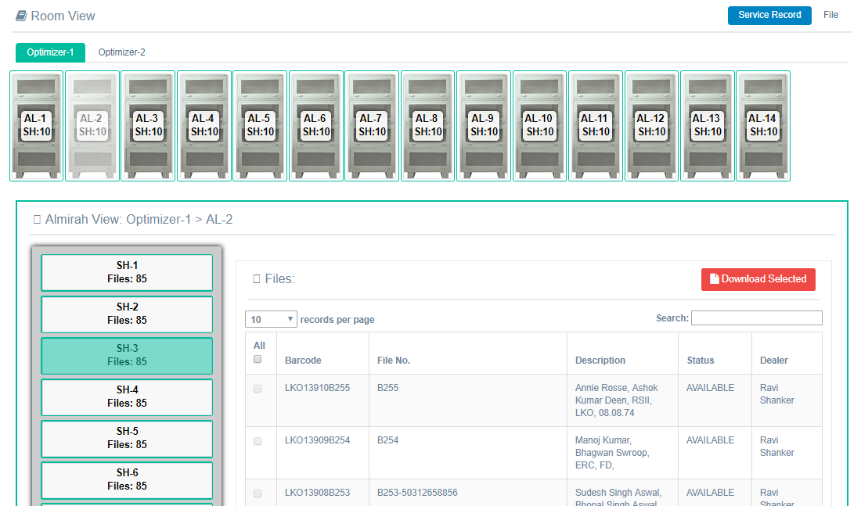
Record Room View – Rooms/Almirahs/Racks
Find what is kept in each Almirah !!
Search using –
File Name
Bar Code
Name/Description

Slide 9
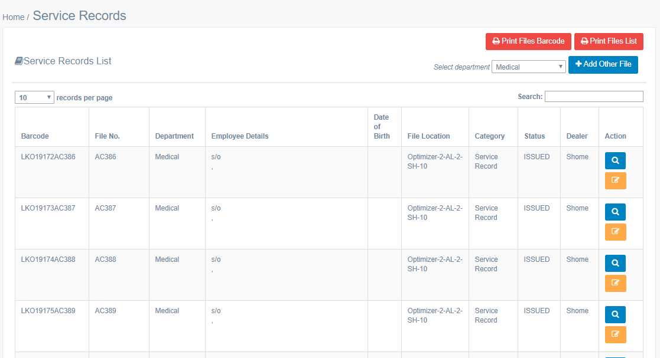
Search for Files with ease

Slide 10





Dak & dispatch manaGement
RECORD EACH INCOMING DAK AND OUTGOING DISPATCH
LETTER ASSIGNMENT
LINKING WITH SMART OFFICE – FILES
FILE / LETTER SEARCH
MIS REPORTS
Receipt Movements
Receipt Status
Receipt No.
Decisions in eFile
Set Flag for Receipt
Approved Draft mail/dispatch)
External
Application
Receipt Creation
External
Application
Smart Office Application

Slide 11
BENEFITS OF SMART OFFICE
FEATURES & ITS BENEFITS

Slide 12
ADVANTAGES OF SMART OFFICE
Bringing in transparency in the system
Improved efficiency in working
Viewing of files based on roles
Search and view file at any point in time (Based on hierarchy)
File can be retrieved anytime
Alerts on urgent files where action is required
Simplified Employee processes – easy adaptability
Improved Accountability
Notes:
12

Slide 13
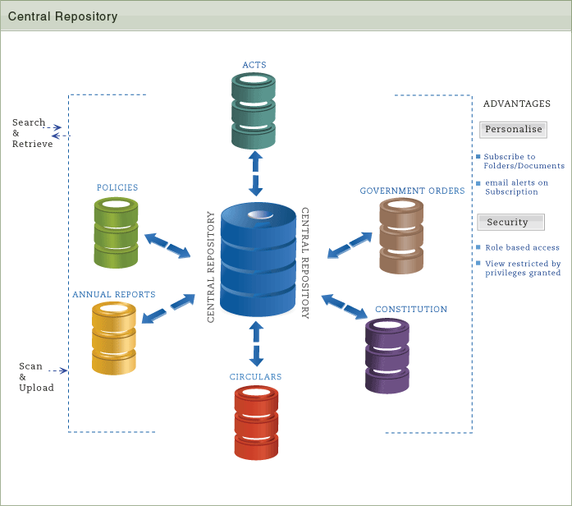
Centralized control – smart office work

Slide 14
THANKING YOU
OPEN FOR QUESTIONS…

