Slide 1
Heartbleed Attack

Slide 2
News
An attack on Community Health Systems that stole patient data was blamed on Heartbleed, as was the theft of hundreds of social ID numbers from the Canadian Revenue Agency.
Yahoo and OKCupid users were briefly advised not to log into their accounts until those services managed patch their installs of OpenSSL, and to change their passwords once they did regain access.

Slide 3
What is Heartbleed?
Heartbleed is a vulnerability in OpenSSL that came to light in April of 2014; it was present on thousands of web servers, including those running major sites like Yahoo.
OpenSSL is an open source code library that implements the TLS and SSL protocols. The vulnerability meant that a malicious user could easily trick a vulnerable web server into sending sensitive information, including usernames and passwords.
OpenSSL is so widely used—when the bug was made public, it affected 17% of all SSL servers—that it precipitated a security crisis.

Slide 4
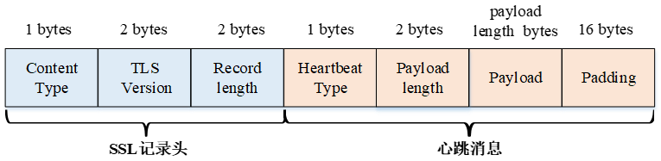
Why is Heartbleed called Heartbleed?
The name Heartbleed comes from heartbeat, which is the name for an important component of the TLS/SSL protocol.
The heartbeat is how two computers communicating with one another let each other know that they're still connected even if the user isn't downloading or uploading anything at the moment.
The Heartbleed vulnerability gets its name because attackers can use heartbeat requests to extract information from a target server

Slide 5
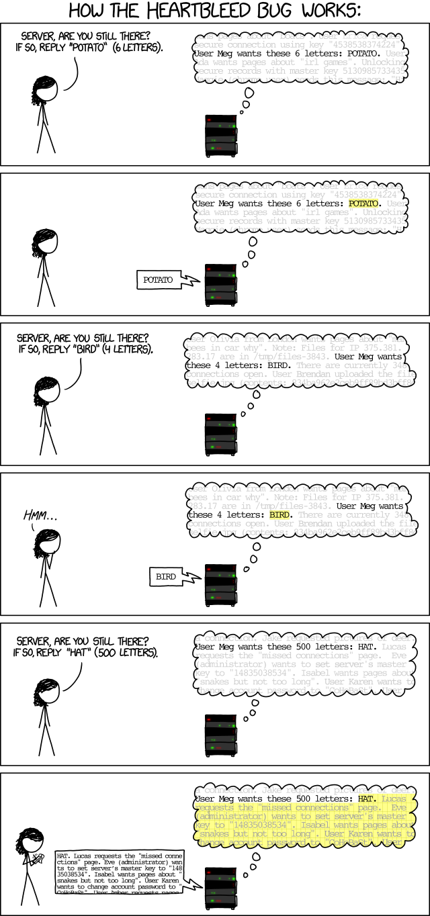
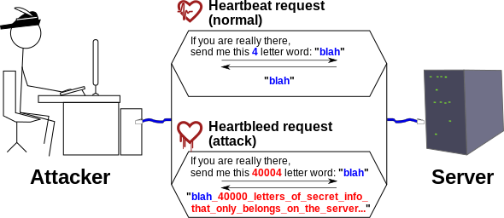
How does Heartbleed work?
normal case:
vulnerable case:
https://xkcd.com/1354/
Notes:
a heartbeat request includes information about its own length, but the vulnerable version of the OpenSSL library doesn't check to make sure that information is accurate, and an attacker can use this to trick the target server into allowing the attacker access to parts of its memory that should remain private.
Heartbleed is dangerous because it lets an attacker see the contents of that memory buffer, which could include sensitive information.

Slide 6
Heartbleed code
A single line of code contains the mistake that gave rise to the Heartbleed vulnerability:
memcpy(bp, pl, payload);
memcpy() is the command that copies data.
bp is the place it's copying it to
pl is where it's being copied from
payload is the length of the data being copied.
As we've seen, the problem is that there's never any attempt to check if the amount of data in pl is equal to the value given of payload.

Slide 7
How was Heartbleed discovered?
Heartbleed was actually discovered by two different groups, working independently, in very different ways.
The first to discover was in the course of a review of OpenSSL's open source codebase by a Google engineer
The second discovery happened at a Finnish cybersecurity firm just a few weeks later. It was during a series of simulated attacks against servers running OpenSSL.

Slide 8
The Heartbleed fix
/* Read type and payload length first */
if (1 + 2 + 16 > s->s3->relent)
return 0; /* silently discard */
hbtype = *p++;
n2s(p, payload);
if (1 + 2 + payload + 16 > s->s3->rrec.length)
return 0; /* silently discard per RFC 6520 sec. 4 */
pl = p;
The first part of this code makes sure that the heartbeat request isn't 0 KB, which can cause problems.
The second part makes sure the request is actually as long as it says it is.

