Slide 1

Heartbleed Bug
Chun-Hao Hsu
Jin-Ching Jeng
Notes:
I’m Jinny, and my partner is Chun-Hao. Our topic is heartbleed.

Slide 2



News on Heartbleed exploits
Since 2014
Attack on Community Health Systems that stole 4.5M patient data
Theft of hundreds of social ID numbers from the Canadian Revenue Agency
Heartbleed bug affects Yahoo, OKCupid sites; users face losing passwords
and more cases…
Notes:
First of all, we start from some news on heartbleed we found. These 3 cases all happened in 2014
The first news is an attack on Community Health Systems that millions of patient data were stolen.
The second news is an attack on Canadian Revenue Agency that hundreds of social ID numbers were stolen. (2014)
Even big companies like Yahoo suffered from heartbleed. They even asked users not to log into their accounts until the bug got fixed.
There are more cases if you google heartbleed…

Slide 3


What is Heartbleed?
Heartbleed is a vulnerability in OpenSSL that came to light in April 2014; it was present on thousands of web servers, including those running major sites like Yahoo.
OpenSSL is an open source code library that implements TLS/SSL protocols. The vulnerability meant that a malicious user could easily trick a vulnerable web server into sending sensitive information.
OpenSSL is so widely used—when the bug was made public, it affected 17% of all SSL servers—that it precipitated a security crisis.
Notes:
…, it means that the attacker can get the sensitive information including usernames and passwords from the vulnerable web server
Because openSSL is widely used, the heartbleed affected seventeen percent of all SSL servers, which is quite a lot.

Slide 4


Why is Heartbleed called Heartbleed?
Even if the user doesn't exchange data for a certain period, user sends a heartbeat request to the server to let each other know that they're still connected.
If the server receives it, it continues to maintain the connection and sends a heartbeat response.
Heartbeat: mechanism in TLS to determine completed connection
Heartbleed vulnerability gets its name because attackers can use heartbeat requests to extract information from a target server.
Notes:
It helps to understand heartbleed by knowing where its name comes from.
The name Heartbleed comes from Heartbeat
As we know that after TLS handshake, the server and client need to maintain a persistent connection, but it can consume a lot of server resources when there are many connected clients.
Heartbeat is a mechanism in TLS to determine completed connections, so they can close these connections to reduce server’s load.
for example, if the connection haven’t finished, the user will send a heartbeat request to the server like this, even the user doesn’t exchange data for a certain period. and the server will also send back a heartbeat response. That is heartbeat!
Heartbleed vulnerability gets its name because attackers can use heartbeat requests to get information from a target server.

Slide 5
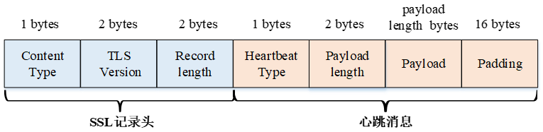
How does Heartbleed work?
A heartbeat request includes information about its own length, but the vulnerable version of the OpenSSL library doesn't check to make sure that information is accurate
An attacker can use this to trick the target server into allowing the attacker access to parts of its memory that should remain private.
TLS record
Heartbeat message
Notes:
Heartbleed is dangerous because it lets an attacker see the contents of that memory buffer, which could include sensitive information.
A heartbeat message includes 4 parts, type, payload length, payload and padding. When client sends a heartbeat request to server, the server will return the same payload back to client as a heartbeat response. The problem here is that what if a client sends a 5bytes massage but says its length is 100?
The answer is the server will try to respond a 100 bytes message from its own memory space which is scary.

Slide 6
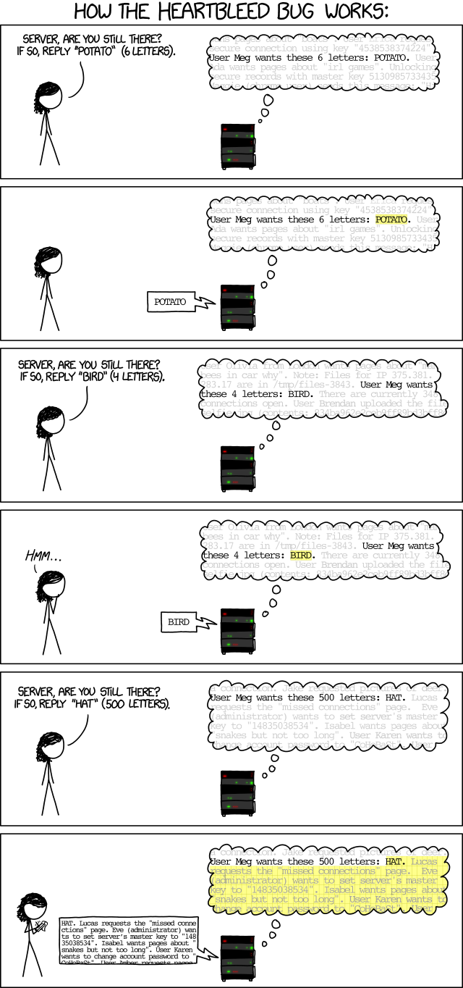
How does Heartbleed work?
normal case
vulnerable case
https://xkcd.com/1354/
Notes:
Here’s a scenario to understand how does the heartbleed work
User will ask the server like “hey server, if you are still alive, reply me the message POTATO which is 6 letters”, and the server will reply “potato” which is exactly 6 letters.
…, and the server will reply to 500 letters directly without checking the exact length of HAT message
These is kind of a buffer overflow issue

Slide 7
Heartbleed code
A single line of code contains the mistake that gave rise to the Heartbleed vulnerability:
memcpy(bp, pl, payload);
memcpy() is the command that copies data.
bp is the place it's copying it to
pl is where it's being copied from
payload is the length of the data being copied.
As we've seen, the problem is that there's never any attempt to check if the amount of data in pl is equal to the value given of payload.
Notes:
we can find how this vulnerability works from the code of the heartbeat, it uses a function call memcpy(memory copy) which takes the place to copy to, and where to copy from, the last parameter is the length of the data.Memory copy will create a buffer space based on the payload length without checking if the amount of data in payload is equal to the given size value

Slide 8
Heartbleed code
normal case
A single line of code contains the mistake that gave rise to the Heartbleed vulnerability:
memcpy(bp, pl, payload);
memcpy() is the command that copies data.
bp is the place it's copying it to
pl is where it's being copied from
payload is the length of the data being copied.
As we've seen, the problem is that there's never any attempt to check if the amount of data in pl is equal to the value given of payload.
vulnerable case
Notes:
in normal case, the data it tries to copy is match the length of the array, so no matter there is anything remains in the buffer(for example, the system didn’t erase the data in the memory space when it was freed from last time used this memory space), it will still be overwritten by the data it’s going to copy.
However, if the attacker modified the length here, the buffer server creates will be way more longer than the heartbeat message and only copy the message to the very first space of the buffer. Now, attacker can get some information if there is anything remains in the rest of space. Through this way, Attacker can keep sending heartbeat request until he gets enough information he wants.

Slide 9


The Heartbleed fix
/* Read type and payload length first */
if (1 + 2 + 16 > s->s3->relent) // no payload
return 0; /* silently discard */
hbtype = *p++;
n2s(p, payload);
// heartbeat message server ready to reply > actual heartbeat message
if (1 + 2 + payload + 16 > s->s3->rrec.length)
return 0; /* silently discard per RFC 6520 sec. 4 */
pl = p;
Notes:
The first part of this code makes sure that the heartbeat request isn't 0 KB, which can cause problems.
The second part makes sure the request is actually as long as it says it is. To fix this problem, the next update of OpenSSL add some check mechanism to see if the length aligned with the data.
For 1st line marked in yellow, when the payload length is 0, it will return 0;
in addition, when the heartbeat message server ready to reply is greater than the length of heartbeat message it suppose to be, it will also return 0.
after adding this,the server will only respond when client sends a heartbeat request with payload greater than 0 and payload length not greater than the actual payload length.
That’s all for out introduction for heartbleed thank you

