Slide 1
資安防護

Slide 2
參考資料

Slide 5
b

Slide 6
ISO 27001: The 14 control sets of Annex A explained Luke Irwin 18th March 2019
ISO 27001 is the international standard that describes best practice for an ISMS (information security management system).
The Standard takes a risk-based approach to information security. This requires organisations to identify information security risks and select appropriate controls to tackle them.
Those controls are outlined in Annex A of the Standard. There are 114 ISO 27001 Annex A controls, divided into 14 categories.
ISO 27001 controls list: the 14 control sets of Annex A
A.5 Information security policies (2 controls): how policies are written and reviewed.
A.6 Organisation of information security (7 controls): the assignment of responsibilities for specific tasks.
A.7 Human resource security (6 controls): ensuring that employees understand their responsibilities prior to employment and once they’ve left or changed roles.
A.8 Asset management (10 controls): identifying information assets and defining appropriate protection responsibilities.
A.9 Access control (14 controls): ensuring that employees can only view information that’s relevant to their job role.

Slide 7
A.10 Cryptography (2 controls): the encryption and key management of sensitive information.
A.11 Physical and environmental security (15 controls): securing the organisation’s premises and equipment.
A.12 Operations security (14 controls): ensuring that information processing facilities are secure.
A.13 Communications security (7 controls): how to protect information in networks.
A.14 System acquisition, development and maintenance (13 controls): ensuring that information security is a central part of the organisation’s systems.
A.15 Supplier relationships (5 controls): the agreements to include in contracts with third parties, and how to measure whether those agreements are being kept.
A.16 Information security incident management (7 controls): how to report disruptions and breaches, and who is responsible for certain activities.
A.17 Information security aspects of business continuity management (4 controls): how to address business disruptions.
A.18 Compliance (8 controls): how to identify the laws and regulations that apply to your organisation.

Slide 12
對於每一種允許之遠端存取類型，均應先取得授權，建立使用限制、組態需求、連線需求及文件化，使用者之權限檢查作業應於伺服器端完成

Slide 14
稽核
1.依規定時間週期及紀錄留存政策，保留稽核紀錄
2.確保資通系統有稽核特定事件之功能，並決定應稽核之特定資通系統事件
3.應稽核資通系統管理者帳號所執行之各項功能
定期審查稽核事件

Slide 15
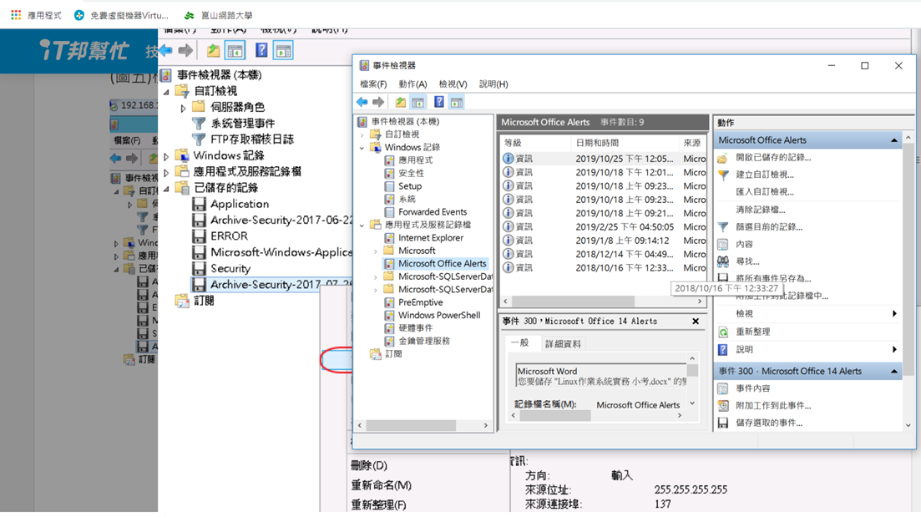

Slide 16
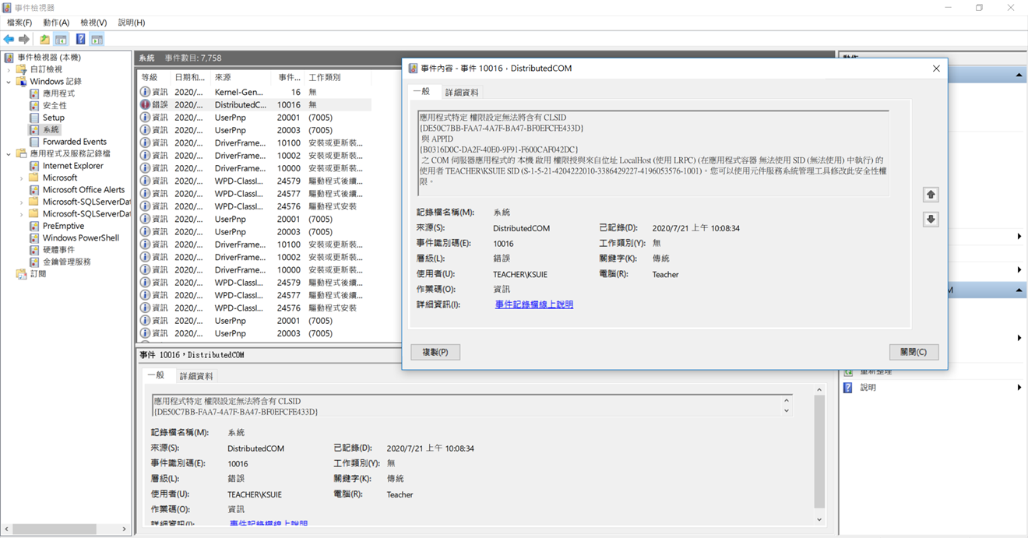

Slide 17
資通系統產生之稽核紀錄應包含事件類型、發生時間、發生位置及任何與事件相關之使用者身分識別等資訊，並採用單一日誌紀錄機制，確保輸出格式之一致性

Slide 18



各式系統的log analysis
Access log
Error log
詳解MySQL四種Log機制 以日誌稽核解析追蹤事件
https://www.netadmin.com.tw/netadmin/zh-tw/technology/BB40A3DA009A43F780864702D13C42FE

Slide 19
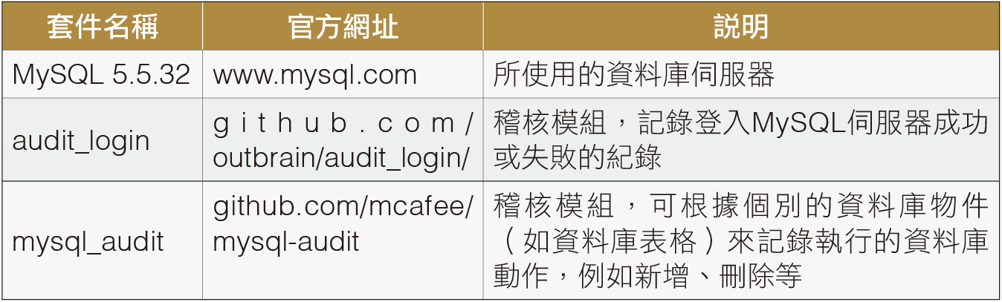

Slide 20
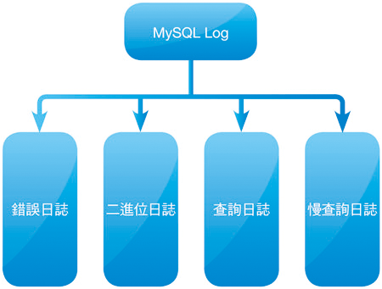
MySQL伺服器所提供的日誌類型

Slide 24
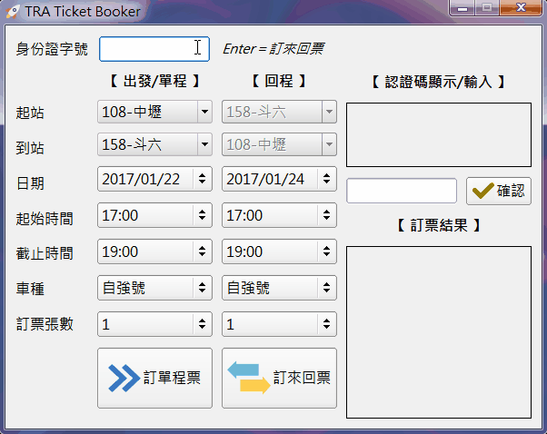
https://github.com/gw19/TRA-Ticket-Booker

