Slide 1
VIVO Developer Workshop

Slide 2
Overview: Debugging
Connecting eclipse to Tomcat
Including additional property and data
Reviewing expected behavior with custom example data getter
Debugging data getter

Slide 3
Connecting eclipse and Tomcat for debugging
Can try https://marketplace.eclipse.org/content/eclipse-tomcat-plugin
https://blogs.mulesoft.com/dev/tomcat-tcat-server/debugging-your-tomcat-webapp-with-eclipse
Go to tomcat bin directory: catalina jpda start
In eclipse:
Run -> Debug Configuration -> Remote Java Application. Right click and select “New”.
Name “tomcat (local)”
Project: vivo-api
Select Apply and then Debug

Slide 4
Runtime.properties (my version)
Vitro.defaultNamespace = http://vivo.workshop.edu/individual/
rootUser.emailAddress = (put in your email address)
Database
VitroConnection.DataSource.url = jdbc:mysql://localhost/workshopvivo
VitroConnection.DataSource.username = workshopvivo
VitroConnection.DataSource.password = workshopvivo
Comment out smtp
#email.smtpHost = smtp.mydomain.edu
#email.replyTo = vivoAdmin@mydomain.edu

Slide 5
Incorporate new property and data
Rename the following files to use .n3 extension instead of .n3workshop. Files should now be:
VIVO\home\src\main\resources\rdf\tbox\filegraph\customProperty.n3
VIVO\home\src\main\resources\rdf\abox\filegraph\customData.n3
VIVO\home\src\main\resource\rdf\display\everytime\customDataGetters.n3
Replace shortview_config.n3 with contents of shortview_config.n3swap
VIVO\webapp\src\main\webResources\WEB-INF\resources\shortview_config.n3
Replace searchIndexerConfiguration.n3 with contents of searchIndexerConfigurationVivo.n3swap
VIVO\home\src\main\resources\rdf\display\everytime\searchIndexerConfigurationVivo.n3

Slide 6
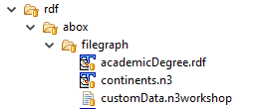
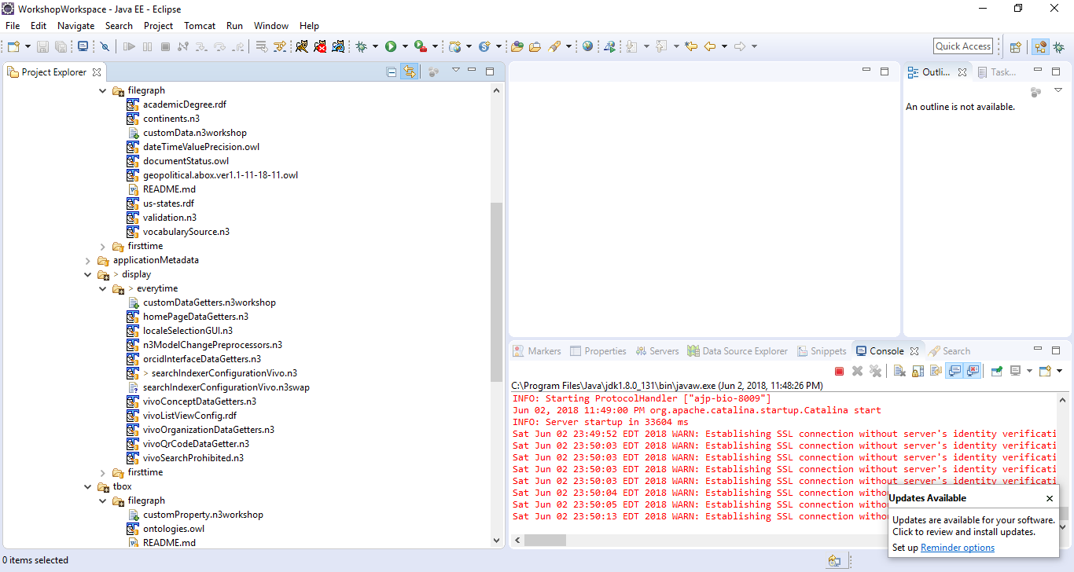
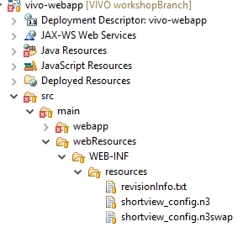
Incorporate new property and data

Slide 7
Incorporate new property and data
Stop Tomcat
Go to VIVO directory and redeploy
mvn clean install –s installer\settings.xml
Check home directory (specified as vivo-dir in settings.xml)
Start Tomcat

Slide 8
What did we just add
customProperty.n3
Define a new property
vivo:hasCoverColor rdf:type owl:DatatypeProperty ;
rdfs:label "Has Cover Color" ;
rdfs:domain <http://purl.org/ontology/bibo/Article>
customData.n3
Two articles, “Rainbows are wonderful” and “Unicorns are wonderful”, both with author (Razia Sultan). Also have abstracts.
customDataGetters.n3
For a person, retrieve cover colors of publications authored by this person
Other files to be explained later

Slide 9
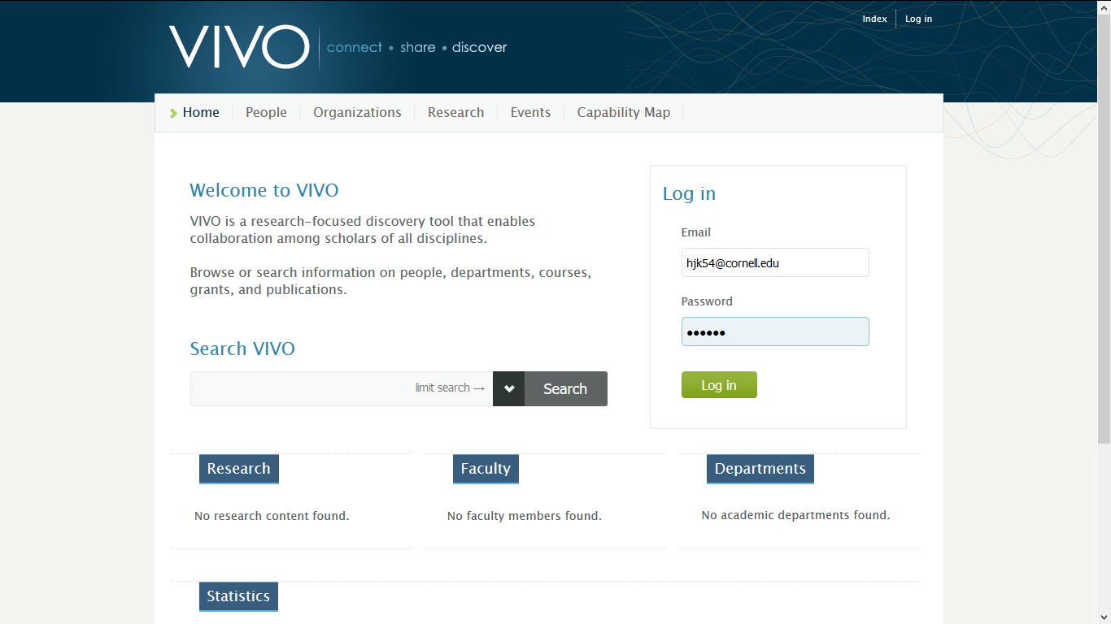
Notes:
Compare with live versions to show what search results usually look like. Example: https://vivo.ufl.edu/search

Slide 10
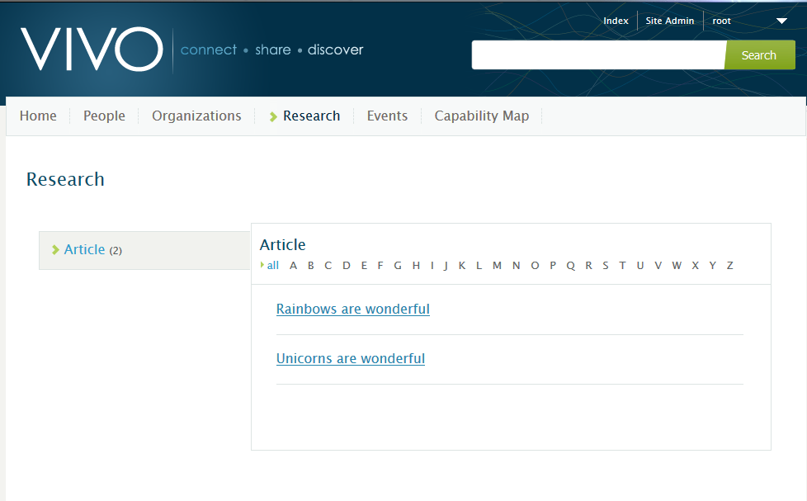
Notes:
You should see the following when you login and look at the research tab: two publications.

Slide 11
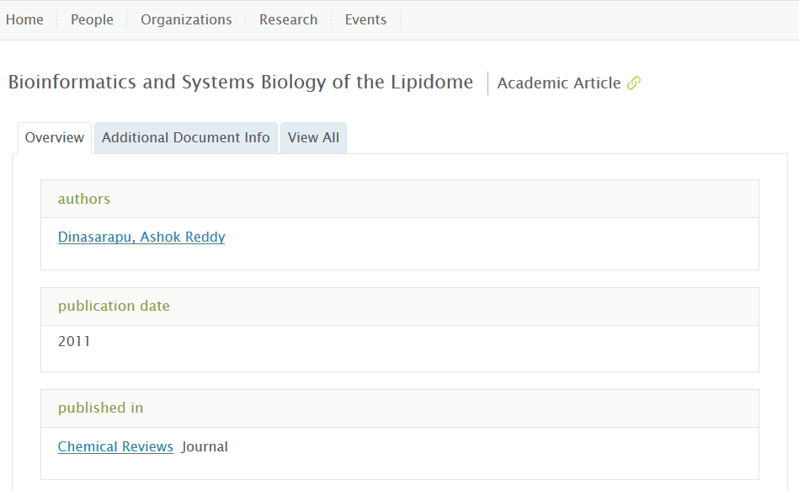
For reference: regular VIVO

Slide 12
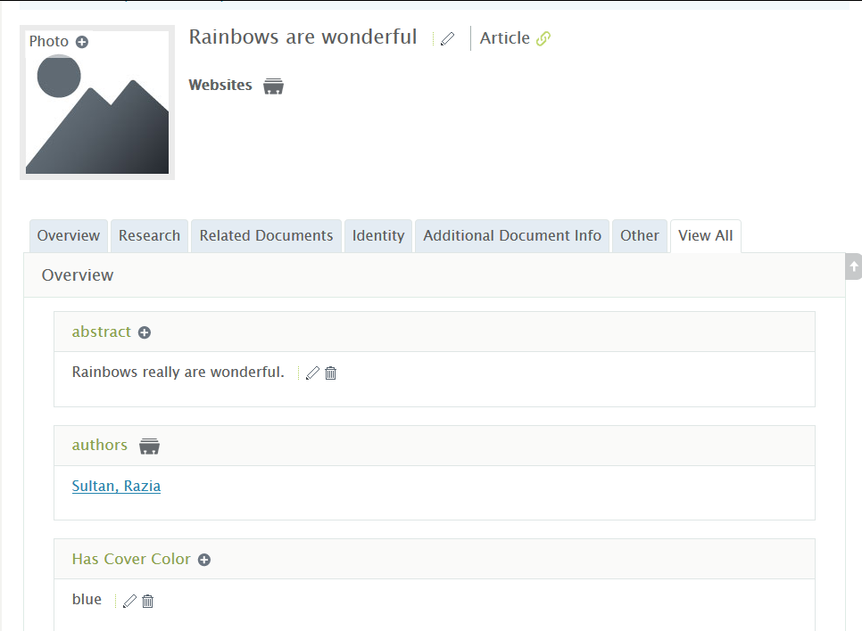
Cover color property and value

Slide 13
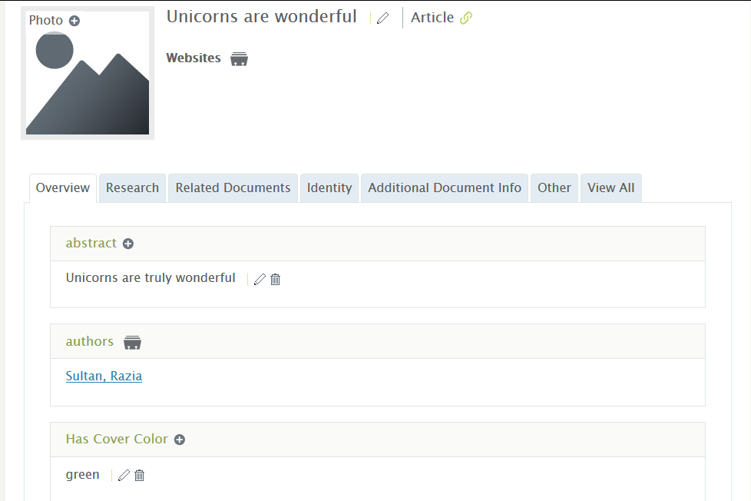
Cover color property and value

Slide 14
Author page
Expectation: Show all cover colors of articles authored by Razia Sultan
Blue and Green
Only one value is showing when two should be visible
Debug
Code that executes and returns results of query retrieving cover colors for articles authored by an individual

Slide 15
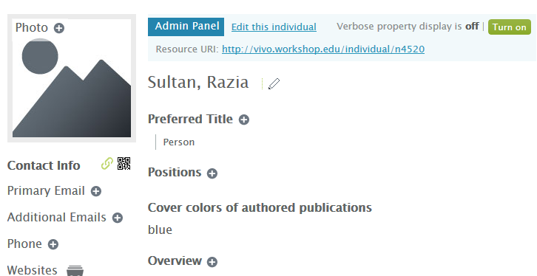
Author page: only one color
Should show both blue and green since author has two publications, one with a blue cover color and one with green

Slide 16
Very high level overview
Process for rendering individual
Foaf:Person
Individual—
foaf-person.ftl
(Template associated with individuals of type foaf:Person)
Display cover colors
Find and retrieve information from related data getters
CoverColorDataGetter
Query: Get cover colors for articles authored by this person

Slide 17
CustomDataGetters.n3
foaf:Person display:hasDataGetter display:coverColorDataGetter .
display:coverColorDataGetter
a <java:edu.cornell.mannlib.vitro.webapp.utils.dataGetter.CoverColorDataGetter> ;
display:saveToVar "color" ;
display:query ""“ …
SELECT DISTINCT ?color
WHERE
{ ?individualURI vivo:relatedBy ?authorship . ?authorship rdf:type vivo:Authorship .
?authorship vivo:relates ?article .
?article rdf:type bibo:Article . ?article vivo:hasCoverColor ?color .
} """ .

Slide 18
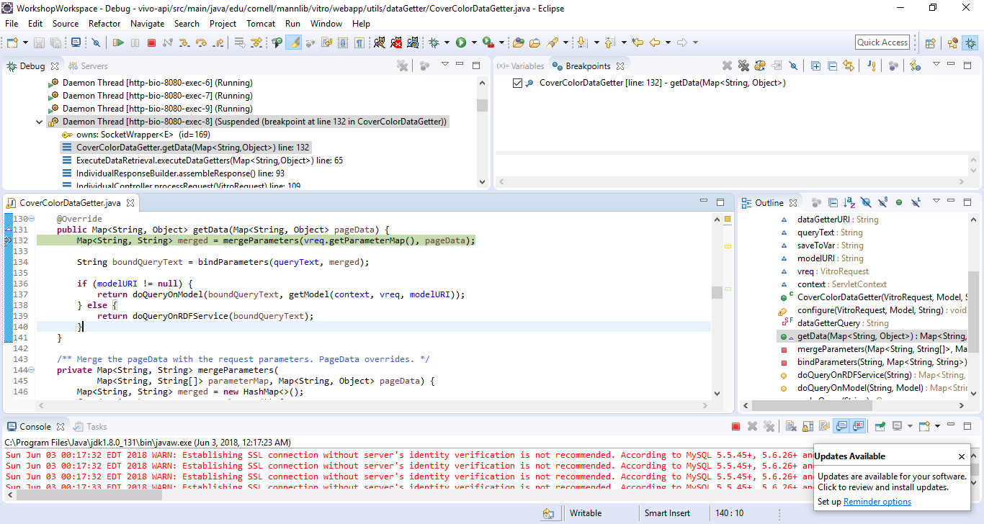
Notes:
Debugging pane shows the stack of calls. You can also use the variables view to see contents of variables as you step through the code

Slide 19
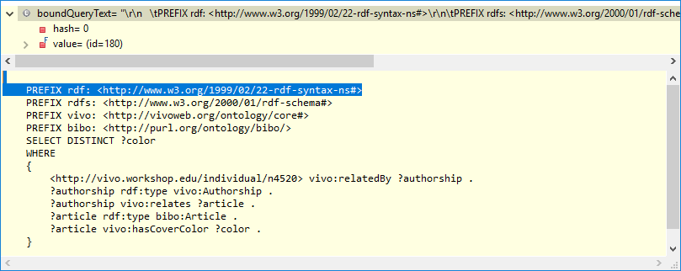
Hovering over a variable can also show you the contents of the variable. In this case, you can see the actual query being executed at this point once variables have values substituted in (e.g. uri is bound with the value of the individual whose profile is being viewed, etc.).

Slide 20
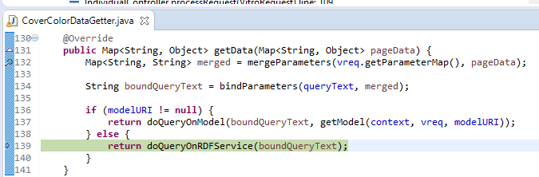
Stepping through code. Need to step into doQueryOnRDFService to see what values are being returned

Slide 21
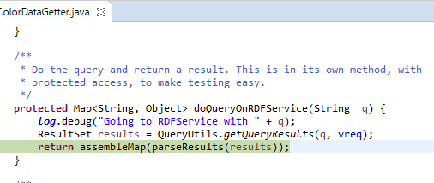
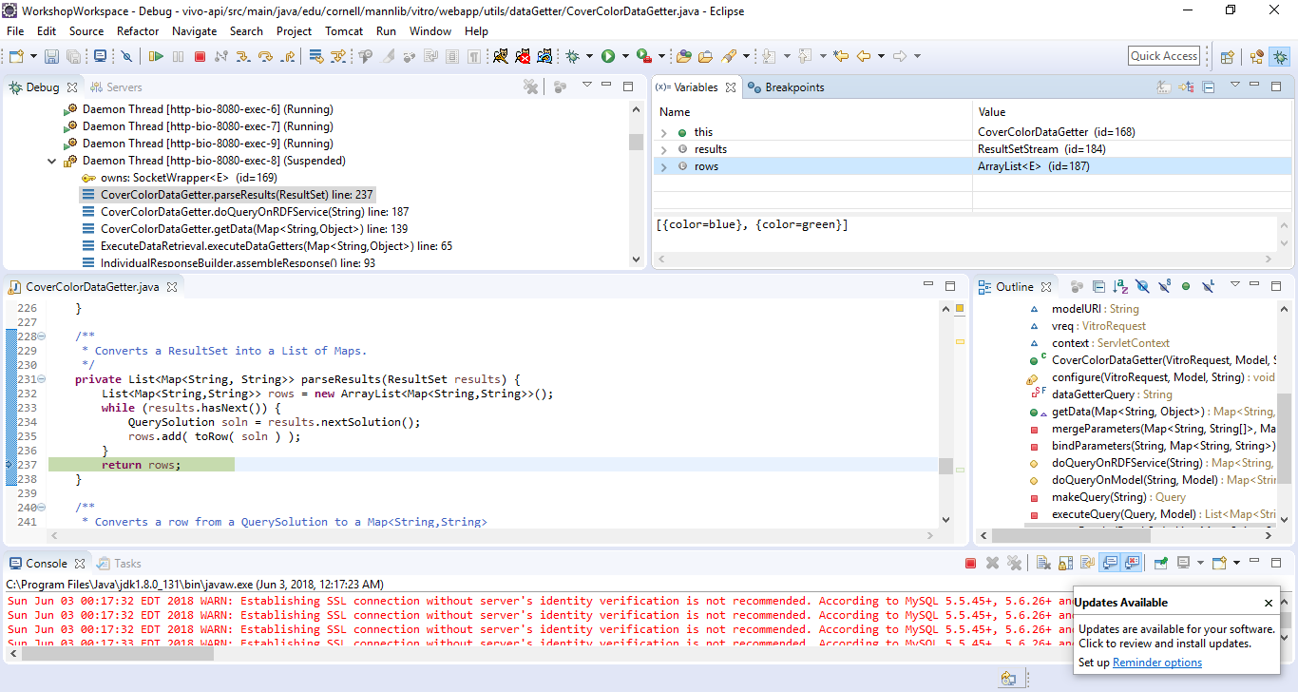

Slide 22
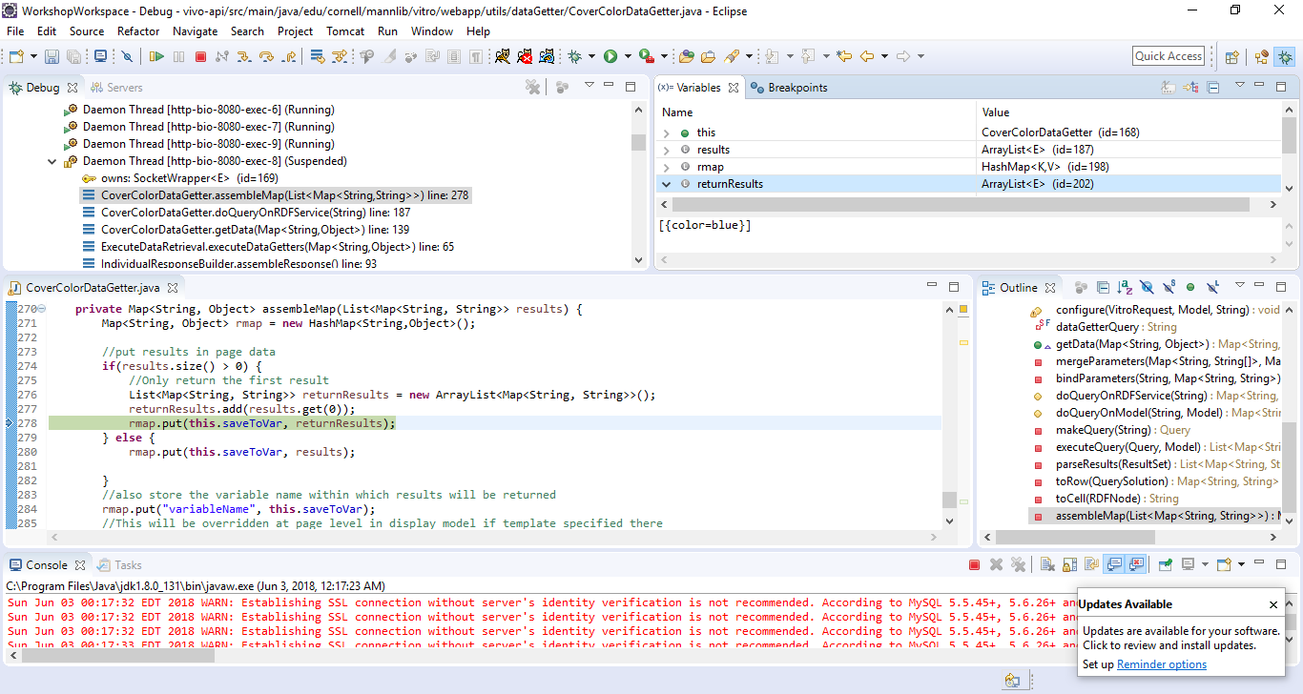
Delete lines 274-279 and 282, leaving only the line rmap.put(this.saveToVar, results); before the comment “also store the…”

Slide 23
Next steps
Stop tomcat
Make changes to the code
From VIVO directory, mvn clean install –s installer\settings.xml
Restart tomcat
Check page

Slide 24
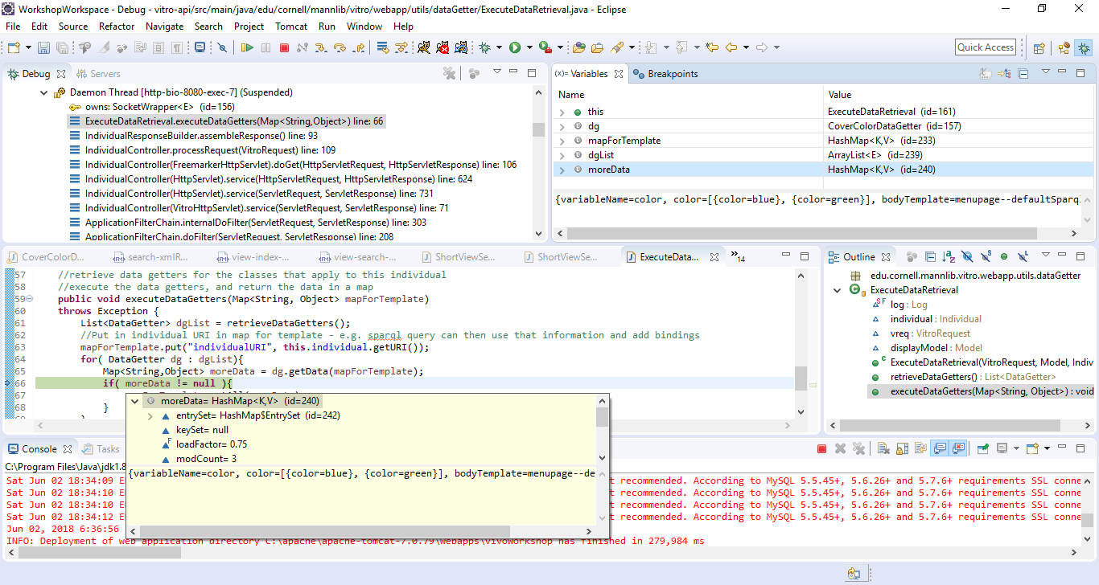
Notes:
Debugging pane shows the stack of calls. You can also use the variables view to see contents of moreData as well as hover over moreData to see the contents there.

Slide 25
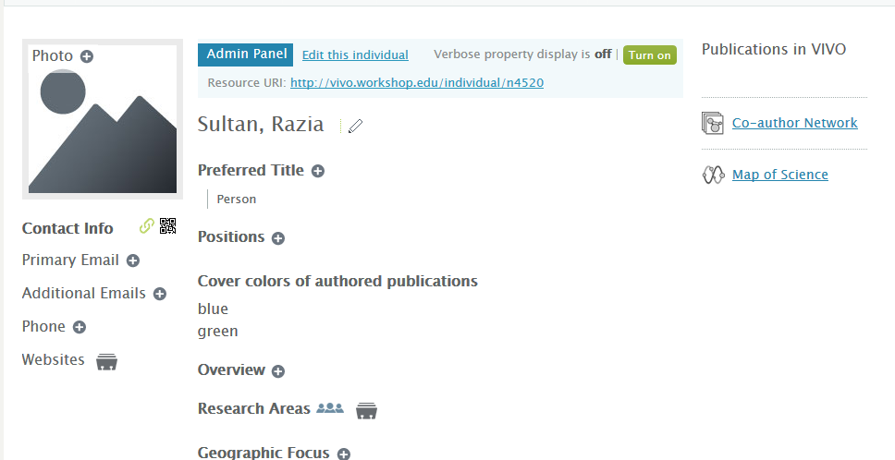
Working version for author page
List of cover colors

Slide 26
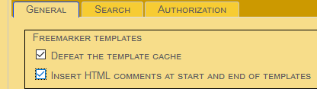
Testing without restarting
I just want to test out if changes to the templates/JavaScript work
Using the developer panel:
Select defeat template cache
Go to deployed webapp directory
E.g.: tomcat directory/
webapps\vivoworkshop\themes\wilma\templates\individual—foaf-person.ftl
Line 104, change text to “Publication cover colors”

Slide 27
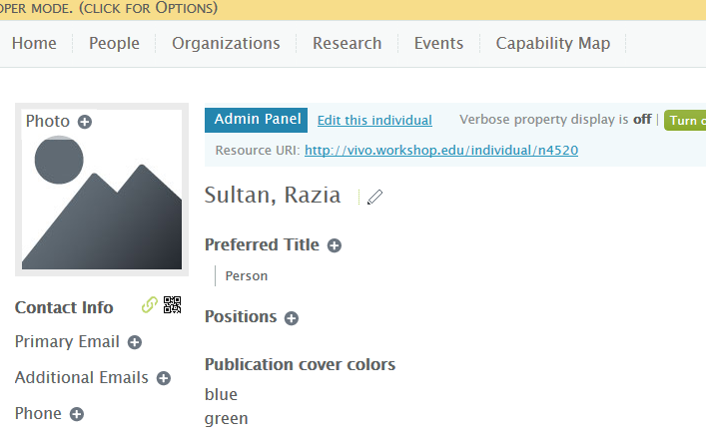
After template change
Important! If you don’t save the change in the actual code, redeploying the webapp will overwrite any changes you made in the webapp directory.
Make sure to save desired changes in the code.
Changed heading

