Slide 1
VIVO Developer Workshop

Slide 2
For reference
Git/GitHub
Loading project into eclipse

Slide 3
Git and GitHub
Some Git documentation:
https://docs.gitlab.com/ee/gitlab-basics/start-using-git.html
https://guides.github.com/introduction/git-handbook/
Code at
https://github.com/j2blake/2018_dev_VIVO/ and https://github.com/j2blake/2018_dev_Vitro
Clone repository
git clone git@github.com:j2blake/2018_dev_Vitro.git Vitro
git clone git@github.com:j2blake/2018_dev_VIVO.git VIVO
In VIVO directory:
git checkout workshopBranch

Slide 4
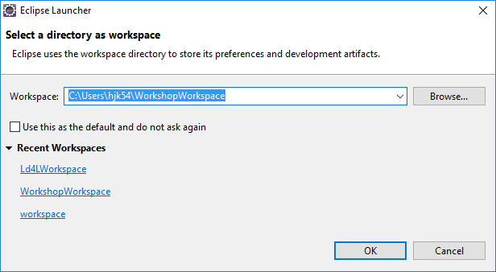
Loading project into eclipse
You can select a folder to act as the workspace for your eclipse project.

Slide 5
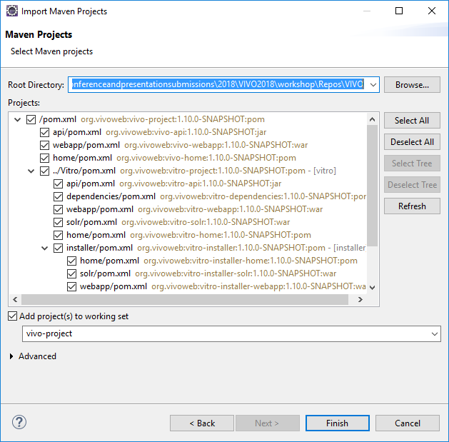
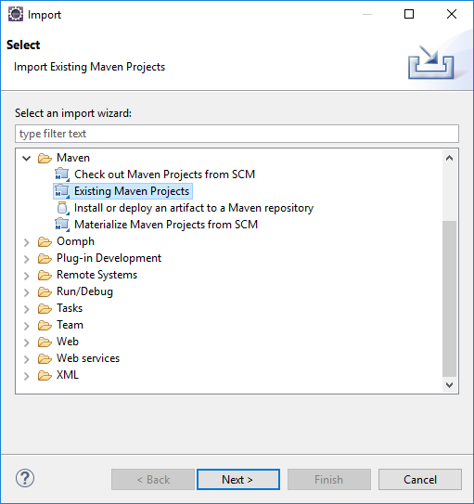
Loading project into eclipse
File -> Import -> Existing Maven Project -> Directory where you git cloned VIVO

Slide 6
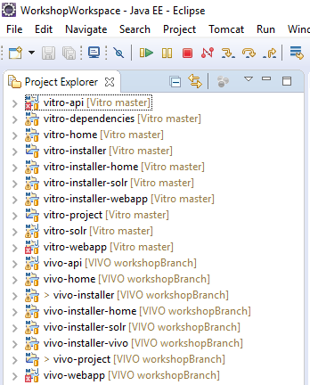
Loading project into eclipse
Multiple vitro directories
Multiple VIVO directories
Should be checked out to workshopBranch

