Slide 1
VIVO Developer Workshop

Slide 2
Overview: Search configuration
Configuration for what populates the search index (e.g. add field or add values to the ALLTEXT field)
Specific to a particular class/type of entity being indexed
Configuration for what information is queried and displayed in search results view
Specific to a particular class/type of index being queried/displayed

Slide 3
Search index configuration
Add cover color information as separate field and for searching by
Data/object properties are automatically added to ALLTEXT in some cases but we will specify that as well
Want a separate field in the search index capturing color
Perhaps we want more advanced functions on the front-end based on search index contents
Add cover color information to the search results view i.e. the information shown about a publication in the search results

Slide 4
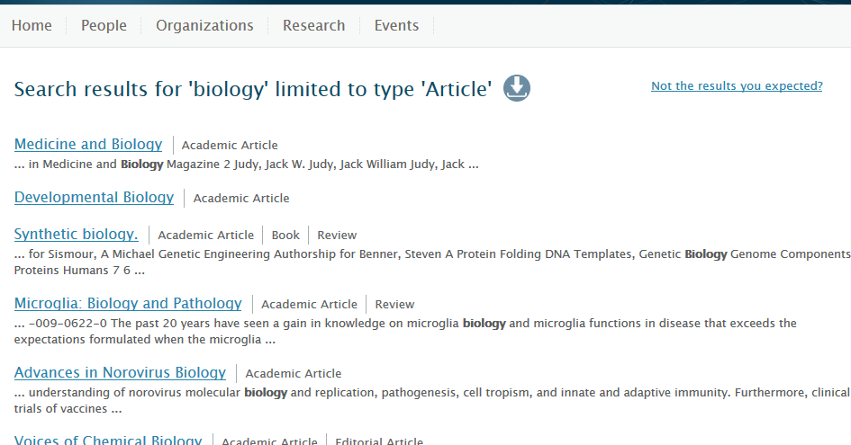
For reference: regular VIVO

Slide 5
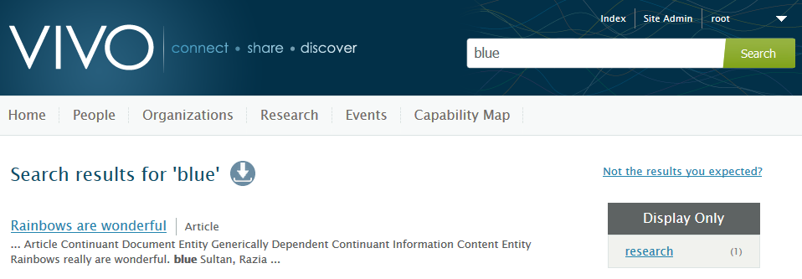
Search results (by default)

Slide 6
Adding cover color to search index
VIVO\home\src\main\resources\rdf\display\everytime\searchIndexerConfigurationVivo.n3
Specify the query that needs to be executed
Whose results will populate the fields specified
And in what context (e.g. for what class or type of individual)

Slide 7
Adding cover color to search index
##Custom Search indexing for cover color
:vivodocumentModifier_CoverColor
a searchIndex:documentBuilding.SelectQueryDocumentModifier ,
searchIndex:documentBuilding.DocumentModifier ;
rdfs:label "Cover Color" ;
:hasTargetField "ALLTEXT" ;
:hasTargetField "ALLTEXTUNSTEMMED" ;
:hasTargetField "covercolor_string" ;
:hasSelectQuery """

Slide 8
Adding cover color to search index (cont.)
PREFIX rdf: <http://www.w3.org/1999/02/22-rdf-syntax-ns#>
PREFIX rdfs: <http://www.w3.org/2000/01/rdf-schema#>
PREFIX vivo: <http://vivoweb.org/ontology/core#>
PREFIX bibo: <http://purl.org/ontology/bibo/>
SELECT ?color
WHERE {
?uri vivo:hasCoverColor ?color .
?uri rdf:type bibo:Article .
}
""" .
Notes:
This is the actual query that will be executed and whose results will be made available to populate the target fields in the search index

Slide 9
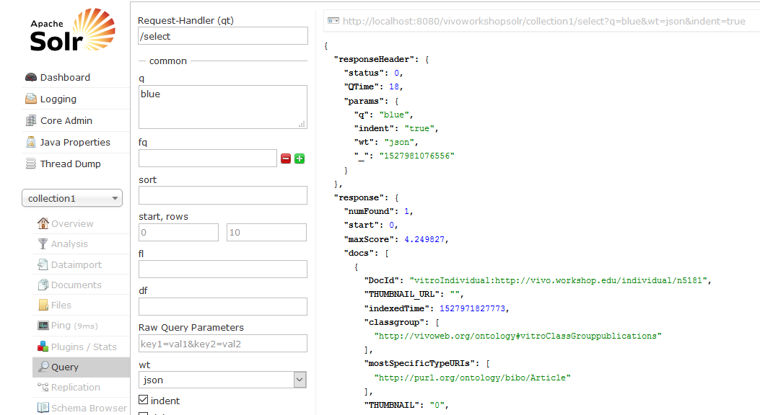
Search results: Solr
Notes:
Select collection1 in the core drop down. Click query. Type in blue and then execute query. Results show in the right-hand pane.

Slide 10
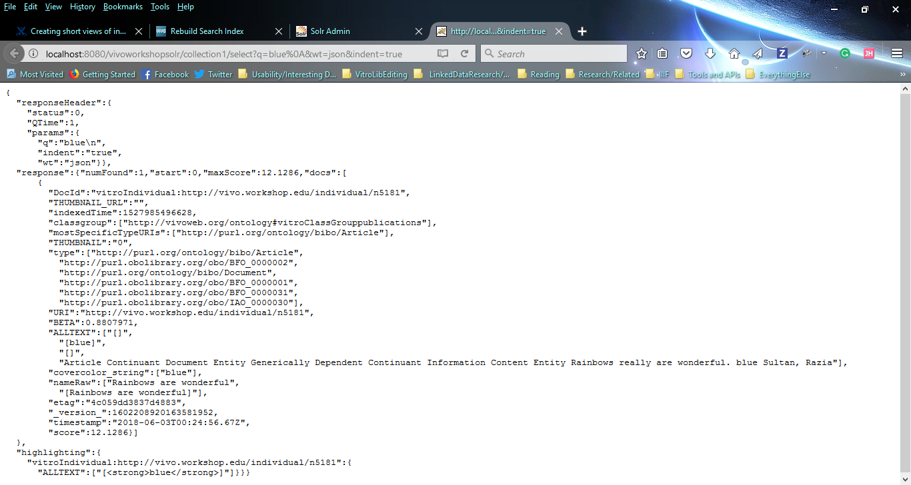
Search results: Solr

Slide 11
DocId =
vitroIndividual: + URI
ALLTEXT
And
Covercolor_string fields

Slide 12
Search View Configuration
VIVO\webapp\src\main\webResources\WEB-INF\shortview_config.n3
Specify the query to retrieve results to be displayed
Specify the template to be used to display these results
VIVO\webapp\src\main\webapp\templates\freemarker\body\partials\shortview\view-search-publication.ftl

Slide 13
Search View Configuration
bibo:Article display:hasCustomView display:articleCustomView .
display:articleCustomView a display:customViewForIndividual ;
display:appliesToContext "SEARCH" ;
display:hasTemplate "view-search-publication.ftl" ;
display:hasDataGetter display:articleColorDataGetter .

Slide 14
Search View Configuration
display:articleColorDataGetter
a <java:edu.cornell.mannlib.vitro.webapp.utils.dataGetter.SparqlQueryDataGetter> ;
display:saveToVar "color" ;
display:query ""“ …
SELECT DISTINCT ?color
WHERE
{
?individualUri rdf:type bibo:Article .
?individualUri vivo:hasCoverColor ?color .
}
""" .

Slide 15
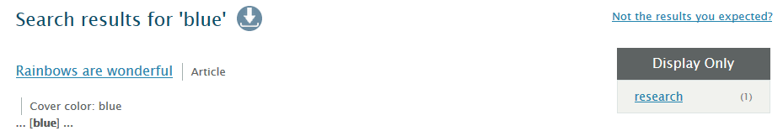

With search view changes

Slide 16
For reference
Git/GitHub
Loading project into eclipse

Slide 17
Git and GitHub
Some Git documentation:
https://docs.gitlab.com/ee/gitlab-basics/start-using-git.html
https://guides.github.com/introduction/git-handbook/
Code at
https://github.com/j2blake/2018_dev_VIVO/ and https://github.com/j2blake/2018_dev_Vitro
Clone repository
git clone git@github.com:j2blake/2018_dev_Vitro.git Vitro
git clone git@github.com:j2blake/2018_dev_VIVO.git VIVO
In VIVO directory:
git checkout workshopBranch

Slide 18
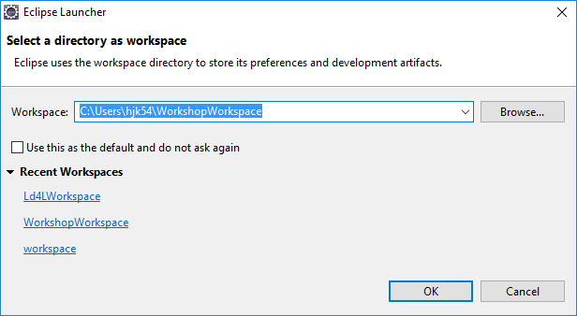
Loading project into eclipse
You can select a folder to act as the workspace for your eclipse project.

Slide 19
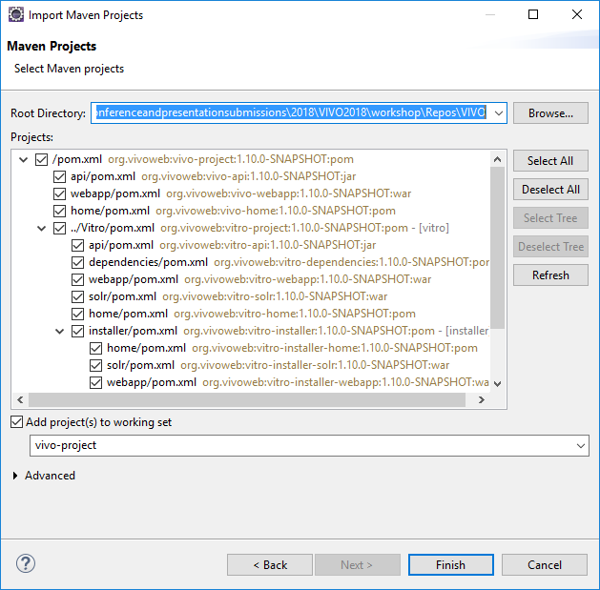
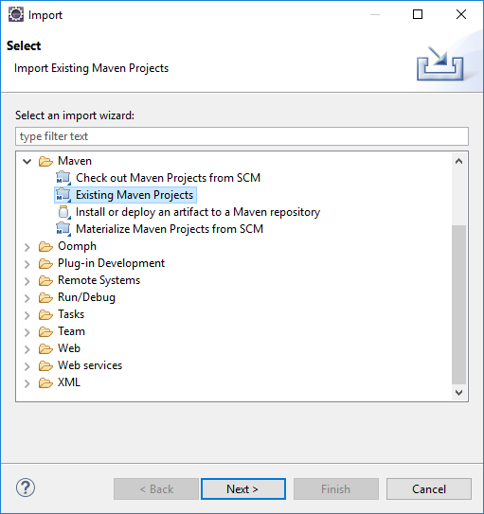
Loading project into eclipse
File -> Import -> Existing Maven Project -> Directory where you git cloned VIVO

Slide 20
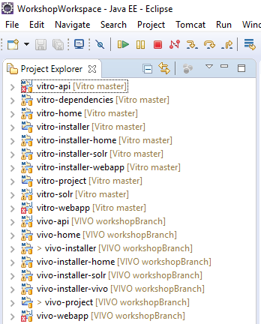
Loading project into eclipse
Multiple vitro directories
Multiple VIVO directories
Should be checked out to workshopBranch

