Slide 1







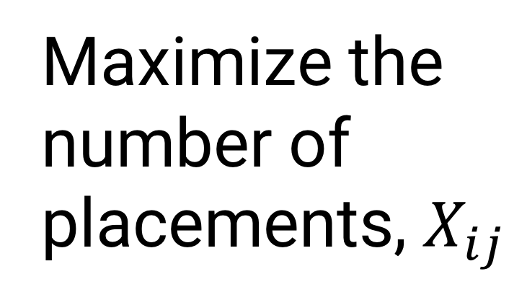
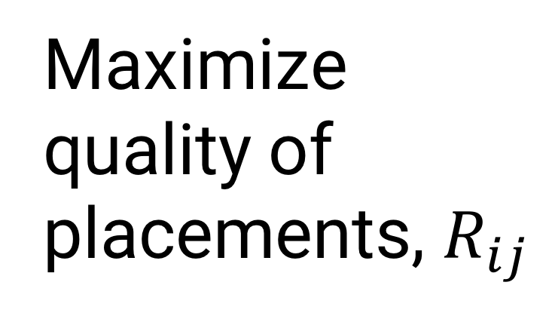
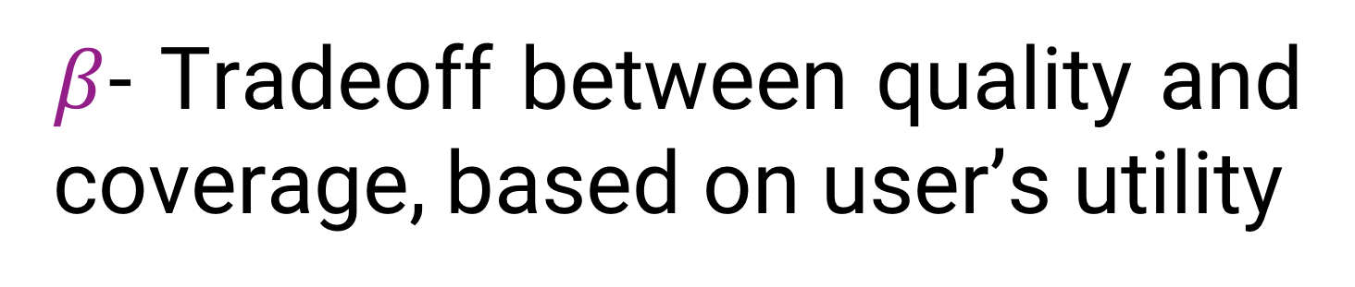
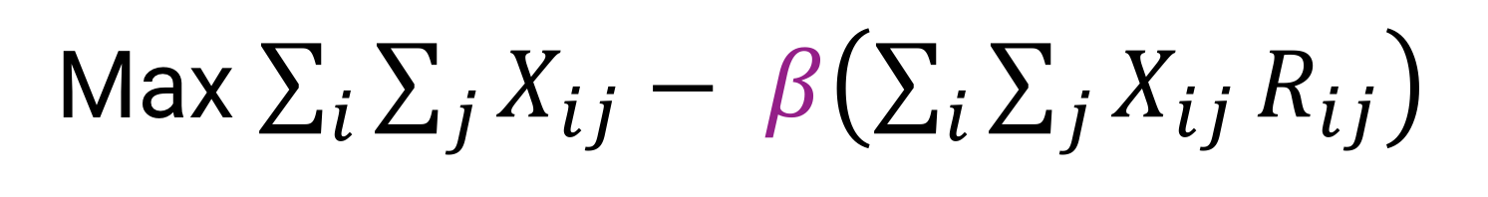
TA Works | Improving the end-to-end TA assignment process
PROBLEM
OBJECTIVES
Three times each year, the Management Sciences department relies on five systems & four people to complete the TA assignment process.
Develop an end-to-end software system to streamline the TA assignment process
Formulate a multi-objective optimization problem to assign more, high-quality graduate students to TA placements
The result is a process time of over seven days due to continuous rework, overproduction and wait time.
SOLUTION
APPROACH
System Diagram
Formulation
1
Problem Analysis
Mapped current state
Gathered requirements
Course Content
Upload
A
Maximize coverage and quality of TA placements
Medium Fidelity Prototypes
Utilized HTML/CSS
B
TA Application
Max $\sum_{i}{\sum_{j}{X_{ij}}}− β\left(\sum_{i}{\sum_{j}{X_{ij}}R_{ij}}\right)$
3
Applicant Cleanup
C
Low Fidelity Prototypes
Utilized Balsamiq for quick iteration
Seven Iterations
Maximize the number of placements, $X_{ij}$
Maximize quality of placements, $R_{ij}$
2
D
Instructor Rankings
User Interviews
Conducted 25 interviews
4
Matching Algorithm
E
$β$- Tradeoff between quality and coverage, based on user’s utility
F
Match Results
s.t. Feasibility constraints
7
Usability Tests
Conducted six usability test
Software Development
Utilized Django framework
Followed Agile process
5
Five Iterations
OUTCOME
100% of historical tests resulted in better coverage and better quality scores for Teaching Assistant assignments.
Testing & Validation
Used historical data & testing framework
6
8
Final Product
TA assignment formulation
& system integration
One modular system replaces five systems & two people to decrease cycle time by 12 days a year.
“A great addition to our department” – MSCI Instructor
Team 4: Laura Dobson, Johnson Kan, Amy Leblond, Sarah Watts
WATERLOO | ENGINEERING
Advisor & Client: Dr. Mark Smucker
MANAGEMENT ENGINEERING

