Slide 1
Inner Classes Lambda Expressions

Slide 2
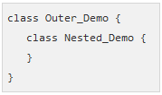
Inner Classes
Also called Nested Classes
In Java, just like methods, variables of a class too can have another class as its member.
Writing a class within another is allowed in Java.
The class written within is called the nested class, and the class that holds the inner class is called the outer class.
The following shows the syntax to write a nested class. Here, the class Outer_Demo is the outer class and the class Inner_Demo is the nested class

Slide 3
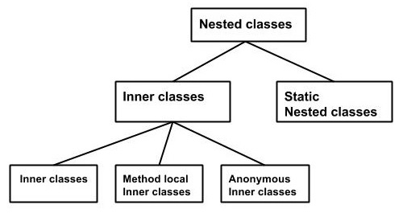
Inner Classes
Nested classes are divided into two types −
Non-static nested classes − These are the non-static members of a class.
Static nested classes − These are the static members of a class.

Slide 4
Inner Classes (non-static nested classes)
Inner classes are a security mechanism in Java
We know a class cannot be associated with the access modifier private, but if we have the class as a member of other class, then the inner class can be made private. And this is also used to access the private members of a class.
Inner classes are of three types depending on how and where you define them. They are −
Inner Class
Method-local Inner Class
Anonymous Inner Class

Slide 5
Inner Class
Creating an inner class is quite simple. You just need to write a class within a class. Unlike a class, an inner class can be private and once you declare an inner class private, it cannot be accessed from an object outside the class.
Following is the program to create an inner class and access it. In the given example, we make the inner class private and access the class through a method.
Here you can observe that Outer_Demo is the outer class, Inner_Demo is the inner class, display_Inner() is the method inside which we are instantiating the inner class, and this method is invoked from the main method.
If you compile and execute the above program, you will get the following result: “This is an Inner Class”

Slide 6
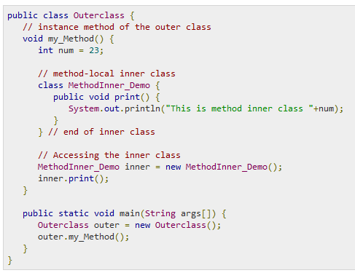
Inner Class (cont.)

Slide 7
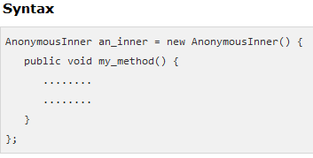
Anonymous Inner Class
An inner class declared without a class name is known as an anonymous inner class. In case of anonymous inner classes, we declare and instantiate them at the same time. Generally, they are used whenever you need to override the method of a class or an interface.

Slide 8
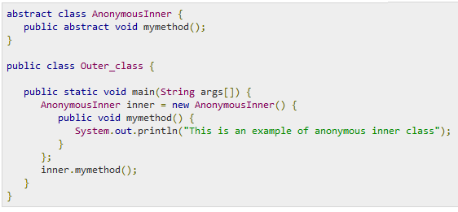
Anonymous Inner Class (cont.)
The following program shows how to override the method of a class using anonymous inner class.
Output: “This is an example of anonymous inner class”

Slide 9
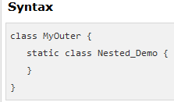
Static Nested Class
A static inner class is a nested class which is a static member of the outer class. It can be accessed without instantiating the outer class, using other static members. Just like static members, a static nested class does not have access to the instance variables and methods of the outer class.

Slide 10
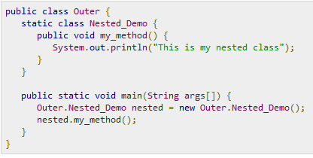
Static Nested Class (cont.)
Instantiating a static nested class is a bit different from instantiating an inner class. The following program shows how to use a static nested class.
Output: “This is my nested class”
Source: https://www.tutorialspoint.com/java/java_innerclasses.htm

Slide 11

Lambda Expressions
Lambda expressions are introduced in Java 8 and are touted to be the biggest feature of Java 8.
Lambda expression facilitates functional programming, and simplifies the development a lot.
A lambda expression is characterized by the following syntax.

Slide 12
Lambda Expressions
Following are the important characteristics of a lambda expression.
Optional type declaration − No need to declare the type of a parameter. The compiler can inference the same from the value of the parameter.
Optional parenthesis around parameter − No need to declare a single parameter in parenthesis. For multiple parameters, parentheses are required.
Optional curly braces − No need to use curly braces in expression body if the body contains a single statement.
Optional return keyword − The compiler automatically returns the value if the body has a single expression to return the value. Curly braces are required to indicate that expression returns a value.

Slide 13
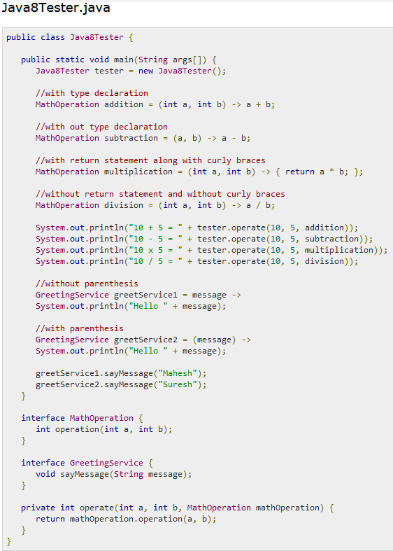
Lambda Expressions Example

Slide 14
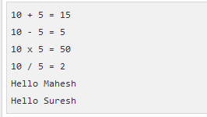
Lambda Expressions Example
Compile the program and it should produce the following output
The following are the important points to be considered in the above example.
Lambda expressions are used primarily to define inline implementation of a functional interface, i.e., an interface with a single method only. In the above example, we've used various types of lambda expressions to define the operation method of MathOperation interface. Then we have defined the implementation of sayMessage of GreetingService.
Lambda expression eliminates the need of anonymous class and gives a very simple yet powerful functional programming capability to Java.

Slide 15
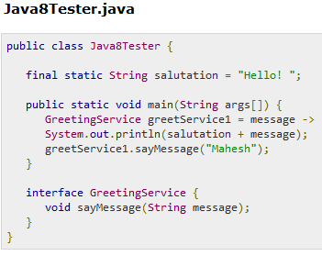

Lamba Expressions Scope
Using lambda expression, you can refer to any final variable or effectively final variable (which is assigned only once). Lambda expression throws a compilation error, if a variable is assigned a value the second time
Example: Output:
Source: https://www.tutorialspoint.com/java8/java8_lambda_expressions.htm

