Slide 1
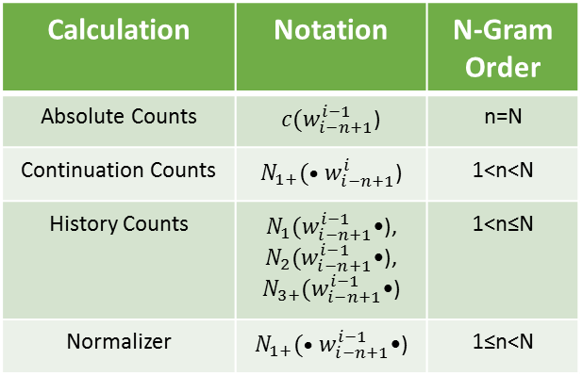
Calculation | Notation | N-Gram Order
Absolute Counts | $c(w_{i−n+1}^{i−1}$) | n=N
Continuation Counts | $N_{1+}(•w_{i−n+1}^{i}$) | 1<n<N
History Counts | $N_{1}(w_{i−n+1}^{i−1}$•), $N_{2}(w_{i−n+1}^{i−1}$•), $N_{3+}(w_{i−n+1}^{i−1}$•) | 1<n≤N
Normalizer | $N_{1+}(•w_{i−n+1}^{i−1}$•) | 1≤n<N

Slide 2
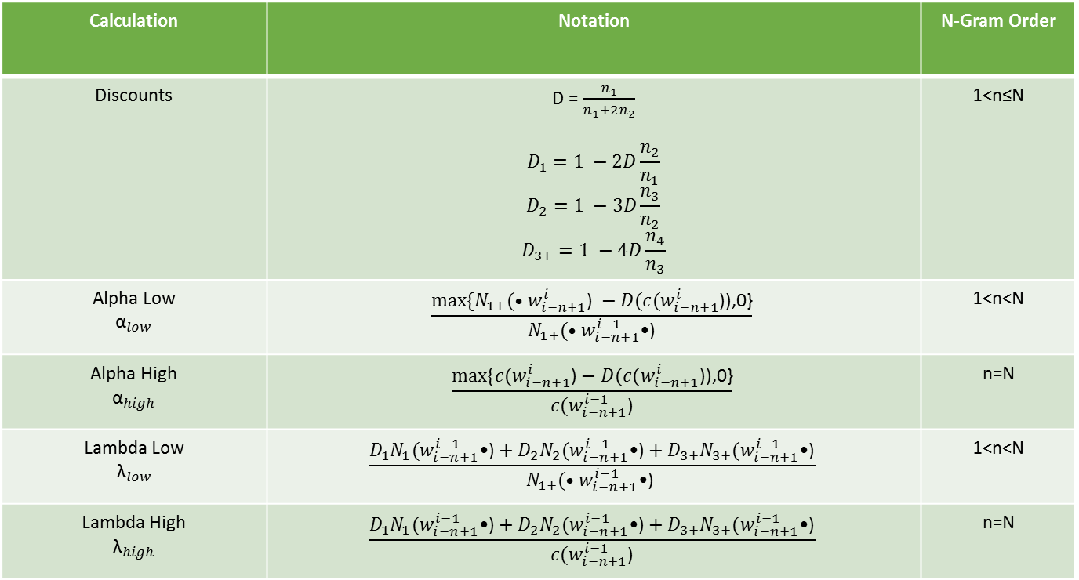
Calculation | Notation | N-Gram Order
Discounts | D = $\frac{n_{1}}{n_{1}+2n_{2}}$ $$D_{1}=1 −2D\frac{n_{2}}{n_{1}}$$ $$D_{2}=1 −3D\frac{n_{3}}{n_{2}}$$ $$D_{3+}=1 −4D\frac{n_{4}}{n_{3}}$$ | 1<n≤N
Alpha Low $${\text{α}}_{low}$$ | $$\frac{max⁡\{N_{1+}(•w_{i−n+1}^{i}\text{)} −D(c(w_{i−n+1}^{i}\text{)}\text{),0\}}}{N_{1+}(•w_{i−n+1}^{i−1}\text{•)}}$$ | 1<n<N
Alpha High $${\text{α}}_{high}$$ | $$\frac{max⁡\{c(w_{i−n+1}^{i}\text{)}−D(c(w_{i−n+1}^{i}\text{)}\text{),0\}}}{c(w_{i−n+1}^{i−1}\text{)}}$$ | n=N
Lambda Low $${\text{λ}}_{low}$$ | $$\frac{D_{1}N_{1}(w_{i−n+1}^{i−1}\text{•)}+D_{2}N_{2}(w_{i−n+1}^{i−1}\text{•)}+D_{3+}N_{3+}(w_{i−n+1}^{i−1}\text{•)}}{N_{1+}(•w_{i−n+1}^{i−1}\text{•)} }$$ | 1<n<N
Lambda High $${\text{λ}}_{high}$$ | $$\frac{D_{1}N_{1}(w_{i−n+1}^{i−1}\text{•)}+D_{2}N_{2}(w_{i−n+1}^{i−1}\text{•)}+D_{3+}N_{3+}(w_{i−n+1}^{i−1}\text{•)}}{c(w_{i−n+1}^{i−1}\text{)}}$$ | n=N

Slide 3
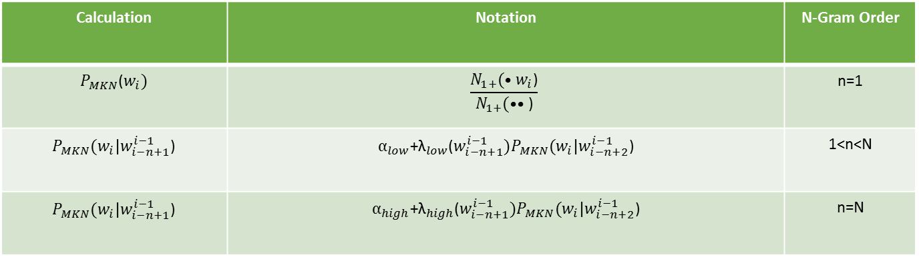
Calculation | Notation | N-Gram Order
$P_{MKN}$($w_{i})$ | $$\frac{N_{1+}(•w_{i}\text{)}}{N_{1+}(••\text{)}}$$ | n=1
$P_{MKN}(w_{i}|w_{i−n+1}^{i−1}$) | $α_{low}$+${\text{λ}}_{low}$($w_{i−n+1}^{i−1})P_{MKN}(w_{i}|w_{i−n+2}^{i−1}$) | 1<n<N
$P_{MKN}(w_{i}|w_{i−n+1}^{i−1}$) | $α_{high}$+${\text{λ}}_{high}$($w_{i−n+1}^{i−1})P_{MKN}(w_{i}|w_{i−n+2}^{i−1}$) | n=N

Slide 4
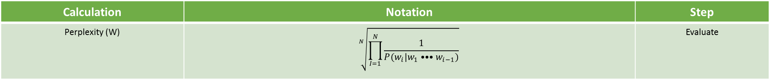
Calculation | Notation | Step
Perplexity (W) | $$\sqrt[N]{\prod_{I=1}^{N}{\frac{1}{P(w_{i}|w_{1}•••w_{i−1})}}}$$ | Evaluate

