Slide 1
PROJECT ANALYSIS FOR ALPHA & BETA COMPANIES

Slide 2



EVENT OVER LAST 6 MONTHS
COVID-19 OUTBREAK IN CHINA
INDIA-CHINA BORDER DISPUTE
BANNING OF CHINESE APPS IN INDIA
AMERICAN BIOWEAPON OR CHINESE VIRUS

Slide 3
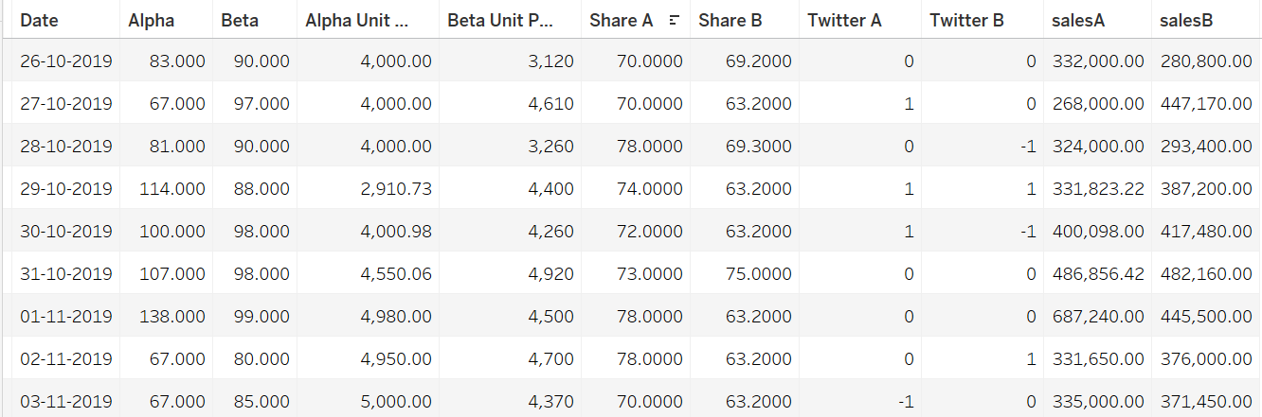
DATA SET

Slide 4
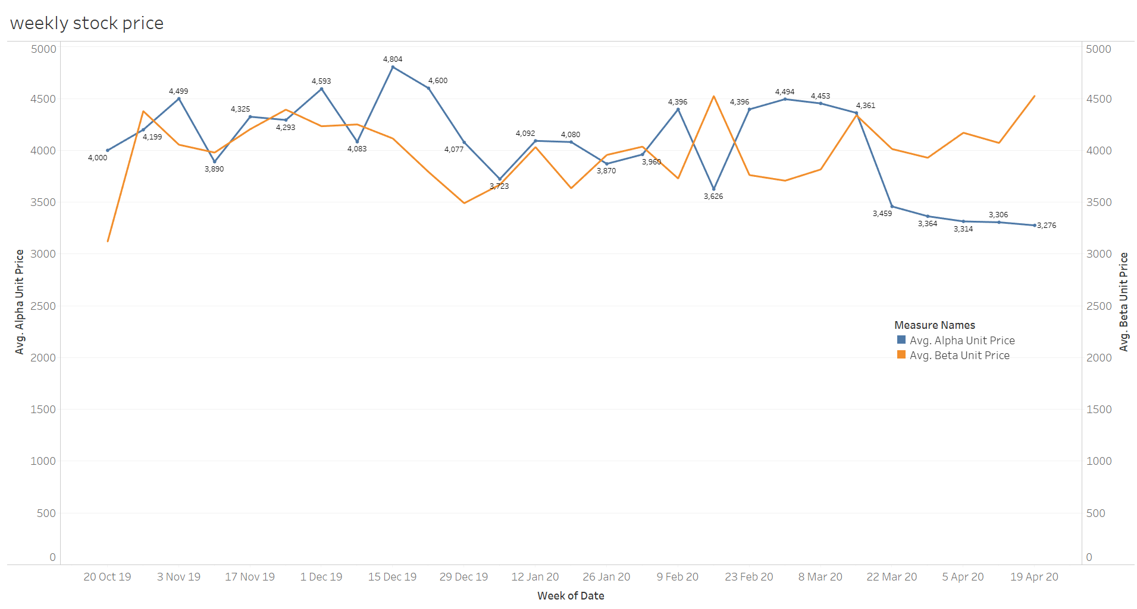
ALPHA & BETA STOCK PRICE
Why??
Why!!!!!!
LOCKDOWN

Slide 5
BEST PERFORMING STOCKS IN LAST SIX MONTHS
Dr Reddy's Laboratories Ltd
Netflix Inc
BETA
Reliance Industries Ltd
WORST PERFORMING STOCKS IN LAST SIX MONTHS
Interglobe Aviation Ltd
ALPHA
Tourism Finance Corporation of India Ltd

Slide 6




INFORMATION
DO YOU READ NEWSPAPER??
WHERE DID YOU GET YOUR INFORMATION??

Slide 7
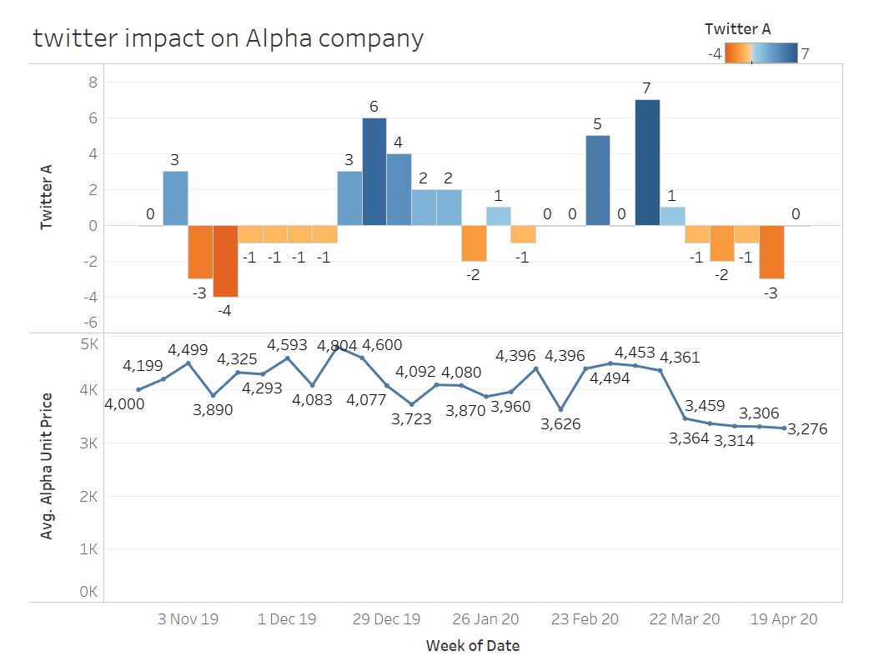

Slide 8
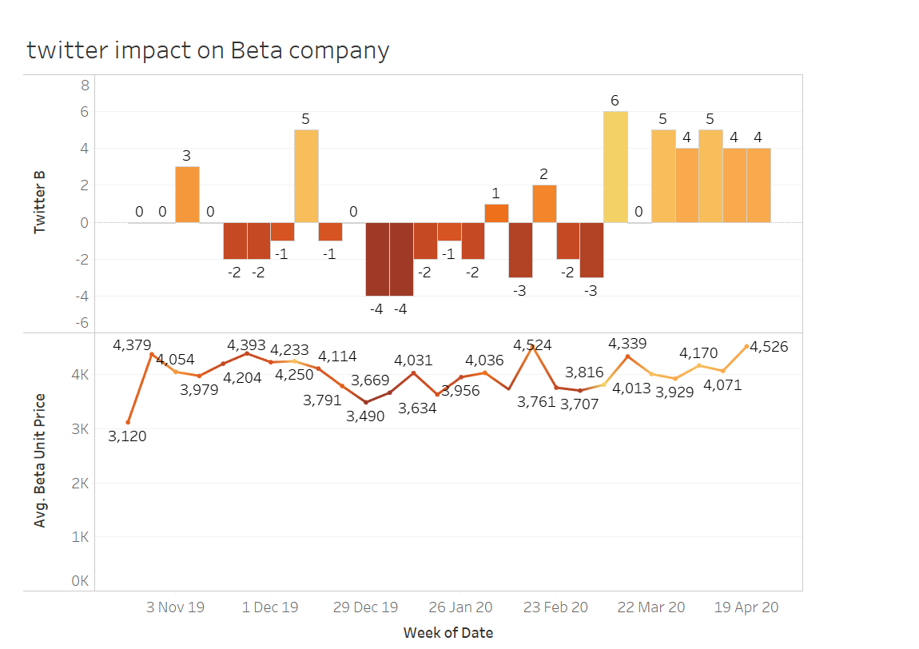

Slide 9
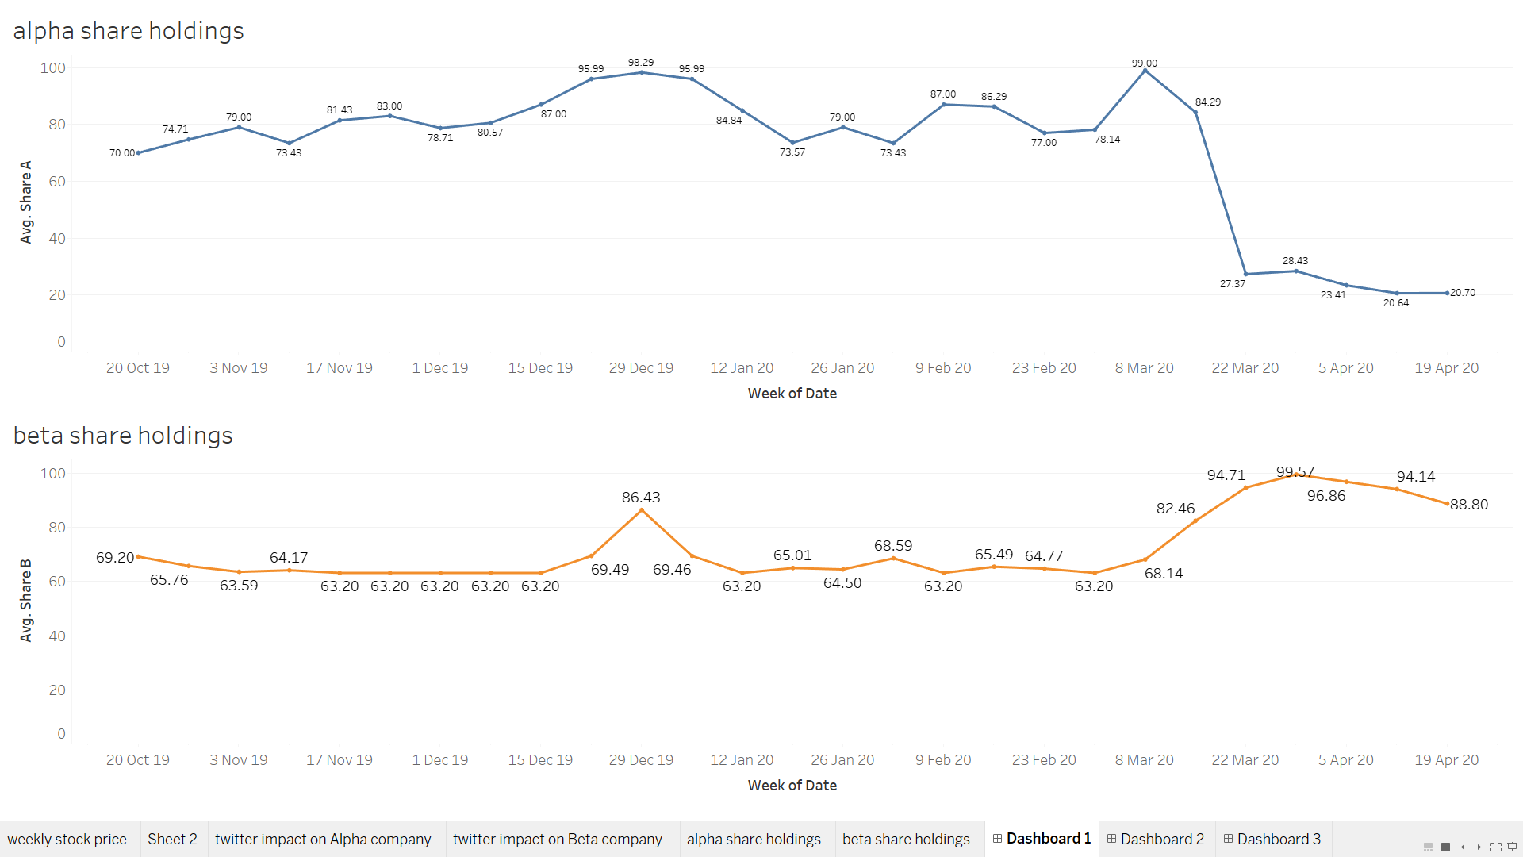

Slide 10
ALPHA AS INDIGO AIRLINES
Strengths
Weakness
Positive Image
Sustaining profits
Services
Over-dependence on volumes
Highly drive workforce
Opportunities
Threats
Growing demand for foreign travel
Competition
Costing

Slide 11
BETA AS NETFLIX
Strengths
Weakness
Growth
Increase in Operational Costs
International Customer Base
Criticism
Brand Equity
Opportunities
Threats
Increase in Customer Base
Competitors
Alliances
Piracy

Slide 12
THANK YOU

