Slide 1
PROJECT ANALYSIS FOR Telsa Sales and Lithium Mining company (LMC)

Slide 2
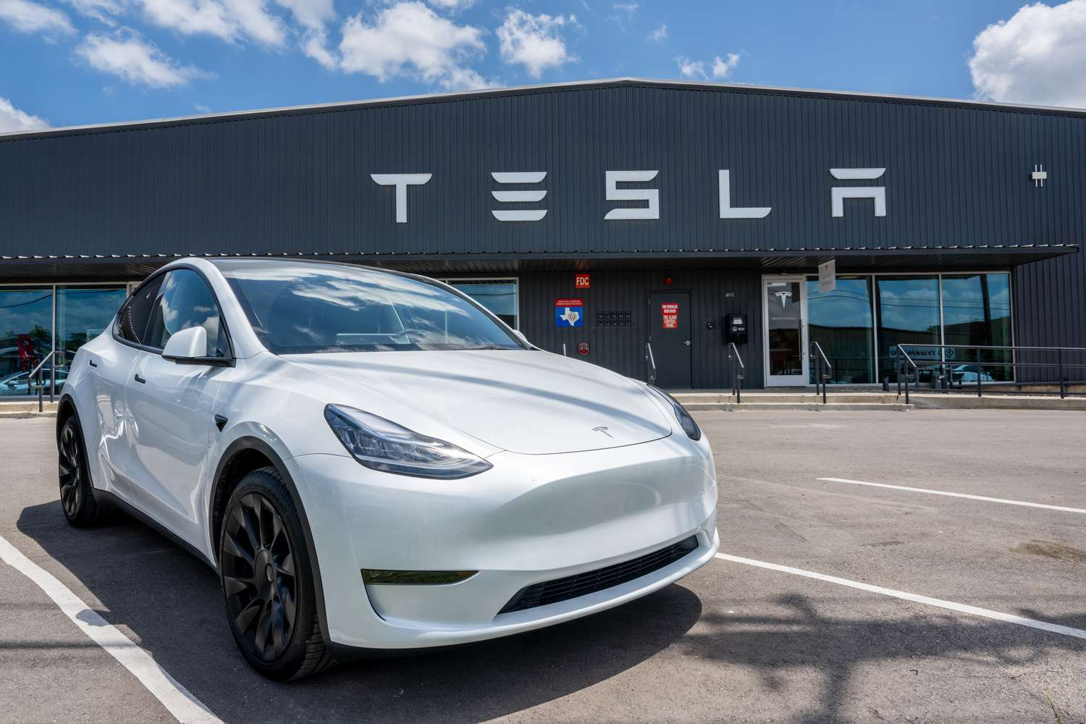
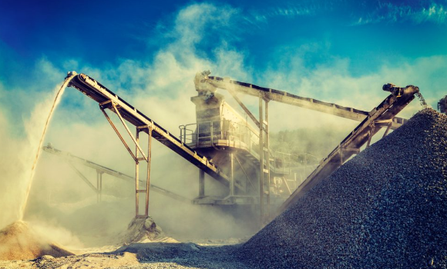

EVENT OVER LAST 6 MONTHS
China Tiwan Conflict (Causing chip shortage )
India discovers Lithium reserves in Rajasthan & J&K
Tesla started their Office in Pune
Lithium price drops after drop in Chinese EV Sales

Slide 3



EVENT OVER LAST 6 MONTHS
COVID-19 OUTBREAK IN CHINA
INDIA-CHINA BORDER DISPUTE
BANNING OF CHINESE APPS IN INDIA
AMERICAN BIOWEAPON OR CHINESE VIRUS

Slide 4
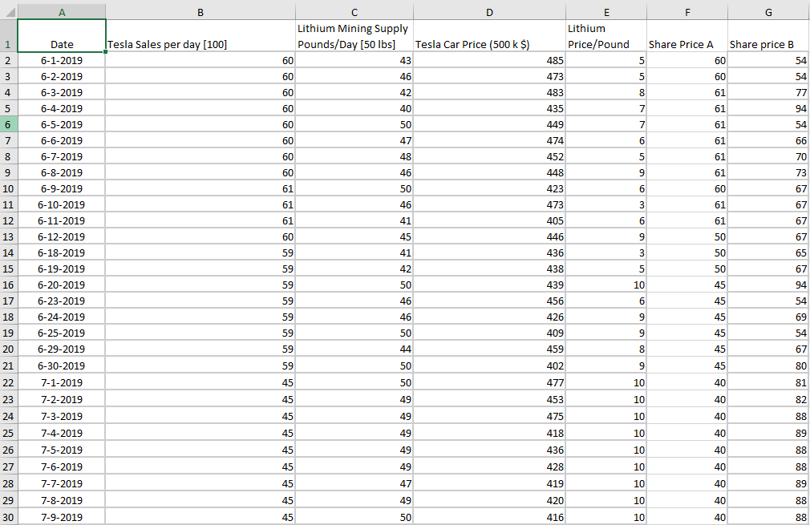
DATA SET

Slide 5
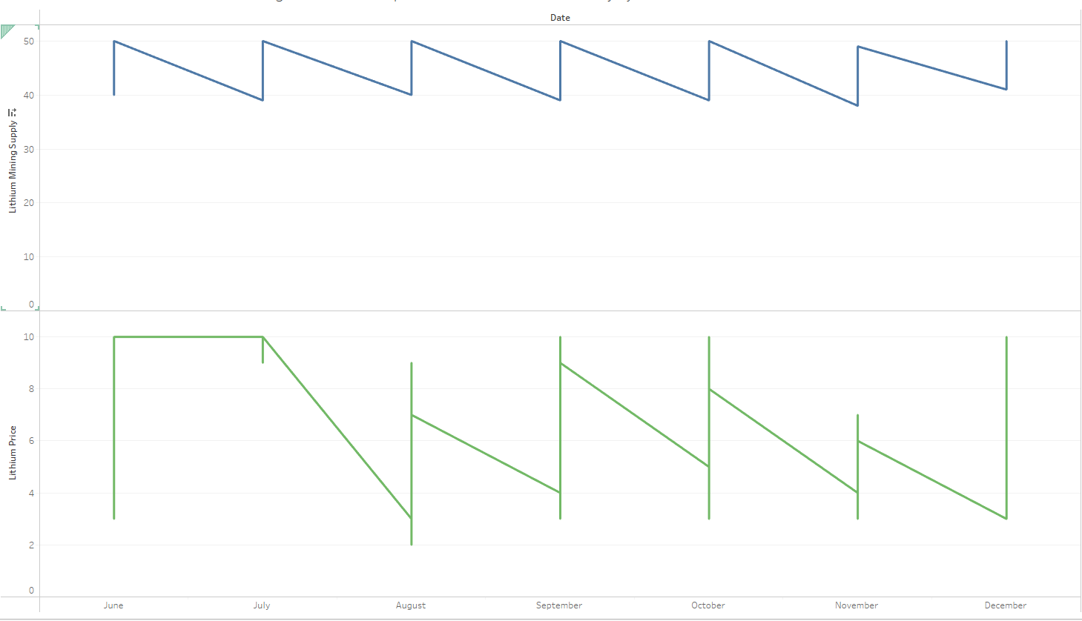
ALPHA & BETA STOCK PRICE
Lithium price stable during June July period May be Lock down imposed
Same Trend in Supply but gets down end of month

Slide 6
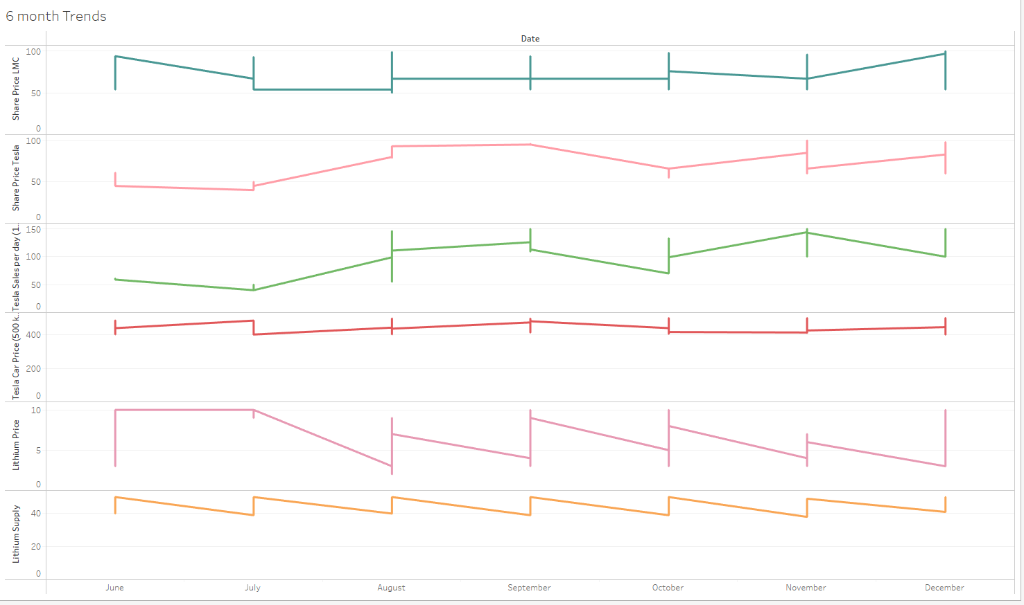

Slide 7
Analysis of Data Trends
Car Price Goes down every month end
Lithium Price goes down Every month end
Eventually increase in Car sales in the end of months / as they expect salary in the end
Eventually increasing in Tesla Shares
End of month there is less supply may be demand is less

Slide 8
Variation in car Sales
Car Sales direct impacted by Car Prices
Battery cards are mostly depended on Lithium
Supply chain for lithium and Price of Lithium Directly impacts car Prices

Slide 9
High
Low
Stars
Electric Vehicles
Sustainable Energy
Model 3
Q marks
Trucks / bigger vehicles
Market Growth
Cash Cow
Model X,Y,S
Dogs
Models With Complains
High Low
Market Share

Slide 10




INFORMATION Source
India energy Storage Alliance

Slide 11
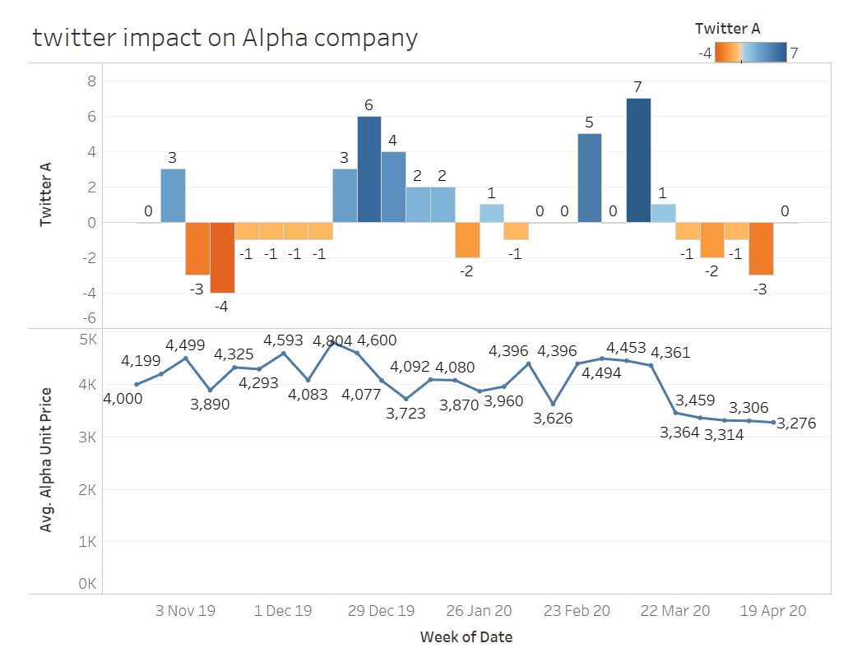

Slide 12
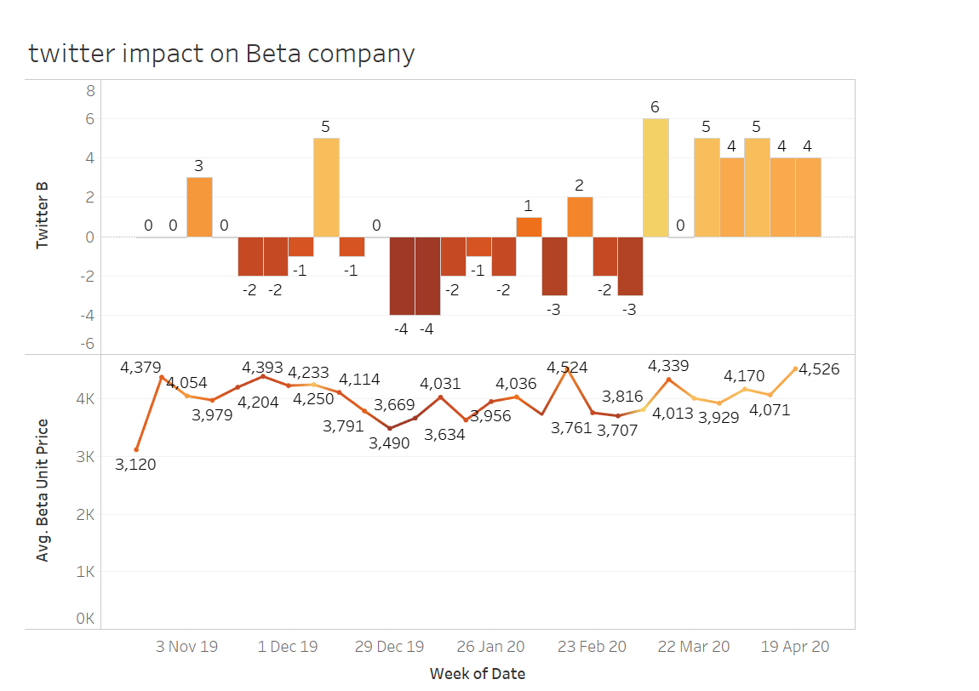

Slide 13
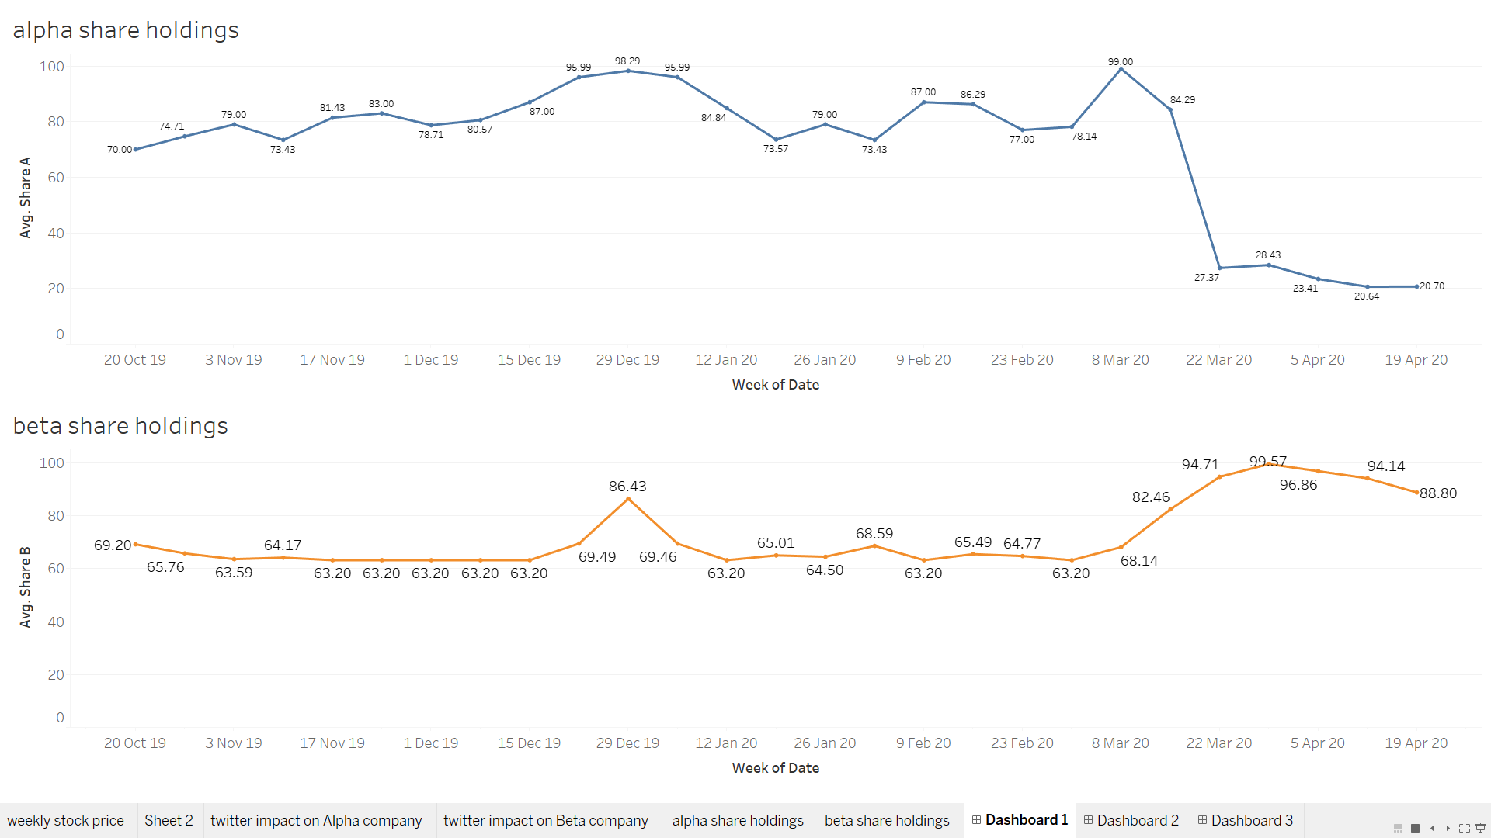

Slide 14
ALPHA AS INDIGO AIRLINES
Strengths
Weakness
Positive Image
Sustaining profits
Services
Over-dependence on volumes
Highly drive workforce
Opportunities
Threats
Growing demand for foreign travel
Competition
Costing

Slide 15
BETA AS NETFLIX
Strengths
Weakness
Growth
Increase in Operational Costs
International Customer Base
Criticism
Brand Equity
Opportunities
Threats
Increase in Customer Base
Competitors
Alliances
Piracy

Slide 16
THANK YOU

