Slide 1
Accurate Detection and Recognition of Dirty Vehicle Plate Numbers for High-Speed Applications
Jitendra Singh
M. Tech PES University

Slide 2
Agenda
1. Introduction & Problem Statement
2. Literature Review
3. Proposed Methodology
4. Novelty & Contribution
5. Gap Analysis
6. Timeline & Work Plan
7. Conclusion & Future Scope

Slide 3
Introduction & Problem Statement
- Importance of License Plate Recognition (LPR)
- Challenges:
• Dirt/Mud/Obstructions
• Motion blur at high speeds
• Reduced recognition accuracy → fraud & enforcement gaps
- Goal: Robust recognition of dirty/obscured plates at high speeds.

Slide 4
Literature Review
Existing ANPR Systems: Fail under dirt/motion blur
OCR Optical Char Recognition (Tesseract, CNN): Reduced accuracy on noisy images
GAN Generative Adversarial Networks -based Augmentation: Limited real-world use
Conclusion: Need for robust dirty plate recognition.

Slide 5
Proposed Methodology
1. Image Acquisition → Kaggle datasets
2. License Plate Detection → YOLO
3. Object Segmentation → Isolate plates
4. Character Recognition → Tesseract/CNN
5. Fraud Detection → Repeated failures flagged

Slide 6
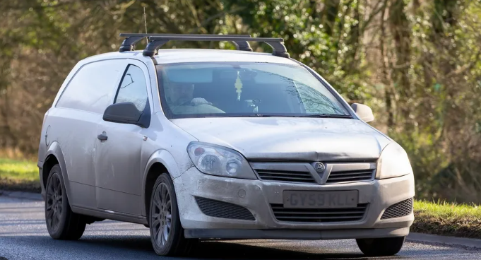


YOLO
Gets Number Plat from Car
If repeated
GY59KLL
CNN Tesseract OCR
Try to detect Actual Number

Slide 7
Algorithms to Explore
• YOLO → License Plate Detection
• Tesseract OCR → Baseline Recognition
• Custom CNN → Dirty plate recognition

Slide 8
Novelty / Contribution
- Dirty Plate Simulation → Image augmentation
- Custom CNN for OCR → For noisy/dirty plates
- Fraud Detection Layer → New addition
- Real-time Suitability → Optimized for highways

Slide 9
Gap Analysis
Existing Systems:
- Good for clean plates
- Poor dirty plate accuracy
- Minimal fraud detection
Proposed Work:
- Dirty plate accuracy improved
- Dedicated fraud detection
- Real-time, high-speed suitable

Slide 10
Timeline of Proposed Work
Phase 1 (Current) → Literature Review, Dataset Collection
Phase 2 → Model Design & Training (YOLO & OCR)
Phase 3 → Testing & Validation
Phase 4 → Final Integration & Report Writing

Slide 11
Conclusion & Future Scope
- Robust LPR for dirty/high-speed vehicles
- Future Scope:
• Real-time system integration
• Edge AI deployment
• GAN-based preprocessing exploration

