Slide 1
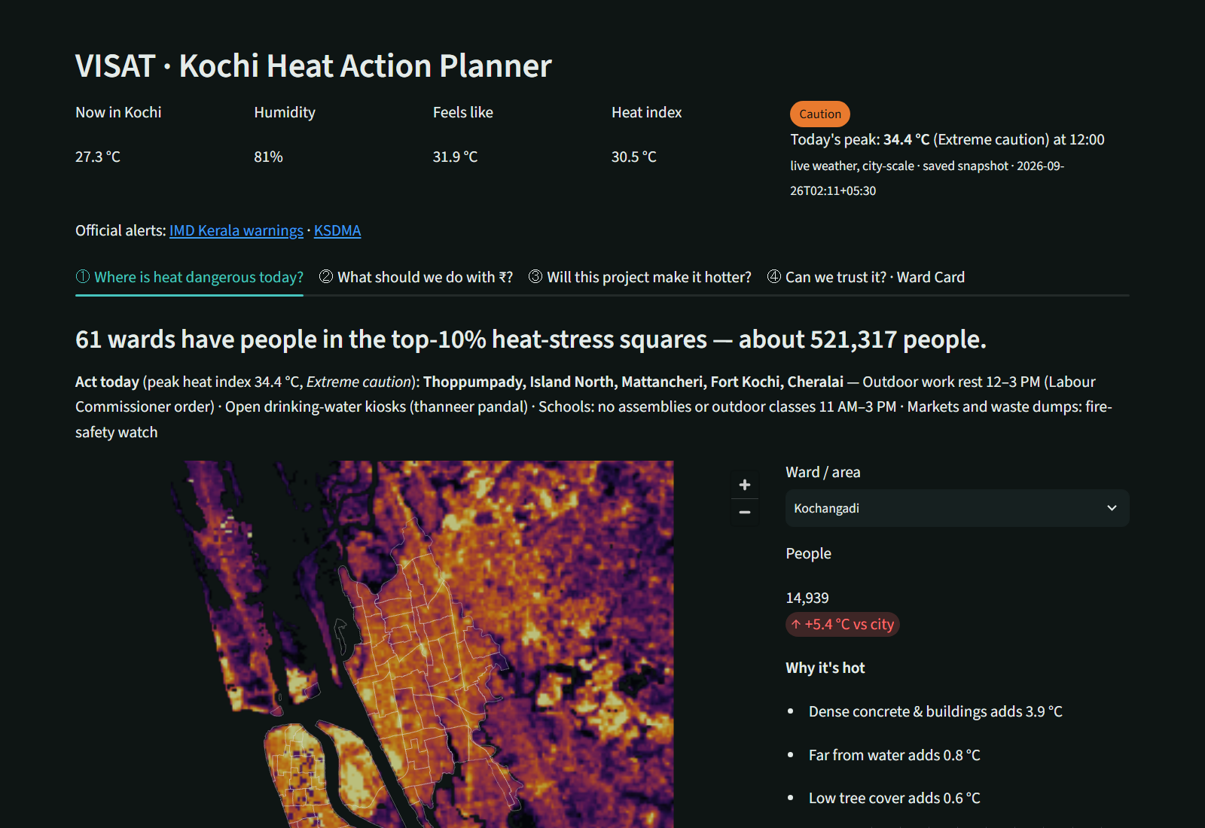
VISAT / KOCHI HEAT ACTION PLANNER
Planning for a cooler Kochi
A data-driven heat action planner
VISAT helps city teams find hot areas, compare cooling actions and screen new projects.
23 scenes • 74 wards • 100 m grid
VISAT Engineering College | HackMe 26
1

Slide 2
VISAT / KOCHI HEAT ACTION PLANNER
From satellite data to a decision
1
2
3
4
Observe
Model
Compare
Prioritise
Satellite, weather and land-cover data
Physics-informed XGBoost on a 100 m grid
Trees, cool roofs, ponds and pavements
Choose the best cooling per rupee
The goal: turn a heat map into a practical ward-level plan.
VISAT Engineering College | HackMe 26
2

Slide 3
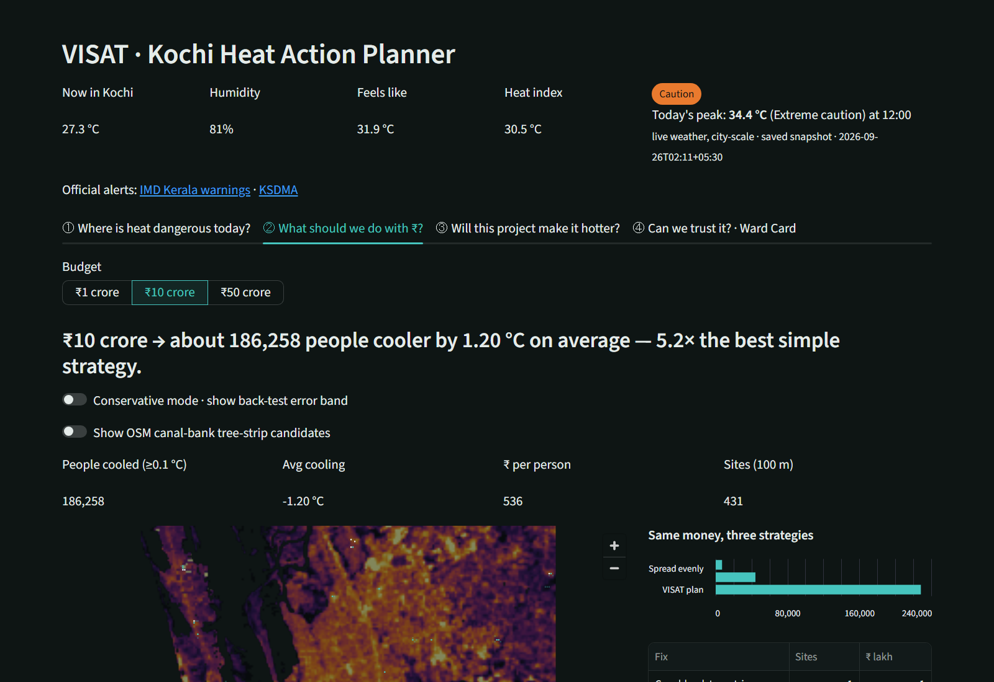
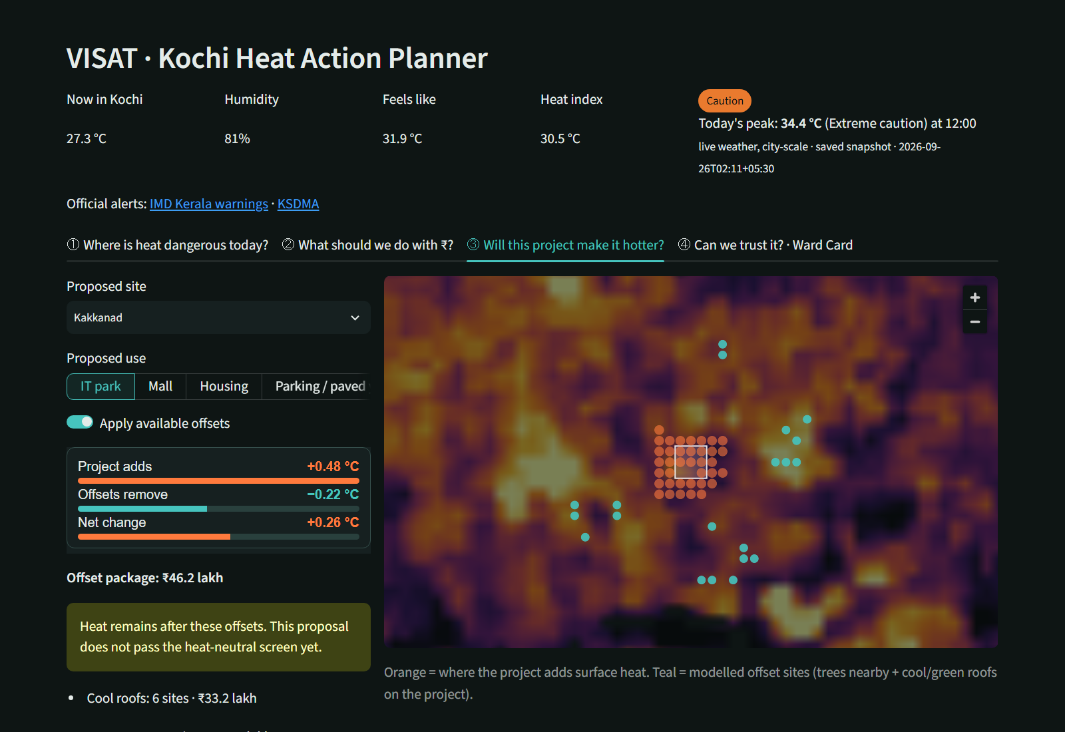
VISAT / KOCHI HEAT ACTION PLANNER
What the app lets a planner do
Budget planner
Project heat check
VISAT Engineering College | HackMe 26
3

Slide 4
VISAT / KOCHI HEAT ACTION PLANNER
Current results
Spatial cross-validation (R²)
Physics-informed XGBoost
0.829
Unconstrained XGBoost
0.839
Linear baseline
0.616
Back-test: r = 0.354 | MAE = 1.396 °C | 8,000 changed cells
ECOSTRESS and CPCB checks are still pending in the saved build.
VISAT Engineering College | HackMe 26
4

Slide 5
VISAT / KOCHI HEAT ACTION PLANNER
A useful prototype, ready for a careful pilot
VISAT connects heat exposure, budgets and project screening in one workflow.
Verify site ownership and permissions.
Review unusually large predicted cooling effects.
Add independent checks and field measurements.
Test the workflow in selected wards.
Next step: choose pilot wards, verify sites, and measure outcomes.
VISAT Engineering College | HackMe 26
5

