Slide 1
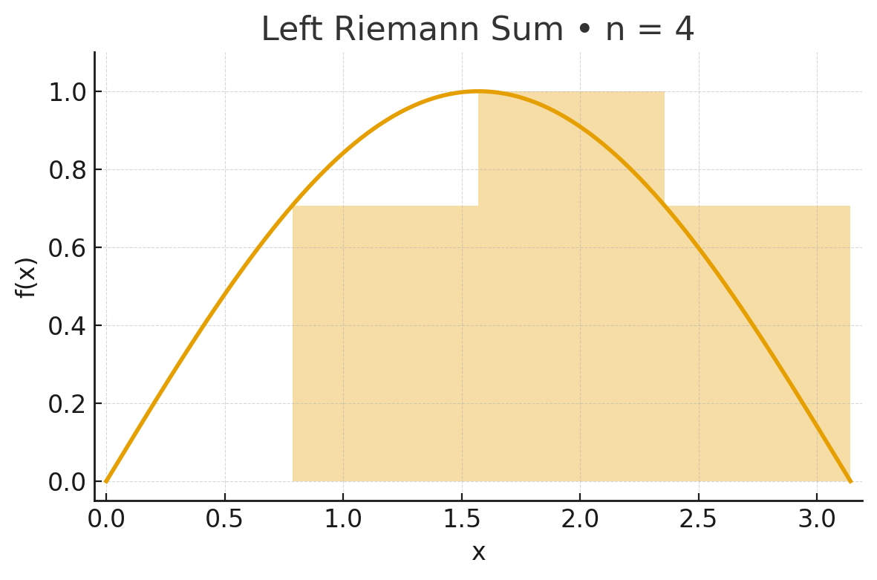
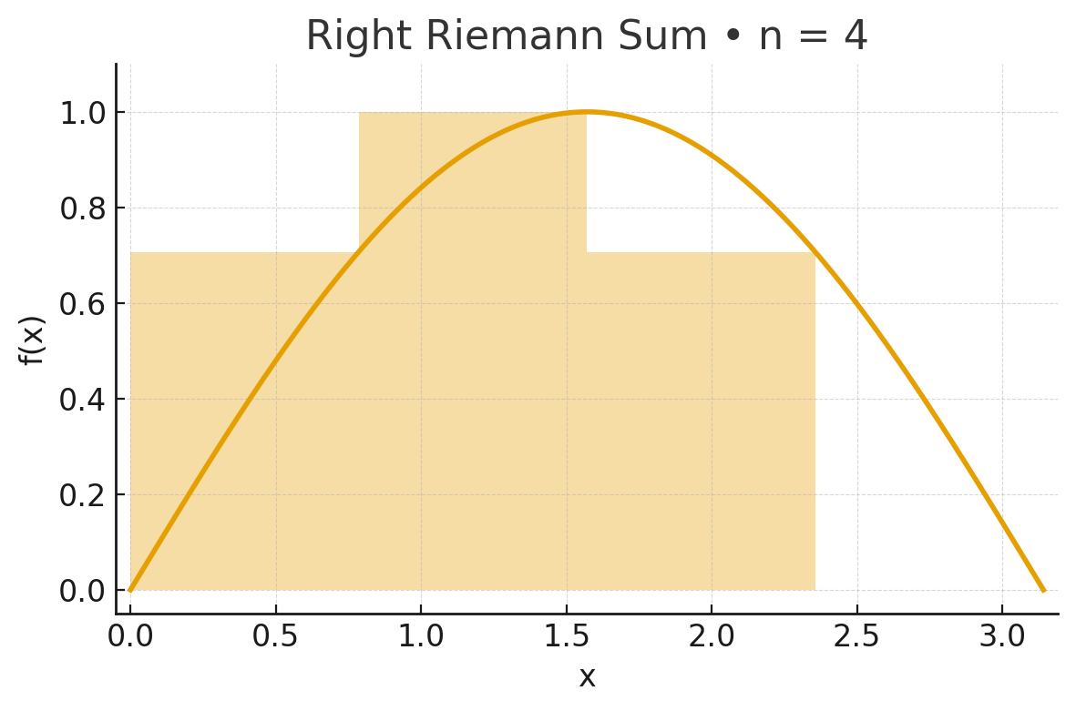
Left vs Right Riemann Sums — f(x) = sin(x) on [0, π] (n = 4)
Actual area = 2.000000 | Estimated (Left) = 1.896119 Error (Left) = -0.103881 | Estimated (Right) = 1.896119 Error (Right) = -0.103881
Left endpoint rectangles
Right endpoint rectangles

Slide 2
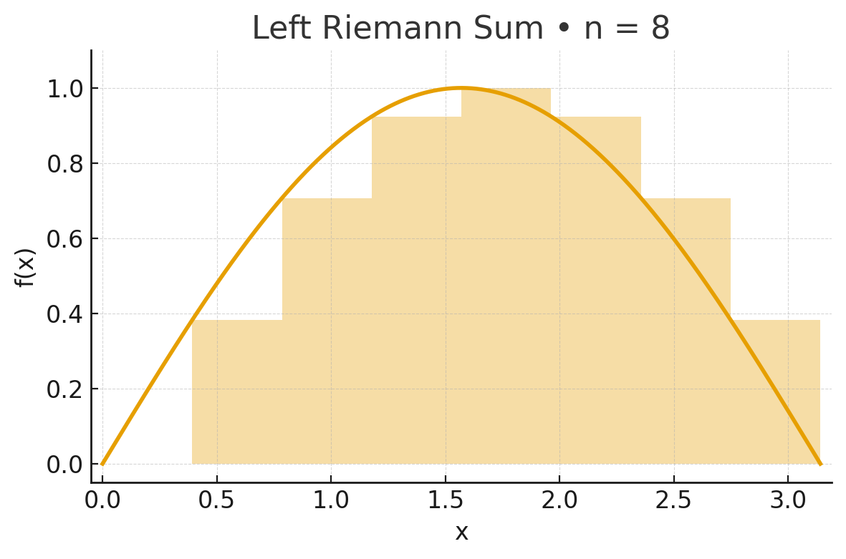
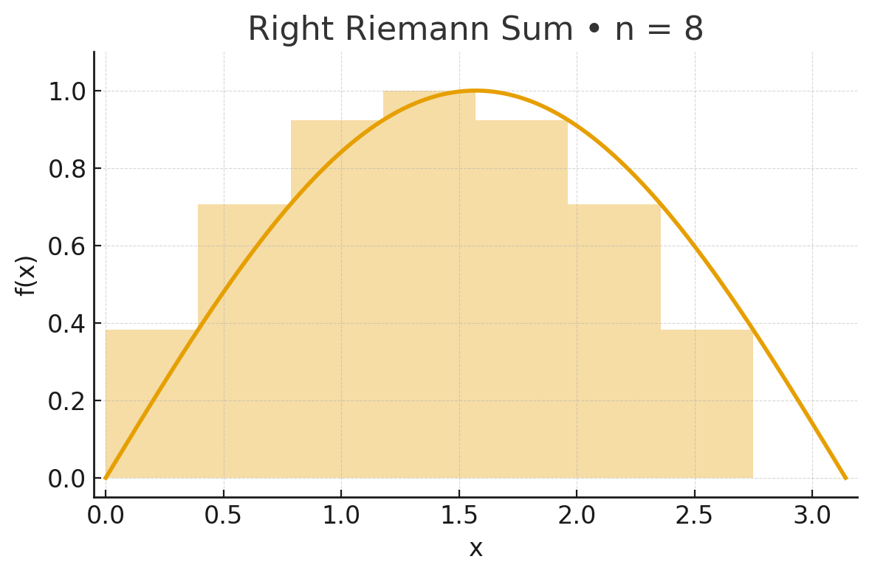
Left vs Right Riemann Sums — f(x) = sin(x) on [0, π] (n = 8)
Actual area = 2.000000 | Estimated (Left) = 1.974232 Error (Left) = -0.025768 | Estimated (Right) = 1.974232 Error (Right) = -0.025768
Left endpoint rectangles
Right endpoint rectangles

Slide 3
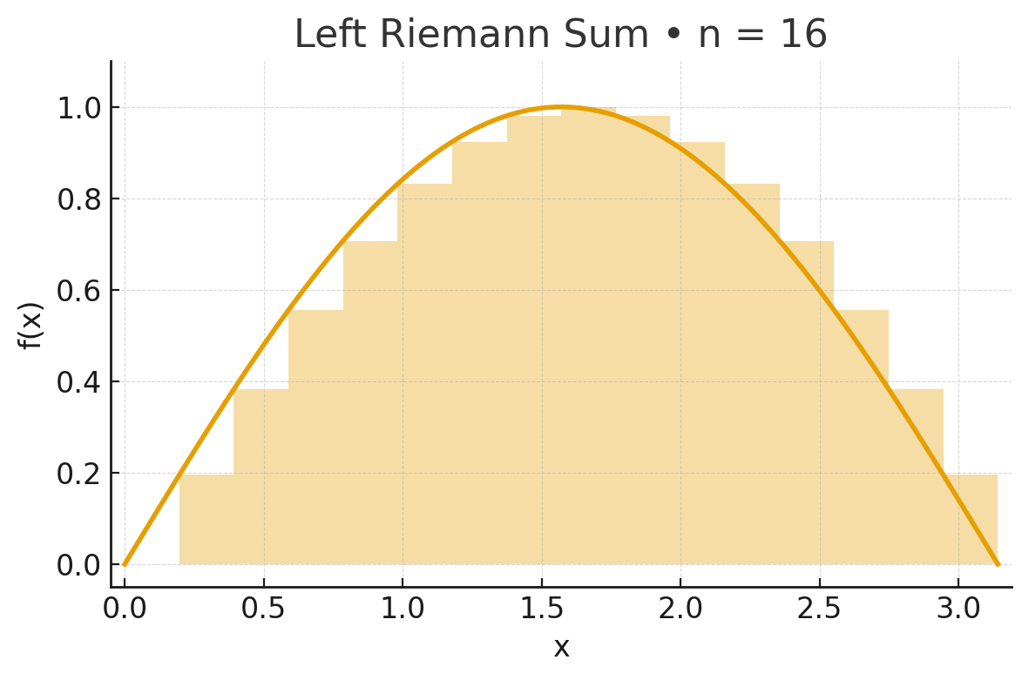
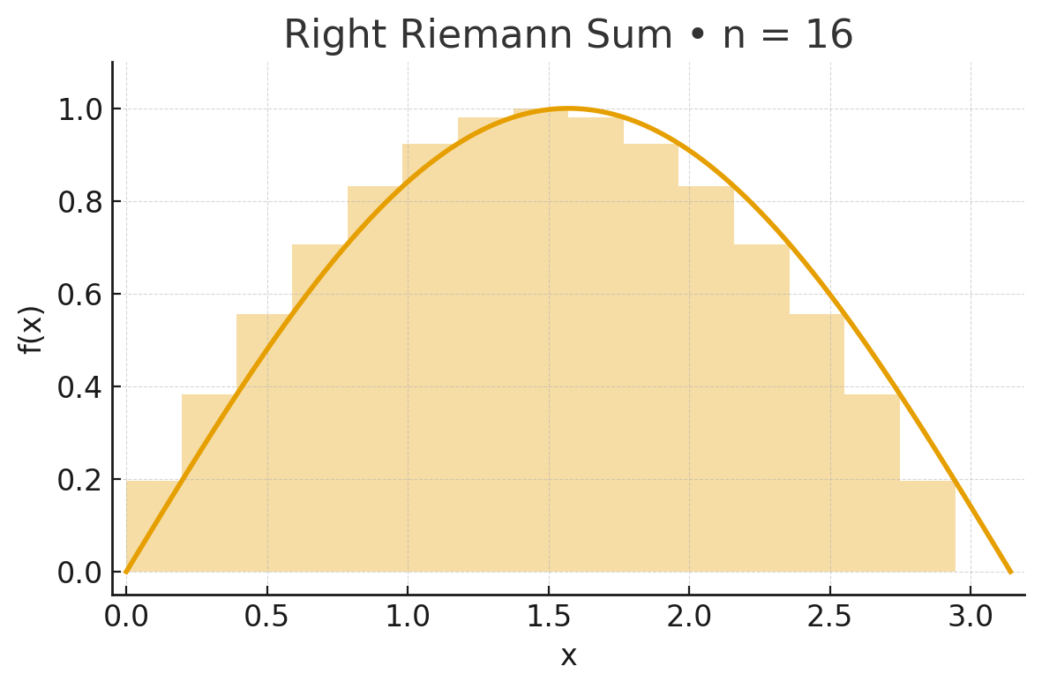
Left vs Right Riemann Sums — f(x) = sin(x) on [0, π] (n = 16)
Actual area = 2.000000 | Estimated (Left) = 1.993570 Error (Left) = -0.006430 | Estimated (Right) = 1.993570 Error (Right) = -0.006430
Left endpoint rectangles
Right endpoint rectangles

Slide 4

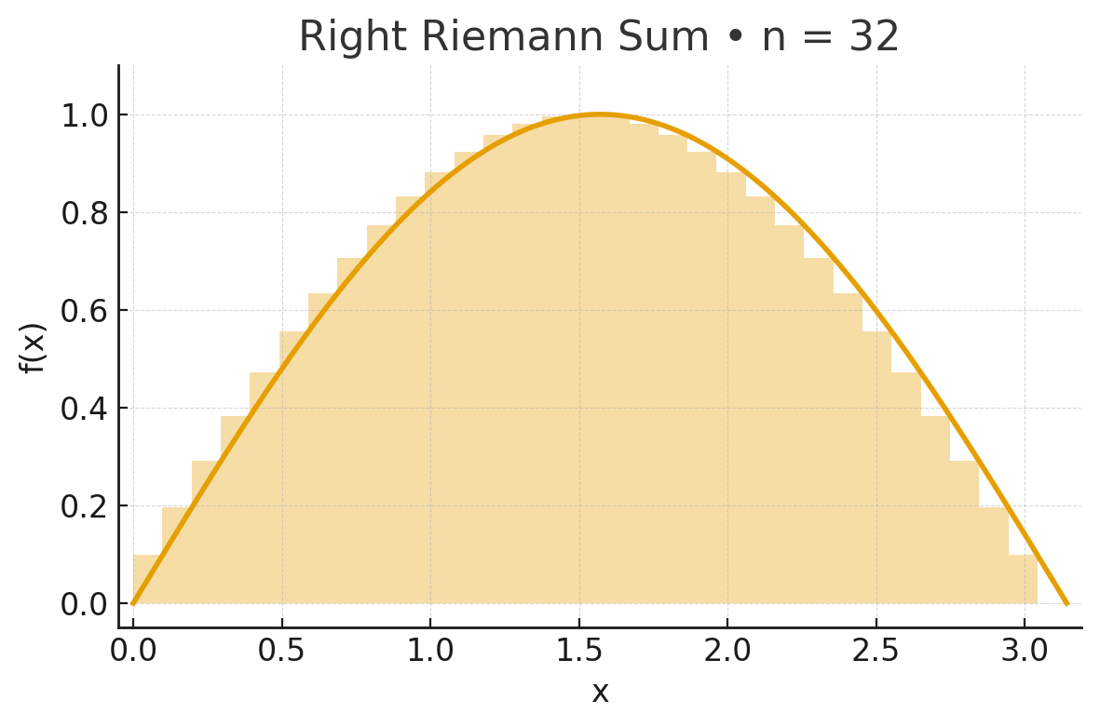
Left vs Right Riemann Sums — f(x) = sin(x) on [0, π] (n = 32)
Actual area = 2.000000 | Estimated (Left) = 1.998393 Error (Left) = -0.001607 | Estimated (Right) = 1.998393 Error (Right) = -0.001607
Left endpoint rectangles
Right endpoint rectangles

