Slide 1
0
true

Slide 2









i
0
$$h$$
l_{o}
@proto: l_{p} | get: 5
@proto: null | get: f_{get}
l_{p}
$$ρ$$
x: l_{o}
i
0
l_{o}
@proto: l_{p} | get: 42
@proto: null | get: f_{get}
$$h$$
$$ρ$$
x: l_{o}
l_{p}
i
1, 4
$$h$$
l_{o}
@proto: l_{p} | get: 5
@proto: null | get: f_{get}
l_{p}
i
$$ρ$$
1, 4
l_{o}
@proto: l_{p} | get: 42
@proto: null | get: f_{get}
$$h$$
x: l_{o} | w: true
$$ρ$$
x: l_{o} | w: true
l_{p}
i
5
$$h$$
l_{o}
@proto: l_{p} | get: 5
@proto: null | get: f_{get}
l_{p}
i
5
l_{o}
@proto: l_{p} | get: 42
@proto: null | get: f_{get}
$$h$$
$$ρ$$
x: l_{p} | w: true | y: f_{get}
$$ρ$$
x: l_{o} | w: true
l_{p}

Slide 3

i
0
$$h$$
l_{o}
@proto: l_{p}
@proto: null | get: f_{get}
l_{p}
$$ρ$$
x: l_{o}
i
1, 2
$$h$$
l_{o}
@proto: l_{p}
@proto: null | get: f_{get}
l_{p}
$$ρ$$
x: l_{o} | w: false
i
3, 0
$$h$$
l_{o}
@proto: l_{p}
@proto: null | get: f_{get}
l_{p}
$$ρ$$
x: l_{p} | w: false
i
1, 4
$$h$$
l_{o}
@proto: l_{p}
@proto: null | get: f_{get}
l_{p}
$$ρ$$
x: l_{p} | w: true
i
5
l_{o}
@proto: l_{p}
@proto: null | get: f_{get}
$$h$$
$$ρ$$
x: l_{p} | w: true | y: f_{get}
l_{p}
…

Slide 4


i
0
$$h$$
l_{o}
@proto: l_{p}
@proto: null | get: f_{get}
l_{p}
$$ρ$$
x: l_{o}
i
0
l_{o}
@proto: l_{p}
@proto: null | get: f_{get}
$$h$$
$$h$$
l_{o}
$$ρ$$
x: l_{o}
l_{p}
i
1, 2
@proto: l_{p}
@proto: null | get: f_{get}
l_{p}
$$ρ$$
x: l_{o} | w: false
i
1, 2
l_{o}
@proto: l_{p}
@proto: null | get: f_{get}
$$h$$
$$ρ$$
x: l_{o} | w: false
l_{p}
i
3, 0
$$h$$
l_{o}
@proto: l_{p}
@proto: null | get: f_{get}
l_{p}
i
3, 0
l_{o}
@proto: l_{p}
@proto: null | get: f_{get}
$$h$$
$$ρ$$
x: l_{p} | w: false
$$ρ$$
x: l_{p} | w: false
l_{p}
i
1, 4
$$h$$
l_{o}
@proto: l_{p}
@proto: null | get: f_{get}
i
l_{p}
1, 4
l_{o}
@proto: l_{p}
@proto: null | get: f_{get}
$$h$$
$$ρ$$
$$ρ$$
x: l_{p} | w: true
l_{p}
x: l_{p} | w: true
i
i
5
l_{o}
@proto: l_{p}
@proto: null | get: f_{get}
$$h$$
5
l_{o}
@proto: l_{p}
@proto: null | get: f_{get}
$$h$$
l_{p}
$$ρ$$
l_{p}
$$ρ$$
x: l_{p} | w: true | y: f_{get}
x: l_{p} | w: true | y: f_{get}
. . .

Slide 5
















i
0
$$h$$
l_{o}
@proto: l_{p} | get: $∅$
@proto: null | get: f_{get}
l_{p}
$$ρ$$
x: l_{o}
$$d$$
l_{o}: { @proto, get } | l_{p}: { @proto, get }
i
0
$$h$$
l_{o}
@proto: l_{p} | get: $∅$
@proto: null | get: f_{get}
{ @proto, get }
{ @proto, get }
l_{o}
$$d$$
$$h$$
l_{o}
$$ρ$$
x: l_{o}
l_{p}
l_{p}
i
1, 2
@proto: l_{p} | get: $∅$
@proto: null | get: f_{get}
l_{p}
$$ρ$$
x: l_{o} | w: false
i
1, 2
$$h$$
l_{o}
@proto: l_{p} | get: $∅$
@proto: null | get: f_{get}
{ @proto, get }
{ @proto, get }
l_{o}
$$d$$
$$ρ$$
x: l_{o} | w: false
l_{p}
l_{p}
i
3, 0
$$h$$
l_{o}
@proto: l_{p} | get: $∅$
@proto: null | get: f_{get}
l_{p}
i
3, 0
$$h$$
l_{o}
@proto: l_{p} | get: $∅$
@proto: null | get: f_{get}
{ @proto, get }
{ @proto, get }
l_{o}
$$d$$
$$ρ$$
x: l_{p} | w: false
$$ρ$$
x: l_{p} | w: false
l_{p}
l_{p}
i
1, 4
$$h$$
l_{o}
@proto: l_{p} | get: $∅$
@proto: null | get: f_{get}
i
l_{p}
1, 4
$$h$$
l_{o}
@proto: l_{p} | get: $∅$
@proto: null | get: f_{get}
{ @proto, get }
{ @proto, get }
l_{o}
$$d$$
$$ρ$$
$$ρ$$
x: l_{p} | w: true
l_{p}
l_{p}
x: l_{p} | w: true
i
$$h$$
l_{o}
@proto: l_{p} | get: $∅$
@proto: null | get: f_{get}
i
5
$$h$$
l_{o}
@proto: l_{p} | get: $∅$
@proto: null | get: f_{get}
{ @proto, get }
{ @proto, get }
l_{o}
$$d$$
5
l_{p}
l_{p}
l_{p}
$$ρ$$
x: l_{p} | w: true | y: f_{get}
$$ρ$$
. . .
x: l_{p} | w: true | y: f_{get}
…

Slide 6
i
0
$$h$$
l_{o}
@proto: l_{p} | get: $∅$
@proto: null | get: f_{get}
i
0
$$h$$
l_{o}
@proto: l_{p} | get: 5
@proto: null | get: f_{get}
l_{p}
l_{p}
$$ρ$$
x: l_{o}
$$d$$
l_{o}: { @proto, get } | l_{p}: { @proto, get }
$$ρ$$
x: l_{o}
i
1, 2
$$h$$
l_{o}
@proto: l_{p} | get: $∅$
@proto: null | get: f_{get}
i
1, 4
$$h$$
l_{o}
@proto: l_{p} | get: 5
@proto: null | get: f_{get}
l_{p}
l_{p}
$$ρ$$
x: l_{o} | w: false
$$ρ$$
x: l_{o} | w: true
i
3, 0
$$h$$
l_{o}
@proto: l_{p} | get: $∅$
@proto: null | get: f_{get}
i
5
$$h$$
l_{o}
@proto: l_{p} | get: 5
@proto: null | get: f_{get}
l_{p}
l_{p}
$$ρ$$
x: l_{p} | w: false
$$ρ$$
x: l_{p} | w: true | y: f_{get}
i
1, 4
$$h$$
l_{o}
@proto: l_{p} | get: $∅$
@proto: null | get: f_{get}
l_{p}
$$ρ$$
x: l_{p} | w: true
i
5
$$h$$
l_{o}
@proto: l_{p} | get: $∅$
@proto: null | get: f_{get}
l_{p}
$$ρ$$
x: l_{p} | w: true | y: f_{get}
…

Slide 7

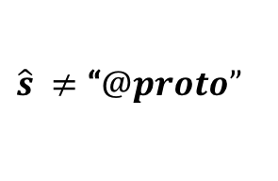


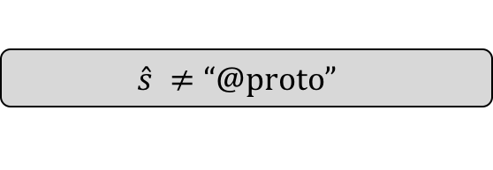
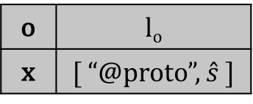
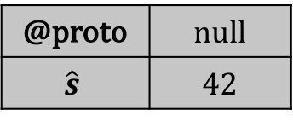






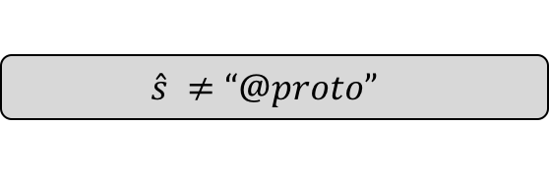


i
1
$$true$$
$$π$$
$$ρ$$
o | l_{o}
@proto | null
l_{o}
$$\hat{s}=\text{“}@proto”$$
$$\hat{s} ≠\text{“}@proto”$$
i
2
$$\hat{s} ≠\text{“}@proto”$$
$$π$$
i
2
$$\hat{s}=\text{“}@proto”$$
$$π$$
$$ρ$$
o | l_{o}
@proto | null
$$\hat{s}$$ | 42
$$ρ$$
o | l_{o}
@proto | 42
l_{o}
l_{o}
i
3
$$\hat{s}=\text{“}@proto”$$
$$π$$
i
3
$$\hat{s} ≠\text{“}@proto”$$
$$π$$
o | l_{o}
x | [ “@proto” ]
@proto | 42
l_{o}
o | l_{o}
x | [ “@proto”, $\hat{s}$ ]
@proto | null
$$\hat{s}$$ | 42
$$ρ$$
$$ρ$$
l_{o}

Slide 8
i
1
$$true$$
$$π$$
$$ρ$$
o | l_{o}
@proto | null
l_{o}
$$\hat{s}=\text{“}@proto”$$
$$\hat{s} ≠\text{“}@proto”$$
i
2
$$\hat{s} ≠\text{“}@proto”$$
$$π$$
i
2
$$\hat{s}=\text{“}@proto”$$
$$π$$
$$ρ$$
o | l_{o}
@proto | null
$$\hat{s}$$ | 42
$$ρ$$
o | l_{o}
@proto | 42
l_{o}
l_{o}
i
3
$$\hat{s}=\text{“}@proto”$$
$$π$$
i
3
$$\hat{s} ≠\text{“}@proto”$$
$$π$$
o | l_{o}
x | [ “@proto” ]
@proto | 42
l_{o}
o | l_{o}
x | [ “@proto”, $\hat{s}$ ]
@proto | null
$$\hat{s}$$ | 42
$$ρ$$
$$ρ$$
l_{o}

Slide 9
Extended JS programs
Rosette
JSIL Symbolic Interpreter
JS-2-JSIL
Compiler
Extended JSIL programs
Counter-model

Slide 10












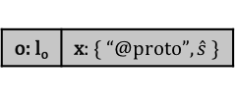


i
2
$$h$$
l_{o}
@proto: null
{ @proto }
l_{o}
$$d$$
$$ρ$$
o: l_{o}
true
$$π$$
$$\hat{s}=\text{“}@proto”$$
$$\hat{s}≠\text{“}@proto”$$
i
2
$$h$$
l_{o}
@proto: 42
{ @proto }
l_{o}
$$d$$
i
2
$$h$$
l_{o}
@proto: null | $\hat{s}$: 42
{ @proto, $\hat{s}$ }
l_{o}
$$d$$
$$ρ$$
o: l_{o}
$$\hat{s}=\text{“@}\text{proto}\text{”}$$
$$π$$
$$ρ$$
o: l_{o}
$$\hat{s}≠\text{“@}\text{proto}\text{”}$$
$$π$$
i
3
$$h$$
l_{o}
@proto: 42
{ @proto }
l_{o}
$$d$$
i
3
$$h$$
l_{o}
@proto: null | $\hat{s}$: 42
{ @proto, $\hat{s}$ }
l_{o}
$$d$$
$$ρ$$
o: l_{o} | x: { “@proto” }
$$\hat{s}=\text{“@}\text{proto}\text{”}$$
$$π$$
$$ρ$$
o: l_{o} | x: { “@proto”, $\hat{s} \}$
$$\hat{s}≠\text{“@}\text{proto}\text{”}$$
$$π$$

