Slide 1
0
true

Slide 2

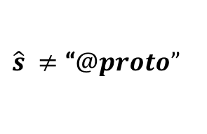


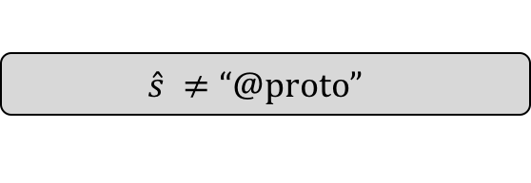
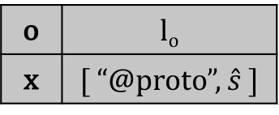
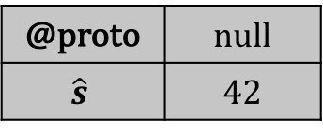






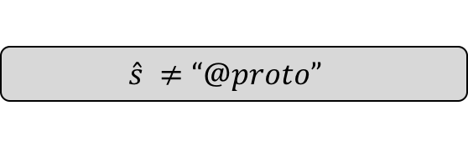


i
1
$$true$$
$$π$$
$$ρ$$
o | l_{o}
@proto | null
l_{o}
$$\hat{s}=\text{“}@proto”$$
$$\hat{s} ≠\text{“}@proto”$$
i
2
$$\hat{s} ≠\text{“}@proto”$$
$$π$$
i
2
$$\hat{s}=\text{“}@proto”$$
$$π$$
$$ρ$$
o | l_{o}
@proto | null
$$\hat{s}$$ | 42
$$ρ$$
o | l_{o}
@proto | 42
l_{o}
l_{o}
i
3
$$\hat{s}=\text{“}@proto”$$
$$π$$
i
3
$$\hat{s} ≠\text{“}@proto”$$
$$π$$
o | l_{o}
x | [ “@proto” ]
@proto | 42
l_{o}
o | l_{o}
x | [ “@proto”, $\hat{s}$ ]
@proto | null
$$\hat{s}$$ | 42
$$ρ$$
$$ρ$$
l_{o}

Slide 3
Rosette implementations of built-in functions
Extended JS programs
JS-2-JSIL
Compiler
Rosette
JSIL Symbolic Interpreter
Extended JSIL programs
Counter-model

