Slide 1

Extending the Mashic Compiler
Enforcing Security Policies in the Presence of Malicious Advertisements
José Fragoso Santos
Equipe Project INDES
INRIA Sophia Antipolis Méditerranée

Slide 2











Mashups...
Gadgets
Combine data and/or code from multiple origins to create a new service

Slide 3



Not all gadgets are equal
Two major types of gadgets
Gadgets that manipulate the integrator state directly
Gadgets that provide an interface for the integrator
External Services
Advertisements
Type I
Type II

Slide 4

Not all gadgets are equal
There are two major types of gadgets
Integrator.js
Integrator.js
Communication happens from the integrator to the gadget
Communication happens from the gadget to the integrator
Gadget C
Gadget C
Type I
Type II

Slide 5
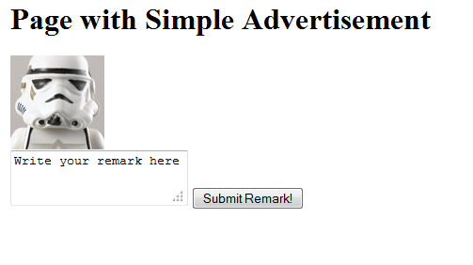
Type I – A simple example
<html>
<head>
<title>Web Page with Simple Banner</title>
<script type=“text/javascript” src=“http://www.A.com/banner”/>
<script type=“text/javascript”>
…
</script>
</head>
<body onload=“iniatialize()”>
<h1>Page with Simple Banner</h1>
<div id=“bannerAd”></div>
<textarea>Write your remark here</textarea>
<button onclick=“btnFunction()”>Submit Remark!</button>
</body>
</html>
AD
function updateBanner(){
var taArray = document.getElementsByTagName("textarea");
var str = "";
for(var i=0; i<taArray.length; i++) str += taArray[i].value;
var index = isAbout(str);
var div = document.getElementById("bannerAd");
removeChildNodes(div);
div.appendChild(anchors[index]);
};
Integrator Code
The gadget is accessing integrator information that does not belong to him to select which ad to present
Gadget Code

Slide 6
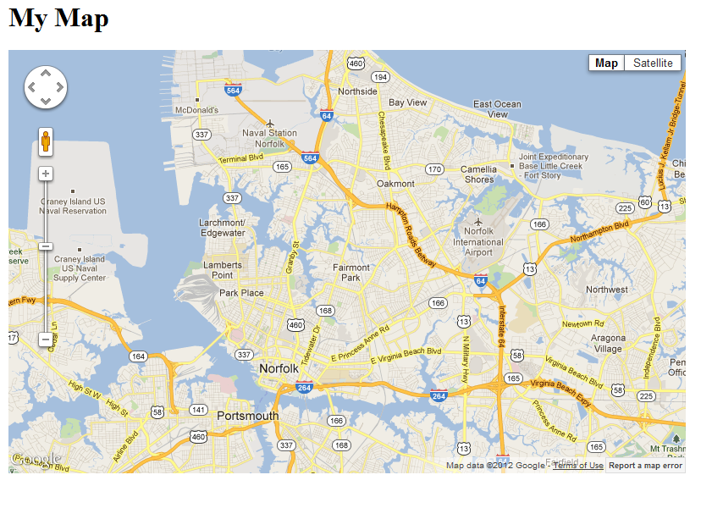
Type II – A simple example
<html>
<head>
<title>Google Maps Hello World</title>
<script type=“text/javascript” src=“http://maps.google.com/maps/api”/>
<script type=“text/javascript”>
var initialize = function() {
…
}
<script>
</head>
<body onload=“iniatialize()”>
<h1>My Map</h1>
<div id=“map”></div>
</body>
</html>
Gadget Code
var latlng = new google.maps.LatLng(36, -76);
var options = {
zoom: 12,
center: latlng,
mapTypeId:google.maps.MapTypeId.ROADMAP
};
var mdiv = document.getElementById("map");
var map = new google.maps.Map(mdiv, options);
Integrator Code

Slide 7
Including External Gadgets…
Internal script that combines the external content
integrator.html
Integrator.js
<script>
dom
External Code
<script>
<script>
Gadget A
Gadget A
<iframe>
Gadget C

Slide 8
Including External Gadgets…
integrator.html
Integrator.js
<script>
dom
“A page within a page”
<script> Tag
<script>
<script>
<iframe> Tag
Gadget A
Gadget A
<iframe>
Gadget C

Slide 9
<iframe> versus <script>
integrator.html
Integrator.js
Gadgets included using the script tag can read/write page information directly
<script>
dom
Gadgets included within an iframe cannot access the external page directly
<script>
<script>
Gadget A
Gadget A
<iframe>
Gadget C

Slide 10
<script>: Security Vulnerabilities
integrator.html
Integrator.js
dom
Gadgets included using the script tag can circumvent the integrator code!!!
Gadget A
Gadget B
Gadget C

Slide 11

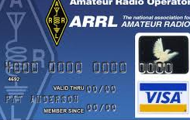
<script>: Security Vulnerabilities
integrator.html
Integrator.js
dom
Integrity
Gadget A
Gadget B
Confidentiality
Gadget C

Slide 12
<script>: Security Vulnerabilities
External gadgets represent real threats to existing mashups!!!
External gadgets cannot be trusted in security sensitive mashups
“Readers of the New York Times were greeted with by an animated image of a fake virus scan”
These threats are real!
2009
“Members of Facebook were presented with ads deceptively portraying private images of their family and friends”

Slide 13
<iframe> and PostMessage
integrator.html
integrator.html
Interframe communication is asynchronous
Integrator.js
<script>
dom
PostMessage
<script>
<script>
Only strings can be passed between frames
Gadget A
Gadget A
<iframe>
Gadget C

Slide 14




Same Origin Policy
A script cannot read the content of a document from a different ORIGIN than the page that contains the script
Domain Name
App Layer Protocol
Port number
pageA.html
pageB.html
dom
dom
Integrator
Integrator
Gadget I
Gadget I
Gadget I
www.A.com
src: www.A.com
src: www.B.com

Slide 15


Mashup Security Problem
Gadgets with the script tag
Gadgets with the iframe tag
Security Issues
Communication
Programmers resign security for the sake of functionality!!!
Communication
Security

Slide 16

Mashup Isolation: a recipe
Attacks on Javascript Mashup Communication
Adam Barth and Colin Jackson and William Li
Web 2.0 Security and Privacy 2009
integrator.html
Integrator.js
dom
Messages via PostMessage API
Proxy Interface
…
Part of the dom for gadget interaction
Listener Interface
Gadget C
Gadget C
iframe

Slide 17
Mashup Isolation: A Recipe
The gadget listener function marshals B as a string and sends it to the integrator via PostMessage.
The integrator proxy marshals A as a string and invokes the respective function of the
gadget listener library.
The integrator demarshalls B from m_{B} and updates node N2.
The gadget exposes function f and the integrator wants to compute f(A) and store its value on N2 whenever N3 is clicked
The gadget listener function demarshals m_{A} and invokes the appropriate gadget function. The integrator awaits blocked.
N3 is clicked
The integrator reads the value stored in N1.
integrator.html
A
Integrator.js
dom
…
N3
Proxy Interface
Click!
m_{A}
m_{B}
N1: A
Listener Interface
f(A) = B
N2
N2
N2: B
B
Gadget C
Gadget C
iframe

Slide 18
Mashic: Automating Mashup Isolation
Mashic Compiler
Zhengqin Luo and Tamara Rezk
CSF 2012
Goals
Automatically secure mashups
Correctness and Security guarantees!
An unique number associated with
an object in a frame.
How?
Integrator can refer to objects that are defined inside the gadget...
Apply a CPS transformation to the
integrator code
Use Opaque Object Handles (OOH)

Slide 19
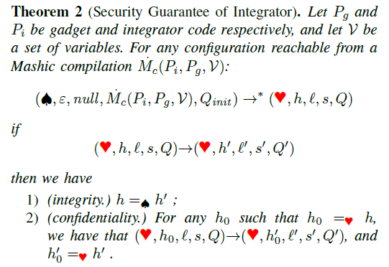
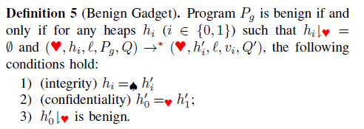
Mashic: Soundness and Security
Assumption
Benign Gadget: Type II Gadget
Theorem
Correcteness
The compiled mashup preserves the original semantics
Theorem
Security
After Mashic compilation, the malicious gadget cannot read/write information belonging to the integrator.

Slide 20
Extending Mashic
Challenge
Handle Type I Gadgets
How?
The same way the integrator is allowed to access the objects belonging to the gadget
Almost!
Recalling…
Apply a CPS transformation to the gadget code
Use Opaque Object Handles (OOH) on the gadget side

Slide 21
Supporting Type I Gadgets
Integrator.js
Allow two-sided communication
Listener
Proxy
Current Mashic
Uncontrolled
Add proxy and listener libraries to both the gadget iframe and to the integrator code
Goal
Controlled
Page.html
Listener
Proxy
Control the communication from the gadget to the integrator
iframe
Gadget A

Slide 22
Controlling Gadget – Integrator Com.
Integrator.js
How?
L_{c}
L_{I}
Listener
Proxy
1
Establish a lattice of security levels
Uncontrolled
Track Information Flow in the integrator
5
Controlled
2
Assign a security level to each integrator resource
Confidentiality
Integrity
Page.html
L_{c}xL_{I}
Listener
v^{l} where l is in L_{c}xL_{I}
3
Assign a security level to
each gadget
Proxy
iframe
Check all the gadget – integrator accesses at
runtime
∑ : Gadgets → L_{c}xL_{I}
4
Gadget A

Slide 23
Controlling Gadget – Integrator Com.
Γ(o[p])|_{C}<= ∑(Gadget_{A})|_{C} ?
Integrator.js
The gadget wants to acess the property p of the object o
Listener
The integrator listener
checks if gadget C has permission to read property
p of object o
The gadget proxy library sends a request to the integrator listener library with the id of the object and the name of the property
Proxy
2
If yes, the integrator listener builds a response and sends
it to the gadget proxy
1
3
{4}
{o_{id},p}
Page.html
Listener
Proxy
iframe
Gadget A

Slide 24
Tracking IF in the Integrator
Why?
Keep track of the information that can be sent to each gadget!
Because the integrator is TRUSTED!
How?
Instrument integrator code with IF tracking
operations
Label runtime values with security levels
Highly DYNAMIC approach!

Slide 25

Labeling Runtime Values
Information Flow Security for a Core of JavaScript
Daniel Hedin and Andrei Sabelfeld
CSF 2012
Labeled Object
Original Object
p₁: v₁
Security levels of the object properties
l₁: l₁
Runtime Labeling
p₁: v₁
p₂: v₂
l₂: l₂
p₂: v₂
Stubs to mediate the interaction with the labeled object
p₃: v₃
l₃: l₃
p₃: v₃
Original Properties of the object and respective values
…
…
…
p_{n}: v_{n}
l_{n}: l_{n}
p_{n}: v_{n}
l_{o}: l
Stubs
Security Level of the object

Slide 26

Expressing Security Policies
AdJail: Practical Enforcement of Confidentiality…
Mike Ter Louw et al
USENIX Security Symposium 2010
var names = {P1: “vader”, P2: “luke”};
var secretPins = {P1: “father”, P2: “force”};
1
Label the original dom in a separate configuration file
Object Literals and priimitive values
dom
The programmer has to specify the security level of each integrator resource
var names = {P1: “vader”, P2: “luke”};
var secretPins = new ObjEnv(
{P1: “father”, P2: “force”},
{P1: “secret”, P2: “secret”},
“secret”);
Label values that occur directly in integrator code
2
XmlHTTPRequest…
3
Label other sources/sinks of information

Slide 27

Integrator Instrumentation
On-the-fly Inlining of Dynamic Security Monitors
Jonas Magazinius, Alejandro Russo, Andrei Sabelfeld
COSE 2011
Source Integrator Code
Source Integrator Code
…
if(x) {
y = y + x;
} else {
alert(“hello world”)
}
…
if(x.value) {
l_{pc} = x.level ˅ l_{pc};
y.value = y.value + x.value;
y.level = x.level ˅ y.level ˅ l_{pc};
} else {
alert(“hello world”)
}
IFlow Tracker

Slide 28
Tracking IFlow
Why track information flow dynamically instead of statically enforcing a pre-established policy?
if(h) {
g = function() { l = 1};
} else {
g = function() { l = 0};
}
function f(x) {
if(h) {
eval(“var l”);
}
l = 0
}
var l = 1;
f(3)
Javascript is TOO dynamic!!!
Abstruse scoping rules
And MANY MANY more…
Higher order functions
var x = f();
if(h) { o[x] = 0 }
Dynamic properties

Slide 29
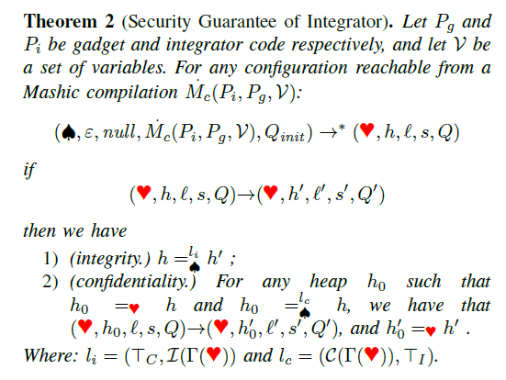
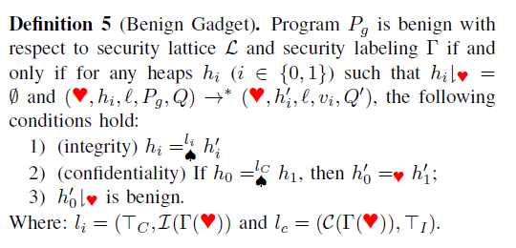
Ext Mashic: Soundness and Security
Assumption
Benign Gadget: A gadget that only tries to access integrator information compatible with its security level
Correcteness
Theorem
The compiled mashup preserves the original semantics
Theorem
Security
After Mashic compilation, the malicious gadget can only read/write integrator information compatible with its security level.

Slide 30
Controlling Integrator – Gadget Com.
Integrator.js
Communication Integrator-Gadget is not verified
Listener
Proxy
Why?
Uncontrolled
The integrator can declassify/endorse whatever he wants
Controlled
Because the gadget is trusted!
Page.html
Listener
A model for delimited information release
Andrei Sabelfeld and Andrew Meyers
ISSS 2003
However…
Proxy
The programmer can make mistakes
iframe
Gadget A

Slide 31
Controlling Integrator – Gadget Com.
Γ(o,p)|_{C}<= ∑(Gadget_{A})|_{C} ?
Γ(v) := ∑(Gadget_{A})
Integrator.js
The integrator wants to invoke gadget function f with arg o.p
Listener
After computing f(o) the gadget sends the result value to the integrator
Upon receiving v the integrator encapsules it in an envelop with the security level of gadget A
If it can the integrator proxy constroys a message with the identifier of the object and the name of the function to invoke and sends it to the gadget iframe
Proxy
3
The integrator proxy library verifies if the argument o can be seen by the gadget
4
2
1
{o_{id}, f}
{v}
Page.html
Listener
Proxy
iframe
Gadget A

Slide 32
Conclusions – Our Goals
Provide a solution for Web Ads based on Mashic
Integrator.js
Integrator.js
1
Browser Independent
2
To be applied to existing mashups
Gadget C
Gadget C
Type II
Type I
3
Correctness and Security guarantees

Slide 33
Related Work
AdJail – Pratical Enforcement of
Confidentiality and Integrity
Policies
Louw et al, USENIX’10
AdSafety – Type Based
Verification of JS SandBoxing
Politz et al, USENIX’11
Mashic: Automated Mashup
Sandboxing
Luo et al, CSF’12
A model for delimited Information
release
Sabelfed et al, ISSS’03
On-the-fly inlining of dynamic Security
monitors
Magazinius et al, COSE’11
IF Secuirity for Core JS
Hedin et al, CSF’12
Staged Iflow for Js
Jhala et al, PLDI’09
Efficient Purely-Dynamic IF Analysis
Flanagan et al, PLAS’09
An Empirical Study of Privacy-Violating
Information Flows in JavaScript Web
Applications
Jang et al, CCS’10
IFlow in JS
Secure
Mashups
IFlow

Slide 34
Thank you!

