Slide 1
Flappy Bird Frame-Based Policy Gradient
Fall 2022

Slide 2
Two New Knowledge
Generalized Advantage Estimation (GAE)
UC Berkley CS285: Lecture 6, Part 4
Video
Slides
Original paper
Proximal Policy Optimization (PPO)
University of Waterloo CS885: Lecture 15b
Video
Slides
Original paper

Slide 3
Outline
Recap
GAE
PPO

Slide 4
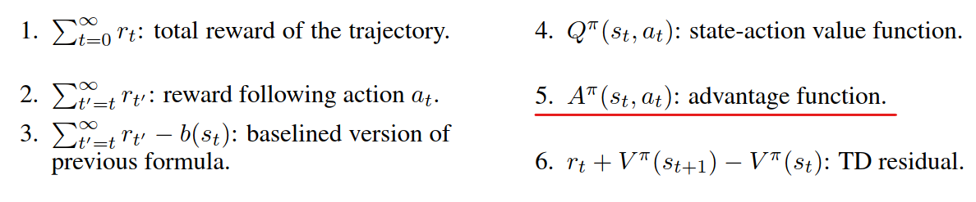
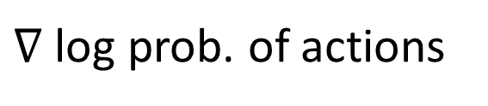
Recap
Policy gradient has 2 parts
Left part is a log probability of executing an action
Right part is an advantage term.
Left part
Right part:
Several formula can be chosen

Slide 5
Outline
Recap
GAE
PPO

Slide 6
Generalized Advantage Estimation (GAE)

Slide 7
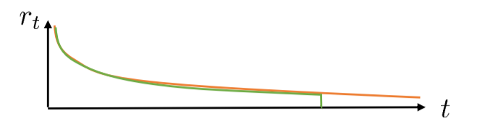
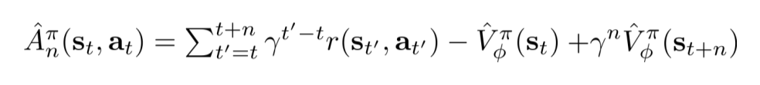
Eligibility traces & n-step returns
The notations of this slide are from cs285-fall2020-lecture-6 p.23
bigger variance
Can we combine these two, to control bias/variance tradeoff?
Cut here before variance gets too big
Smaller variance
Reference: cs285-fall2020-lecture-6 p.23
Notes:
C : actor critic
MC : monte carlo sample

Slide 8
Do We Have to Choose Just One N?
Cut here?
Cut here?

Slide 9
Cut Everywhere All at Once
Cut everywhere all at once and use exponentially-weighted average to add up

Slide 10
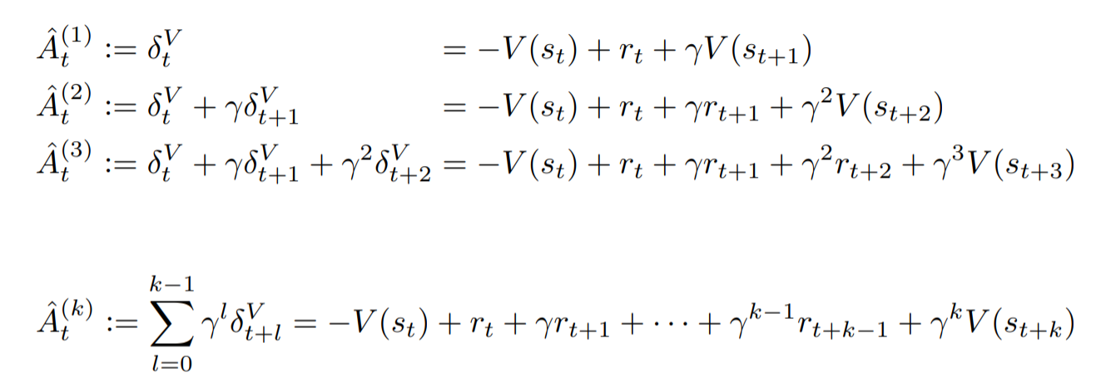
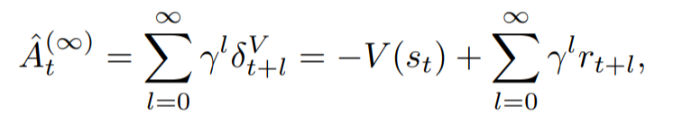

The Derivative of GAE
The notations of this slide are from the original paper
Cut at t+1:
Cut at t+2:
Cut at t+3:

Slide 11
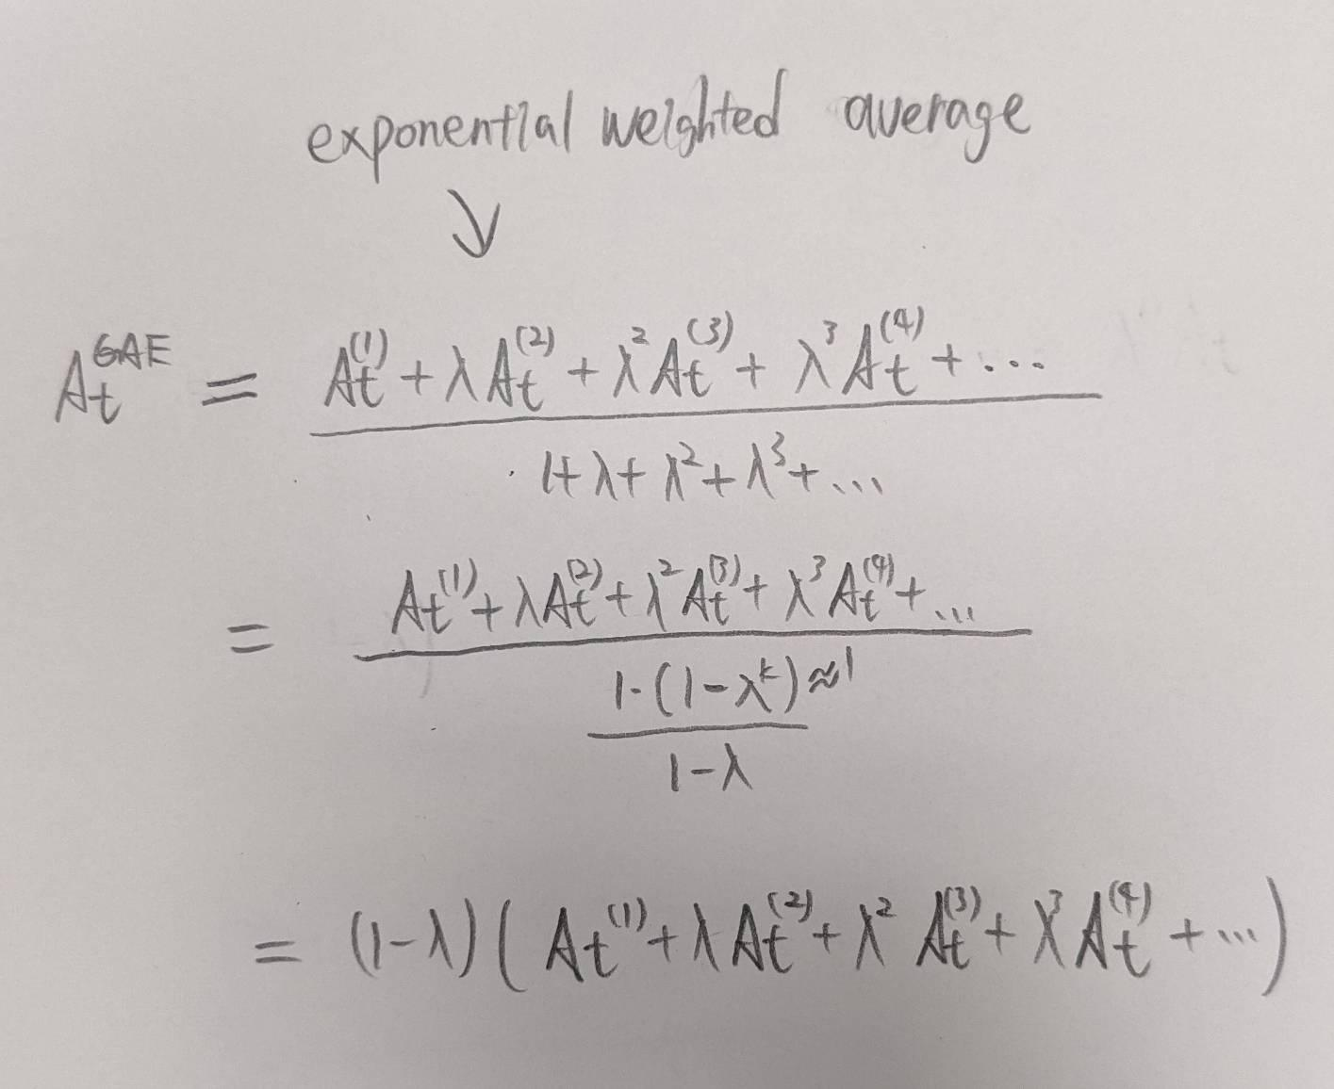
The Derivative of GAE (Con.)
The notations of this slide are from the original paper

Slide 12
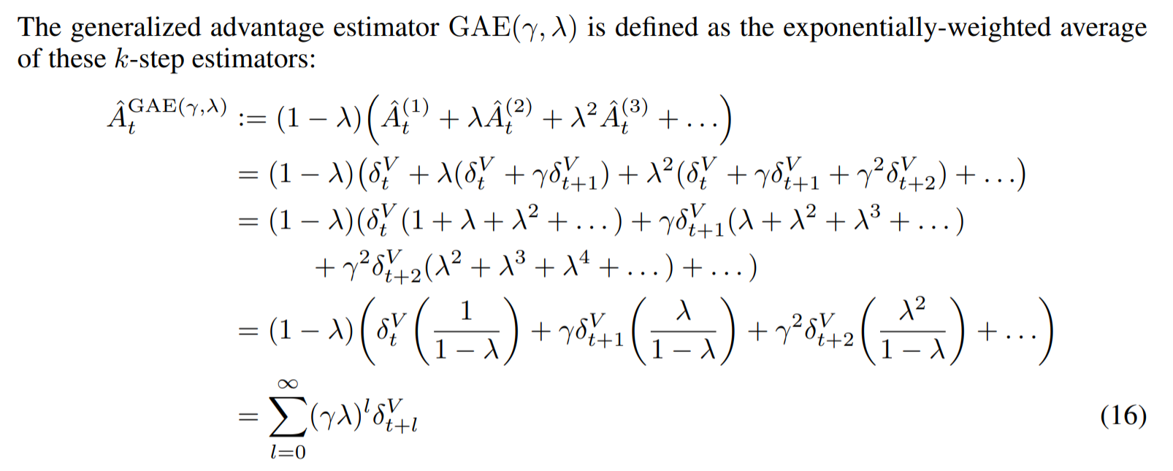
The Derivative of GAE (Con.)
The notations of this slide are from the original paper
Exponentially-weighted average

Slide 13
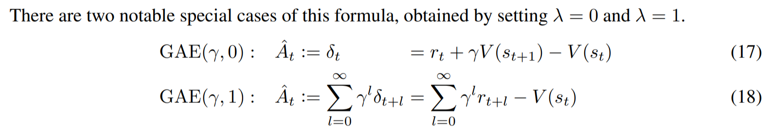
Two Special Case

Slide 14
Outline
Recap
GAE
PPO

Slide 15
Proximal Policy Optimization Algorithms

Slide 16
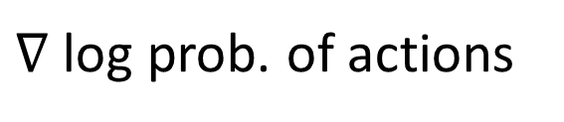
Now We’ve Learned GAE
GAE
Let’s improve the left part

Slide 17
Efficiently Use Data
We should drop all trajectory data after update the agent. Because the distribution of the agent’s action shifts after update.
Can’t we use old data to update the agent more times?
PPO is a method that we could leverage old data by simply multiplying a correction item when update the agent

Slide 18
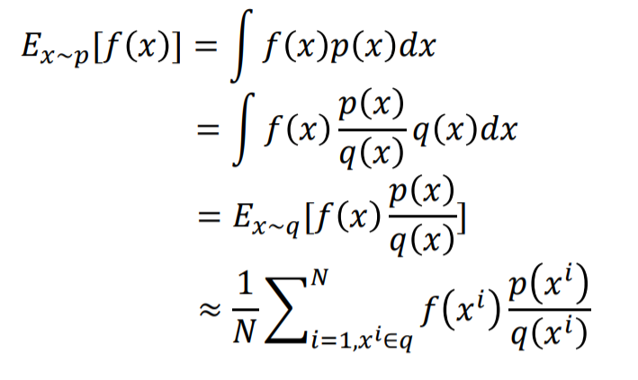
Importance Sampling
Importance sampling is a statistic technique to estimate one distribution by sampling from another distribution
Estimate p from q
Reference: cs885-spring18-lecture15b p.5

Slide 19
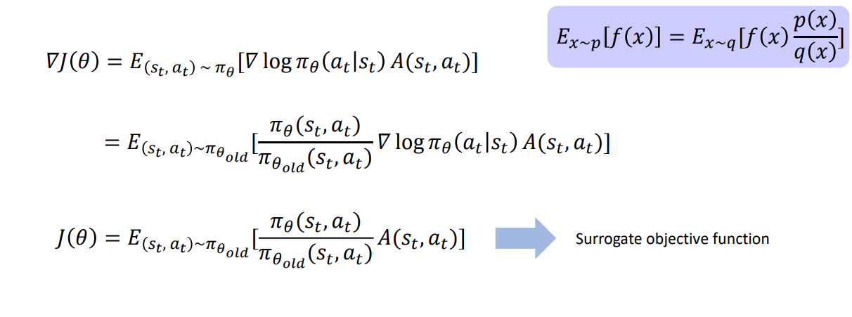
Surrogate Objective
Reference: cs885-spring18-lecture15b p.7

Slide 20
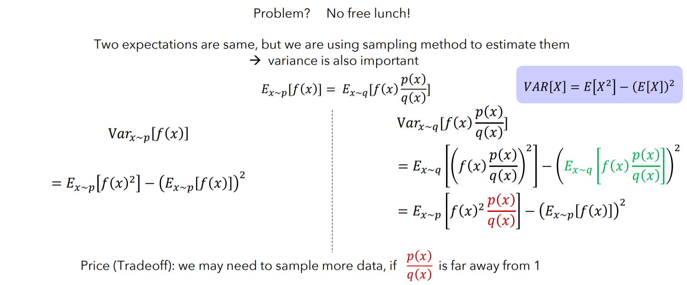
No Free Lunch
Reference: cs885-spring18-lecture15b p.8

Slide 21
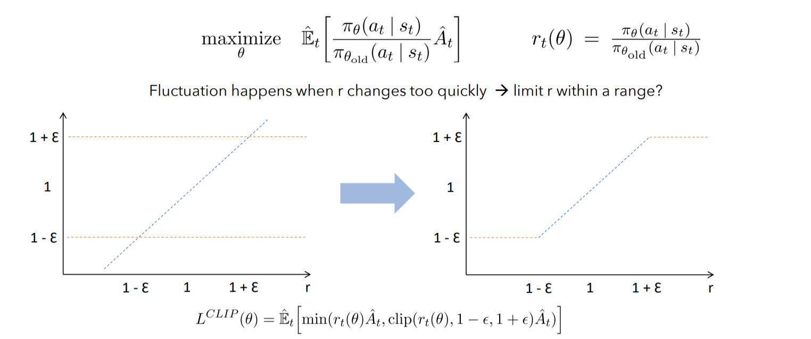
PPO with Clipped Objective
Reference: cs885-spring18-lecture15b p.15

Slide 22
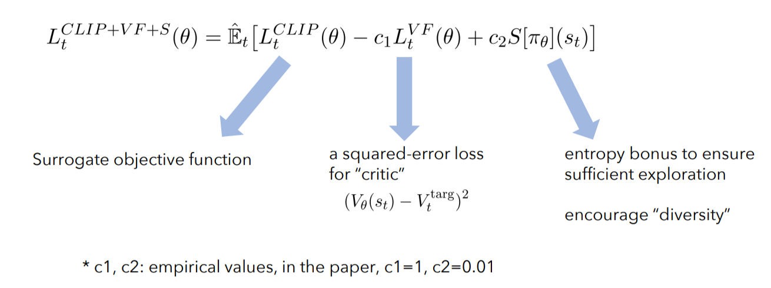
PPO in Practice
Reference: cs885-spring18-lecture15b p.17

Slide 23
Assignment
Running the code of PPO X GAE.
Writing a report about what you observe.
Deadline:
2022/12/22 11:59 p.m.

