Slide 1
DataLab Cup 2: Object Detection
Datalab

Slide 2
Outline
Competition Information
Object detection model
You Only Look Once (YOLO)
Evaluation metric
Mean Average Precision (mAP)
Hints
Precautions
Competition Timeline

Slide 3
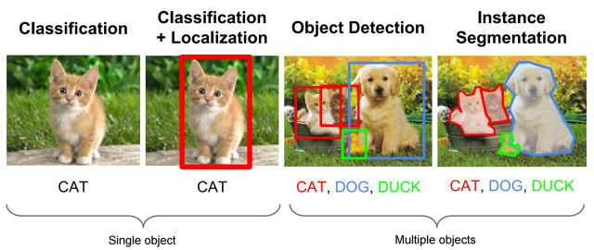
Competition Information
Object Detection
In this competition, we are going to train an object detection model to detect objects in an image.

Slide 4
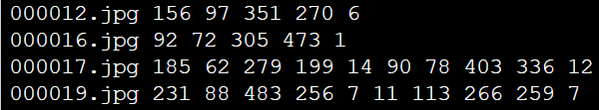

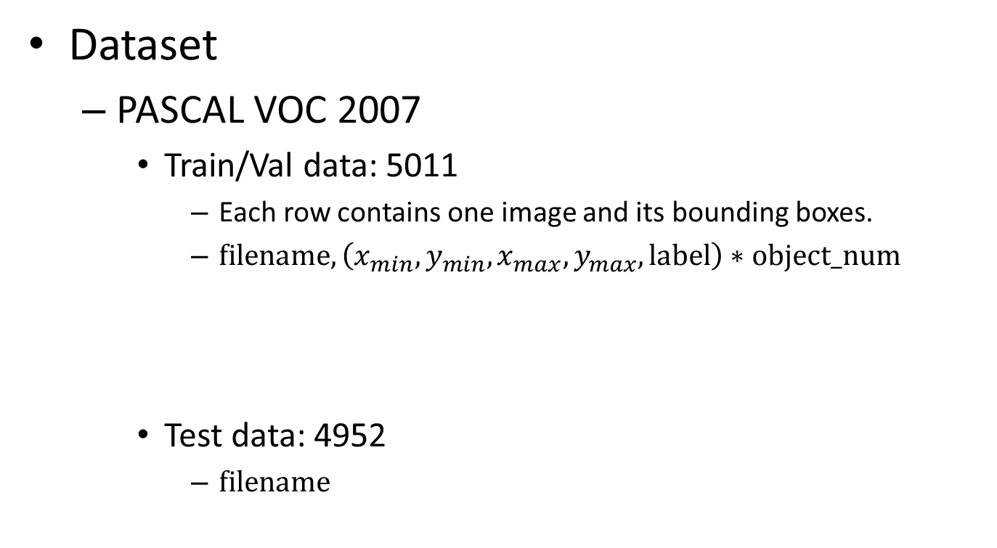
Competition Information
Dataset
PASCAL VOC 2007
Train/Val data: 5011
Each row contains one image and its bounding boxes.
$filename, \left(x_{min},y_{min},x_{max},y_{max},label\right)∗object_num$
Test data: 4952
$filename$

Slide 5
Object Detection Model YOLO
Motivation
Conventional object detection methods require two steps:
Propose some regions that might contain object
Doing classification on all proposed regions
It is inefficient to scan the image twice and costly to do classification on all proposed regions.
What about scanning image once and propose bounding boxes and labels accordingly?

Slide 6
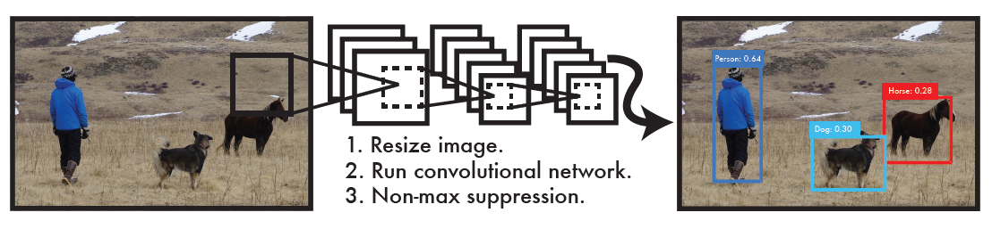
Object Detection Model YOLO
Main idea
Reframe object detection problem as a single regression problem.
Predict bounding box coordinates and class probabilities from image pixels straightly.

Slide 7
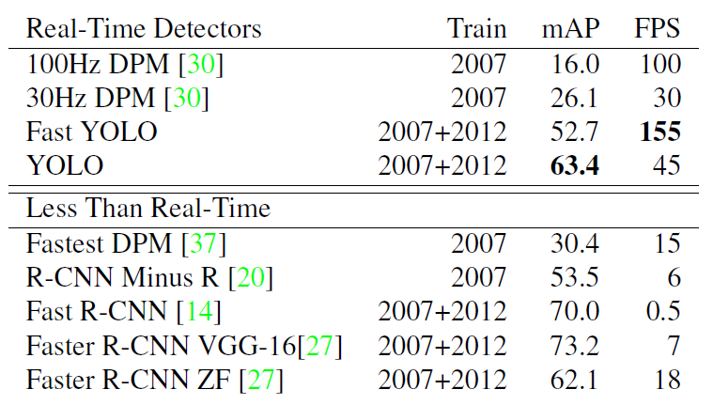
Object Detection Model YOLO
Main idea
YOLO is extremely fast since it requires no complex pipelines to output bounding boxes and object labels.
Notes:
Speed is not the concern in this competition.

Slide 8
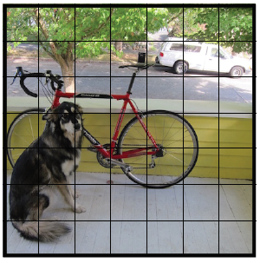

Object Detection Model YOLO
Objective function
YOLO first divides the input image into a $S×S$ grid.
If the center of an object falls into a grid cell, the grid cell is responsible for detecting that object.

Slide 9
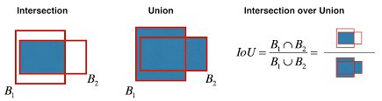
Object Detection Model YOLO
Intersection over Union (IoU)
A metric to evaluate the effectiveness of predict bounding box comparing to the ground truth.

Slide 10

Object Detection Model YOLO
Objective function
Each grid cell predicts $B$ bounding boxes and confidence score for those boxes.
Each bounding box consists of 5 predictions: $x, y, w, h$ and confidence.

Slide 11
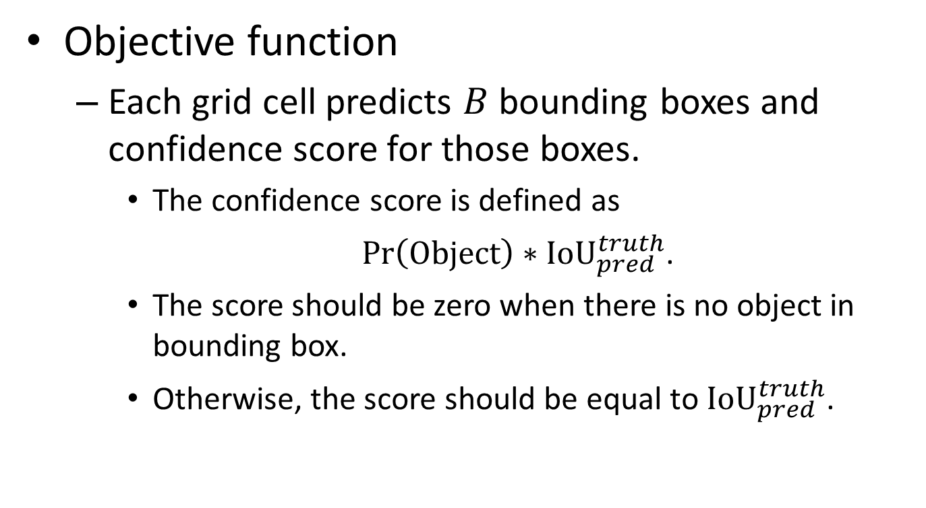
Object Detection Model YOLO
Objective function
Each grid cell predicts $B$ bounding boxes and confidence score for those boxes.
The confidence score is defined as
$\operatorname{Pr}\left(Object\right)∗{IoU}_{pred}^{truth}$.
The score should be zero when there is no object in bounding box.
Otherwise, the score should be equal to ${IoU}_{pred}^{truth}$.

Slide 12
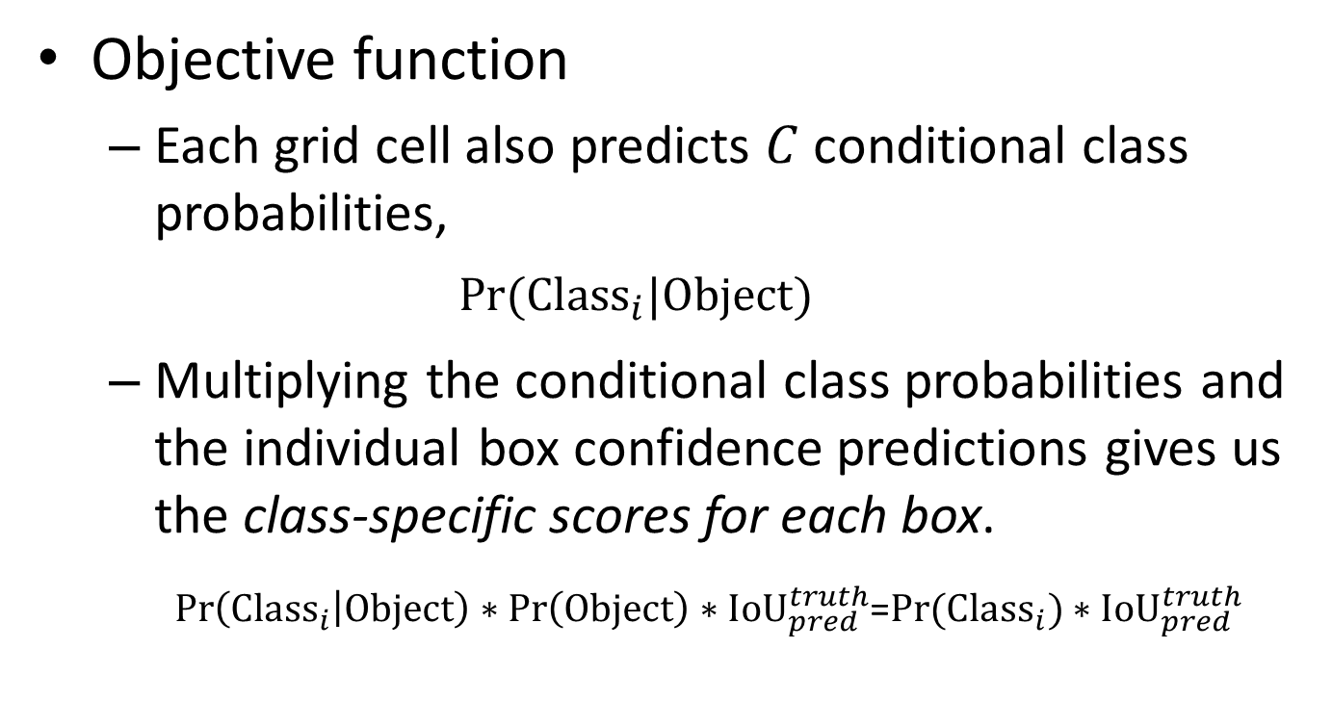
Object Detection Model YOLO
Objective function
Each grid cell also predicts $C$ conditional class probabilities,
$$Pr⁡({Class}_{i}|Object)$$
Multiplying the conditional class probabilities and the individual box confidence predictions gives us the class-specific scores for each box.
$\operatorname{Pr}\left({Class}_{i} | Object\right)∗\operatorname{Pr}\left(Object\right)∗{IoU}_{pred}^{truth}$=$\operatorname{Pr}{({Class}_{i})}∗{IoU}_{pred}^{truth}$
Conditional Class Prob.
Bounding box confidence

Slide 13
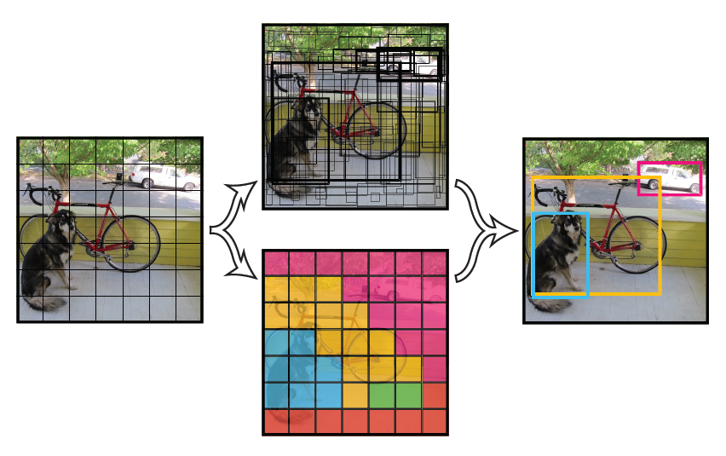

Object Detection Model YOLO
Objective function
The predictions are encoded as an $S×S×(B∗5+C)$ tensor.

Slide 14
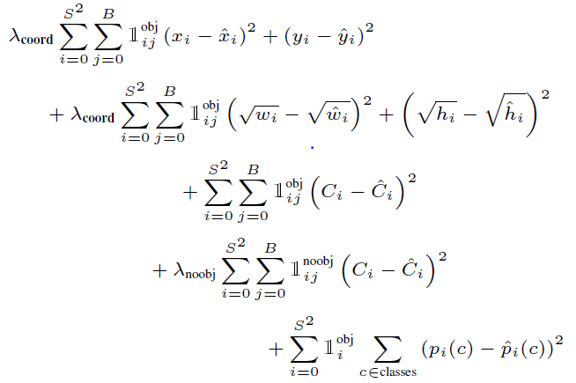
Object Detection Model YOLO
Objective function
During training, the objective function is formulated as below:

Slide 15
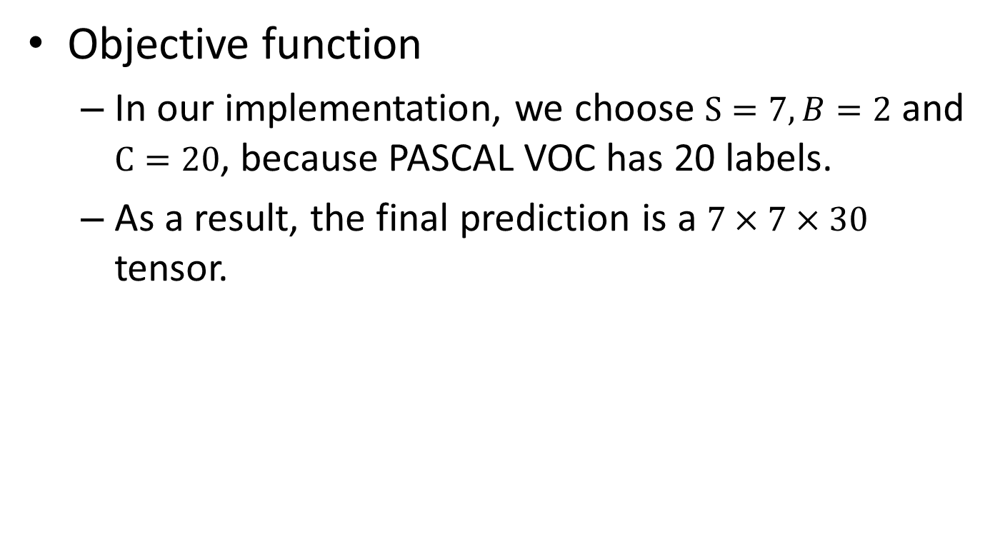
Object Detection Model YOLO
Objective function
In our implementation, we choose $S=7, B=2$ and $C=20$, because PASCAL VOC has 20 labels.
As a result, the final prediction is a $7×7×30$ tensor.

Slide 16
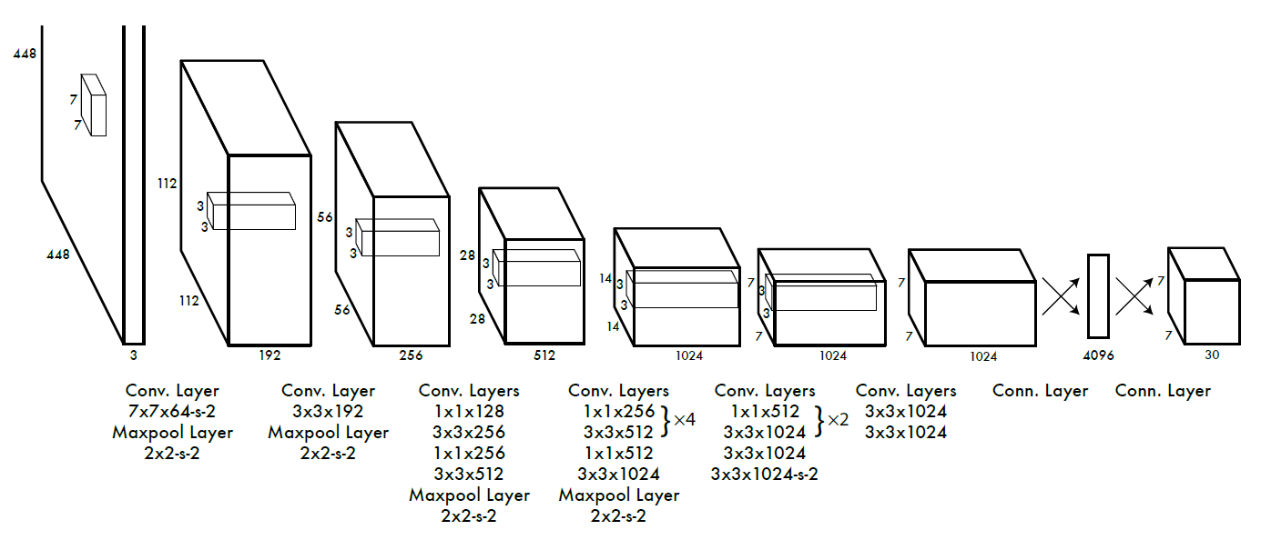
Object Detection Model YOLO
Model architecture
24 convolutional layers followed by 2 fully connected layers.

Slide 17
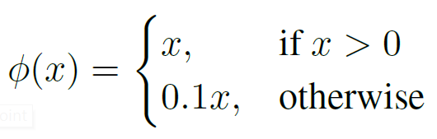
Object Detection Model YOLO
Model architecture
YOLO uses the relu activation function for the final layer and all other layers use the following leaky rectified linear activation function:

Slide 18
Object Detection Model YOLO
Training strategy
Pre-train the first 20 convolutional layers on ImageNet.
Train the whole network end-to-end on PASCAL.
Feature Extractor
YOLO-specific design

Slide 19
Object Detection Model YOLO
Reference
For more detailed explanation, please see the original paper: https://arxiv.org/abs/1506.02640

Slide 20
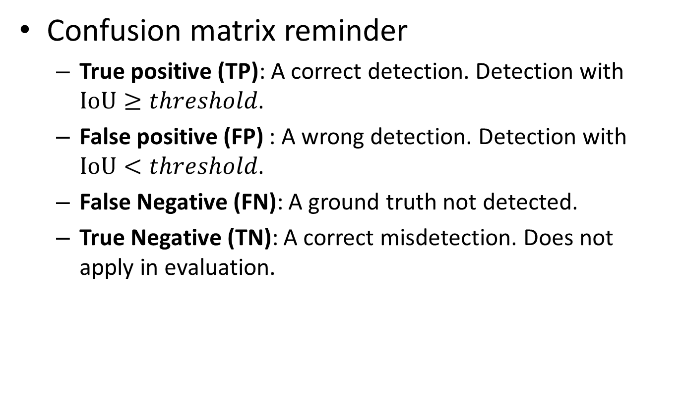
Evaluation Metric Mean Average Precision (mAP)
Confusion matrix reminder
True positive (TP): A correct detection. Detection with $IoU≥threshold$.
False positive (FP) : A wrong detection. Detection with $IoU<threshold$.
False Negative (FN): A ground truth not detected.
True Negative (TN): A correct misdetection. Does not apply in evaluation.

Slide 21
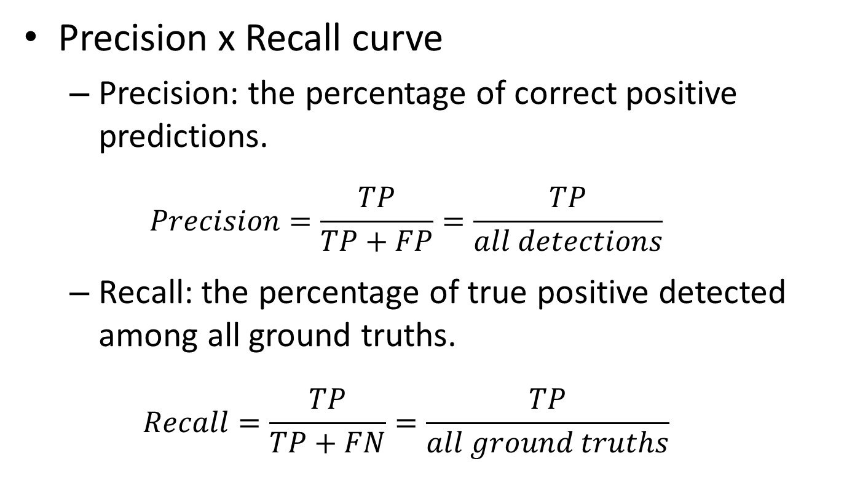
Evaluation Metric Mean Average Precision (mAP)
Precision x Recall curve
Precision: the percentage of correct positive predictions.
$$Precision=\frac{TP}{TP+FP}=\frac{TP}{all detections}$$
Recall: the percentage of true positive detected among all ground truths.
$$Recall=\frac{TP}{TP+FN}=\frac{TP}{all ground truths}$$
Notes:
Confidence threshold high -> TP low and FP low
Confidence threshold low -> Increase TP and FP

Slide 22
Evaluation Metric Mean Average Precision (mAP)
Precision x Recall curve
An object detector of a particular class is considered good if its precision stays high as recall increases.
It means that if you vary the confidence threshold, the precision and recall will still be high.
Notes:
如果 recall 提升，precision 也提升，就代表你的 model 不是亂猜全部都 predict 成 positive

Slide 23
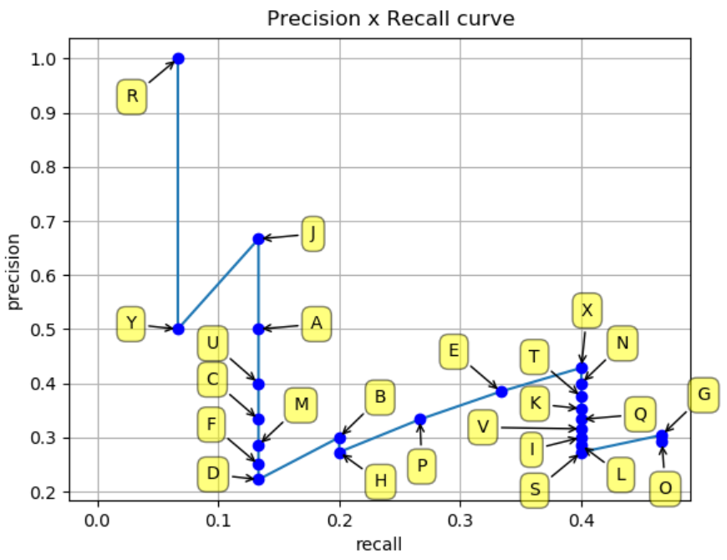
Evaluation Metric Mean Average Precision (mAP)
Precision x Recall curve
False positive increases
True positive increases
Confidence threshold decreases
Notes:
英文字母都是不同的 bb，在這個 threshold 底下，IOU 小於 threshold 的 bb 是 FP，其它的是 TP。
每個 bb 還會 output 他是該物件的機率，我們根據這個機率先 sort 過，然後從機率最高的開始計算它的 precision 跟 recall
由於一開始只有 R 然後 R也是 TP，所以 precision 就等於 1，但是其他 TP 還沒被偵測到，所以 recall 會比較低
Threshold 設小一點，那 recall 就會高 ，但是 precision 會低

Slide 24
Evaluation Metric Mean Average Precision (mAP)
Average Precision (AP)
Smooth the Precision-recall curve and calculate the area under curve (AUC).

Slide 25
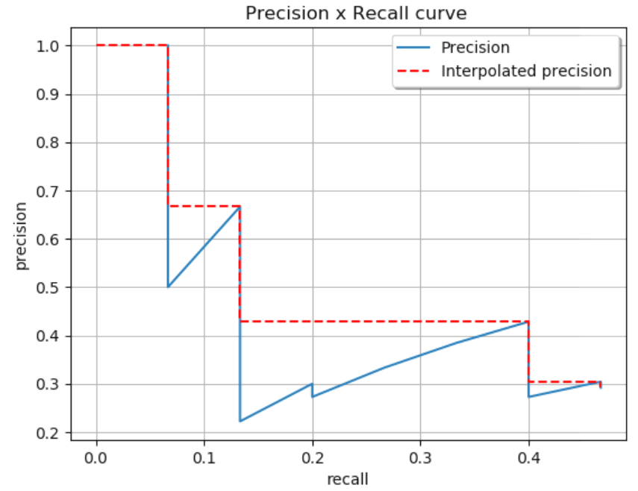
Evaluation Metric Mean Average Precision (mAP)
Average Precision (AP)

Slide 26
Evaluation Metric Mean Average Precision (mAP)
Mean Average Precision (mAP)
Calculate the Average Precision for every class and average them.

Slide 27
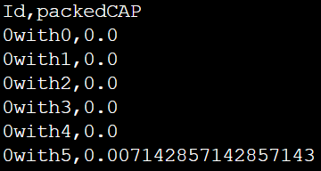
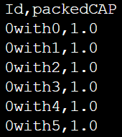
Evaluation Metric Mean Average Precision (mAP)
Mean Average Precision (mAP)
In this competition, we divide testing data into 10 groups and calculate the mAP of all classes.
After deriving the mAP of each class in 10 groups, we compare the result with ground truth and use the mean square error as the final score.
Group 0
-> AP of class 2 in group 0
Calculate MSE
Class 2

Slide 28
Evaluation Metric Mean Average Precision (mAP)
Mean Average Precision (mAP)
For more detailed explanation of mAP, please see https://github.com/rafaelpadilla/Object-Detection-Metrics

Slide 29
Hints
Transfer learning
Data augmentation
Training strategy
Other object detection models

Slide 30
Hints
Transfer learning
Training from scratch is nearly impossible for object detection.
Feel free to replace the feature extractor with other pre-trained model.
Feature Extractor
YOLO-specific design

Slide 31
Hints
Transfer learning
YOLO pre-trained its feature extractor on ImageNet.
How to load pre-trained model is already described in lab - style transfer.
Be careful that different models require different data preprocess.
You can see all the pre-trained models provided by Keras here: https://www.tensorflow.org/api_docs/python/tf/keras/applications

Slide 32
Hints
Data augmentation
The dataset we are using in this competition is the combination of training and validation set from VOC 2007.
It contains only 5012 images in total. Furthermore, the labels are highly imbalanced.
Doing data augmentation not only helps your model generalizing to testing data but also easing the training process.

Slide 33
Hints
Data augmentation
Random scaling and translations are applied when training YOLO.
Note that the bounding box coordinates have to be changed accordingly if the image was transformed.

Slide 34
Hints
Training strategy
Check bugs.
Be patient.

Slide 35
Hints
Other object detection models
Feel free to try other object detection models.
It is ok to read other’s code on GitHub, but you have to implement it in TensorFlow.
It’s not allowed to load other’s pre-trained model which was already trained on object detection task.

Slide 36
Precautions
The final score will be only based on your ranking on private leaderboard(80%) and report(20%).
Training on the datasets not provided by us is forbidden.
Loading the model pre-trained on ImageNet is allowed, while loading the model trained on object detection task is not allowed.
Plagiarism gets you 0 point.
Using ground truth to generate output will get you 0 point.
Cloning codes from GitHub will you get 0 point.
Notes:
Ground truth was encoded in a really naïve way.

Slide 37
Submission
Your report(.ipynb file) should have:
Your code & model weight
Brief ReadME
What kind of models you have tried and how did they work.
Anything you've done and want to tell us.
What problems occurred and how did you solve them.

Slide 38
Kaggle
https://www.kaggle.com/c/datalab-2021-cup2-object-detection

Slide 39
Competition Timeline
2021/11/11 competition announced.
2021/11/25 23:59(UTC) competition deadline.
2021/11/30 23:59(TW) report deadline.
2021/12/21 winner team share.

