Slide 1
Wearable Computing
B04902040王郁婷 B04902103蔡昀達 B04902061 吳家和

Slide 2
Paper
An Intelligent Information Forwarder for Healthcare Big Data Systems with Distributed Wearable Sensors
XPro: A Cross-End Processing Architecture for Data Analytics in Wearables
Network Formation Game for Multi-Hop Wearable Communications over Millimeter Wave Frequencies

Slide 3
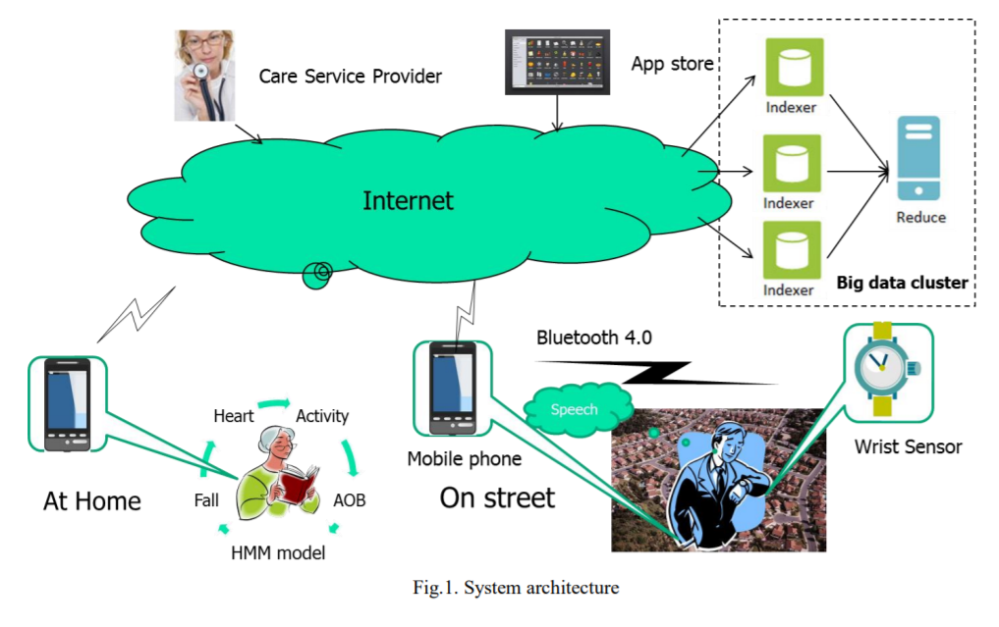
An Intelligent Information Forwarder for Healthcare Big Data Systems with Distributed Wearable Sensors

Slide 4
Problem definition
The data generated by the healthcare devices are often semi-structured or unstructured and have the 3Vs characteristics of big data, i.e., volume, velocity, and variety
Transmit only important information to the big data server for analytics when certain behaviours happen
→ develop context-awareness through the sensor readings that have a weak correlation with observable human behaviours and health conditions

Slide 5
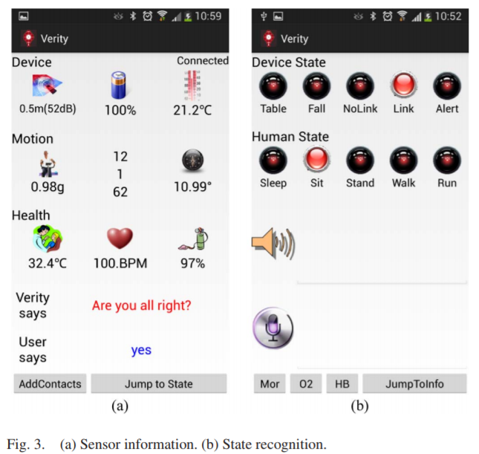

Sensor Information / State Recognition

Slide 6
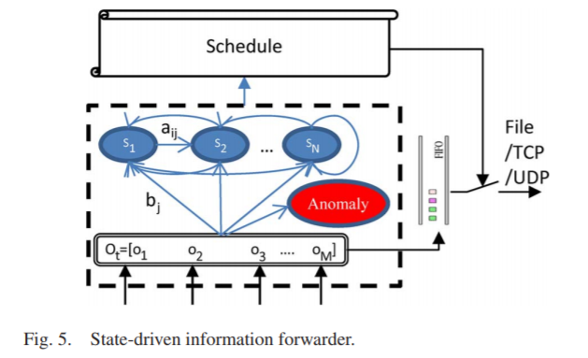
Intelligent Information Forwarder
Context-awareness
use Hidden Markov Model for human behavior recognition
Locality Sensitive Hashing to learn sensor patterns (Instance based learning)
reduce the communication loads and data storage

Slide 7
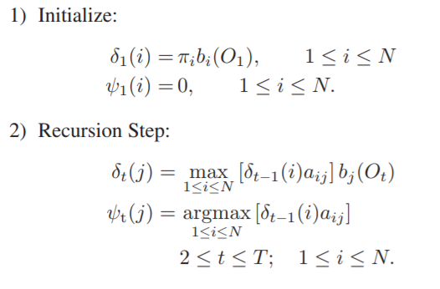
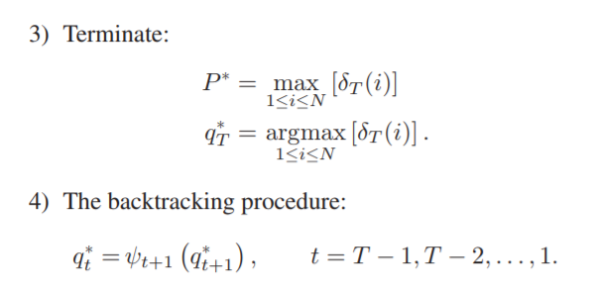
Viterbi algorithm

Slide 8
Anomaly detection
when the winning probability is close to the mean, the instance can be deemed uncertain
the observation witnessed does not belong at all in the sequence
the state at a time step differs for each state determining method within the HMM

Slide 9
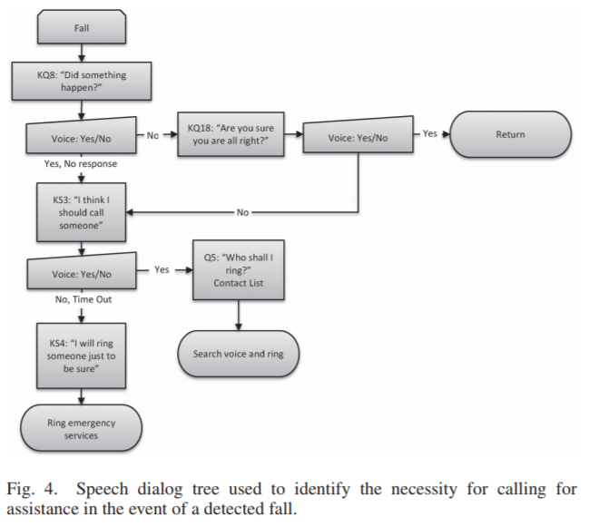
Mobile application-voice tree
The alert follows a decision tree where, at each stage, the user is required to either confirm or deny a statement, causing the device to adjust its operation accordingly.

Slide 10
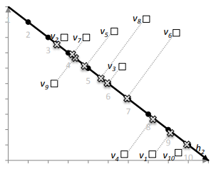
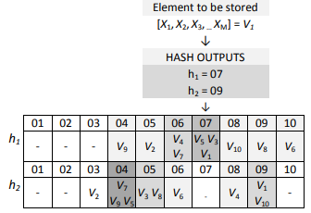


Instance Based Learning of Observation Probability
Locality Sensitive Hashing
store the data in another compressed format which requires only simple look-up operations to determine possible immediate neighbours
Learning - Querying
State Weighted Density(SWD)
Observation Probability

Slide 11
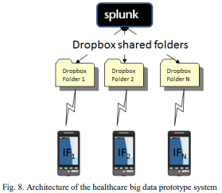
Big Data Server
analize sensor readings and states
to enhance efficiency → Mapreduction Model
receive data through TCP/ UDP port

Slide 12
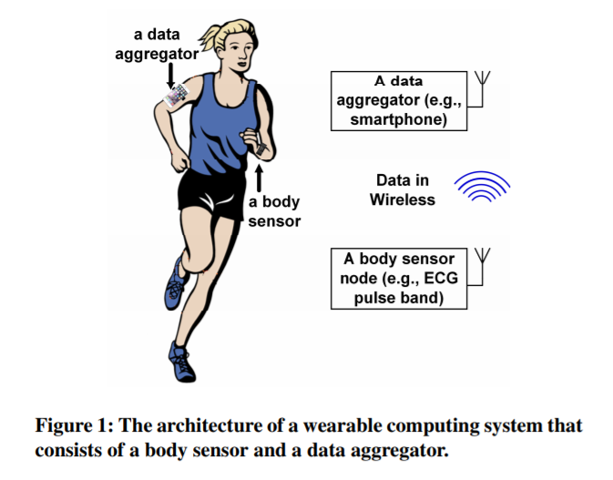
XPro: A Cross-End Processing Architecture for Data Analytics in Wearables
Body Sensor Network
Analytic Engine Design
in-sensor approach
in-aggregator apporach
Wireless Tranceiver Model

Slide 13
Problem definition
Increasing demand for analytic capabilities in local enable real-time feedback and timely intervention.
Typical generic classification designs usually employ a computing-intensive structure.
→ How to efficiently embed a generic classification scheme into wearable computing systems without compromising sensor battery lifetime and system performance.

Slide 14
Analytic engine designs
In-sensor approach performs data analysis in the sensor, this approach reduces the data volume that needs to be transmitted on wireless channels.
In-aggregator approach embeds the entire analytic module in the back-end data aggregator , such as a smartphone, to leverage the increased computational resource and looser energy constraint.

Slide 15
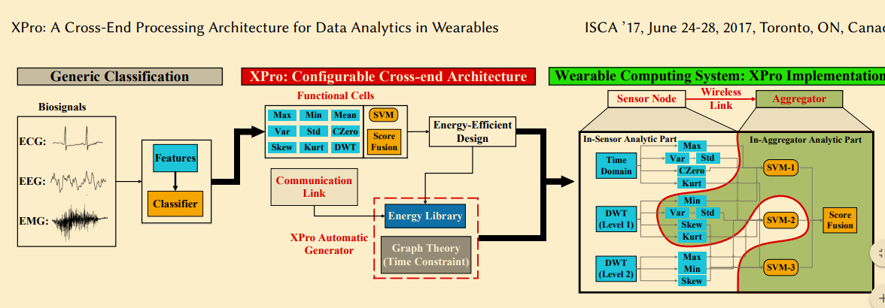
XPro

Slide 16
XPro
Functional Cell
Communication Link
intra-end
inter-end
Automatic XPro Generator
Find the optimal partitioning for the crossend architecture in polynomial time.
Solves the design space searching problem into a standard graph theory problem

Slide 17
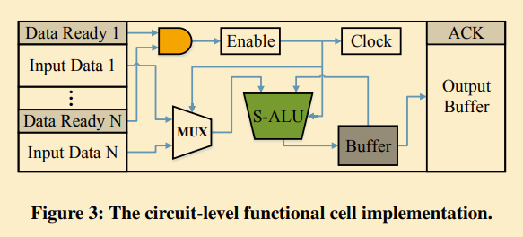
Functional Cells in XPro
Independent and asynchronous micro-computing unit.
Energy-efficient monotonic working mode for the specialized ALU module.
Adopts resource reuse only at the functional cell level.

Slide 18
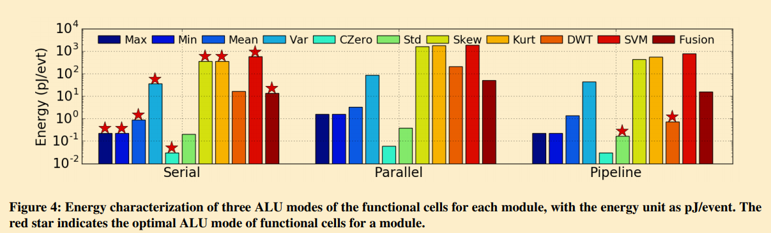
Functional Cells in XPro

Slide 19
Automatic XPro Generator - Energy model

Slide 20
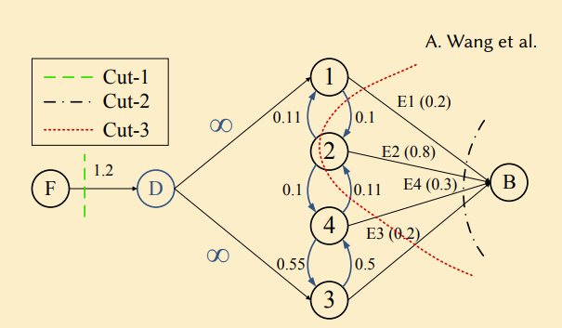
max-flow min-cut problem
minimizes the energy consumption
Delay to be under a maximum limit

Slide 21
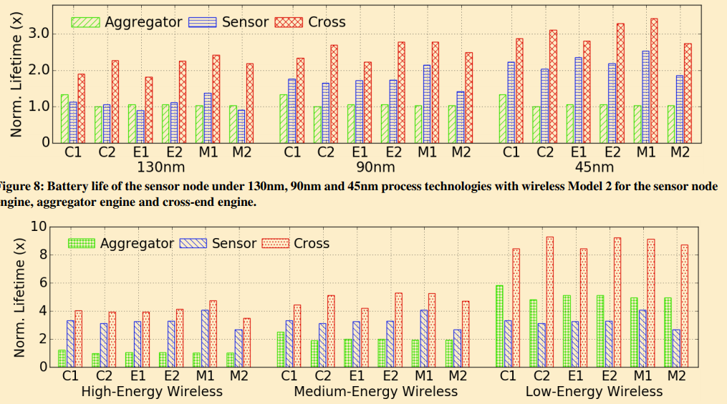
Experiment results
Notes:
process
wireless model

Slide 22
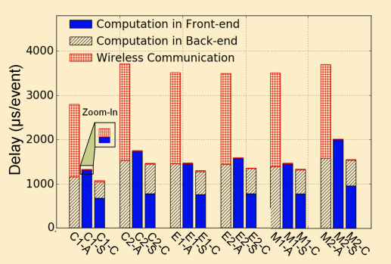
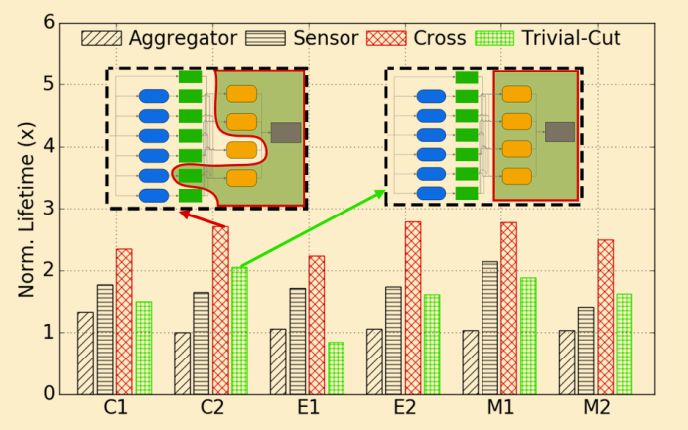
Experiment results
Notes:
delay
effectiveness

Slide 23
Network Formation Game for Multi-Hop Wearable Communications over Millimeter Wave Frequencies
We want to connect massive number of wearable devices
mmW advantage
bandwidth
mmW disadvantage
degradation
blockage

Slide 24
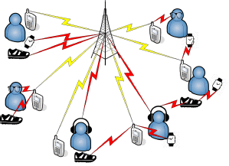
System model
1 base station
M users has L wearables
Each user has 1 mobile phone
Wearables can establish mmW communication with over divices
Mobiles always has Sub-6 GHz communication with BS.
Transmission Capacity, Latency, Privacy
yellow : Sub-6 GHz
red : mmW

Slide 25





Game Definition
Noncooperative game with public signal
Players : WDs
Action : connect to one of WDs, mobiles, base station
Utility functions : capacity, latency, privacy.
pure strategy
mixed strategy
50%
30%
20%

Slide 26
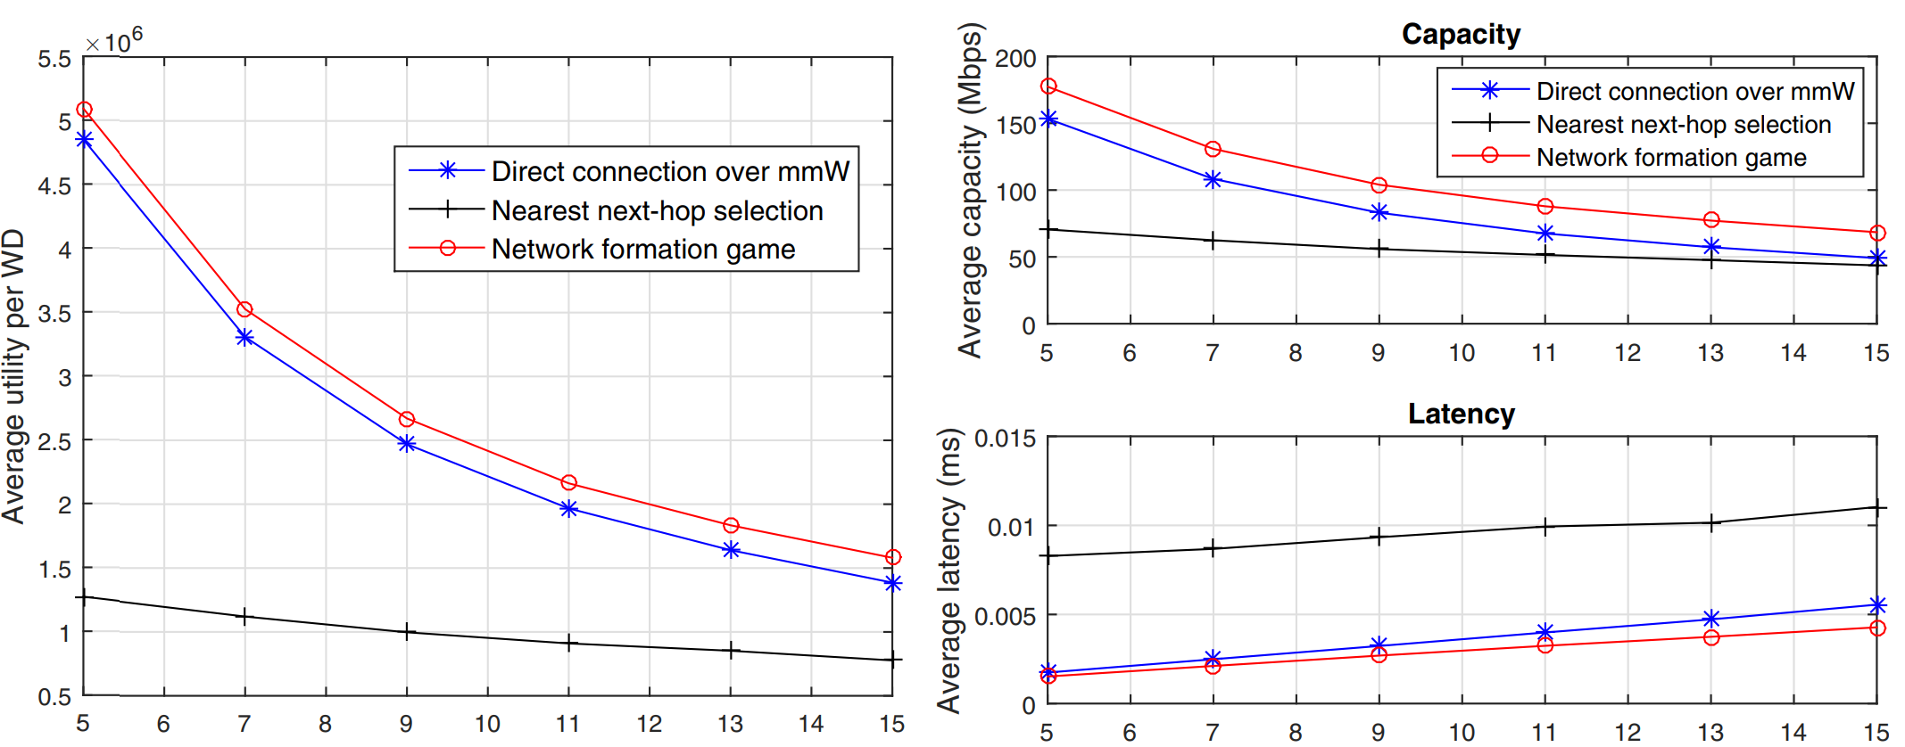
Simulation

