Slide 1
An Introduction to Burrows-Wheeler Transform and FM-index
Burrows, M. and Wheeler, D. J. (1994). A block-sorting lossless data compression algorithm. Technical Report 124, Palo Alto, CA, Digital Equipment Corporation.
Ferragina, P. and Manzini, G. (2000). Opportunistic data structures with applications. In Foundations of Computer Science, 2000. Proceedings. 41st Annual Symposium on (pp. 390-398). IEEE.
http://www.cs.jhu.edu/~langmea/resources/bwt_fm.pdf
https://www.cs.jhu.edu/~langmea/resources/lecture_notes/bwt_and_fm_index.pdf
https://en.wikipedia.org/wiki/Burrows%E2%80%93Wheeler_transform
Yin-Chu Chen
Kun-Mao Chao

Slide 2
Outline
Burrows-Wheeler Transform
Construction
Recovery (not so efficient though)
Ranking and LF mapping
Reversing
Suffix array
FM-index
Backward search
Data structure

Slide 3
Outline
Burrows-Wheeler Transform
Construction
Recovery (not so efficient though)
Ranking and LF mapping
Reversing
Suffix array
FM-index
Backward search
Data structure

Slide 4
Burrows-Wheeler Transform
Given a string T=“abaaba”
Burrows-Wheeler Matrix
abaaba$
baaba$a
aaba$ab
aba$aba
ba$abaa
a$abaab
$abaaba
$abaaba
a$abaab
aaba$ab aba$aba
abaaba$
ba$abaa
baaba$a
T$=abaaba$
Rotate
Sort
All rotations
$<a<b
Burrows, M. and Wheeler, D. J. (1994). A block-sorting lossless data compression algorithm. Technical Report 124, Palo Alto, CA, Digital Equipment Corporation.
Ben Langmead: http://www.langmead-lab.org/teaching-materials/

Slide 5
Burrows-Wheeler Transform
Burrows-Wheeler Matrix
T = “abaaba”
BWT(T) = “ abba$aa ”
$ a b a a b a
a $ a b a a b
a a b a $ a b
a b a $ a b a
a b a a b a $
b a $ a b a a
b a a b a $ a
Last column

Slide 6

Compression and Indexing
characters with similar contexts on the right-hand side in T tend to come together
FM-index
An index combining the BWT with a few small auxiliary data structures

Slide 7
BWT(T) = “ abba$aa ” → T$ = “abaaba$”
$ a b a a b a
a $ a b a a b
a a b a $ a b
a b a $ a b a
a b a a b a $
b a $ a b a a
b a a b a $ a
$
a
a
a
a
b
b
a$
ba
ba
aa
$a
ab
ab
$a
a$
aa
ab
ab
ba
ba
$ a b a a b a
a $ a b a a b
a a b a $ a b
a b a $ a b a
a b a a b a $
b a $ a b a a
b a a b a $ a
sort
bind
sort
new

Slide 8
BWT(T) = “ abba$aa ” → T$ = “abaaba$”
$ a b a a b a
a $ a b a a b
a a b a $ a b
a b a $ a b a
a b a a b a $
b a $ a b a a
b a a b a $ a
a$a
ba$
baa
aab
$ab
aba
aba
$ab
a$a
aab
aba
aba
ba$
baa
$ a b a a b a
a $ a b a a b
a a b a $ a b
a b a $ a b a
a b a a b a $
b a $ a b a a
b a a b a $ a
bind
sort
new

Slide 9
BWT(T) = “ abba$aa ” → T$ = “abaaba$”
bind
sort
bind
sort
a$ab
ba$a
baab
aaba
$aba
aba$
abaa
$aba
a$ab
aaba
aba$
abaa
ba$a
baab
a$aba
ba$ab
baaba
aaba$
$abaa
aba$a
abaab
$abaa
a$aba
aaba$
aba$a
abaab
ba$ab
baaba
$ a b a a b a
a $ a b a a b
a a b a $ a b
a b a $ a b a
a b a a b a $
b a $ a b a a
b a a b a $ a

Slide 10
BWT(T) = “ abba$aa ” → T$ = “abaaba$”
bind
sort
a$abaa
ba$aba
baaba$
aaba$a
$abaab
aba$ab
abaaba
$abaab
a$abaa
aaba$a
aba$ab
abaaba
ba$aba
baabaa
a
b
b
a
$
a
a
$ a b a a b a
a $ a b a a b
a a b a $ a b
a b a $ a b a
a b a a b a $
b a $ a b a a
b a a b a $ a

Slide 11
BWT Ranking
T-ranking
$ a₀ b₀ a₁ a₂ b₁ a₃
a₃ $ a₀ b₀ a₁ a₂ b₁
a₁ a₂ b₁ a₃ $ a₀ b₀
a₂ b₁ a₃ $ a₀ b₀ a₁
a₀ b₀ a₁ a₂ b₁ a₃ $
b₁ a₃ $ a₀ b₀ a₁ a₂
b₀ a₁ a₂ b₁ a₃ $ a₀
$ a₀ b₀ a₁ a₂ b₁ a₃
a₃ $ a₀ b₀ a₁ a₂ b₁
a₁ a₂ b₁ a₃ $ a₀ b₀
a₂ b₁ a₃ $ a₀ b₀ a₁
a₀ b₀ a₁ a₂ b₁ a₃ $
b₁ a₃ $ a₀ b₀ a₁ a₂
b₀ a₁ a₂ b₁ a₃ $ a₀
$ a₀ b₀ a₁ a₂ b₁ a₃

Slide 12
BWT Ranking
T-ranking
$ a₀ b₀ a₁ a₂ b₁ a₃
a₃ $ a₀ b₀ a₁ a₂ b₁
a₁ a₂ b₁ a₃ $ a₀ b₀
a₂ b₁ a₃ $ a₀ b₀ a₁
a₀ b₀ a₁ a₂ b₁ a₃ $
b₁ a₃ $ a₀ b₀ a₁ a₂
b₀ a₁ a₂ b₁ a₃ $ a₀
$ a₀ b₀ a₁ a₂ b₁ a₃
a₃ $ a₀ b₀ a₁ a₂ b₁
a₁ a₂ b₁ a₃ $ a₀ b₀
a₂ b₁ a₃ $ a₀ b₀ a₁
a₀ b₀ a₁ a₂ b₁ a₃ $
b₁ a₃ $ a₀ b₀ a₁ a₂
b₀ a₁ a₂ b₁ a₃ $ a₀

Slide 13
BWT Ranking
B-ranking
$ a₃ b₁ a₁ a₂ b₀ a₀
a₀ $ a₃ b₁ a₁ a₂ b₀
a₁ a₂ b₀ a₀ $ a₃ b₁
a₂ b₀ a₀ $ a₃ b₁ a₁
a₃ b₁ a₁ a₂ b₀ a₀ $
b₀ a₀ $ a₃ b₁ a₁ a₂
b₁ a₁ a₂ b₀ a₀ $ a₃

Slide 14
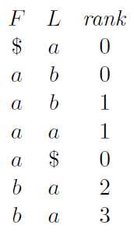
B-ranking

Slide 15
BWT Ranking
LF Mapping
F
L
$ a₃ b₁ a₁ a₂ b₀ a₀
a₀ $ a₃ b₁ a₁ a₂ b₀
a₁ a₂ b₀ a₀ $ a₃ b₁
a₂ b₀ a₀ $ a₃ b₁ a₁
a₃ b₁ a₁ a₂ b₀ a₀ $
b₀ a₀ $ a₃ b₁ a₁ a₂
b₁ a₁ a₂ b₀ a₀ $ a₃

Slide 16
BWT Ranking
LF Mapping
F
L
Count
$ a₀
a₀ b₀
a₁ b₁
a₂ a₁
a₃ $
b₀ a₂
b₁ a₃
$ | a | b
1 | 4 | 2
1 + 1 + 0 -1 = 1
($) (a) (b)
1 + 4 + 1 -1 = 5
($) (a) (b)

Slide 17
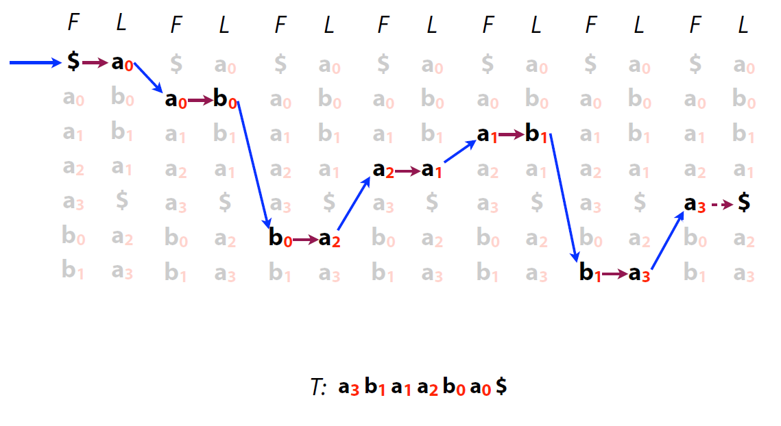
BWT Reverse
Count
a | b
4 | 2

Slide 18
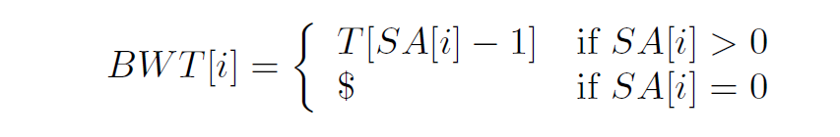
BWT Suffix array (SA)
$ a b a a b a
a $ a b a a b
a a b a $ a b
a b a $ a b a
a b a a b a $
b a $ a b a a
b a a b a $ a
6 |  | $ a b a a b a
5 |  | a $ a b a a b
2 |  | a a b a $ a b
3 |  | a b a $ a b a
0 |  | a b a a b a $
4 |  | b a $ a b a a
1 |  | b a a b a $ a
T$= “a b a a b a $”
0 1 2 3 4 5 6
BWM(T)
SA(T)
BWT(T) = “abba$aa”

Slide 19
Outline
Burrows-Wheeler Transform
Construction
Recovery (not so efficient though)
Ranking and LF mapping
Reversing
Suffix array
FM-index
Backward search
Data structure

Slide 20
FM-index
An index combining the BWT with a few small auxiliary data structures
F can be represented by counting the runs of characters in the alphabet
And L is compressible
Suffix array
C[] and Occ[]
$ a b a a b a
a $ a b a a b
a a b a $ a b
a b a $ a b a
a b a a b a $
b a $ a b a a
b a a b a $ a
Ferragina, P. and Manzini, G. (2000). Opportunistic data structures with applications. In Foundations of Computer Science, 2000. Proceedings. 41st Annual Symposium on (pp. 390-398). IEEE.
Not stored

Slide 21
FM-index Backward Search
T$= “a b a a b a $”
q = “aba”
aba
aba
$ a₃ b₁ a₁ a₂ b₀ a₀
a₀ $ a₃ b₁ a₁ a₂ b₀
a₁ a₂ b₀ a₀ $ a₃ b₁
a₂ b₀ a₀ $ a₃ b₁ a₁
a₃ b₁ a₁ a₂ b₀ a₀ $
b₀ a₀ $ a₃ b₁ a₁ a₂
b₁ a₁ a₂ b₀ a₀ $ a₃
$ a₃ b₁ a₁ a₂ b₀ a₀
a₀ $ a₃ b₁ a₁ a₂ b₀
a₁ a₂ b₀ a₀ $ a₃ b₁
a₂ b₀ a₀ $ a₃ b₁ a₁
a₃ b₁ a₁ a₂ b₀ a₀ $
b₀ a₀ $ a₃ b₁ a₁ a₂
b₁ a₁ a₂ b₀ a₀ $ a₃

Slide 22
FM-index Backward Search
Backward extension
Construct C[] and Occ[]
0 $ a₃ b₁ a₁ a₂ b₀ a₀
1 a₀ $ a₃ b₁ a₁ a₂ b₀
2 a₁ a₂ b₀ a₀ $ a₃ b₁
3 a₂ b₀ a₀ $ a₃ b₁ a₁
4 a₃ b₁ a₁ a₂ b₀ a₀ $
5 b₀ a₀ $ a₃ b₁ a₁ a₂
6 b₁ a₁ a₂ b₀ a₀ $ a₃
C[]
x | $ | a | b
C[x] | 0 | 1 | 5
Occ[]
 | a | b | b | a | $ | a | a
 | 0 | 1 | 2 | 3 | 4 | 5 | 6
$ | 0 | 0 | 0 | 0 | 1 | 1 | 1
a | 1 | 1 | 1 | 2 | 2 | 3 | 4
b | 0 | 1 | 2 | 2 | 2 | 2 | 2

Slide 23
FM-index Backward Search
q = “aba”
aba
x | $ | a | b
C[x] | 0 | 1 | 5
$ a₃ b₁ a₁ a₂ b₀ a₀
a₀ $ a₃ b₁ a₁ a₂ b₀
a₁ a₂ b₀ a₀ $ a₃ b₁
a₂ b₀ a₀ $ a₃ b₁ a₁
a₃ b₁ a₁ a₂ b₀ a₀ $
b₀ a₀ $ a₃ b₁ a₁ a₂
b₁ a₁ a₂ b₀ a₀ $ a₃
 | a | b | b | a | $ | a | a
 | 0 | 1 | 2 | 3 | 4 | 5 | 6
$ | 0 | 0 | 0 | 0 | 1 | 1 | 1
a | 1 | 1 | 1 | 2 | 2 | 3 | 4
b | 0 | 1 | 2 | 2 | 2 | 2 | 2
q=a
SA interval = [1,4]
q=ba
SA interval = [5,6]

Slide 24
FM-index Backward Search
q = “aba”
aba
c | $ | a | b
C[c] | 0 | 1 | 5
$ a₃ b₁ a₁ a₂ b₀ a₀
a₀ $ a₃ b₁ a₁ a₂ b₀
a₁ a₂ b₀ a₀ $ a₃ b₁
a₂ b₀ a₀ $ a₃ b₁ a₁
a₃ b₁ a₁ a₂ b₀ a₀ $
b₀ a₀ $ a₃ b₁ a₁ a₂
b₁ a₁ a₂ b₀ a₀ $ a₃
 | a | b | b | a | $ | a | a
 | 0 | 1 | 2 | 3 | 4 | 5 | 6
$ | 0 | 0 | 0 | 0 | 1 | 1 | 1
a | 1 | 1 | 1 | 2 | 2 | 3 | 4
b | 0 | 1 | 2 | 2 | 2 | 2 | 2
q=ba
SA interval = [5,6]
q=aba
SA interval = [3,4]

Slide 25
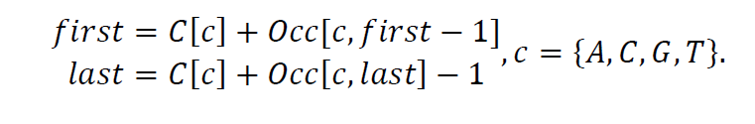
FM-index Backward Search
q = “aba”
aba
c | $ | a | b
C[c] | 0 | 1 | 5
$ a₃ b₁ a₁ a₂ b₀ a₀
a₀ $ a₃ b₁ a₁ a₂ b₀
a₁ a₂ b₀ a₀ $ a₃ b₁
a₂ b₀ a₀ $ a₃ b₁ a₁
a₃ b₁ a₁ a₂ b₀ a₀ $
b₀ a₀ $ a₃ b₁ a₁ a₂
b₁ a₁ a₂ b₀ a₀ $ a₃
 | a | b | b | a | $ | a | a
 | 0 | 1 | 2 | 3 | 4 | 5 | 6
$ | 0 | 0 | 0 | 0 | 1 | 1 | 1
a | 1 | 1 | 1 | 2 | 2 | 3 | 4
b | 0 | 1 | 2 | 2 | 2 | 2 | 2
q=ba
SA interval = [5,6]
q=aba
SA interval = [3,4]

Slide 26
FM-index Backward Search
T$= “a b a a b a $”
0 1 2 3 4 5 6
$ a₃ b₁ a₁ a₂ b₀ a₀
a₀ $ a₃ b₁ a₁ a₂ b₀
a₁ a₂ b₀ a₀ $ a₃ b₁
a₂ b₀ a₀ $ a₃ b₁ a₁
a₃ b₁ a₁ a₂ b₀ a₀ $
b₀ a₀ $ a₃ b₁ a₁ a₂
b₁ a₁ a₂ b₀ a₀ $ a₃
6 |  | $ a b a a b a
5 |  | a $ a b a a b
2 |  | a a b a $ a b
3 |  | a b a $ a b a
0 |  | a b a a b a $
4 |  | b a $ a b a a
1 |  | b a a b a $ a
SA[3]
SA[4]
SA(T)

Slide 27
FM-index Query (another example)
0 | $ c a t t a t t a g g a
1 | a $ c a t t a t t a g g
2 | a g g a $ c a t t a t t
3 | a t t a g g a $ c a t t
4 | a t t a t t a g g a $ c
5 | c a t t a t t a g g a $
6 | g a $ c a t t a t t a g
7 | g g a $ c a t t a t t a
8 | t a g g a $ c a t t a t
9 | t a t t a g g a $ c a t
10 | t t a g g a $ c a t t a
11 | t t a t t a g g a $ c a
T: cattattagga
Query: att
 | $ | a | c | g | t
C | 0 | 1 | 5 | 6 | 8
 | a | g | t | t | c | $ | g | a | t | t | a | a
 | 0 | 1 | 2 | 3 | 4 | 5 | 6 | 7 | 8 | 9 | 10 | 11
$ | 0 | 0 | 0 | 0 | 0 | 1 | 1 | 1 | 1 | 1 | 1 | 1
a | 1 | 1 | 1 | 1 | 1 | 1 | 1 | 2 | 2 | 2 | 3 | 4
c | 0 | 0 | 0 | 0 | 1 | 1 | 1 | 1 | 1 | 1 | 1 | 1
g | 0 | 1 | 1 | 1 | 1 | 1 | 2 | 2 | 2 | 2 | 2 | 2
t | 0 | 0 | 1 | 2 | 2 | 2 | 2 | 2 | 3 | 4 | 4 | 4

Slide 28
FM-index data stucture
String T
Length of T= m
Character : n types (”ACGT”, 4 types)
BWT(T): m characters
Suffix array: m integers
C[]: n integers
Occ[]: n*m integers
With checkpoints and a sampling suffix array
→ more space reduction

